Slide 1
SOAR: Statewide Articulation Agreements
Tracey Readinger
Pennsylvania Department of Education
Bureau of Career and Technical Education
March 22, 2023

Slide 2
SOAR
What does SOAR stand for?
Students Occupationally and Academically Ready
What is the mission of SOAR?
The mission of SOAR is to prepare students for college and careers in a diverse, high performing workforce.

Slide 3
Perkins V
Strengthening Career and Technical Education for the 21st Century Act of 2018 (Perkins V)
In Perkins V, Congress emphasized the importance of high-quality CTE programs that prepare students to be successful in further education and careers. The Act promotes:
Better alignment of CTE programs with state, regional, and local economic needs | Expands career exploration and development activities to the middle grades | Broadening the definition of “special populations” to include homeless individuals, foster youth, youth who have aged out of foster care, and students with parents in active military duty

Slide 4
Programs of Study / SOAR
Benefits of SOAR and Statewide Agreements
Provide a nonduplicative sequence of coursework leading to technical skill proficiency
Decrease the cost of a postsecondary credential
Enter workforce sooner
Be prepared for in-demand occupations

Slide 5
Programs of Study
Currently there are 38 Programs of Study (POS):
In 2022, four (4) Secondary Programs were discontinued as POS delivery and do not qualify for a statewide articulation agreement. These CIP are still valid for secondary CTE delivery.
48.0703 Cabinetmaking and Millwork
46.9999 Construction Trades
47.0699 Vehicle Maintenance Technology
01.8301 Veterinary/Animal Health Tech/Veterinary Assistant
If you have one of these programs, you may wish to establish a local agreement.

Slide 6
SOAR Credits
Graduation years 2020 and prior
Students have three years after high school graduation to take advantage of SOAR credits
Graduation years 2021 and after
Students have 16 months after high school graduation to take advantage of SOAR credits

Slide 7
Programs of Study / SOAR
Components of the POS web page
Title
CIP
Versions
Task List
Academic Crosswalks
Secondary Partners
PDE Website

Slide 8
Programs of Study / SOAR Task Lists
Every three years the task lists are reviewed
Secondary and postsecondary instructors and industry participate
Updates and revisions are made to the task lists
Task list distributed to postsecondary for NEW statewide agreements
Postsecondary enter agreements to CollegeTransfer.net
Task lists are distributed to secondary and postsecondary for final review
Task lists for updated Version/Grad Years are posted to PDE website
Notes:
Currently we have 396 statewide agreements for the 38 Programs of Study. Postsecondary institutions are required to enter the number of matriculants awarded Program of Study Articulated Credit into the postsecondary CIP. At this point in time, early December, Programs of Study in Phase 3 are in the state of Agreements being reviewed and posted to College Transfer.

Slide 9
Statewide Articulation for POS
Award nine or more technical credits in the aligned or related CIP
Courses may not have conditions or prerequisites
For diploma, certificate or associate degree
Up to 16 months after high school graduation beginning 2021

Slide 10
Prerequisites

Slide 11
Prerequisites
ELC 110 is a prerequisite to ELC 200, then it must also be listed on the articulation agreement

Slide 12
POS Student Documentation
2.75 GPA
Technical Core Coursework
Official High School Transcripts
Postsecondary​
Admissions Office where student is applying ​
Completed & Signed Task List
Copy of High School Diploma
PA Certificate of Competency or PSC
Printout of Details Page found on CollegeTransfer.net
Industry Credentials
Programs of Study - SOAR (pa.gov)

Slide 13
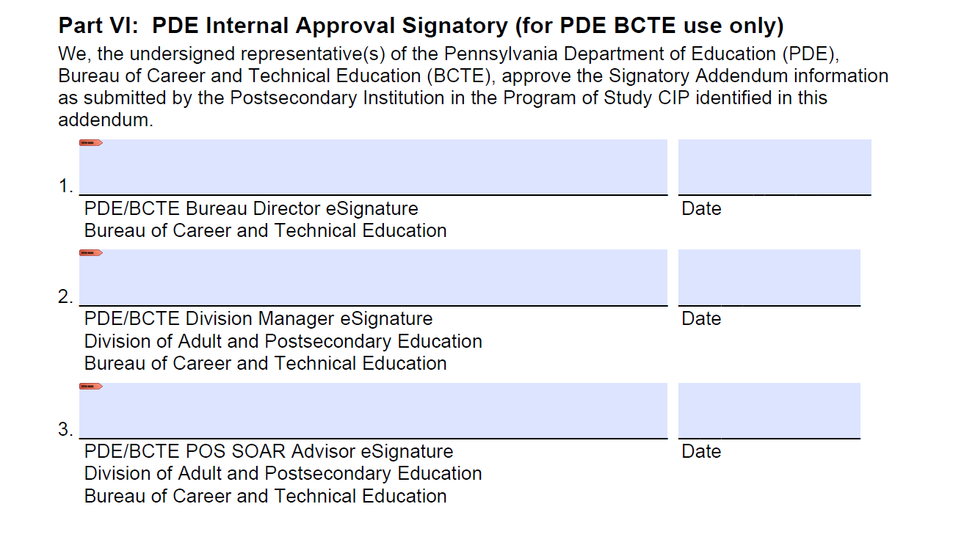
PDF Fillable Signatory Addendum
Must remain PDF fillable and use Adobe E-Signature

Slide 14
Verification
PDE will verify all information on the signatory addendum
Postsecondary website and course catalog should be kept up to date
If incorrect information is submitted, the signatory addendum will be returned
Signatory addendums due by October 31 each year

Slide 15
Revisions
Revisions to courses, course codes, credits, etc.
Submit a new signatory addendum to PDE
Indicate revision in email

Slide 16
Postsecondary Statewide Articulations
College Transfer
Multiple audiences view equivalencies
Secondary Guidance Personnel and Teachers
Students and Parents
Postsecondary Institutions
PDE

Slide 17
Searching for Opportunities
www.CollegeTransfer.net hosts the SOAR agreements
SEARCH > PA Bureau of Career and Technical Education
SELECT > Postsecondary Institution
SELECT > PA Bureau of Career and Technical Education
SELECT > Show Advanced Search Options
SELECT > Major or Program
CONTINUE to check the site for additional statewide agreements
College Transfer Website

Slide 18
Postsecondary Information
Databases must align:
College Transfer
CATS
PIMS
Typical errors found in databases:
Secondary CIP
Postsecondary CIP
Number of Matriculants

Slide 19
SOAR Agreement Participation
Of the 20 postsecondary institutions that currently receive Perkins Funding from 2010-2021:
11 institutions awarded 2289 credits
9 institutions awarded zero SOAR credits

Slide 20
POSAC Reported Over 11 Year Period

Slide 21
SOAR Sustenance
Main Factors
Marketing to prospective students
Review college transfer
Enrolling students
Reporting students
Clarity on postsecondary website
For student understanding
For teachers and school counselors guiding students and parents

Slide 22
SOAR Contact and Website
Bureau of Career and Technical Education
Division of Adult & Postsecondary CTE
Tracey Readinger
trareading@pa.gov
Programs of Study - SOAR

Slide 23
Contact/Mission
For more information on POS/SOAR,
visit the PDE website at www.education.pa.gov
The mission of the Department of Education is to ensure that every learner has access to a world-class education system that academically prepares children and adults to succeed as productive citizens. Further, the Department seeks to establish a culture that is committed to improving opportunities throughout the commonwealth by ensuring that technical support, resources, and optimal learning environments are available for all students, whether children or adults.

