Slide 1
SY<insert year> PVAAS Scatterplots State to IU Region to LEA Public Schools/Charter Schools/Comprehensive CTCs PSSA Math, English Language Arts, Science Keystone Algebra I, Literature, Biology PowerPoint Template with Directions
Contact your IU PVAAS contact or
the PVAAS Statewide Team for PDE with any questions:
(717) 606-1911
pdepvaas@iu13.org
Notes:
Slides 2 through 8 contain directions for generating the scatterplots to include in the PowerPoint template that begins on slide 9. Throughout the PowerPoint, you will need to insert the date for the school year where indicated <insert year>.

Slide 2
Directions
Use the “Data Packets” feature in PVAAS to retrieve a PDF packet of your LEA’s scatterplots
Choose whether to include all PSSA subject areas and Keystone content areas, or only selected areas
Use screen captures of the scatterplots from the PVAAS Data Packet (PDF document) to copy and paste each scatterplot into the indicated slide in this PowerPoint template
Delete any unnecessary slides for subjects, grades, or content areas not selected
Notes:
Use the “Data Packets” feature in PVAAS to retrieve a PDF packet of your LEA’s scatterplots – by using the data packets feature, the schools in your LEA will be spotlighted on the graph for an easy comparison. You must have district level access to create a packet that will highlight all schools in your LEA. If your account only grants you access to one school, only your school will be highlighted on the scatterplots.
Choose whether to include all PSSA subject areas and Keystone content areas, or only selected areas
Use screen captures of the scatterplots from the PVAAS Data Packet (PDF document) to copy and paste each scatterplot into the correct slide (PSSA subject and grade level or Keystone content area) in this PowerPoint template
**Please note** Keystone exams are not grade specific assessments and include all students enrolled in a Keystone related course and took the associated Keystone exam.
Delete any unnecessary slides from the template for any grades, subjects, or courses for areas you do not want in include in your presentation.

Slide 3
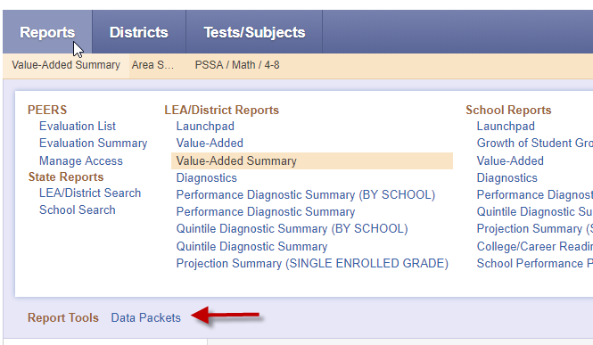
Report Tools – Data Packets
Notes:
Data Packets can be accessed through the Reports Tools section at the bottom of the Reports menu.
Click on the Data Packets link at the bottom left of the menu (see red arrow)

Slide 4
Step 1: Scatterplot Packet
Notes:
In Step One, choose the Scatterplot Packet

Slide 5
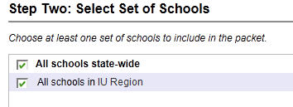
Step 2: Select Schools
Notes:
In Step Two:
Select to include “All schools state-wide” and “All schools in your IU region”, then click Next

Slide 6
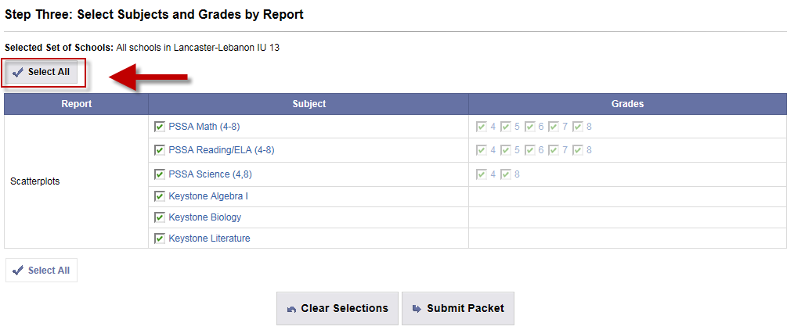
Step 3: Select Subjects and Grade
Notes:
Next use the “Select All” button to select all grades and subject areas. If you wish to choose only specific subject areas, use the check boxes. Then click Submit Packet. It will take you to the next menu.

Slide 7
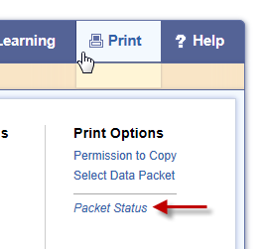
Packet Status
After receiving notification that your packet is available, log back into PVAAS and select Packet Status under the Print menu.
You may then click on the file name to retrieve your packet.
Notes:
You can wait and click the refresh button to retrieve your packet. When the status is marked “Finished”, you can open the PDF. You will receive a notification via email that your packet was successfully submitted and is available.
If you decide to log back in later, you will find your completed packet under the print menu by clicking on “Packet Status”

Slide 8
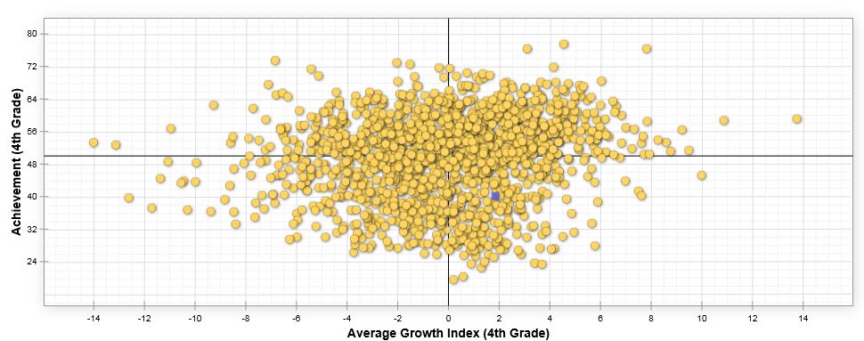
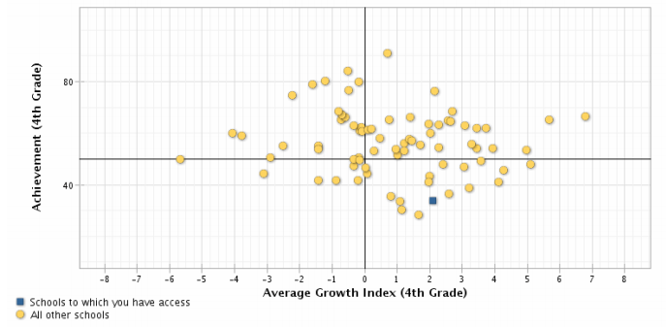
Statewide to IU Region to LEA/District – Grade 4 Math (Sample)
Statewide
Grade 4 Math
IU #
Grade 4 Math
Insert state-wide Scatterplot Here
Insert state-wide Scatterplot Here
Sample
Notes:
Use screen captures from the PDF document to capture and crop the images. Insert them into the correct location in the PowerPoint. In the sample only one school is highlighted so you can see how you schools will appear.

Slide 9
Template
SY<insert year> PVAAS Scatterplots State to IU Region to LEA Public Schools/Charter Schools/Comprehensive CTC PSSA Math, English Language Arts, Science Keystone Algebra I, Literature, Biology
<Insert District Name, Logo>
<Insert Date>

Slide 10
PVAAS Scatterplots – Achievement Data
Scatterplots visually display the following data for schools based on their achievement and growth results each school year.
Achievement Data:
For PSSA Math & ELA, achievement level is represented in Normal Curve Equivalent units (NCE units), where an NCE of 50 equals the state average
For PSSA Science and Keystone content areas, achievement level is represented in scale score points

Slide 11
PVAAS Scatterplots – Growth Data
Growth Data:
Average Growth Index (AGI) is a measure of growth for a group of students. The standard error is applied to ensure a meaningful comparison among districts.
An AGI value equal to or near zero means that the group of students has met the growth standard.
An AGI greater than +1.0 indicates the group of students exceeded the growth standard
An AGI less than -1.0 indicates the group fell short of the growth standard

Slide 12
PVAAS Scatterplots
Each dot on the scatterplot represents a school. Your schools will be indicated with a blue square on each scatterplot.
The following two slides explain the meaning of each of the four regions of the scatterplot.
Notes:
Each dot represents a school.
The following two slides explain the meaning of each of the quadrants on each scatterplot.

Slide 13
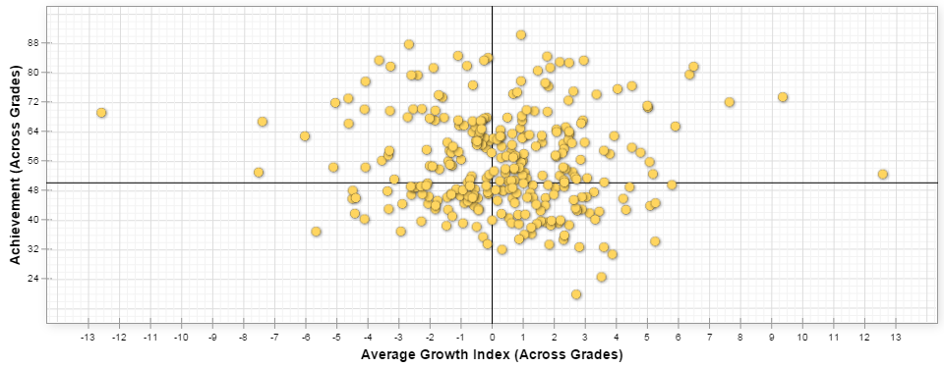
PVAAS Scatterplots – Average Achievement vs. Average Growth Index
ACHIEVEMENT
GROWTH
Notes:
The vertical axis displays the average achievement for each group of students.
[click] The Horizontal Axis displays the Average Growth Index (AGI) .
[click] Here we’ve highlighted zero which represents the standard for PA Academic Growth. In other words, the value of 0 means the group of students maintained their achievement level or performed as expected given their own academic histories. If the AGI is positive or to the right of 0, then we have an indication that the group of students exceeded the standard for PA Academic Growth (i.e., the group of students increased their achievement level or performed higher than expected given their own academic histories). Similarly, if the AGI is negative, then we have an indication that the growth of the group of students did NOT meet the standard for PA Academic Growth (i.e., the group of students did not maintain their achievement level or performed lower than expected given their own academic histories).
[click] And, here we’ve highlighted the state average for the grade and subject.
The intersection of zero and the average achievement forms four regions on the graph.

Slide 14
PVAAS Scatterplots – Meaning of Each Quadrant
Higher Achievement,
Lower Growth
Higher Achievement, Higher Growth
ACHIEVEMENT
Lower Achievement,
Lower Growth
Lower Achievement, Higher Growth
GROWTH
Notes:
If schools fall into this upper right region, they can be described as having higher achievement and higher growth. The farther the dot for the school is away from the intersection of the boundaries, the higher the achievement and/or the greater the evidence of growth. Some apply the term “Excelling” to schools in this quadrant.
If schools fall into the upper left region, they can be described as having higher achievement and lower growth. This lack of growth should be of great concern since continued higher achievement may be in jeopardy. Some apply the term “Slipping” to schools in this quadrant.
Lower achievement and higher growth - this situation may indicate that interventions implemented are producing positive results. Some apply the term “Improving” to schools in this quadrant.
And lower achievement and lower growth - this situation suggests that substantial investigation and remediation is necessary since the students are not achieving and are headed the wrong direction. Some apply the term “Underperforming” to schools in this quadrant.

Slide 15
PVAAS Scatterplots <Insert School Year>
PVAAS Scatterplots Achievement & Growth
SY<insert year>

Slide 16
Statewide to IU Region to LEA/District – Grade 4 Math
Statewide
Grade 5 Math
IU <insert IU # or name>
Grade 5 Math
Insert State-wide
Scatterplot Here
Insert IU-wide
Scatterplot Here
Insert state-wide Scatterplot Here
Insert IU-wide Scatterplot Here
Notes:
State compared to LEA for Selected Grade(s) and Subject
IU Region compared to LEA for Selected Grade(s) and Subject

Slide 17
Statewide to IU Region to LEA/District – Grade 5 Math
Statewide
Grade 6 Math
IU <insert IU # or name>
Grade 6 Math
Insert State-wide
Scatterplot Here
Insert IU-wide
Scatterplot Here
Insert Statewide Scatterplot Here
Insert IU-wide Scatterplot Here
Notes:
State compared to LEA for Selected Grade(s) and Subject
IU Region compared to LEA for Selected Grade(s) and Subject

Slide 18
Statewide to IU Region to LEA/District – Grade 6 Math
Statewide
Grade 6 Math
IU <insert IU # or name>
Grade 6 Math
Insert State-wide
Scatterplot Here
Insert IU-wide
Scatterplot Here
Insert Statewide Scatterplot Here
Insert IU-wide Scatterplot Here
Notes:
State compared to LEA for Selected Grade(s) and Subject
IU Region compared to LEA for Selected Grade(s) and Subject

Slide 19
Statewide to IU Region to LEA/District – Grade 7 Math
Statewide
Grade 7 Math
IU <insert IU # or name>
Grade 7 Math
Insert State-wide
Scatterplot Here
Insert IU-wide
Scatterplot Here
Insert Statewide Scatterplot Here
Insert IU-wide Scatterplot Here
Notes:
State compared to LEA for Selected Grade(s) and Subject
IU Region compared to LEA for Selected Grade(s) and Subject

Slide 20
Statewide to IU Region to LEA/District – Grade 8 Math
Statewide
Grade 8 Math
IU <insert IU # or name>
Grade 8 Math
Insert State-wide
Scatterplot Here
Insert IU-wide
Scatterplot Here
Insert Statewide Scatterplot Here
Insert IU-wide Scatterplot Here
Notes:
State compared to LEA for Selected Grade(s) and Subject
IU Region compared to LEA for Selected Grade(s) and Subject

Slide 21
Statewide to IU Region to LEA/District - Keystone Algebra I
Statewide
Keystone Algebra I
IU <insert IU # or name>
Keystone Algebra I
Insert State-wide
Scatterplot Here
Insert IU-wide
Scatterplot Here
Insert Statewide Scatterplot Here
Insert IU-wide Scatterplot Here
Notes:
State compared to LEA for Selected Grade(s) and Subject
IU Region compared to LEA for Selected Grade(s) and Subject

Slide 22
Statewide to IU Region to LEA/District – Grade 4 English Language Arts
Statewide
Grade 4 ELA
IU <insert IU # or name>
Grade 4 ELA
Insert State-wide
Scatterplot Here
Insert IU-wide
Scatterplot Here
Insert Statewide Scatterplot Here
Insert IU-wide Scatterplot Here
Notes:
State compared to LEA for Selected Grade(s) and Subject
IU Region compared to LEA for Selected Grade(s) and Subject

Slide 23
Statewide to IU Region to LEA/District – Grade 5 English Language Arts
Statewide
Grade 5 ELA
IU <insert IU # or name>
Grade 5 ELA
Insert State-wide
Scatterplot Here
Insert IU-wide
Scatterplot Here
Insert Statewide Scatterplot Here
Insert IU-wide Scatterplot Here
Notes:
State compared to LEA for Selected Grade(s) and Subject
IU Region compared to LEA for Selected Grade(s) and Subject

Slide 24
Statewide to IU Region to LEA/District – Grade 6 English Language Arts
Statewide
Grade 6 ELA
IU <insert IU # or name>
Grade 6 ELA
Insert State-wide
Scatterplot Here
Insert IU-wide
Scatterplot Here
Insert Statewide Scatterplot Here
Insert IU-wide Scatterplot Here
Notes:
State compared to LEA for Selected Grade(s) and Subject
IU Region compared to LEA for Selected Grade(s) and Subject

Slide 25
Statewide to IU Region to LEA/District – Grade 7 English Language Arts
Statewide
Grade 7 ELA
IU <insert IU # or name>
Grade 7 ELA
Insert State-wide
Scatterplot Here
Insert IU-wide
Scatterplot Here
Insert Statewide Scatterplot Here
Insert IU-wide Scatterplot Here
Notes:
State compared to LEA for Selected Grade(s) and Subject
IU Region compared to LEA for Selected Grade(s) and Subject

Slide 26
Statewide to IU Region to LEA/District – Grade 8 English Language Arts
Statewide
Grade 8 ELA
IU <insert IU # or name>
Grade 8 ELA
Insert State-wide
Scatterplot Here
Insert IU-wide
Scatterplot Here
Insert Statewide Scatterplot Here
Insert IU-wide Scatterplot Here
Notes:
State compared to LEA for Selected Grade(s) and Subject
IU Region compared to LEA for Selected Grade(s) and Subject

Slide 27
Statewide to IU Region to LEA/District – Keystone Literature
Statewide
Keystone Literature
IU <insert IU # or name>
Keystone Literature
Insert State-wide
Scatterplot Here
Insert IU-wide
Scatterplot Here
Insert Statewide Scatterplot Here
Insert IU-wide Scatterplot Here
Notes:
State compared to LEA for Selected Grade(s) and Subject
IU Region compared to LEA for Selected Grade(s) and Subject

Slide 28
Statewide to IU Region to LEA/District - Grade 4 Science
Statewide
Grade 4 Science
IU <insert IU # or name>
Grade 4 Science
Insert State-wide
Scatterplot Here
Insert IU-wide
Scatterplot Here
Insert Statewide Scatterplot Here
Insert IU-wide Scatterplot Here
Notes:
State compared to LEA for Selected Grade(s) and Subject
IU Region compared to LEA for Selected Grade(s) and Subject

Slide 29
Statewide to IU Region to LEA/District – Grade 8 Science
Statewide
Grade 8 Science
IU <insert IU # or name>
Grade 8 Science
Insert State-wide
Scatterplot Here
Insert IU-wide
Scatterplot Here
Insert Statewide Scatterplot Here
Insert IU-wide Scatterplot Here
Notes:
State compared to LEA for Selected Grade(s) and Subject
IU Region compared to LEA for Selected Grade(s) and Subject

Slide 30
Statewide to IU Region to LEA/District – Keystone Biology
Statewide
Keystone Biology
IU <insert IU # or name>
Keystone Biology
Insert State-wide
Scatterplot Here
Insert IU-wide
Scatterplot Here
Insert Statewide Scatterplot Here
Insert IU-wide Scatterplot Here
Notes:
State compared to LEA for Selected Grade(s) and Subject
IU Region compared to LEA for Selected Grade(s) and Subject

Slide 31
Next Steps
<Insert any other relevant achievement or growth data>
<Insert your LEA’s plan of action based on this information>
Next Steps
Who?
What?
When?
Notes:
<Insert any other relevant achievement or growth data>
<Insert your LEAs plan of action based on this information>
Next Steps
Who?
What?
When?

Slide 32
Contact
Contact SAS EVAAS Support Team
Issues concerning accessing or navigating the system
Contact PVAAS Statewide Team, pdepvaas@iu13.org
Issues concerning policies or use of the reporting
Contact local IU PVAAS Point of Contact
On PVAAS login page, pvaas.sas.com
Notes:
Several points of contact to support you:
•SAS PVAAS Support Team for issues concerning access in the system.
•Contact PVAAS Statewide Team – pdepvaas@iu13.org
•Local IU PVAAS Point of contact – link on PVAAS login page

Slide 33
Contact/Mission
For more information on the
Pennsylvania Value-Added Assessment System (PVAAS), please visit PDE’s website at
www.education.pa.gov.
The mission of the department is to academically prepare children and adults to succeed as productive citizens. The department seeks to ensure that the technical support, resources and opportunities are in place for all students, whether children or adults, to receive a high quality education.
Notes:
For more information on the Pennsylvania Value-Added Assessment System (PVAAS), please visit PDE’s website at www.education.pa.gov.

