Slide 1
Strategies: Educational Excellence for Health Care Providers and Educators Presenters: Rebecca Conway and Tracey Readinger
Pennsylvania Department of Education
Bureau of Career and Technical Education
November 2, 2023

Slide 2
Today’s discussion will focus on:
The Shifting Landscape
Program Approval Types
Change to MDS 3.0
Procedure Evaluations
FBI Reports
Common Issues Identified in Compliance Reviews

Slide 3
The Training Landscape
7 of 13 facility programs terminated for CMS deficiencies
20 of 22 school programs inactivated were CTC
4 of 7 new programs in private sector are non-traditional

Slide 4
Program Approvals
LTC Facility
Train employees only at no cost to trainee
Public/Private School
Train the general public; tuition is charged
Contract Trainer
Consultant trains employees under contract with facility

Slide 5
MDS 3.0 - RAI
Version 1.18.11 effective October 1, 2023
Section G (Functional Status) replaced by Section GG (Functional Abilities and Goals)
Documentation of ADLs by NAs will feed data collection for this section
Care Area Assessments (CAAs) may be triggered by data in GG

Slide 6
MDS 3.0 – RAI Continued
Additional Resources
Your facility’s RNAC
Centers for Medicare and Medicaid Services
Minimum Data Set (MDS) 3.0 Resident Assessment Instrument (RAI) Manual | CMS
Video Library from CMS Compliance Group
Resources for MDS 3.0 Changes Effective October 1, 2023 | CMS Compliance Group
American Association of Post-Acute Care Nurses Website
5 Major MDS Changes - October 1, 2023 (aapacn.org)

Slide 7
Procedure Evaluation Checklists
§ 483.152 Requirements for approval of a nurse aide training and competency evaluation program.
For a nurse aide training and competency evaluation program to be approved by the State, it must, (4) Ensure that— (i) Students do not perform any services for which they have not trained and been found proficient by the instructor.
PDE must see documentary evidence skills were evaluated in the lab prior to being performed in clinical
Procedure evaluation checklists are not the same thing as the Performance Checklist

Slide 8
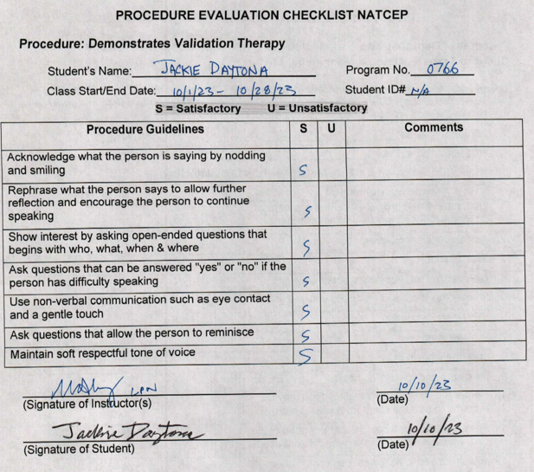
Procedure Evaluation Checklists

Slide 9
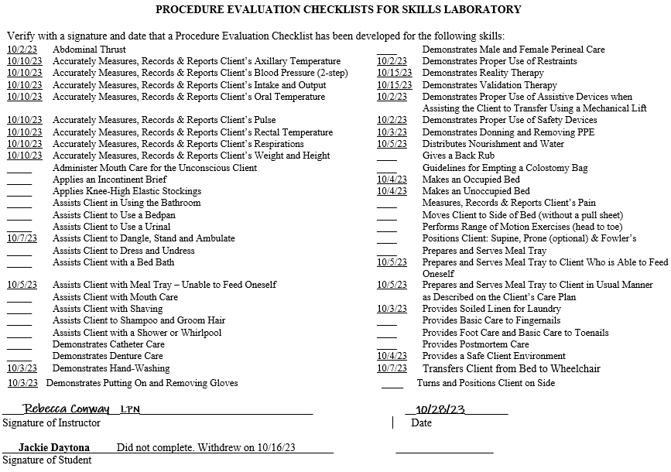
Procedure Evaluation Checklists

Slide 10
Common Issues in Compliance Reviews
FBI Reports
Performance Checklists
Nurse Aide Training Report
Self Study Booklet

Slide 11
FBI Process
Can be found on Instructor's Corner (pa.gov)
Criminal History Record Information
Process for Procuring an FBI Report
Programs extract pertinent information for prospective students
Education-Based Program Must request from PDE | Long-Term Care Facility-Based Program Request from PDE if student is not employed at facility | Long-Term Care Facility-Based Program If student is employed by facility, include letter of employment with compliance review documents

Slide 12
Nurse Aide Training Report - Dates

Slide 13
Nurse Aide Training Report - Signatures

Slide 14
Performance Checklist
Legal document
Required by federal regulations
Initial and date each item
Signed and dated by instructor
Signed and dated by student
Student receives original

Slide 15
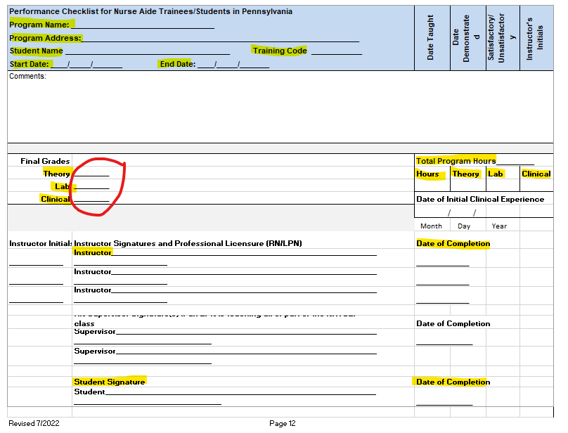
Performance Checklist Sample

Slide 16
Self-Study Booklet
Answer all questions
Add columns and rows to OBRA table on page 13
Reimbursement letters/sponsor invoices on page 18
Supplemental items printed and included
Class and student records on a flash drive
Pages 21, 22, 23, and 24 signed
Verify completed thoroughly
Send password separately

Slide 17
In conclusion, we focused on:
The Shifting Landscape
Program Approval Types
Change to MDS 3.0
Procedure Evaluations
FBI Reports
Common Issues Identified in Compliance Reviews

Slide 18
NATCEP Contact and Website
Bureau of Career and Technical Education
Division of Adult & Postsecondary CTE
Rebecca Conway
rebconway@pa.gov
Tracey Readinger
trareading@pa.gov
Instructor's Corner (pa.gov)

Slide 19
Contact/Mission
For more information on Nurse Aide Training,
visit the PDE website at www.education.pa.gov
The mission of the Department of Education is to ensure that every learner has access to a world-class education system that academically prepares children and adults to succeed as productive citizens. Further, the Department seeks to establish a culture that is committed to improving opportunities throughout the commonwealth by ensuring that technical support, resources, and optimal learning environments are available for all students, whether children or adults.

