Slide 1
The Pennsylvania Dashboard for the…

Slide 2
Instructions & Info

Slide 3
Instructions & Info: Select and Hover!
Don’t be shy! Try selecting or hovering over the data visualizations to reveal a wealth of useful information.

Slide 4
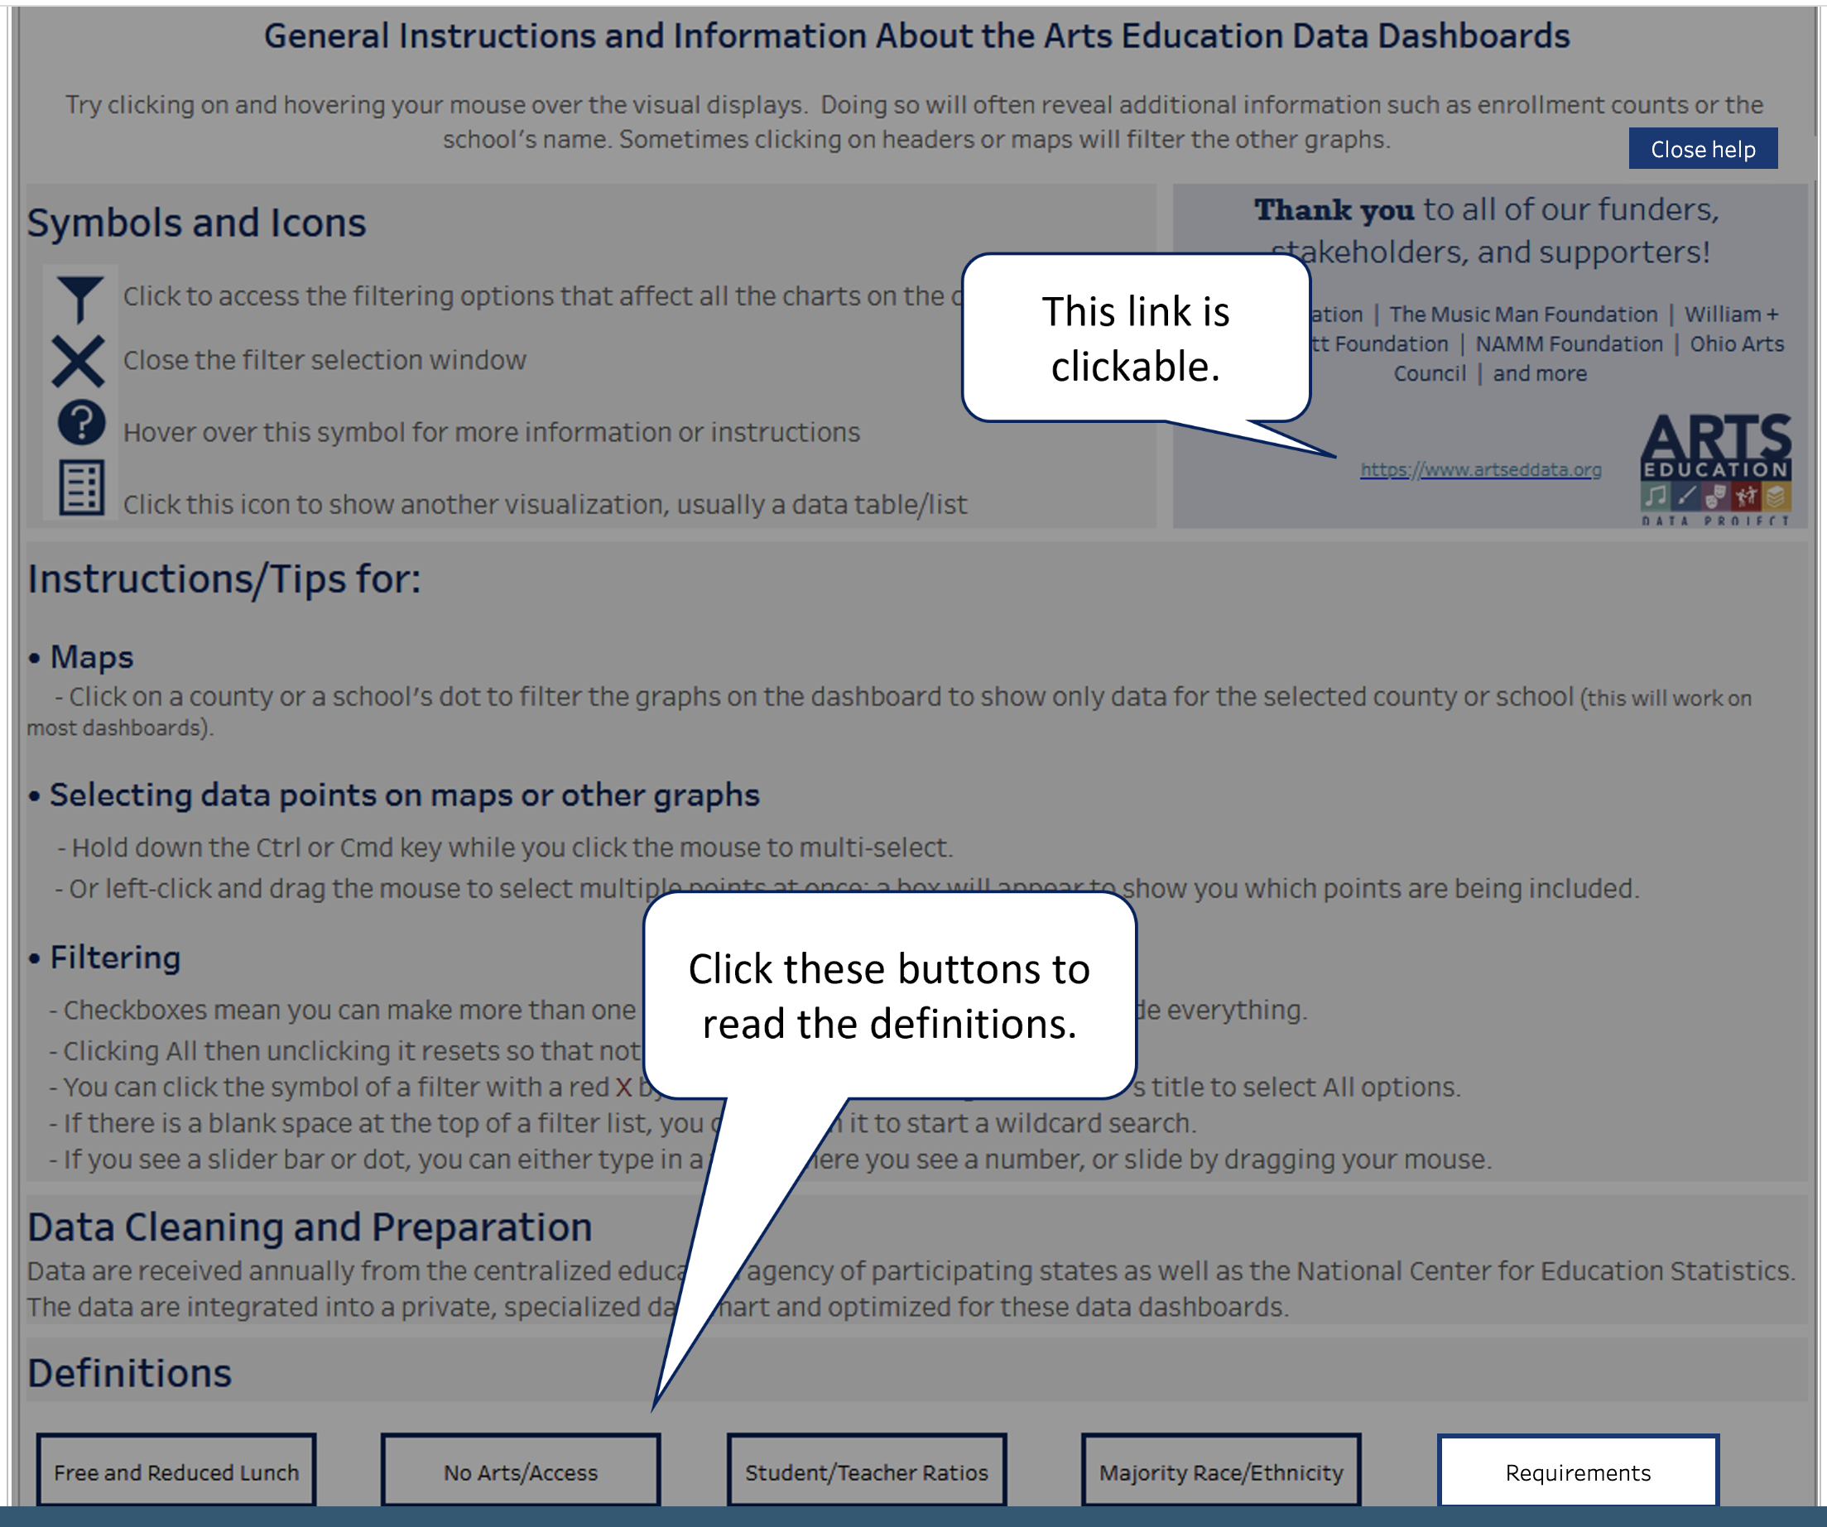
Instructions & Info: Help
Select the Help button in the upper right-hand corner to better understand how this page presents data.

Slide 5
Instructions & Info: Symbols and Icons
The Symbols and Icons are important components of each tab’s webpage.

Slide 6
Instructions & Info: Tips
The Instructions & Info tab provides tips for working with the data visualizations.

Slide 7
Instructions & Info: Definitions
Select any of the five buttons to learn more about the definitions for these metrics.

