Slide 1
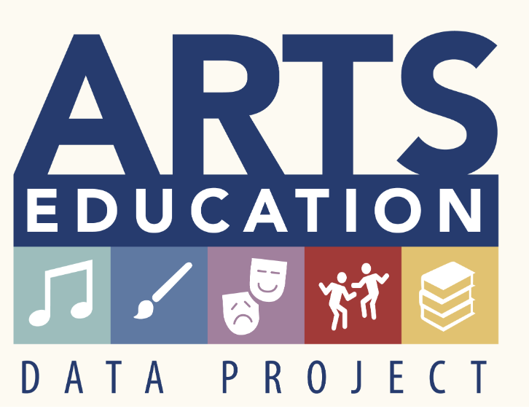
The Pennsylvania Dashboard for the…

Slide 2
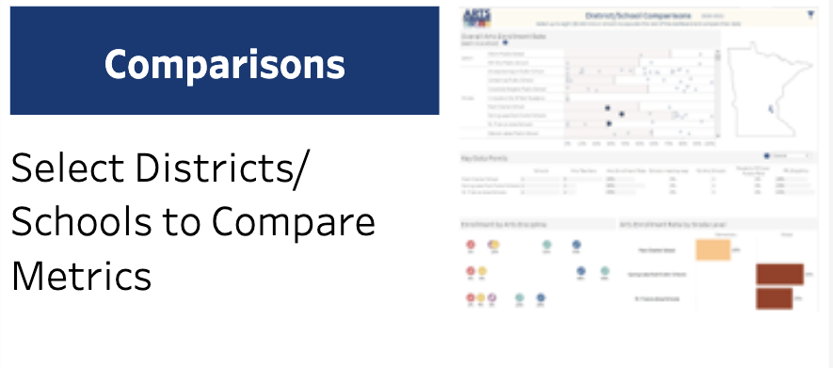
Comparisons

Slide 3
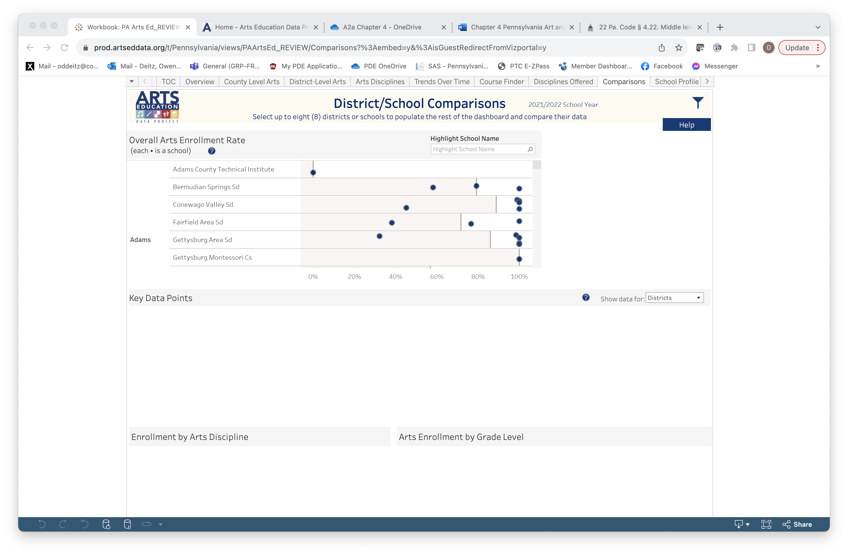
Comparisons
The Comparisons tab provides opportunity to explore similarities and differences in art education access data among schools that have unique commonalities.
There are lots of filter options in this tab!
Filter for county, then scroll to see the dots highlighted by the selected school name.
(See slide 5)
Selecting this symbol provides ways to choose districts or schools that you want to compare.

Slide 4
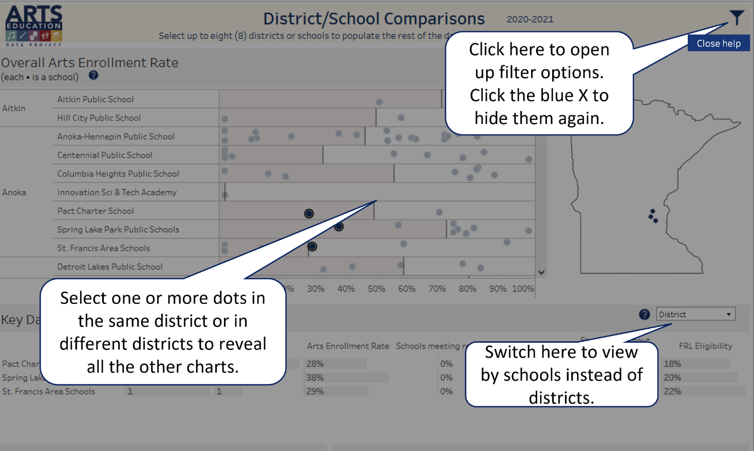
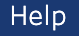
Comparisons: Help
Select the Help button in the upper right-hand corner to better understand how this page presents data.

Slide 5
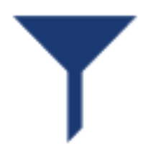
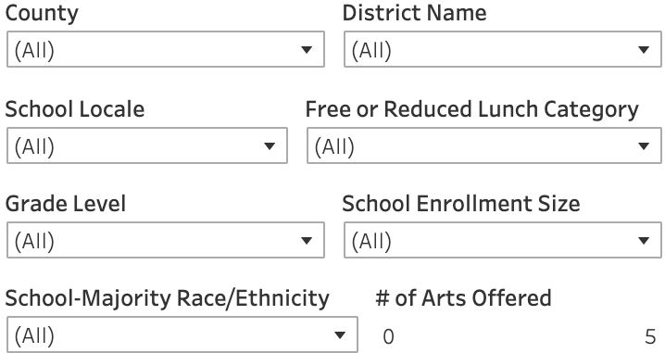
Comparisons: Filter Icon
Select the filter icon and drop-down lists to filter by County, District, School Locale, FRL, Grade Level, School Enrollment Size, Race/Ethnicity, or # of Arts Offered.

Slide 6
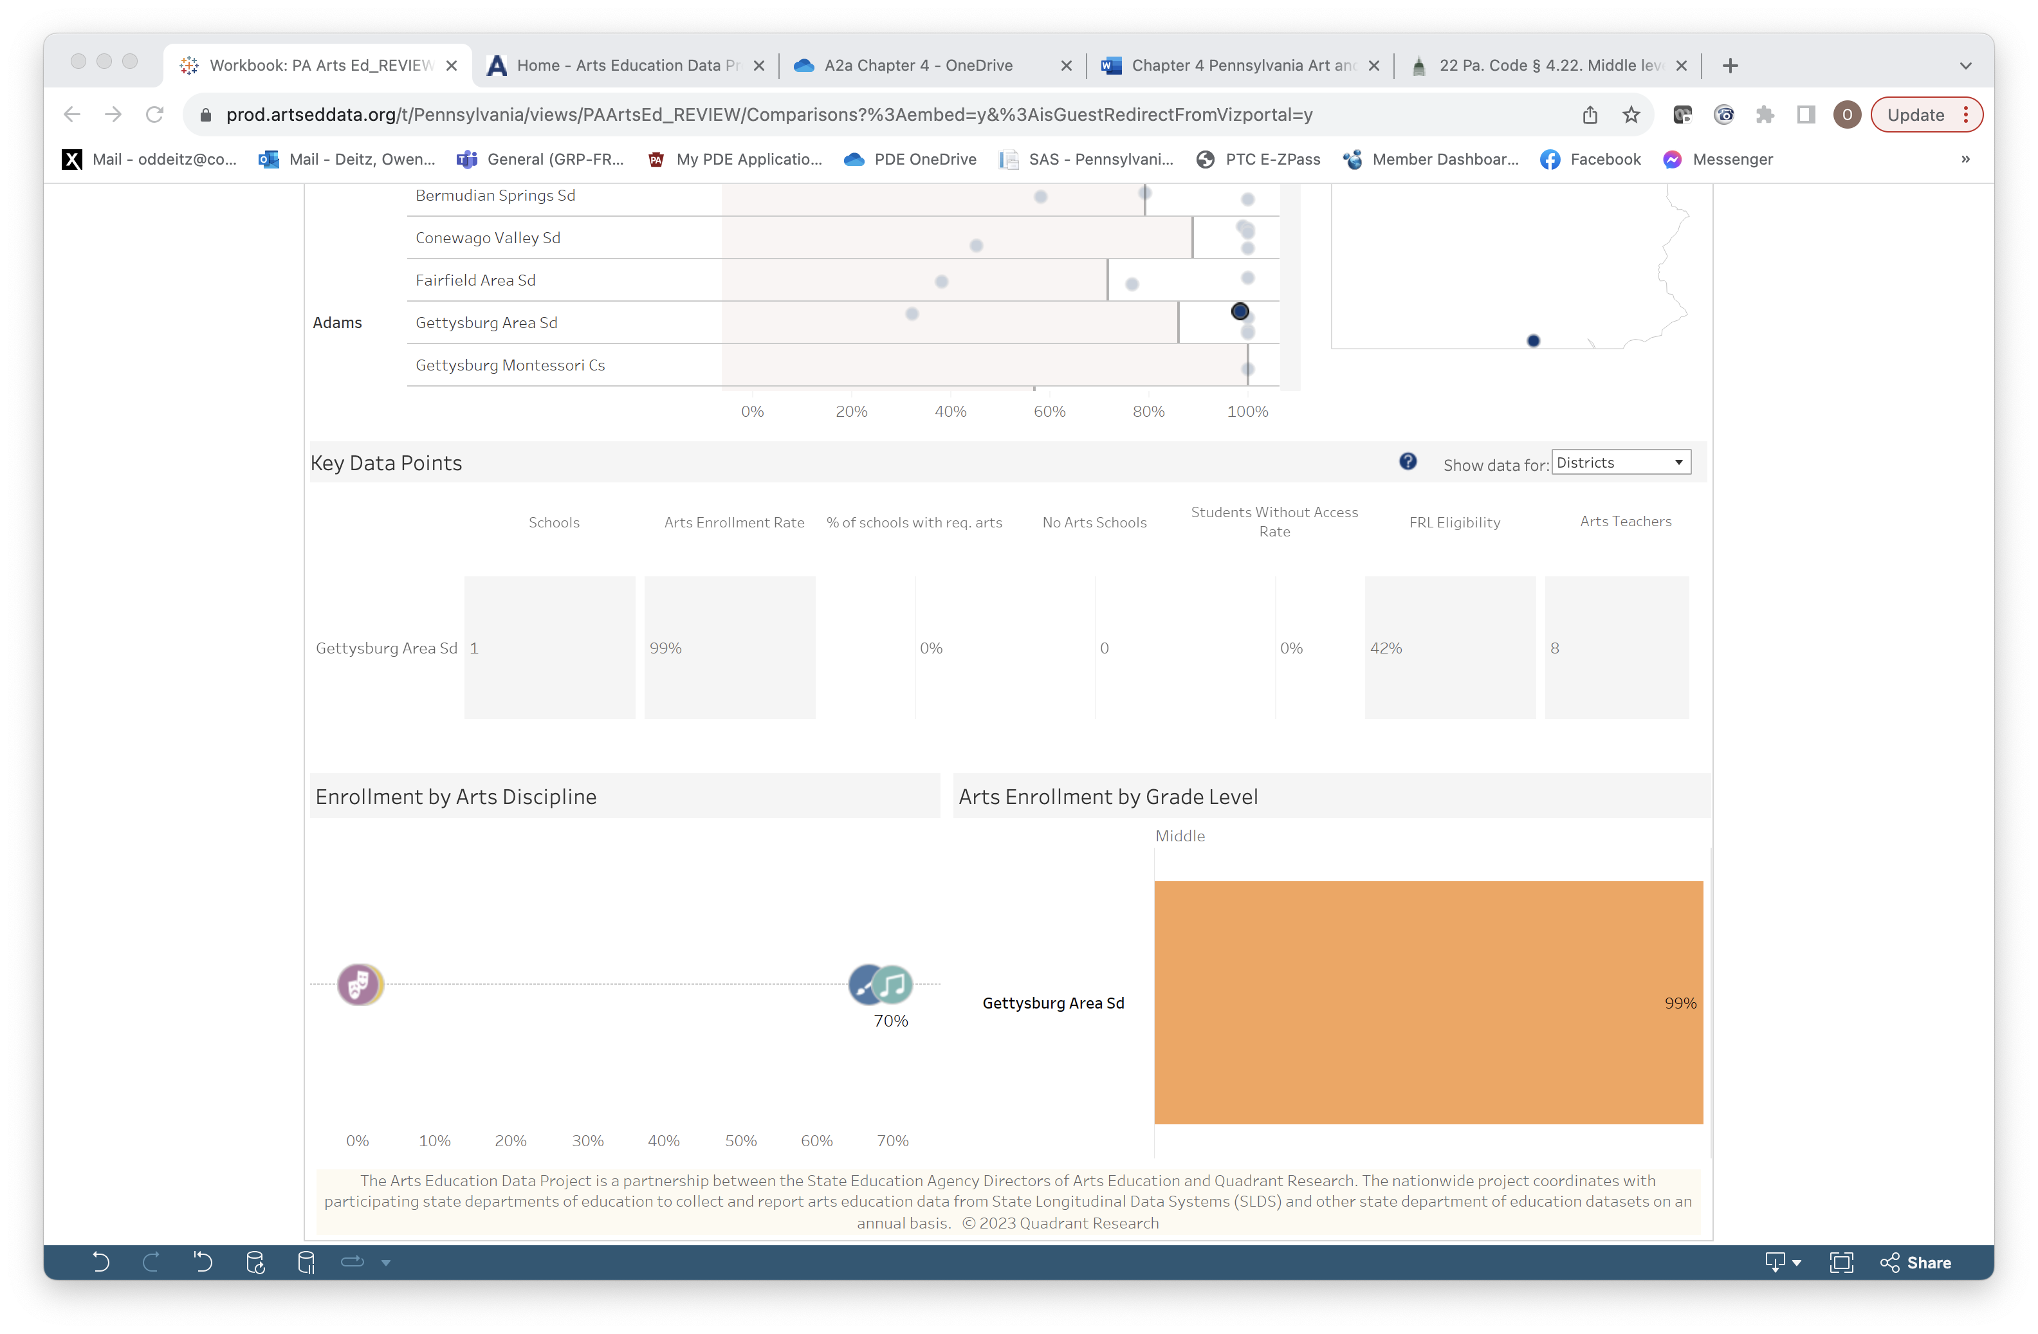
Comparisons: District and School List
Selecting information for Comparison can be done at several levels:
…at the County level,
…at the District level,
…or at the Individual School level. Each school’s data dot is positioned on the scale based on the % of students enrolled in arts courses at that school.
Clicking on any one of these levels generates specific data for that level in Key Data Point, Enrollment by Arts Discipline and Arts Enrollment by Grade Level.

Slide 7
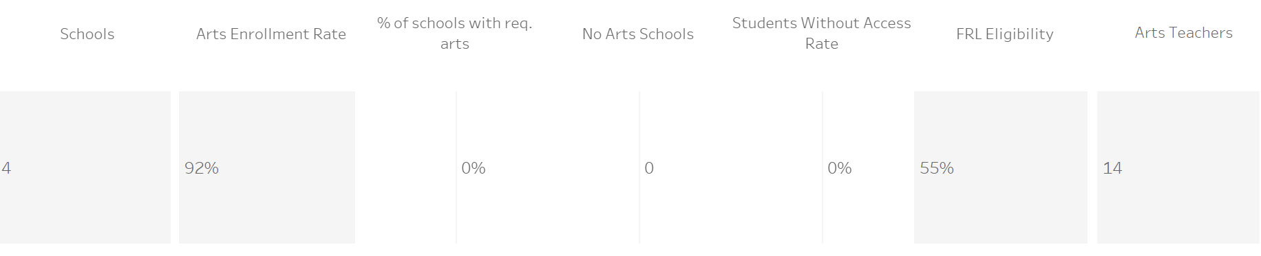
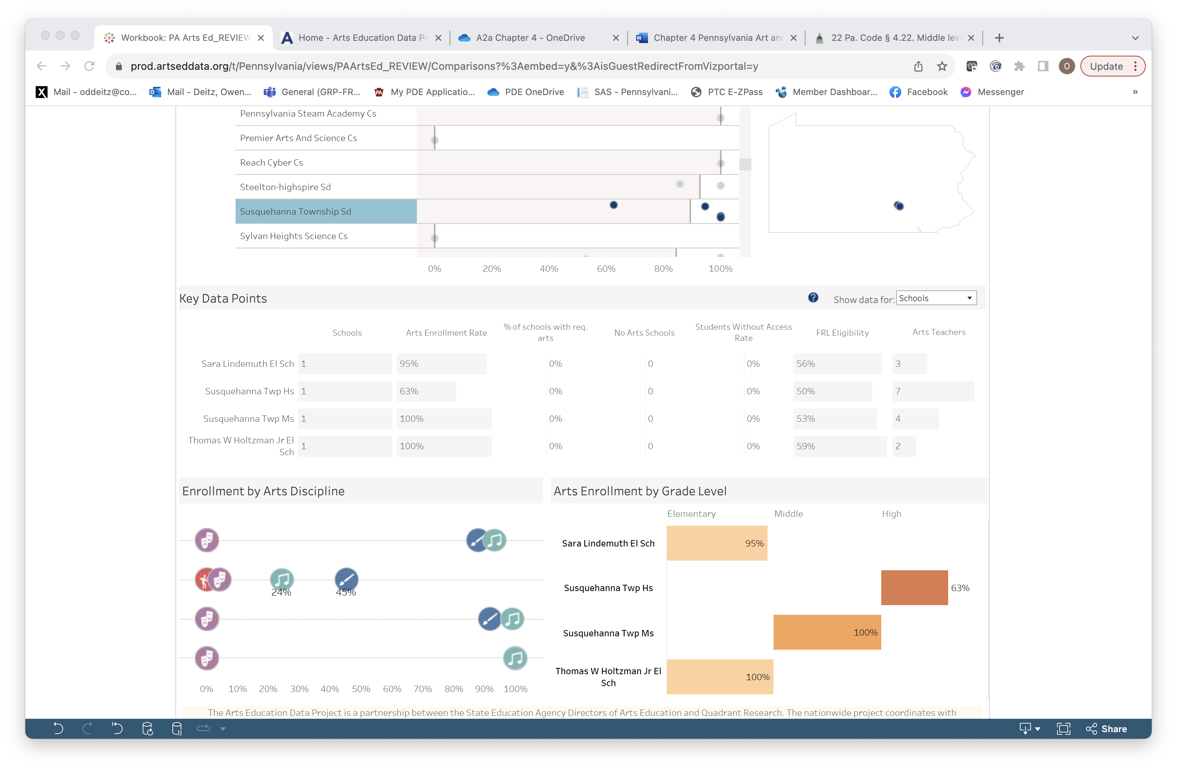
Comparisons: District & School Level
Key Data Points generates data at the District level or the School level.
District Level
School Level
(Same District)

Slide 8
Comparisons
Enrollment by Arts Discipline and Grade Level will also be generated for selected schools. Selecting an arts icon will provides more information.

Slide 9
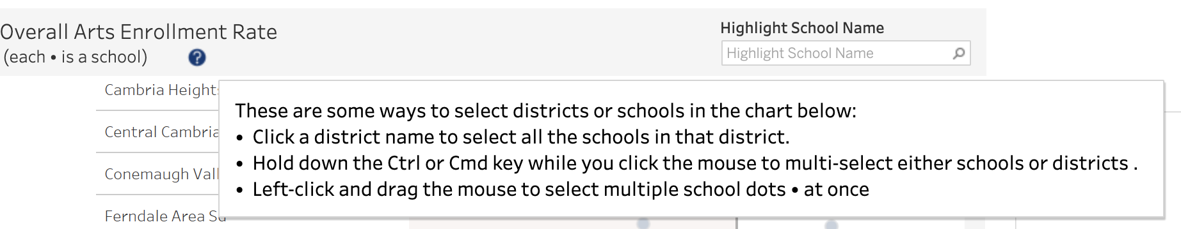
Comparisons: Multiple Schools & Diostroicts
Using the directions found by selecting this symbol, you can add additional schools or districts to your comparison list.

