Slide 1
Identify Closing Probabilities
Masters E-A through E-K

Slide 2
Session Six Objectives
1. The three parts of the projected path of travel
2. Measuring following distance with time
3. Measuring stopping distance with time
4. Measuring sight distance with time
5. Identifying probable errors of other users
6. Determining a high or low probability of conflict
7. Determining when a potential conflict can occur and how much of your space it might occupy

Slide 3
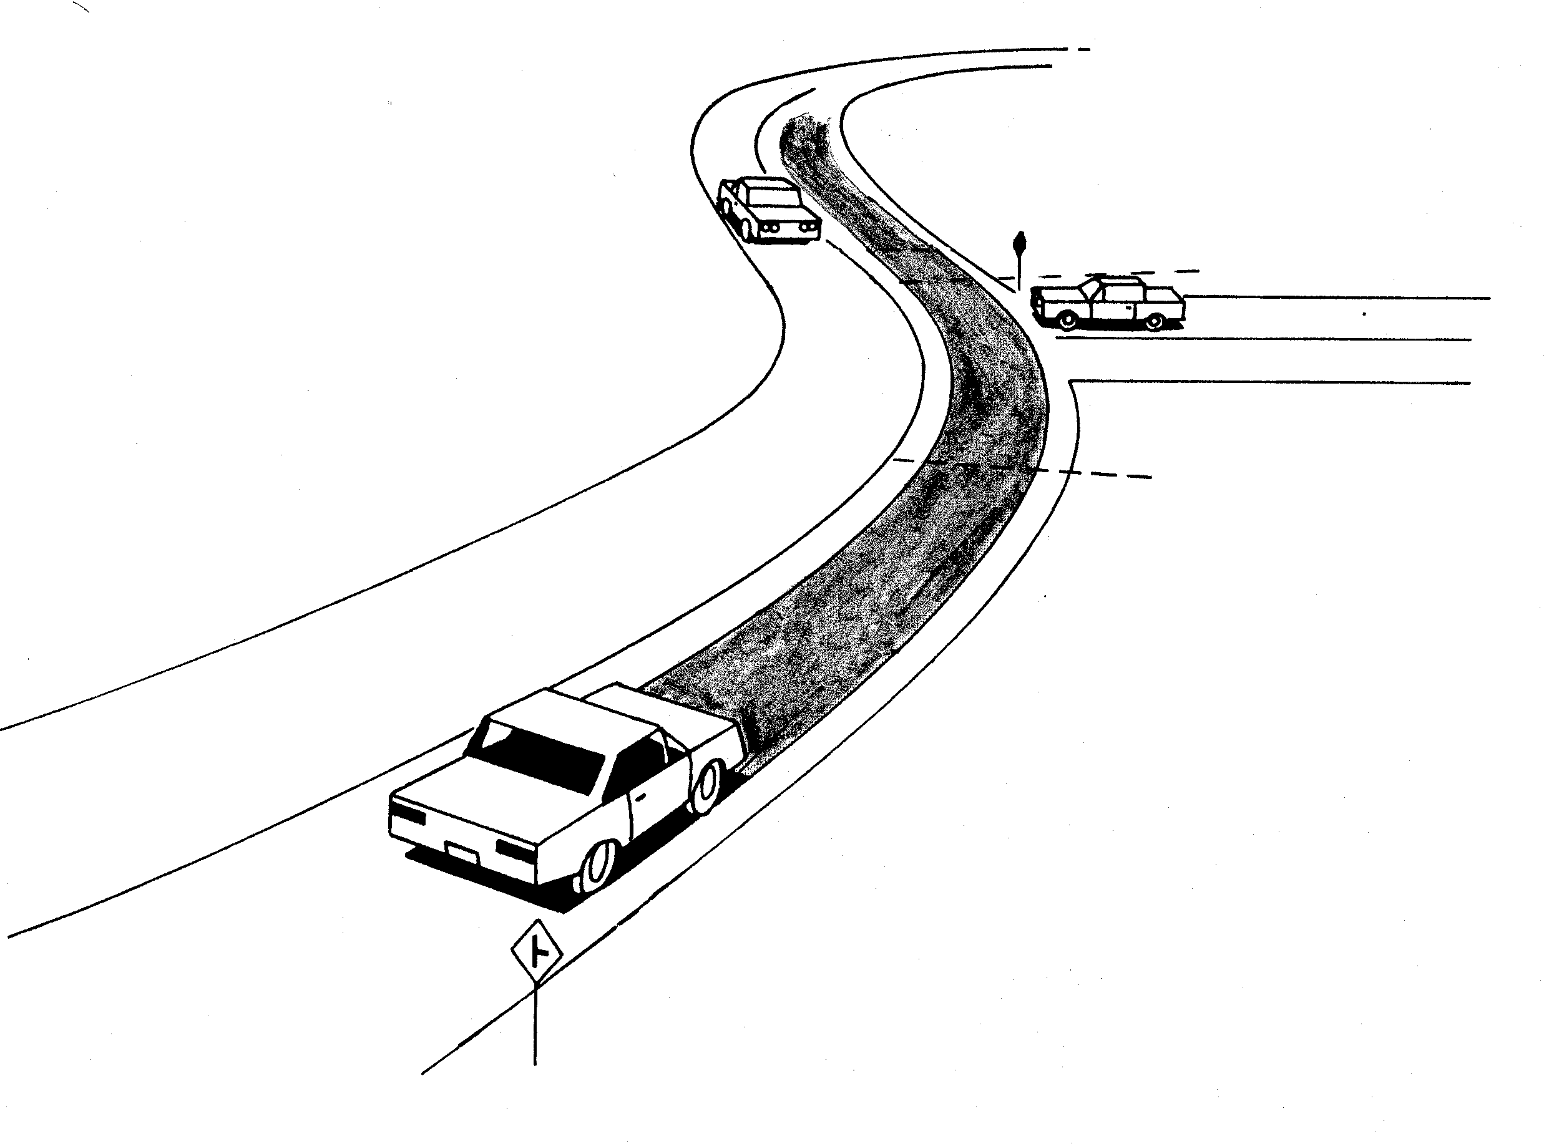
Projected Path of Travel
---------------------Visual Lead
Stopping Distance
Following Distance

Slide 4
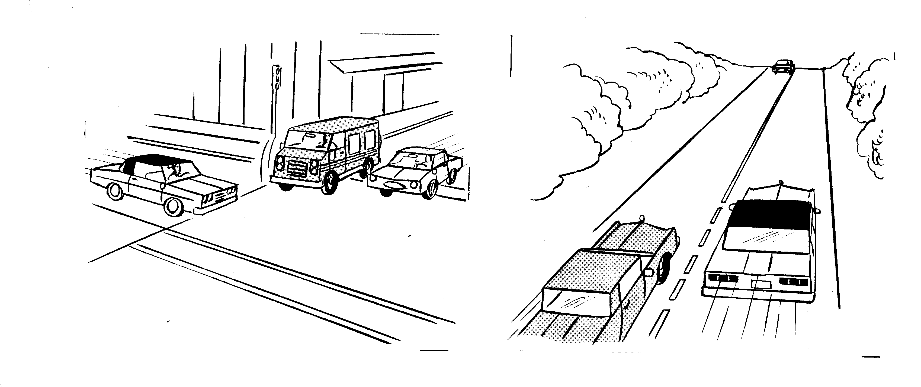
Identify Problem Errors
Fails to yield right-of-way Fails to observe pavement markings
Failure to Observe Laws

Slide 5
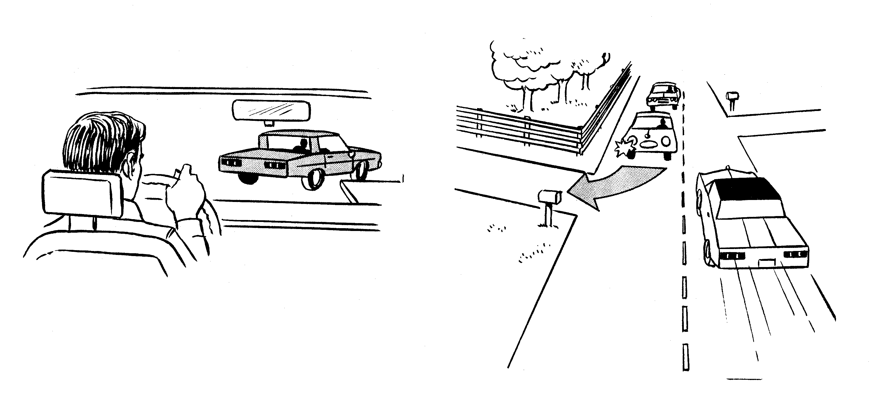
Identify Probable Errors
Sharp curbing Narrow side road
Improper Responses to Highway Conditions

Slide 6
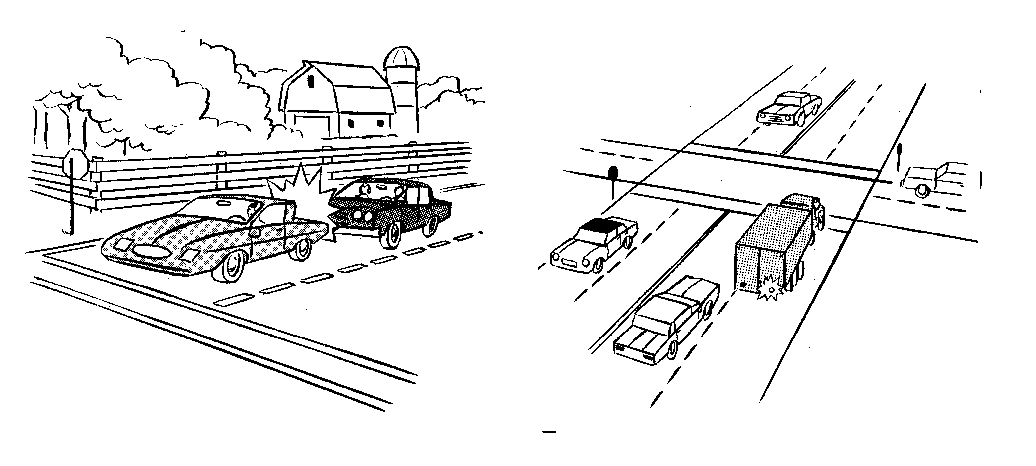
Identify Probable Errors
Follows too Closely Drives in Blind Spot
Improper Responses to Other User Actions

Slide 7
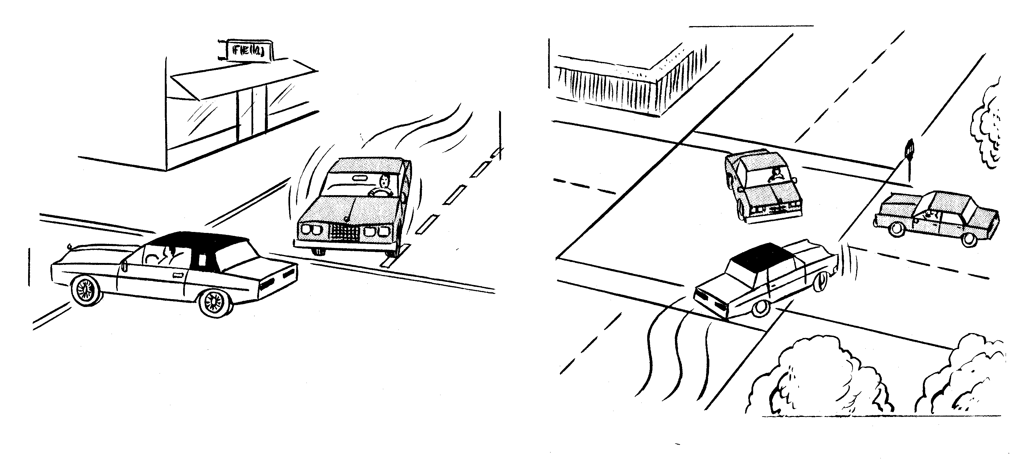
Identify Probable Errors
Lose Control in Skid Swerves too Quickly
Improper Vehicle Control Actions

Slide 8
Evaluate Conflict
Probabilities of Other Users

Slide 9
Driver Actions are Very Limited
Drivers can change direction
Drivers can change speed
Drivers can communicate
Focus on the action that could cause a closing

Slide 10
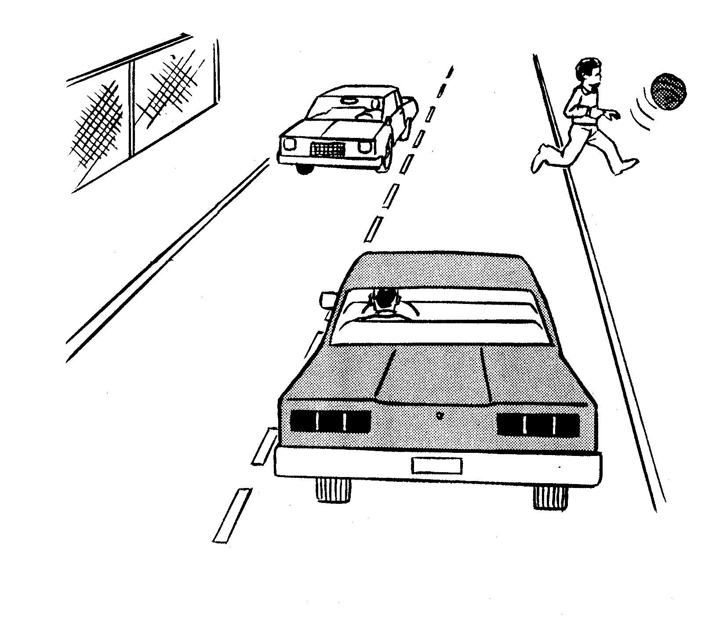
Evaluate for Conflict Probabilities
Identify Low Chance of Conflict
More evidence against a conflict

Slide 11
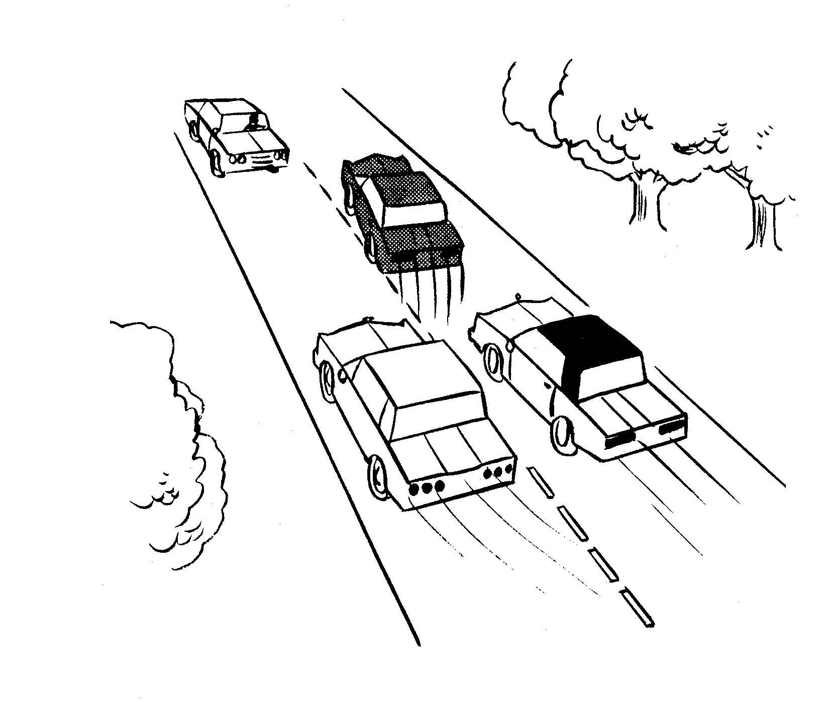
Evaluation for Conflict Probabilities
Identify High Chance of Conflict
More evidence for a conflict

Slide 12
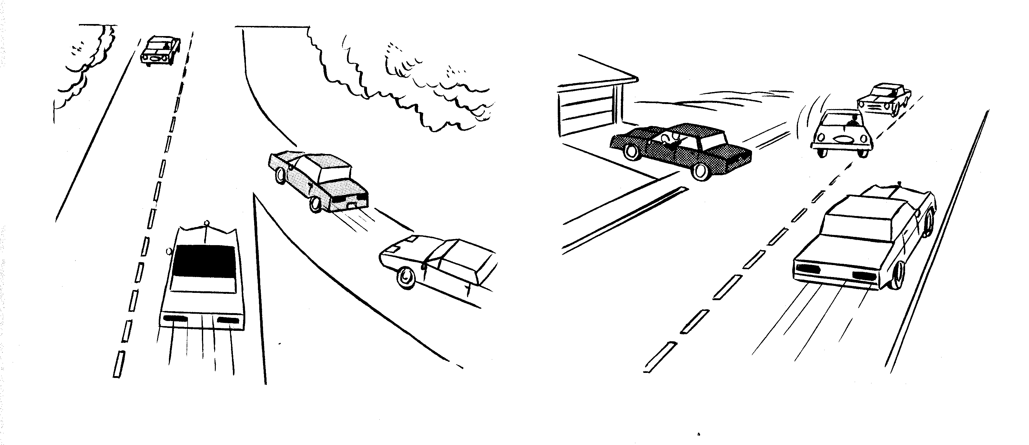
Identify Probable Point of Conflict
Judge speed of closing Judge amount of space needed

Slide 13
Contact/Mission
For more information on the (the topic of the presentation) please visit PDE’s website at www.education.pa.gov
The mission of the Department of Education is to ensure that every learner has access to a world-class education system that academically prepares children and adults to succeed as productive citizens. Further, the Department seeks to establish a culture that is committed to improving opportunities throughout the commonwealth by ensuring that technical support, resources, and optimal learning environments are available for all students, whether children or adults.

