Slide 1
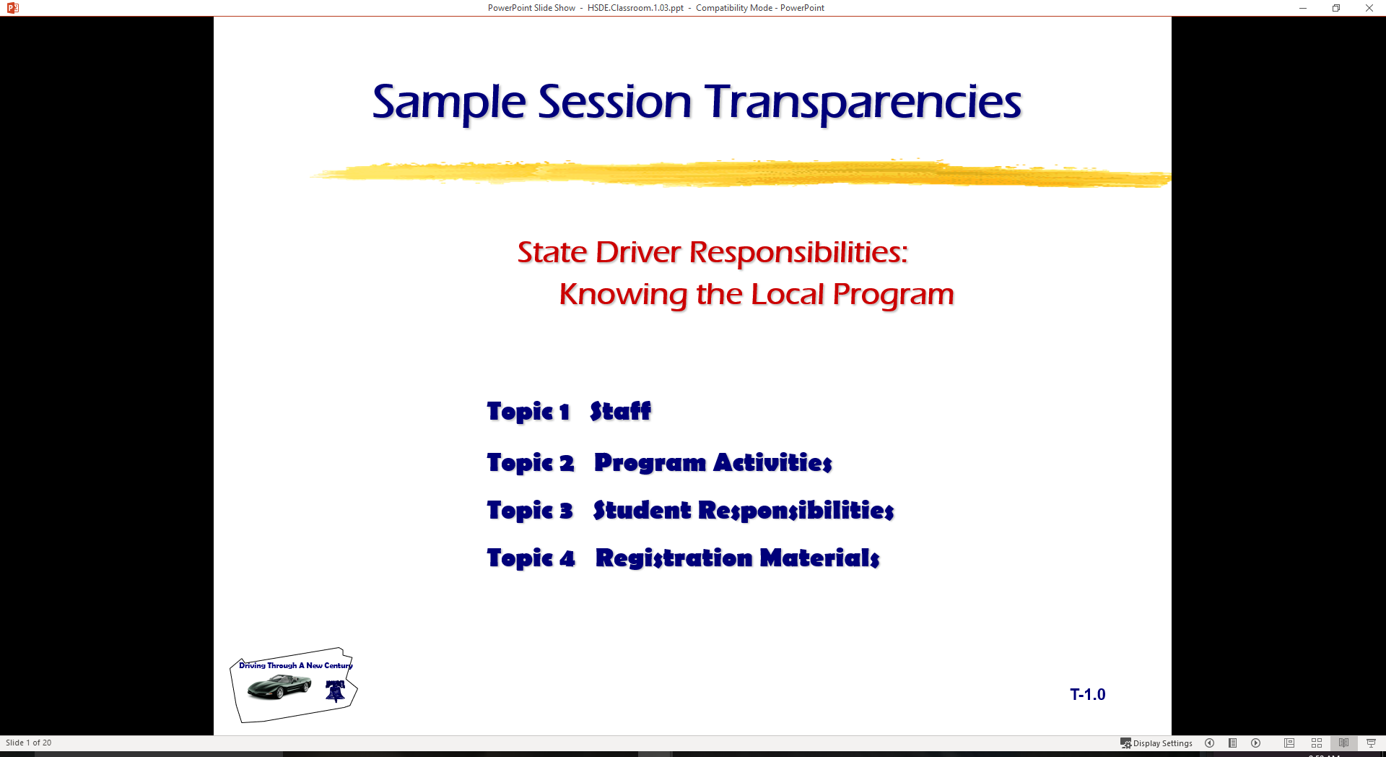
Driver Responsibilities:
Knowing the Local Program
  Topic 1 Staff
  Topic 2 Program Activities
  Topic 3 Student Responsibilities
  Topic 4 Registration Materials
  Topic 5 What is New in Driver Education
  Topic 6 Vision and Perception
  Topic 7 Central Space and Blind Zones

Slide 2
Introduction
Traffic Safety Institute Staff
  ……………. is administrative support
  ………….. is coordinator of TSI Program
  …………… is coordinator of laboratory, in-car work, and student observers
Instructional Staff
  ………………. is instructor and coordinator of Model HSDE program
  ……………….. is instructor for range and in-car activities
  Students will observe and work with the lab phases

Slide 3
Class activities
Classroom Lectures (large group activity)
Individualized Classroom Activities (small groups or individually)
Assessments (graded activities)
Simulation (small group activities)
  Visit simulation units
  Need to limit class size to twenty is based on simulation and range activities

Slide 4
In-car Activities
Range activities are grouped activities
  Space and reference point lab
  Vehicle Balance and Control (AutoControl Monster)
  Basic skills audit (You may practice with your car)
  Traction loss control (wet surface training)
In-car activities are grouped activities
  Driver skills audit
  Remedial training
  Basic skill training
  Perceptual skill training
  Final audit of skills and performances

Slide 5
Attendance Policy
Hour requirement for completion and certification
When student misses fourth class or simulation
  dropped from class activities
  may make up work during next term class
  “I” grade will be issued
    must retake class if activities are not made up in next term
When a student misses third in-car activity
  suspended from in-car activities
  may make up work during next term class
  “I” grade will be issued
  must retake class if activities are not made up in next term
“I” grades turn to “F” grade if not made up during next term class

Slide 6
Passing classroom to participate
A student must be passing classroom and simulation activities to participate in the in-car activities.
Example: if student fails test or is below passing... s/he is suspended from in-car activities
Attendance rules will apply

Slide 7
Rules of Conduct
We expect you to cooperate with our staff in any activity area.
Food and drinks are not allowed in vehicle or simulator
  electrical components
  dangers to passengers
Abusive language will not be tolerated.
Treat instructors and fellow class members with respect.
Ask questions that are relative to the program and subject matter.
Keep a notebook or portfolio of all classroom/laboratory activities.
Be ready for class activities in a timely manner.
Cell phones will be confiscated if they are used during class/lab time.

Slide 8
Penalties for Breaking Rules of Conduct
Student will be removed from activity and treated as missing the class, simulation, or in-car activity
Attendance rules will be enforced as listed above.
Tests, scores, or audits for the time missed will be recorded as a “0.”

Slide 9
Registration and waiver information
Must be completed and returned by next classroom session for scheduling groups
Waiver signature needed by parent if under age 18.

Slide 10
Class schedule of activities
Grouping arrangements
Tentative schedule depends on:
  Model school programs
  Our facilities availability
Overall groupings will be based on your forms returned
We will have the first example of groupings starting on Tuesday
Homework will be kept to a minimum
Lab will be made available for make-up work

Slide 11
Complete a class project
Pick a Traffic Safety topical area by ………….
Prepare a written topic paper, PowerPoint with notations, or video
Prepare a fifteen minute class presentation
Be prepared for oral presentation by ………………
A schedule will be developed based on the topical areas
May be used as the basis for a Senior Project

Slide 12
In a Traffic Safety Program…
Evaluate your needs as a driver
Provide some basic skill development
Provide perceptual training skills
Develop a recognition of the problem concerning new drivers
Our goal is to provide good experiences that will help novice drivers make good decisions in the future
View the video “Young Drivers: The High Risk Years” and discuss the issues presented..

Slide 13
Graduated License Program
Affects you as a new driver
The basis for provisional and graduated licensing comes from high insurance claims and risk assumption by new drivers.
Look at copies of the “Graduated Driver’s License” pamphlet provided with textbook
  Review licensing process
  Answer GDL questions

Slide 14
Class assignments
Begin with next Monday’s session.
Groupings and first laboratory sessions will be made available.
A notebook or portfolio will be needed.
Class activity information will be made available.
Capability to operate more than one video presentation for individual work

Slide 15
What Is New in Driver Education
Modern Vehicle Technology Issues
  Steering and Hand Positioning (Airbag)
  Multiple Steering Techniques (Rack/Pinion)
  Knowing Oversteer/Understeer Principles
    ABS, TSC, and ESP…
    Vision Control, Motion Control, THEN Steering Control
  BGE Mirror Method (Multiple Lanes)
  Reference Points (Vehicle Design)
  Alert Symbols and Warning Symbols (Control Panel)
  Divided Attention Tasks (Distracted Driving Issues)

Slide 16
Program Questions ?
From the Parents
From the Students
Auto Control Monster…

Slide 17
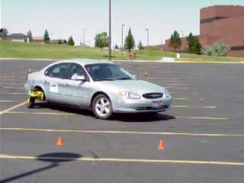

Slide 18
Driver Education Program Goals
Demonstrate a working knowledge of
  laws for operating and owning an automobile
  rules for operating and owning an automobile
  procedures for operating and owning an automobile
  occupant restraints and new vehicle technology
Use a space management system to
  obtain correct information about driving maneuvers
  make reduced-risk decisions about driving maneuvers
  adjusting position and/or speed to avoid conflicts and reduce risk

Slide 19
Driver Education Program Goals
A student completing this driver education program will:
Manage factors that affect driver performance by
  developing refusal skills with alcohol and other drugs
  controlling displays of anger in traffic situations
  eliminating aggressive actions in traffic flow
  maintaining fitness and attitudes needed for reduced-risk driving performance
Protect natural resources by
  safe disposal of trash and toxic products
  conserving fuel and energy resources
  utilizing manufacturer’s vehicle maintenance specifications

Slide 20
Driver Education Program Goals
In ………, driver education students acquire the essential knowledge, skills, and experiences to perform reduced-risk driving practices in the total traffic environment.
Mastery of classroom and in-car instruction include:
Modeling behaviors
Knowledge and skills assessment
Observation
Parental/Mentor involvement
Continuous life-long learning of reduced-risk driving

Slide 21
Vision and Perception
Seeing Techniques
Perceiving Techniques
In-Car Habits

Slide 22
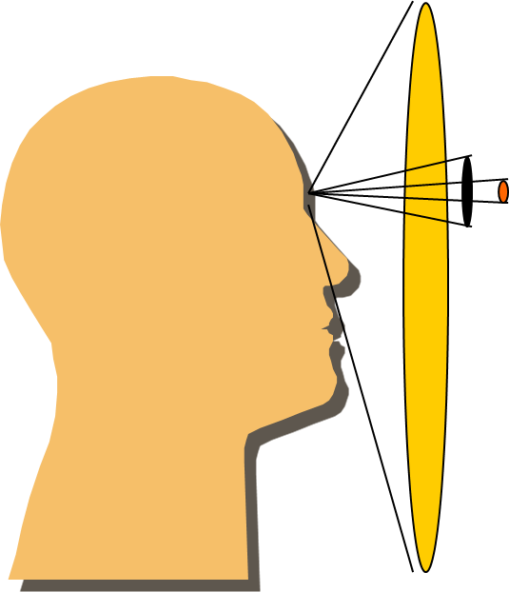
Vision and Perception
Fovial Vision Field
  Focus, Controlled Activity
  Field Independent
Useful Field of View
  Depth, Movement, Position
  Field Dependent
Peripheral Vision Field
  Changes in Color, Movement
  Field Dependent

Slide 23
Vision and Perception
Input-Process-Output
(S)IPDE Process
Time Relevant

Slide 24
Vision and Perception Systems
Identify Process (Searching)
Smith System - Aiming High , Eyes Moving, Getting Big Picture
Perceptual Driving System - Scan, Path of Travel, Space Cushion
Zone Control System - Look for LOS/POT Restrictions
SEE System - Search for Open LOS/POT

Slide 25
Vision and Perception
Predict Process (Evaluating)
Smith - Big Picture, A Way Out of Situation
Perceptual - 2 sec/4 sec/12 sec, hazard criticality
Zone Control - changing or closed zones
SEE - Evaluate space for speed or position adjustments

Slide 26
Vision and Perception
Decide Process (Evaluating)
Smith - Leave Yourself an Out
Perceptual - minimize, separate, compromise
Zone Control - check for open space
SEE - Evaluate space for speed or position adjustments

Slide 27
Vision and Perception
Execute Process (Responding)
Smith - Make Sure Others See You
Perceptual - communicate, speed, or position change
Zone Control - communicate, speed, or position change
SEE - execute communication, speed, or position change

Slide 28
Vision and Perception
Following Interval
Smith - 1 car for 10mph ( now 2-3 seconds)
Perceptual - 2 sec minimum, 3 or more seconds based on conditions
Zone Control - gaining 4 seconds minimum or more based on conditions
SEE - use a 4 second minimum and adjust for weather conditions

Slide 29
Perception
Being Perceptive is a Learned Process
Perceiving Problems Takes Time
Managing Visual Inputs Is Critical
Managing Time and Space is Primary Decision Tool

Slide 30
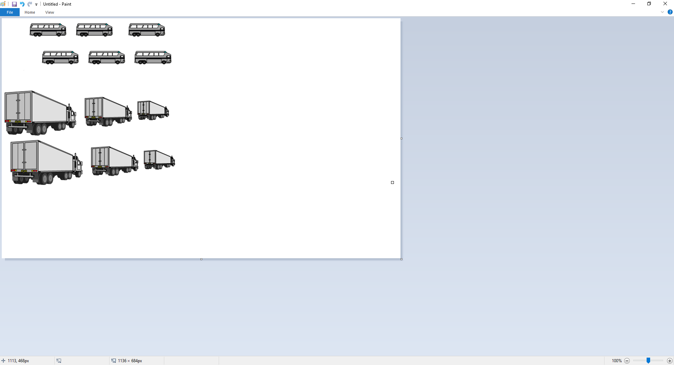
Language Example
Saville, Der Dago
Tousin busis inaro
Nocho, Demis troux
Summit cowsin
Summit doux
Notes:
Say Villie, der day go Say Wiilie, there they go
A tousin buses in a row A thousand buses in a row
No Choe, dem is trucks No Joe, them is trucks
Some mit cows in Some with cows in
Some mit ducks Some with ducks
Notice that you can now read this after LEARNING WHAT TO LOOK FOR in the language scheme.

Slide 31
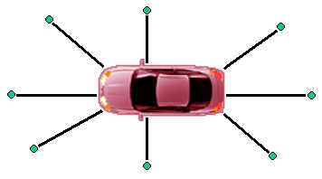
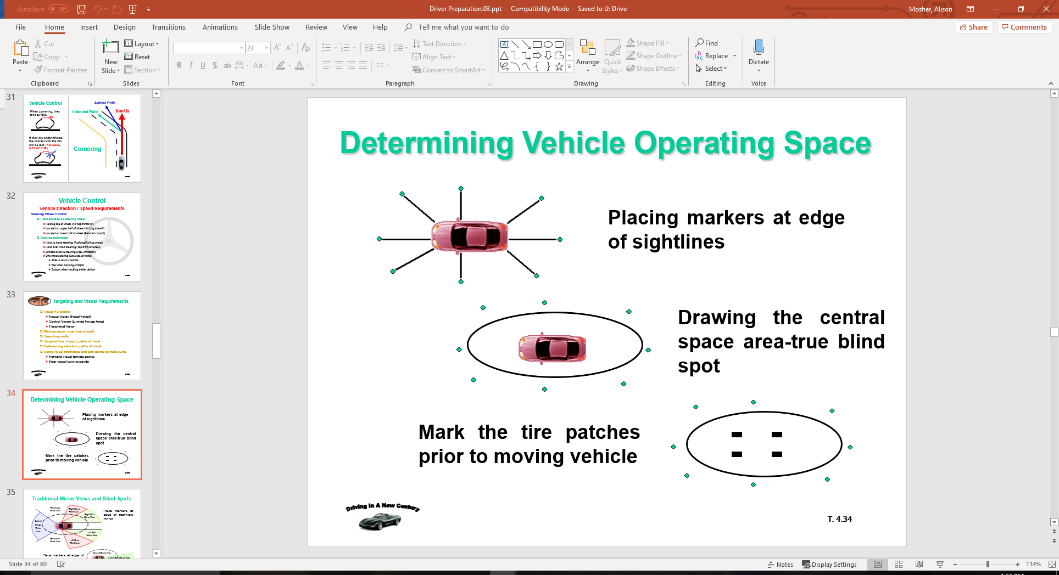

Determining Vehicle Operating Space
Placing markers at edge of sightlines
Drawing the central space area-true blind spot
Mark the tire patches prior to moving vehicle

Slide 32
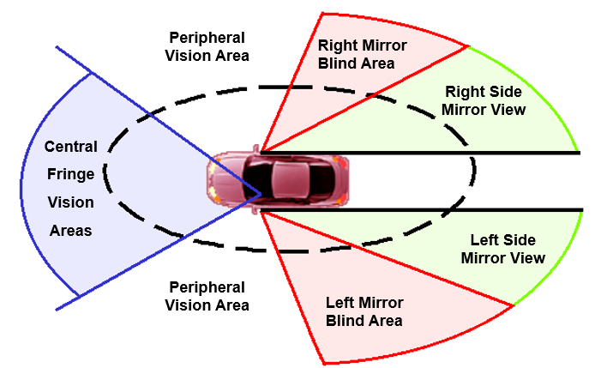
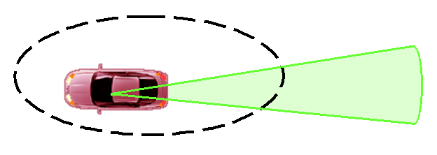
Traditional Mirror Views and Blind Spots
Place markers at edge of rear-view mirror
Place markers at edge of mirror view areas

Slide 33
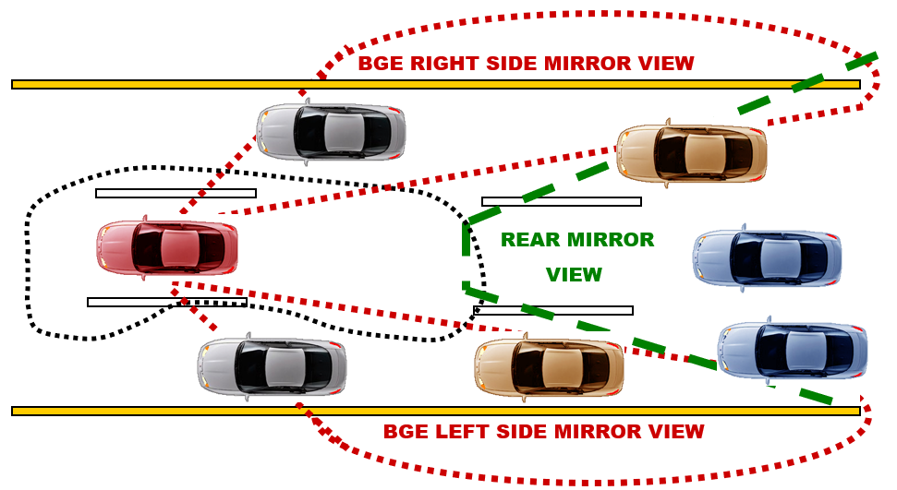
Mirror Blind Spot and Glare Elimination (BGE)
The BGE side mirror setting (15 degree to outside) will allow for view to the side in addition to the rear view.
Reference: Blindzone & Glare Elimination (BGE) Mirror Settings (G. Platzer, 1996)

Slide 34
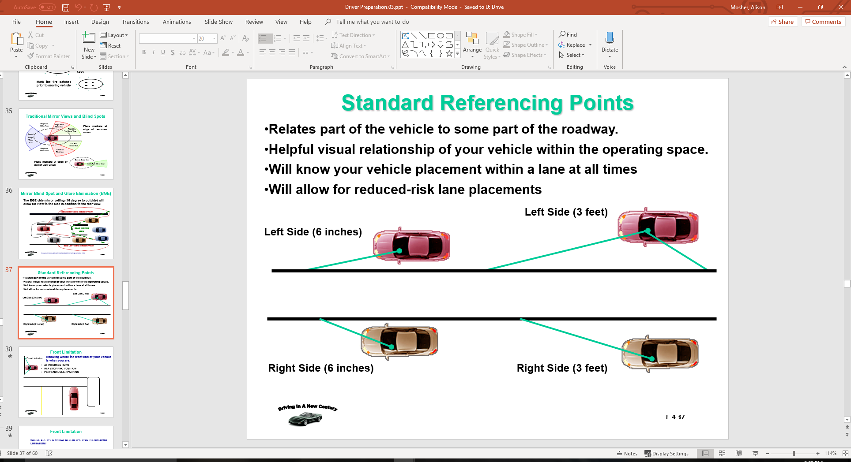
Standard Referencing Points
Relates part of the vehicle to some part of the roadway.
Helpful visual relationship of your vehicle within the operating space.
Will know your vehicle placement within a lane at all times
Will allow for reduced-risk lane placements

Slide 35
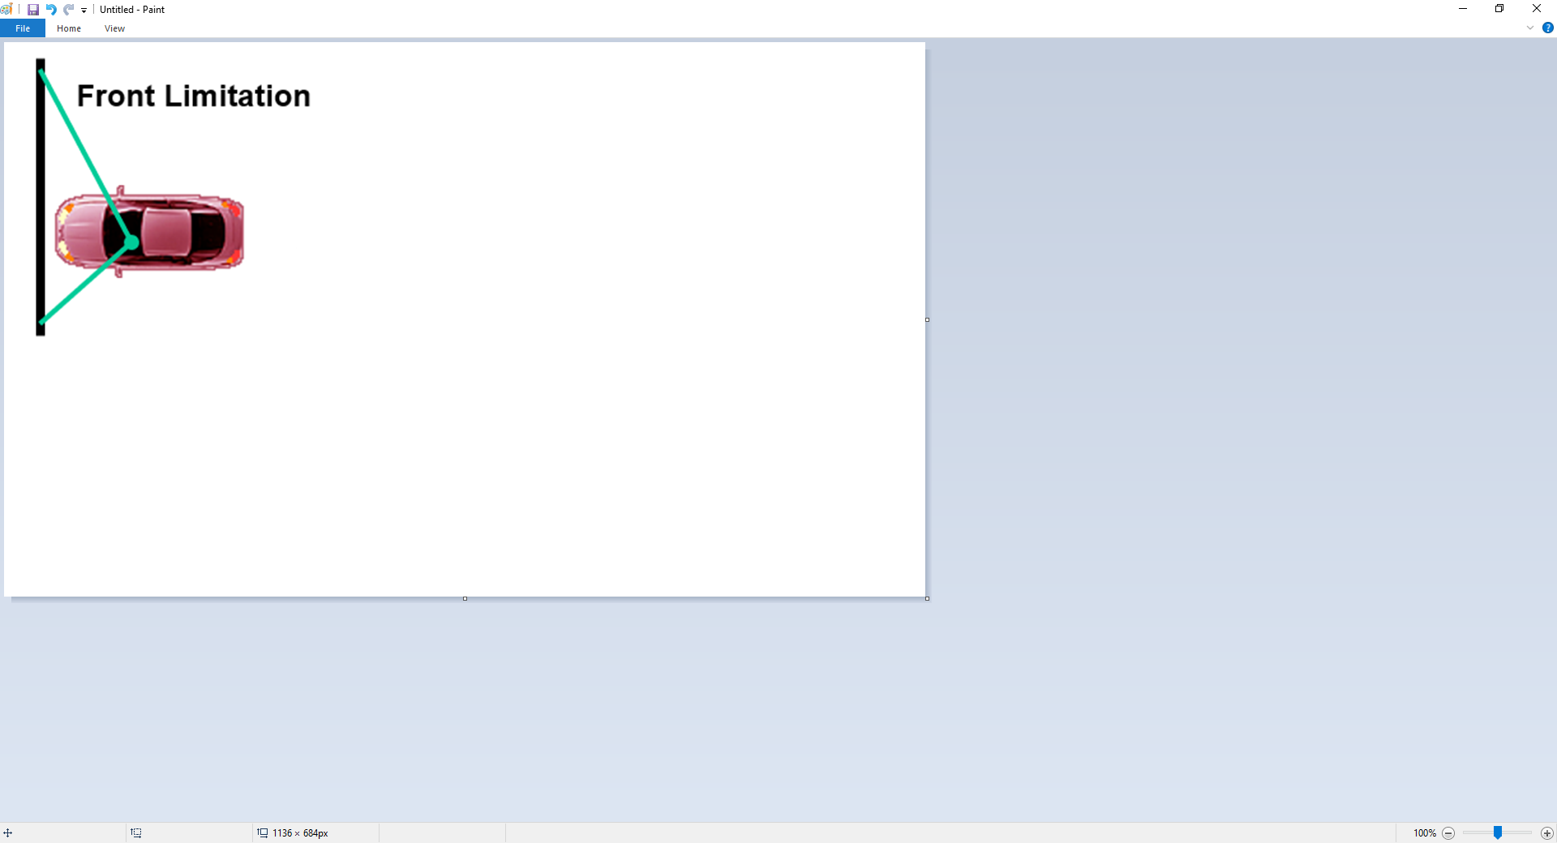
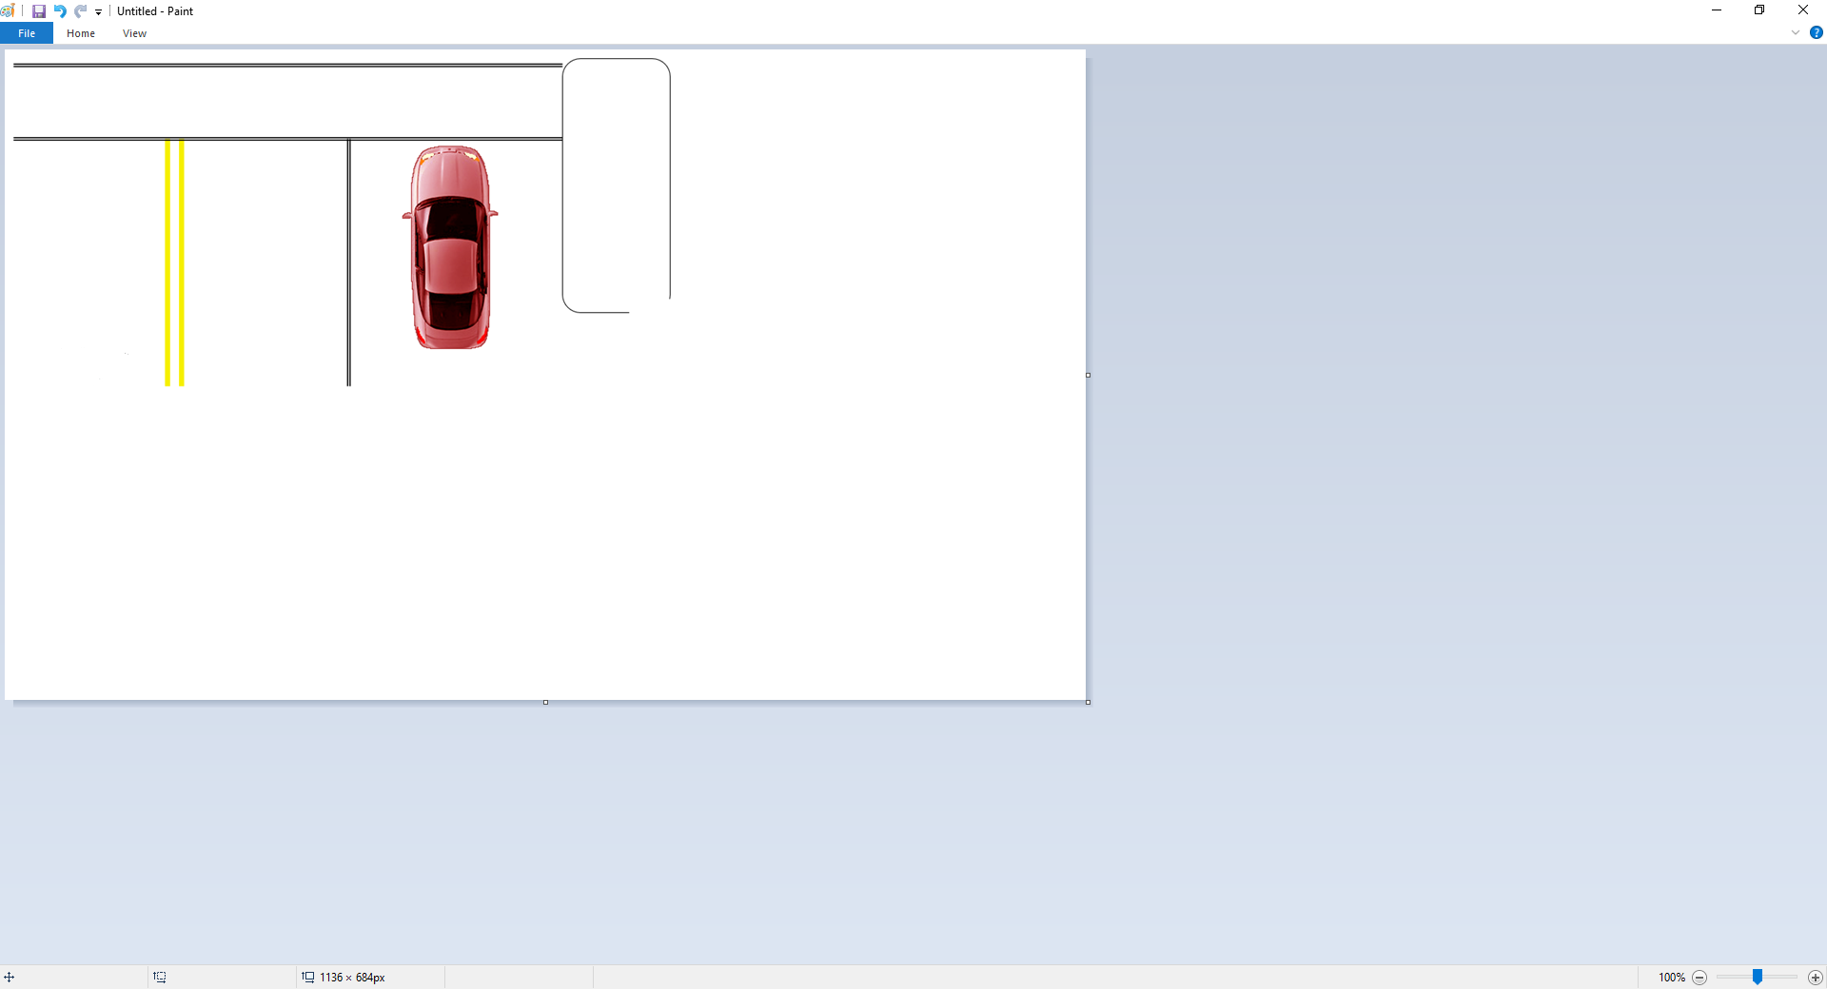
Front Limitation
Knowing where the front end of your vehicle is when you are:
AT INTERSECTIONS
IN A STOPPING POSITION
PERPENDICULAR PARKING

Slide 36
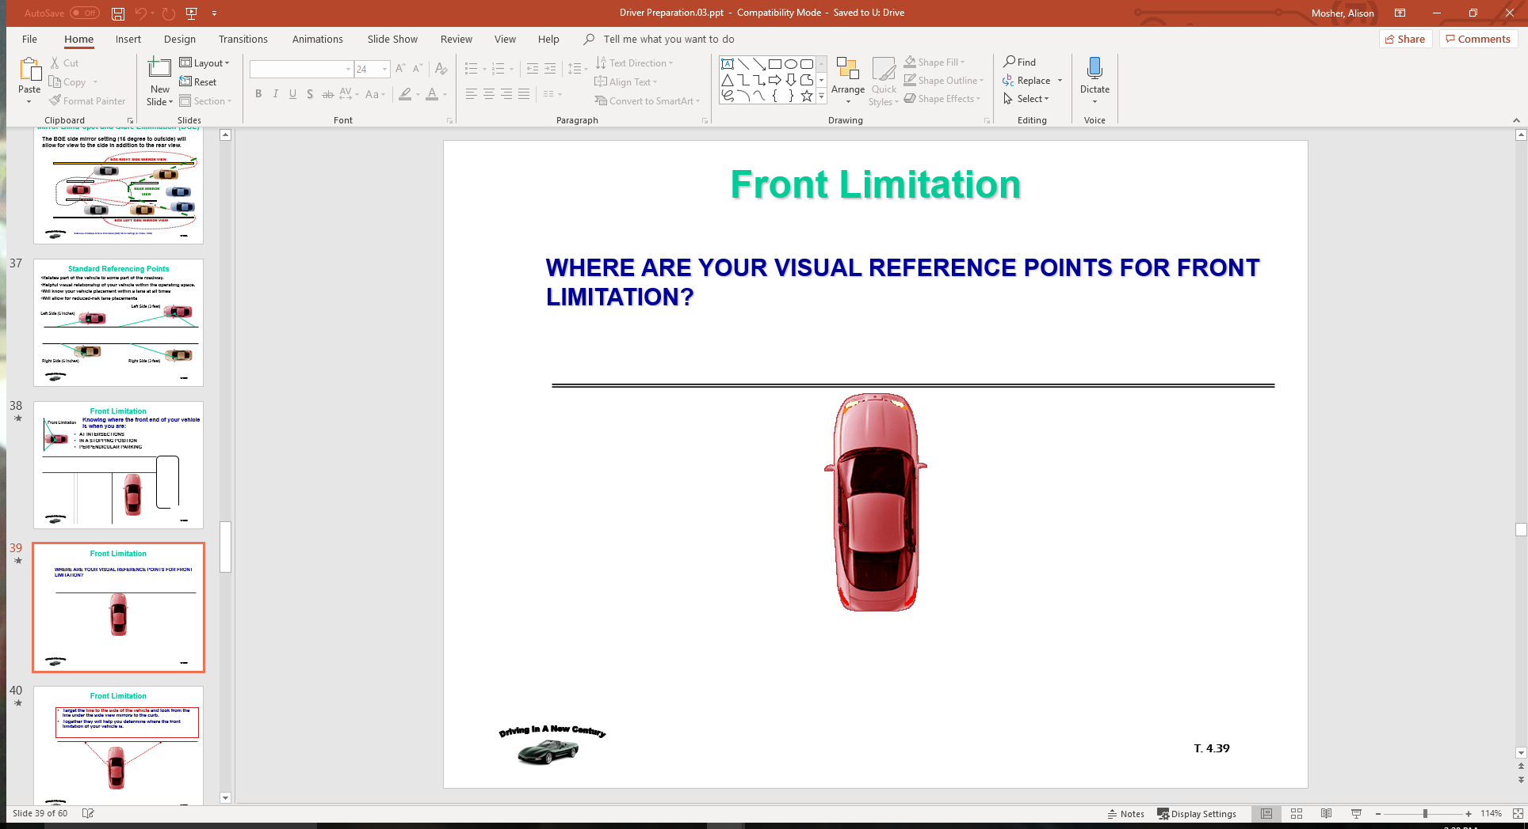
Front Limitation
WHERE ARE YOUR VISUAL REFERENCE POINTS FOR FRONT LIMITATION?

Slide 37
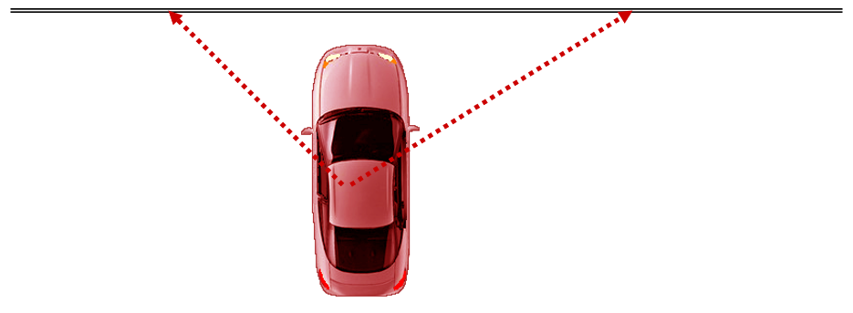
Front Limitation
Target the line to the side of the vehicle and look from the line under the side view mirrors to the curb.
Together they will help you determine where the front limitation of your vehicle is.

Slide 38
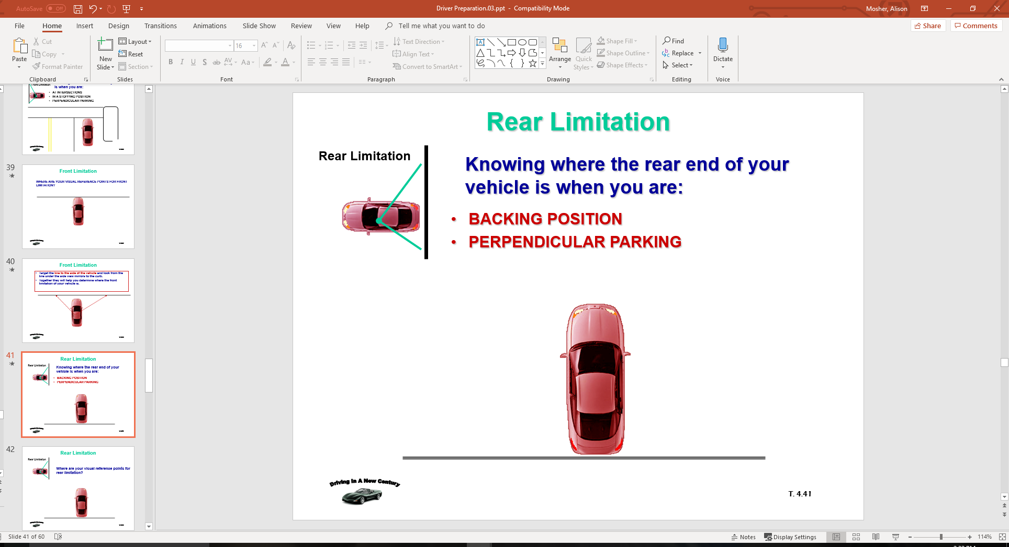
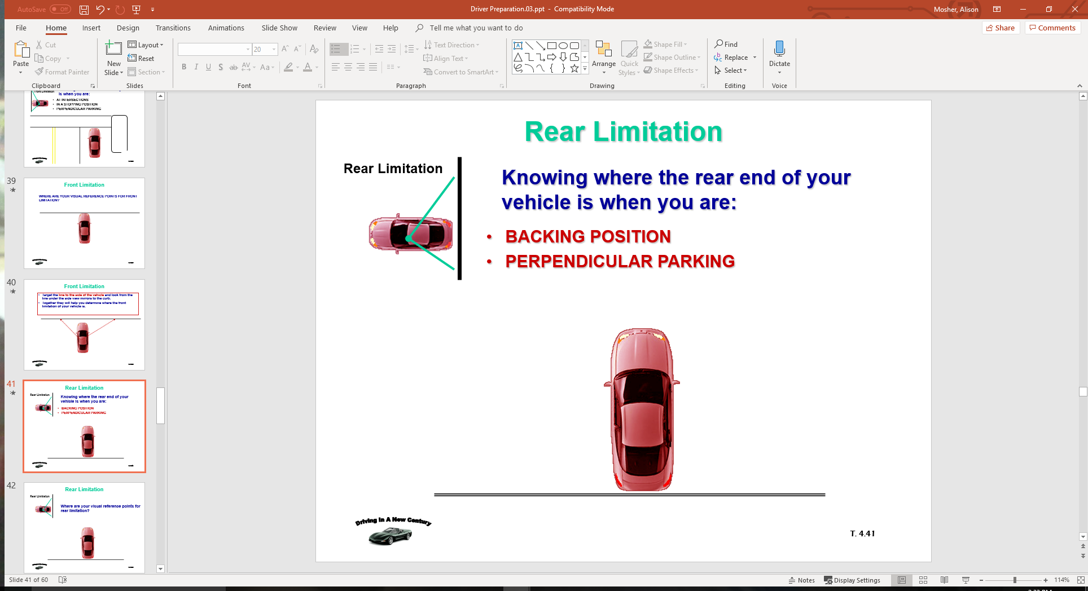
Rear Limitation
Knowing where the rear end of your vehicle is when you are:
BACKING POSITION
PERPENDICULAR PARKING

Slide 39
Rear Limitation
Where are your visual reference points for rear limitation?

Slide 40
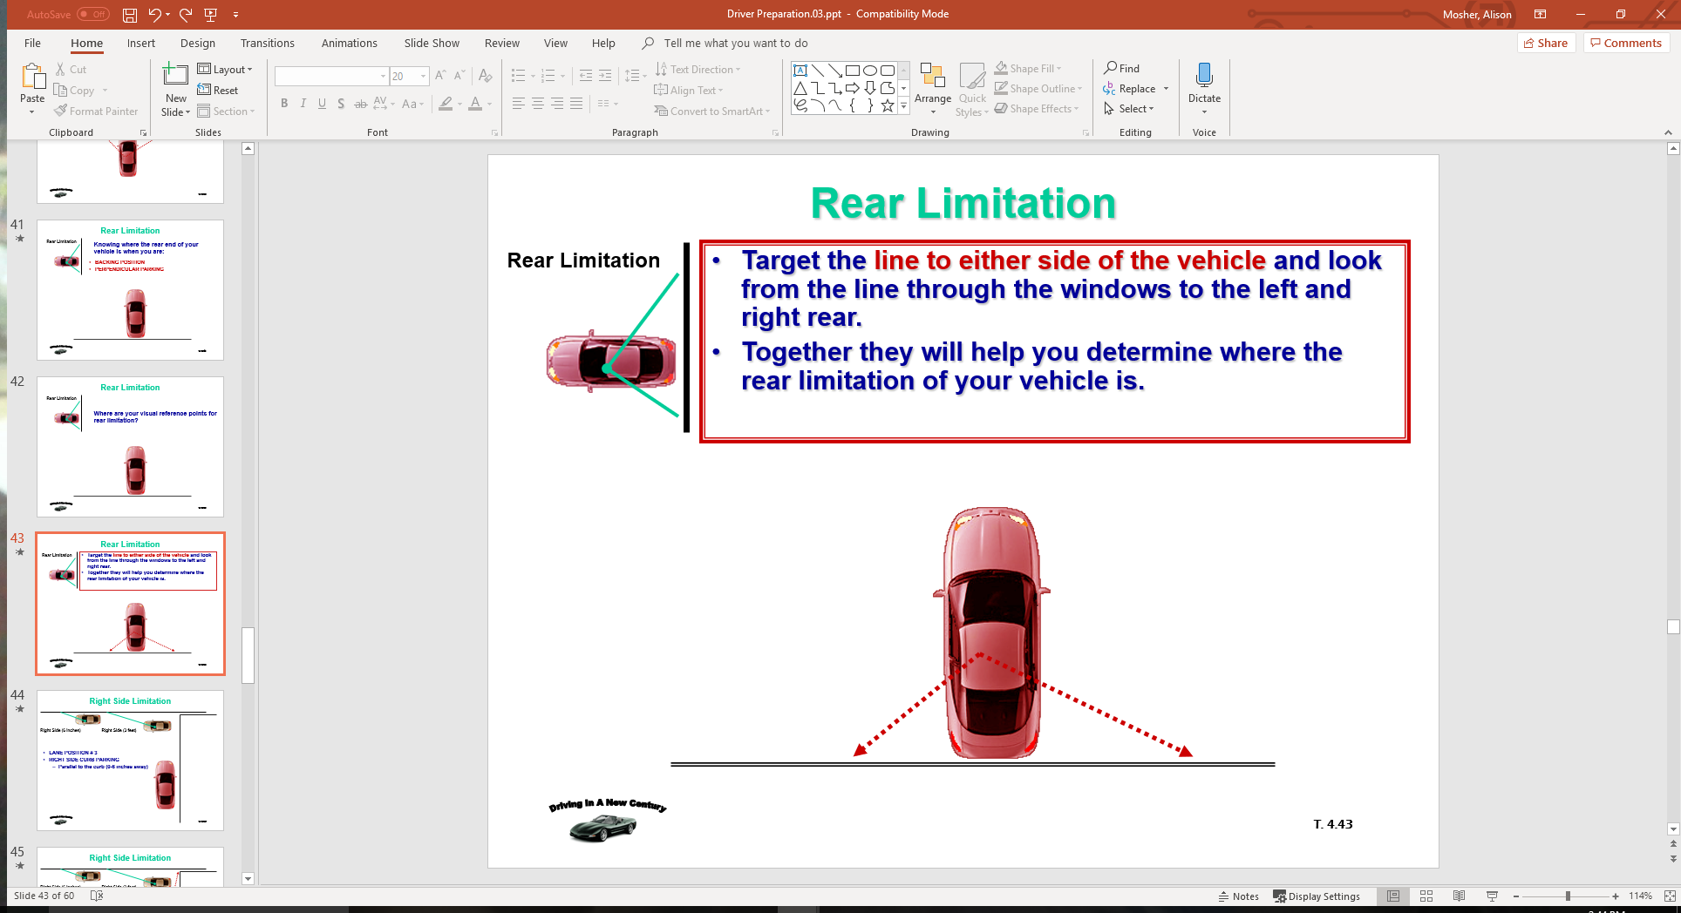
Rear Limitation
Target the line to either side of the vehicle and look from the line through the windows to the left and right rear.
Together they will help you determine where the rear limitation of your vehicle is.

Slide 41
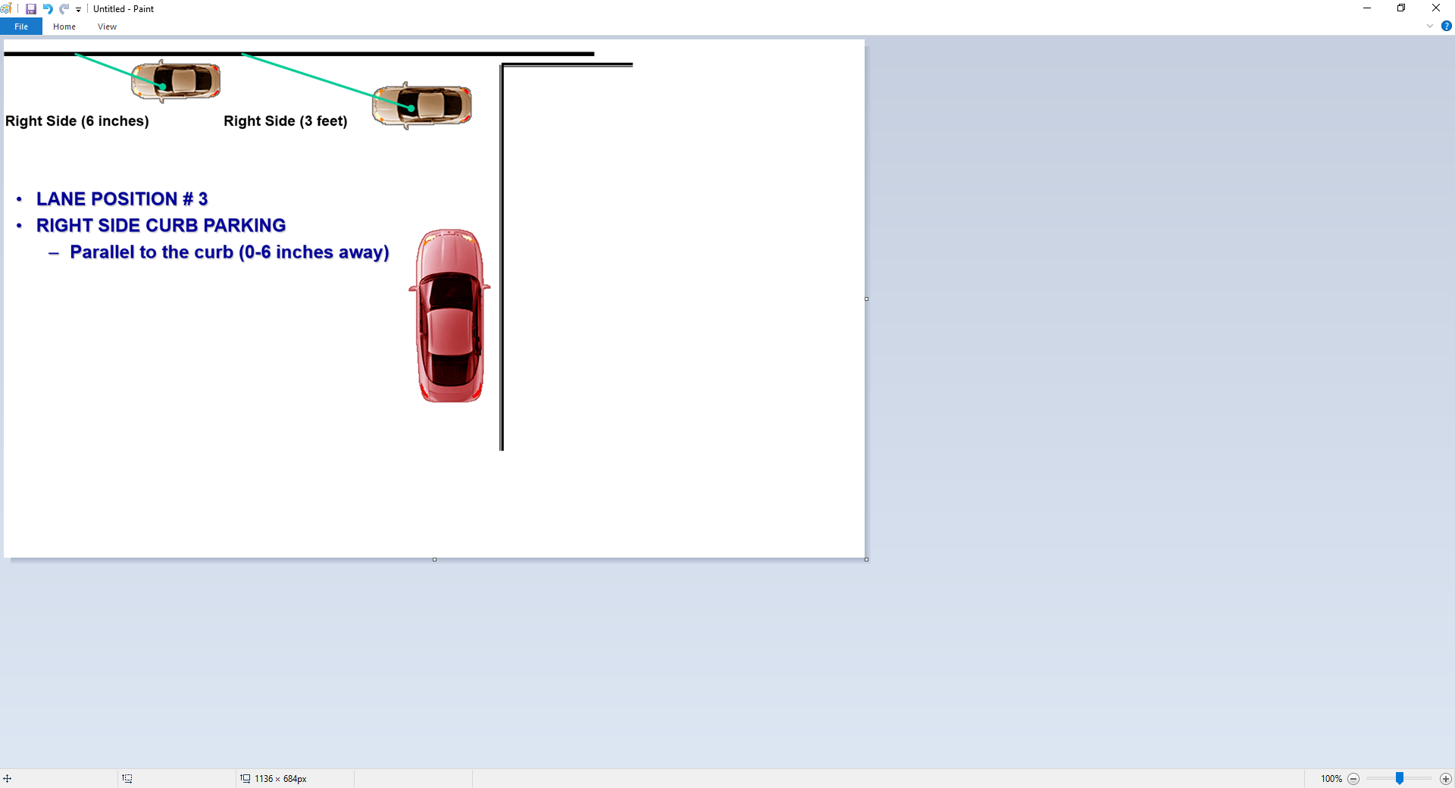
Right Side Limitation

Slide 42
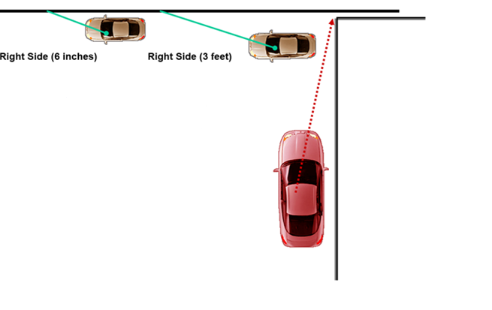
Right Side Limitation
Your line of sight reference is aligning the middle of your vehicle to the curb or the edge line of roadway.

Slide 43
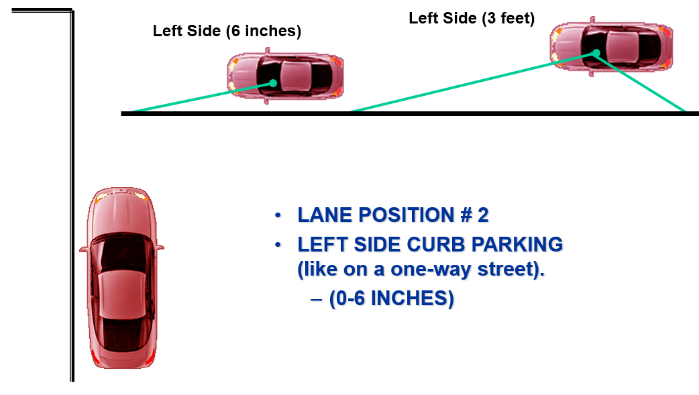
Left Side Limitation

Slide 44
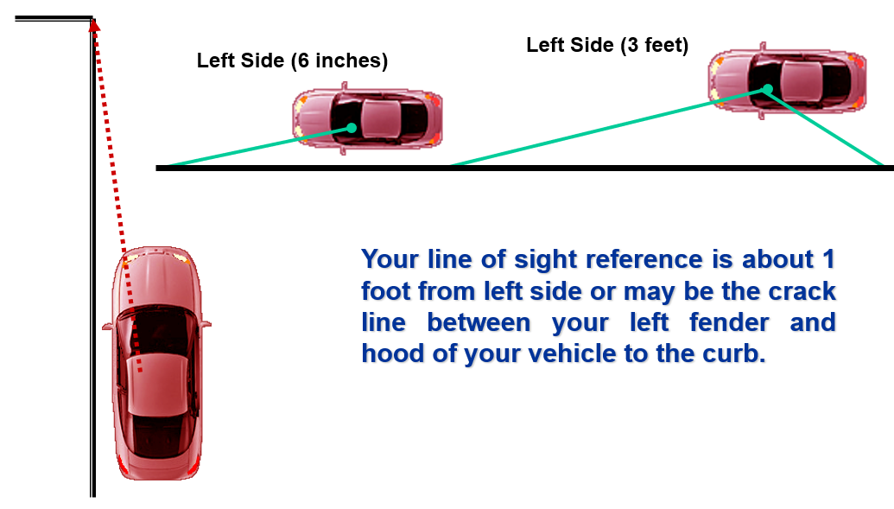
Left Side Limitation

Slide 45
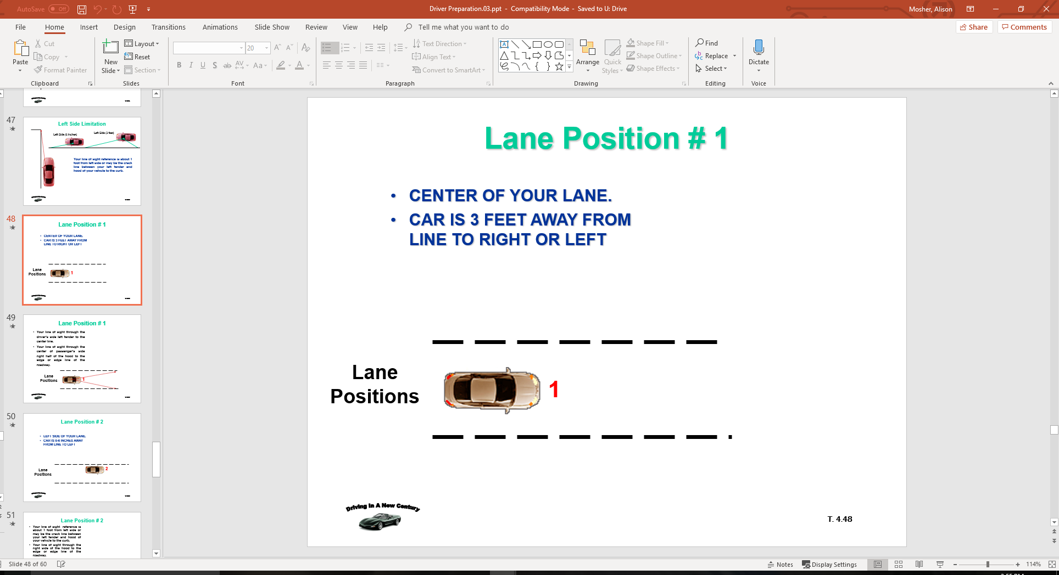
Lane Position # 1
CENTER OF YOUR LANE.
CAR IS 3 FEET AWAY FROM LINE TO RIGHT OR LEFT

Slide 46
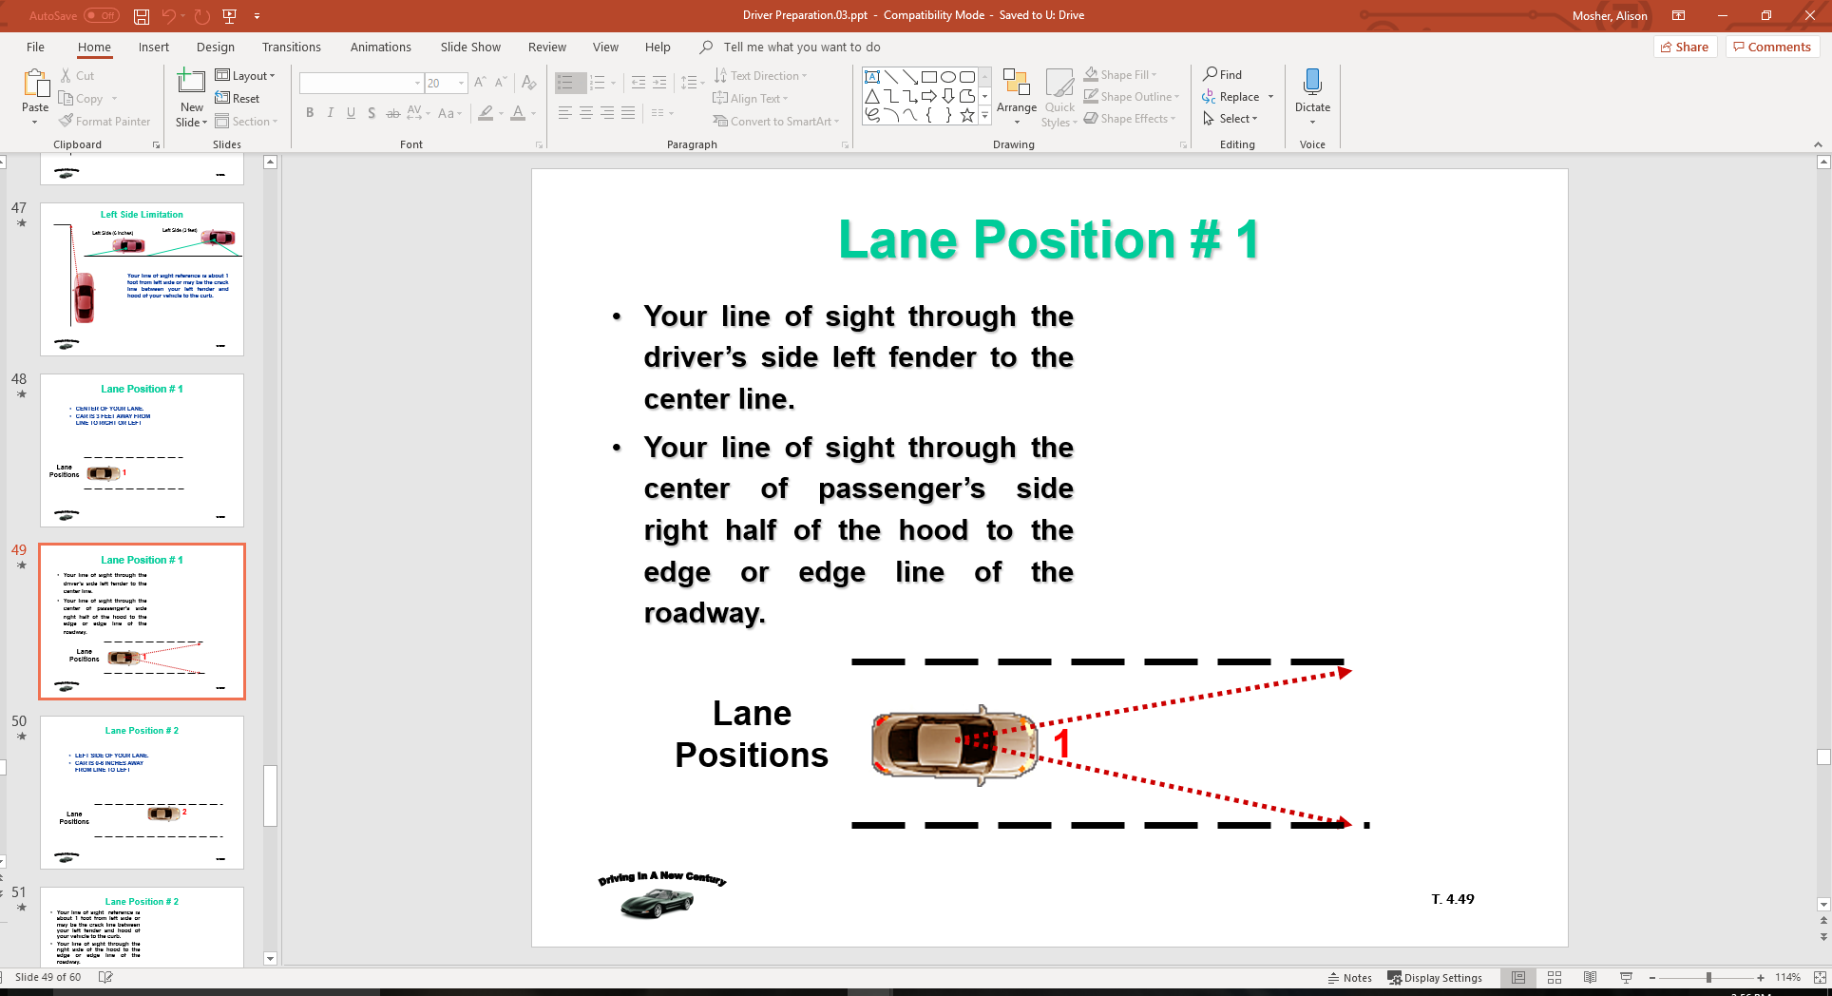
Lane Position # 1
Your line of sight through the driver’s side left fender to the center line.
Your line of sight through the center of passenger’s side right half of the hood to the edge or edge line of the roadway.

Slide 47
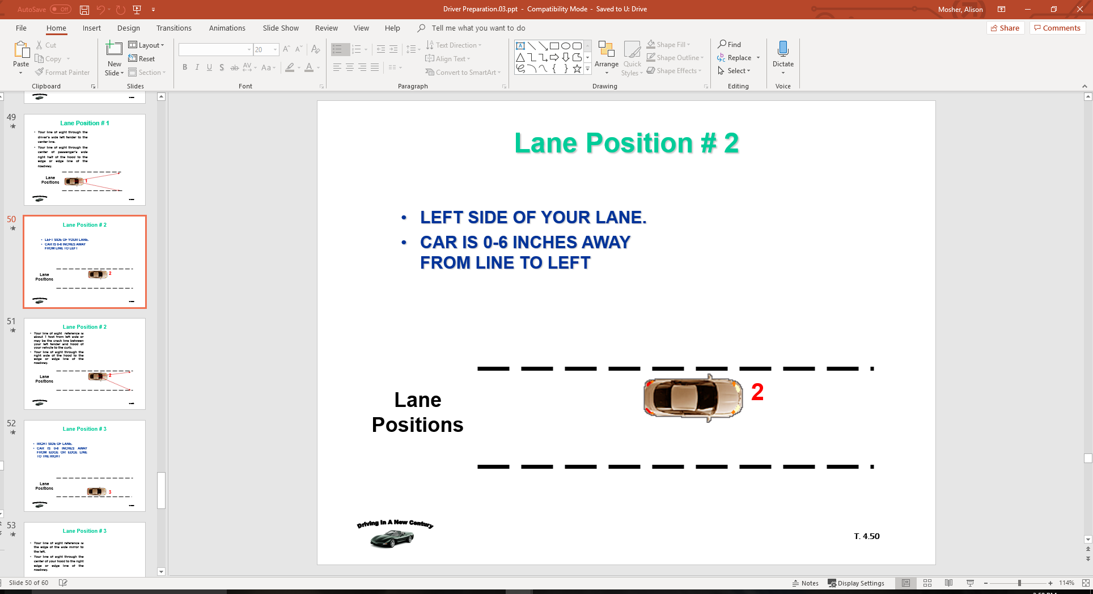
Lane Position # 2
LEFT SIDE OF YOUR LANE.
CAR IS 0-6 INCHES AWAY FROM LINE TO LEFT

Slide 48
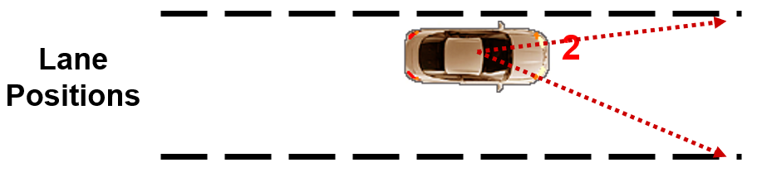
Lane Position # 2
Your line of sight reference is about 1 foot from left side or may be the crack line between your left fender and hood of your vehicle to the curb.
Your line of sight through the right side of the hood to the edge or edge line of the roadway.

Slide 49
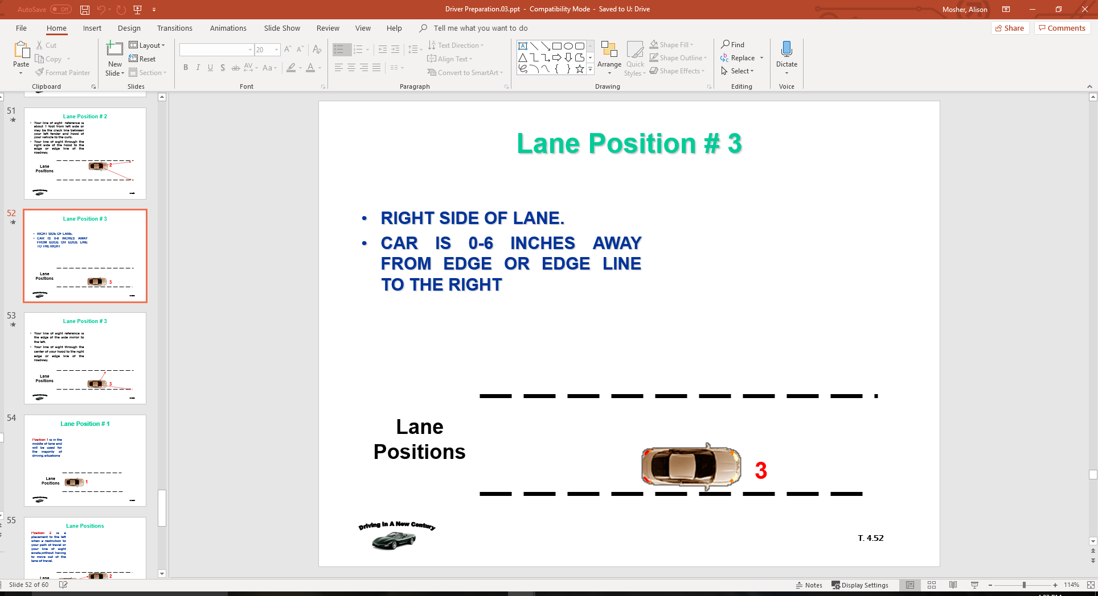
Lane Position # 3
RIGHT SIDE OF LANE.
CAR IS 0-6 INCHES AWAY FROM EDGE OR EDGE LINE TO THE RIGHT

Slide 50
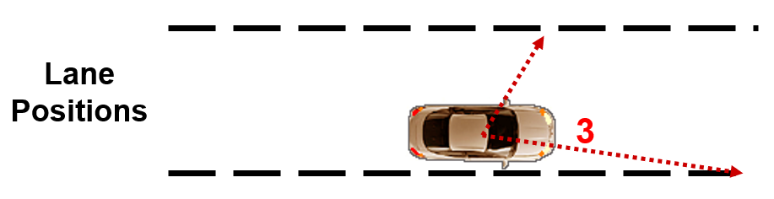
Lane Position # 3
Your line of sight reference is the edge of the side mirror to the left.
Your line of sight through the center of your hood to the right edge or edge line of the roadway.

Slide 51
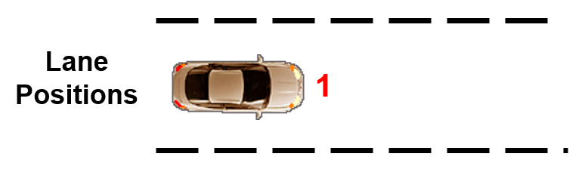
Lane Position # 1
Position 1 is in the middle of lane and will be used for the majority of driving situations

Slide 52
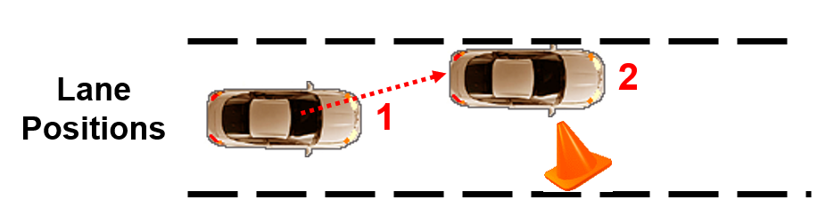
Lane Positions
Position 2 is a placement to the left when a restriction to your path of travel or your line of sight exists,without having to move out of the lane of travel.

Slide 53
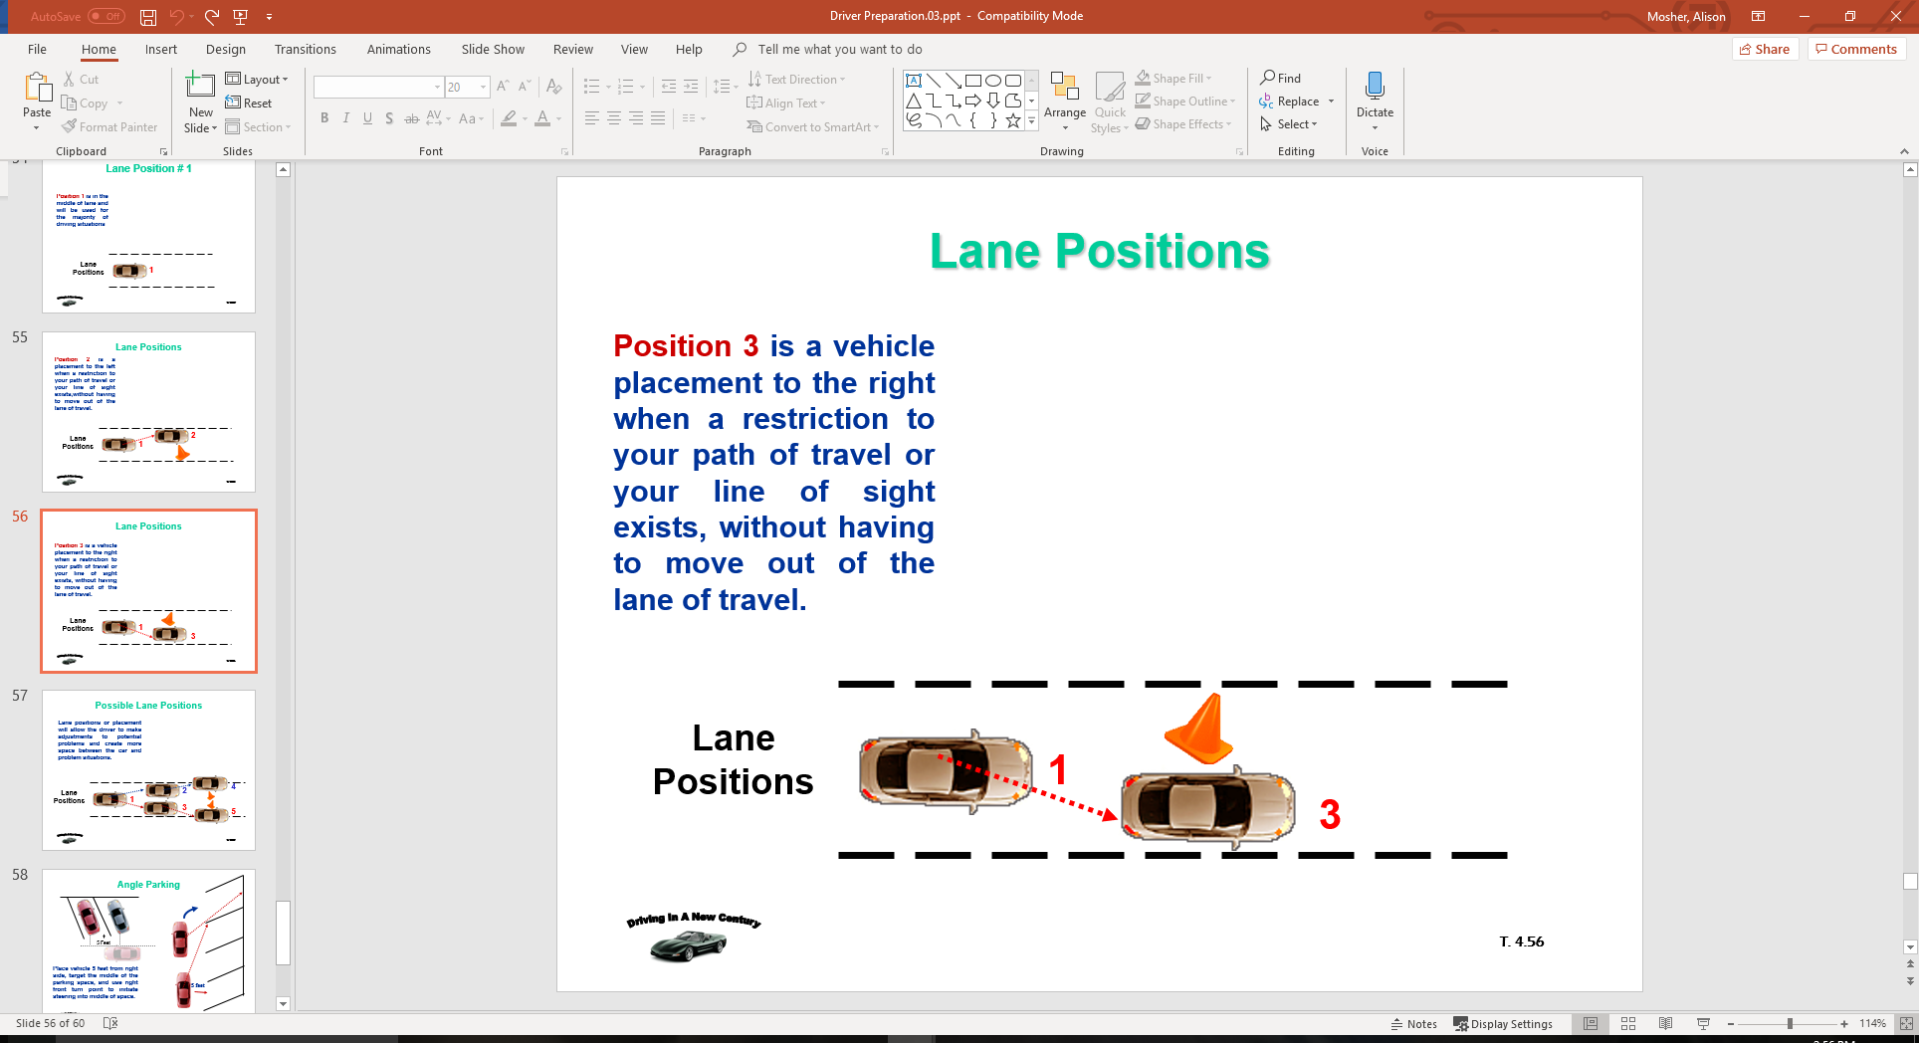
Lane Positions
Position 3 is a vehicle placement to the right when a restriction to your path of travel or your line of sight exists, without having to move out of the lane of travel.

Slide 54
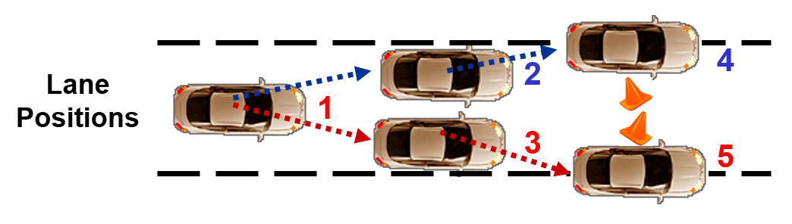
Possible Lane Positions
Lane positions or placement will allow the driver to make adjustments to potential problems and create more space between the car and problem situations.

Slide 55
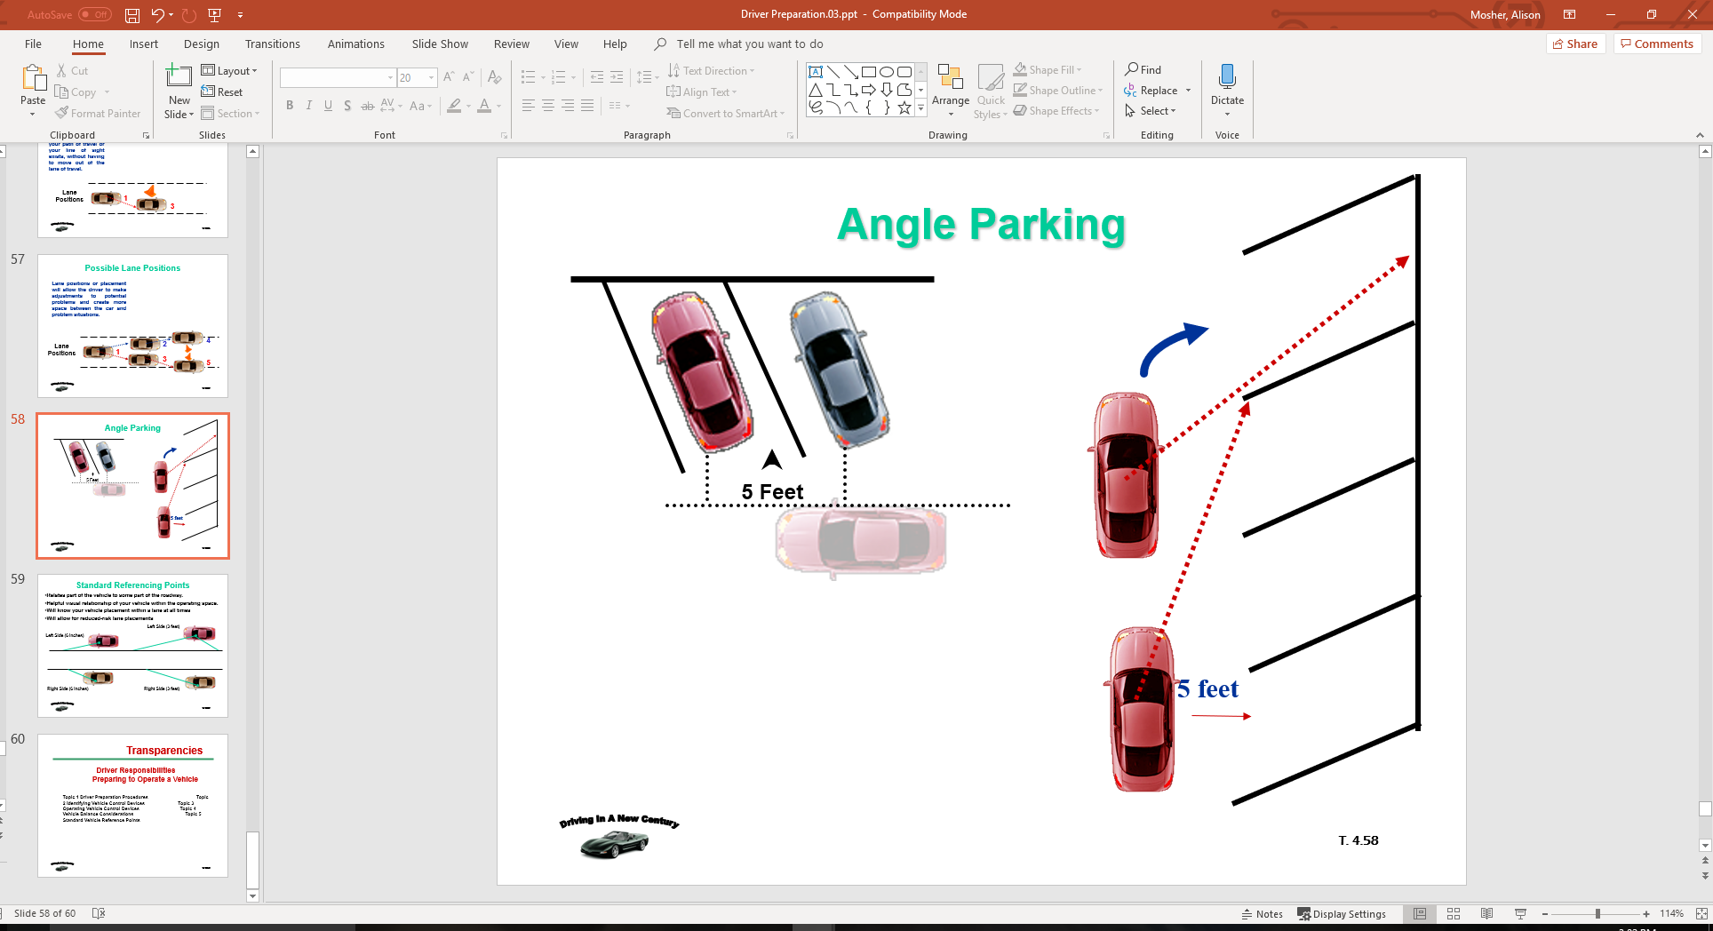
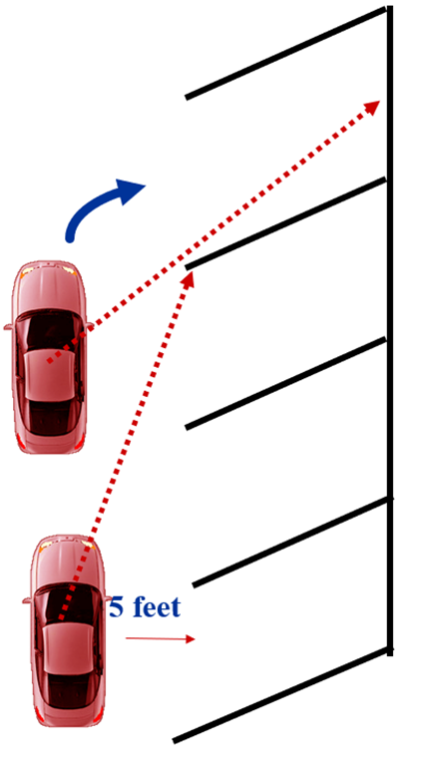
Angle Parking
Place vehicle 5 feet from right side, target the middle of the parking space, and use right front turn point to initiate steering into middle of space.

Slide 56
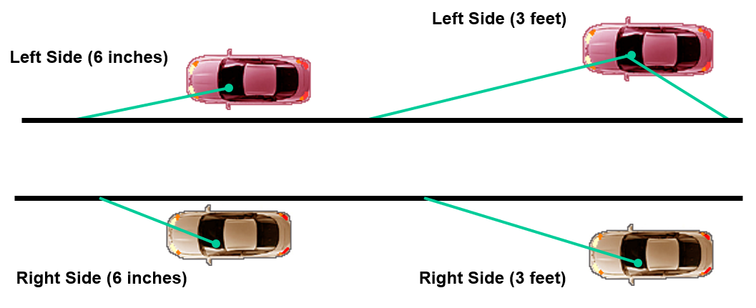
Standard Referencing Points
Relates part of the vehicle to some part of the roadway.
Helpful visual relationship of your vehicle within the operating space.
Will know your vehicle placement within a lane at all times
Will allow for reduced-risk lane placements

Slide 57
Contact/Mission
For more information on Driver’s Education and Safety please visit PDE’s website at www.education.pa.gov
The mission of the Department of Education is to ensure that every learner has access to a world-class education system that academically prepares children and adults to succeed as productive citizens. Further, the Department seeks to establish a culture that is committed to improving opportunities throughout the commonwealth by ensuring that technical support, resources, and optimal learning environments are available for all students, whether children or adults.

