Slide 1
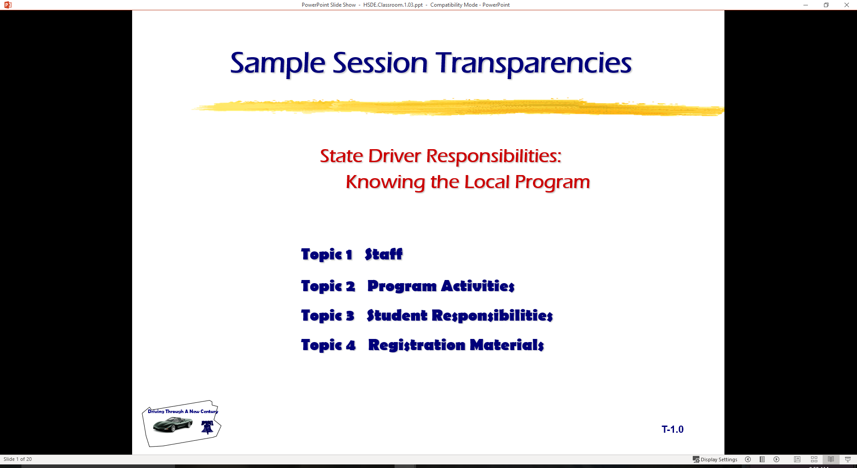
  Information Processing: Moderate Risk Environment
  Topic 1 Processing Information
  Topic 2 Intersections, Curves, and Hills
  Topic 3 Passing

Slide 2
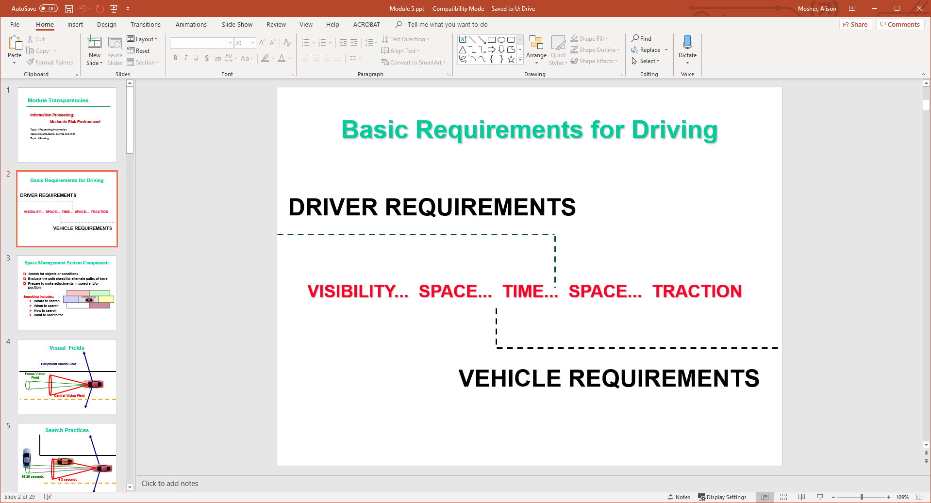
Basic Requirements for Driving
DRIVER REQUIREMENTS
  VISIBILITY... SPACE... TIME... SPACE... TRACTION
        VEHICLE REQUIREMENTS

Slide 3

Space Management System Components
Search for objects or conditions
Evaluate the path ahead for alternate paths of travel
Prepare to make adjustments in speed and/or position
Searching includes:
  Where to search
  When to search
  How to search
  What to search for

Slide 4
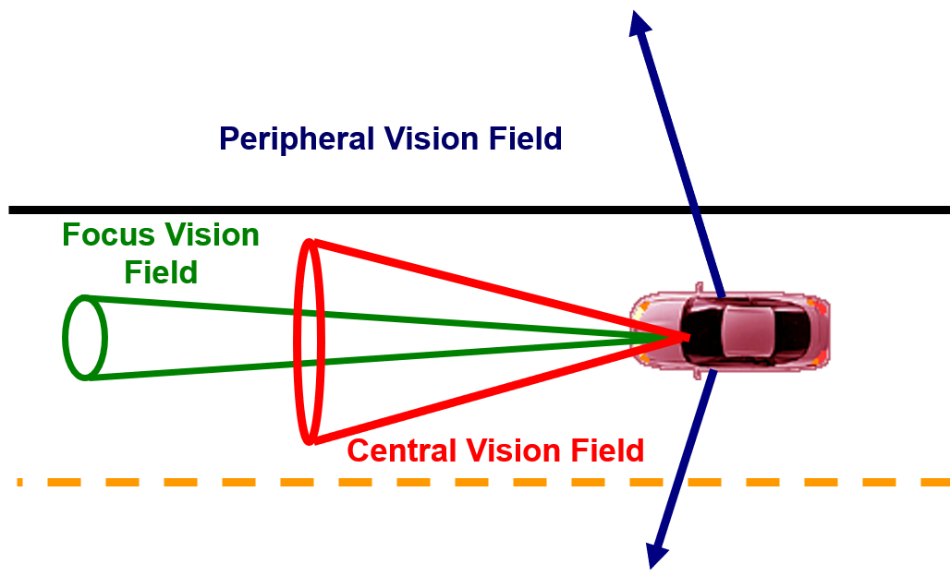
Visual Fields

Slide 5
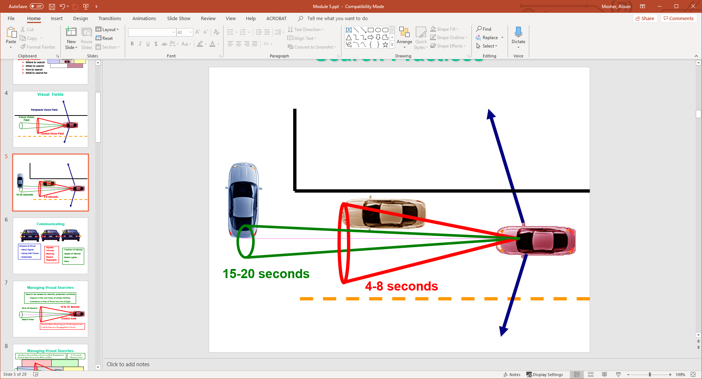
Search Practices

Slide 6
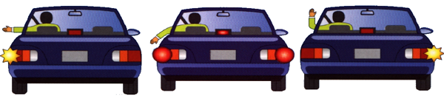
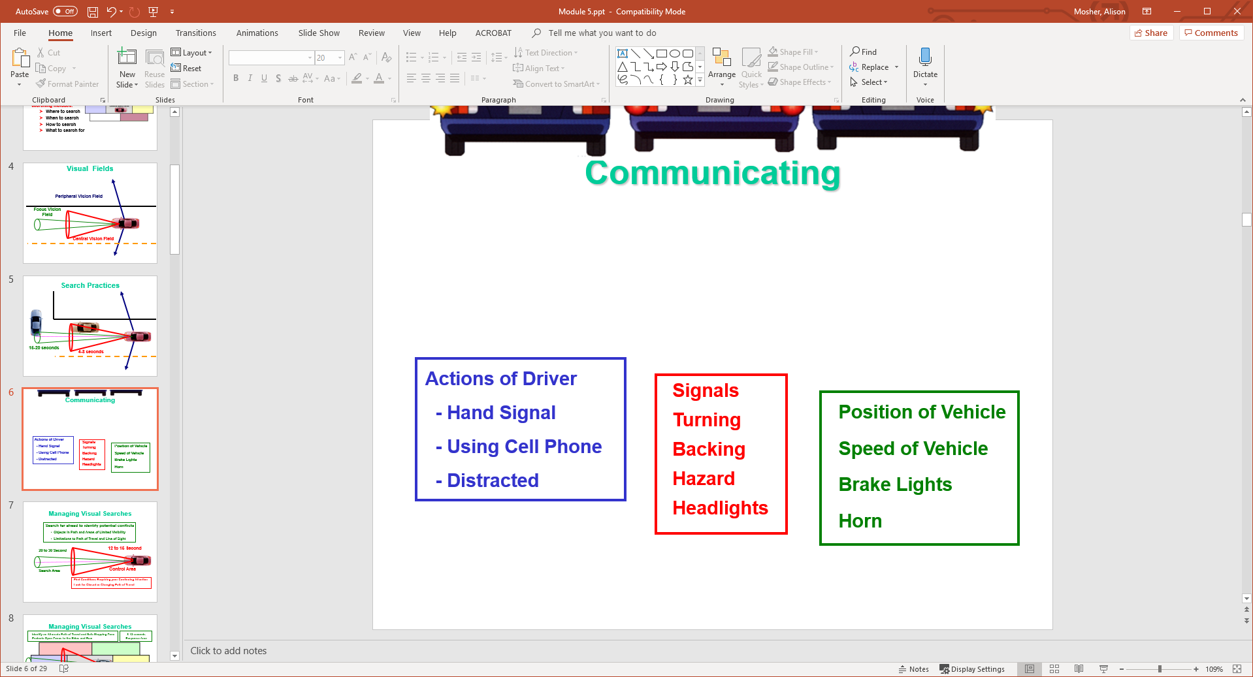
Communicating

Slide 7
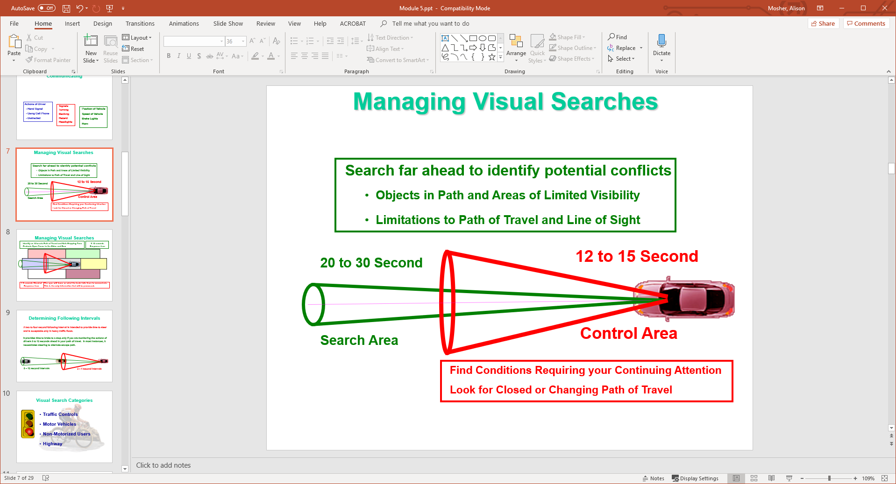
Managing Visual Searches

Slide 8
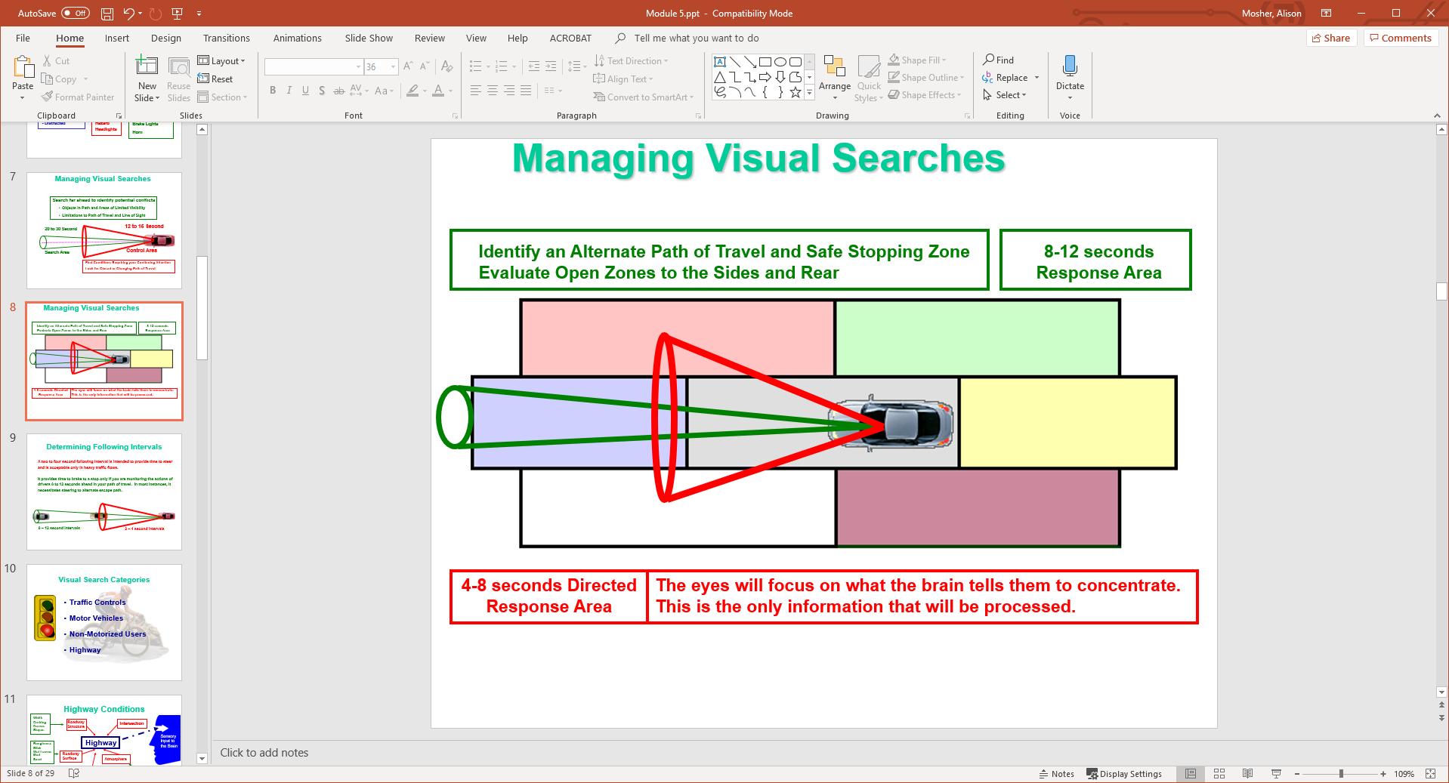
Managing Visual Searches

Slide 9
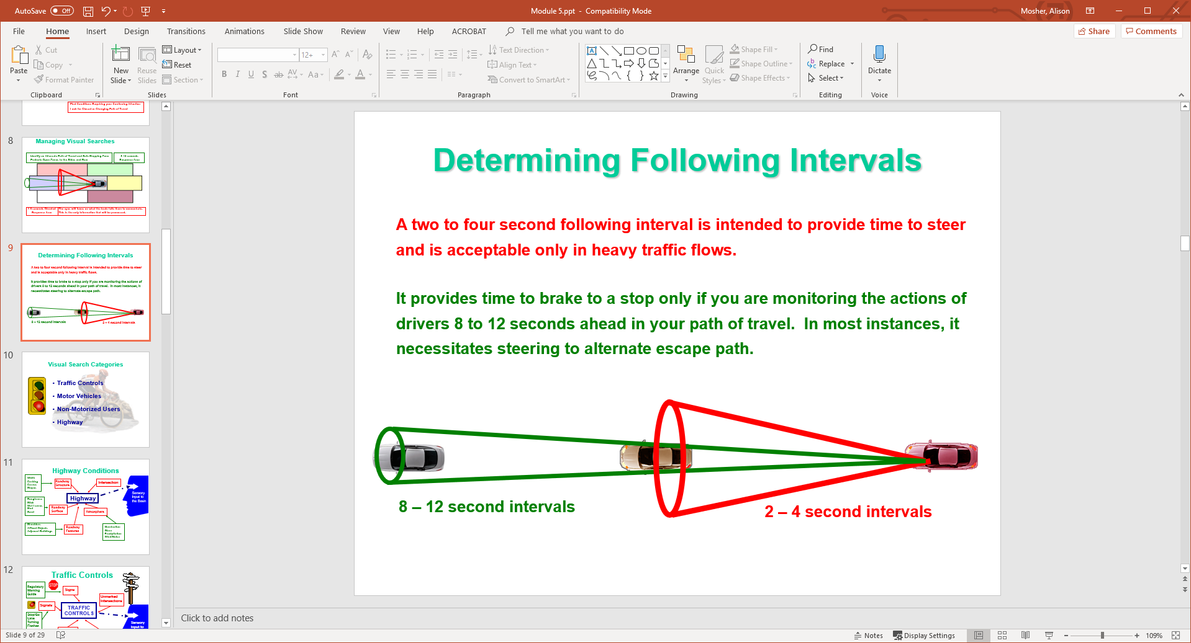
Determining Following Intervals
A two to four second following interval is intended to provide time to steer and is acceptable only in heavy traffic flows.
It provides time to brake to a stop only if you are monitoring the actions of drivers 8 to 12 seconds ahead in your path of travel. In most instances, it necessitates steering to alternate escape path.

Slide 10
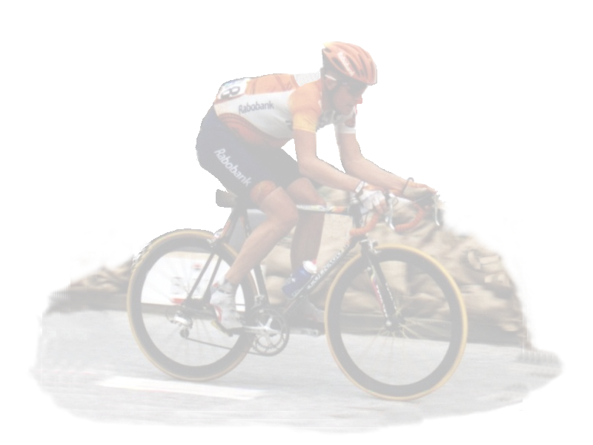

Visual Search Categories
Traffic Controls
Motor Vehicles
Non-Motorized Users
Highway

Slide 11
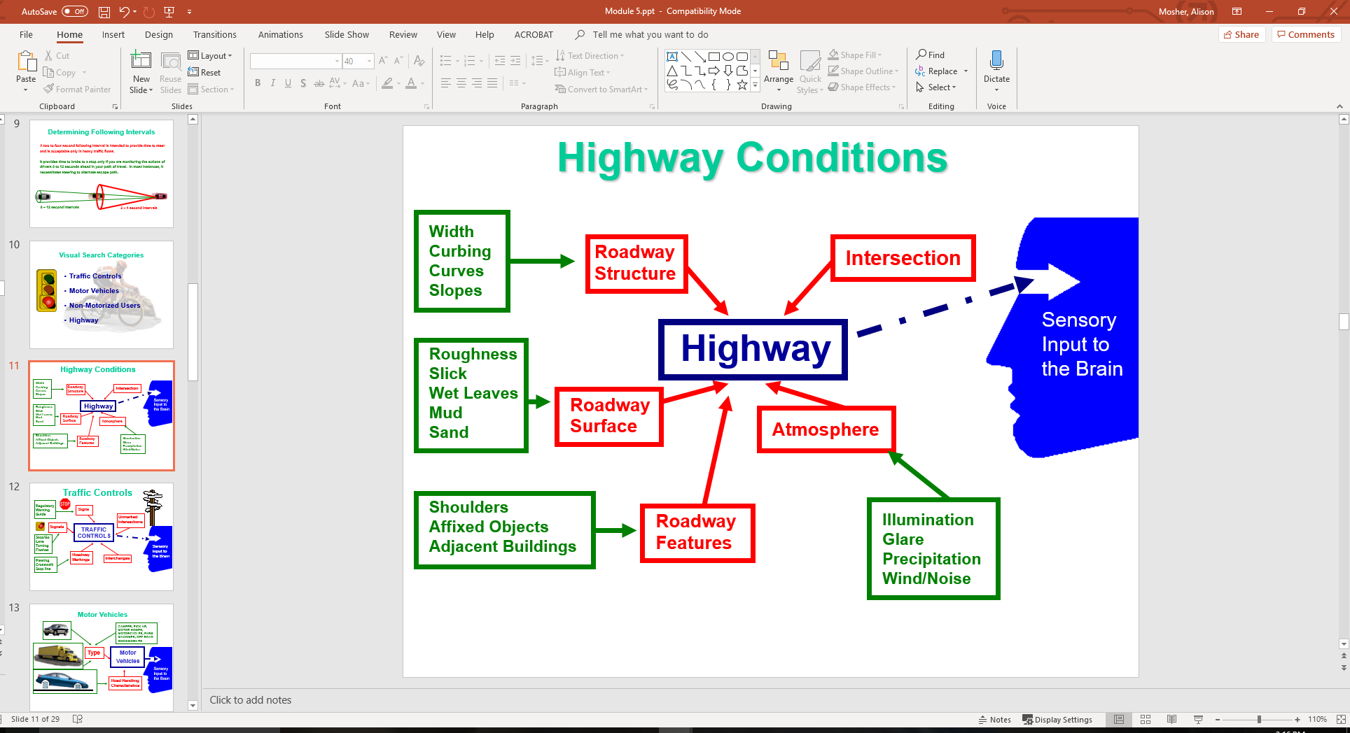
Highway Conditions

Slide 12
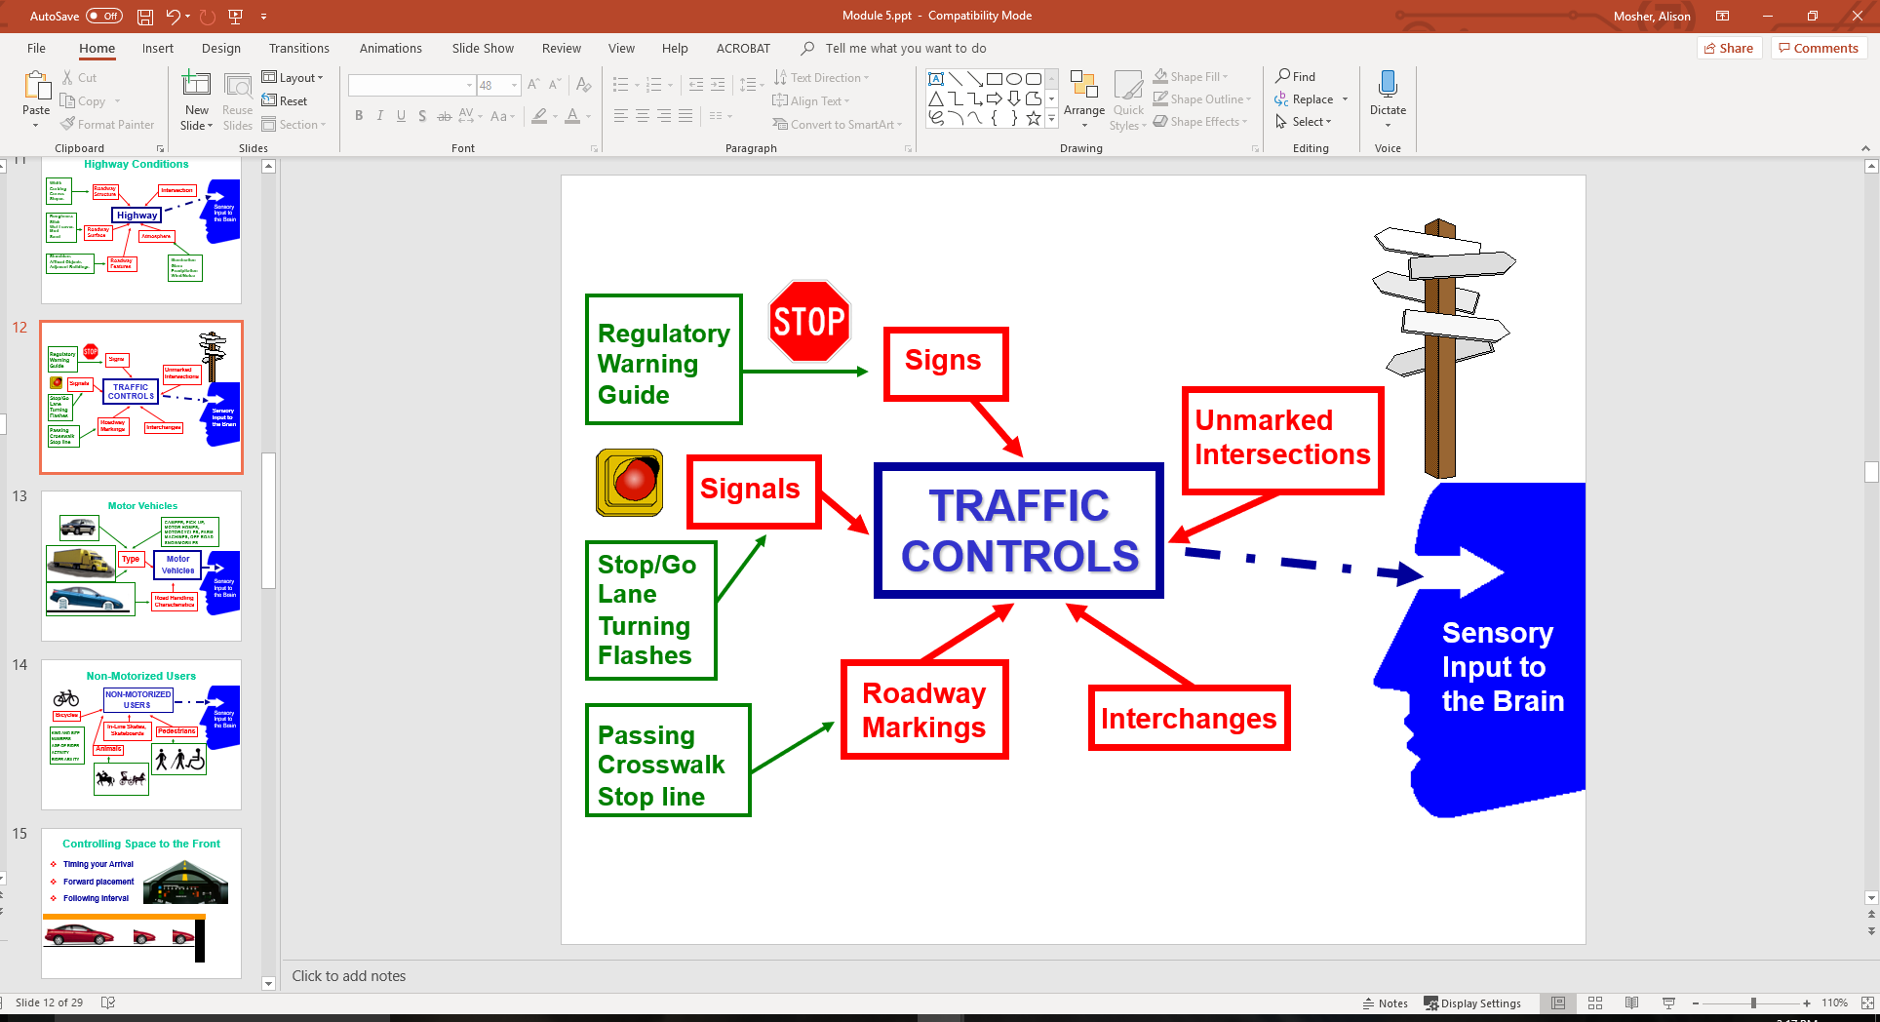
Traffic Controls

Slide 13
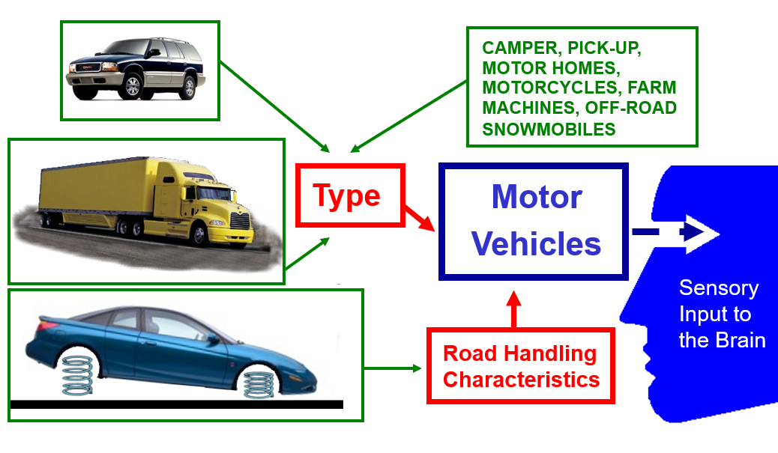
Motor Vehicles

Slide 14
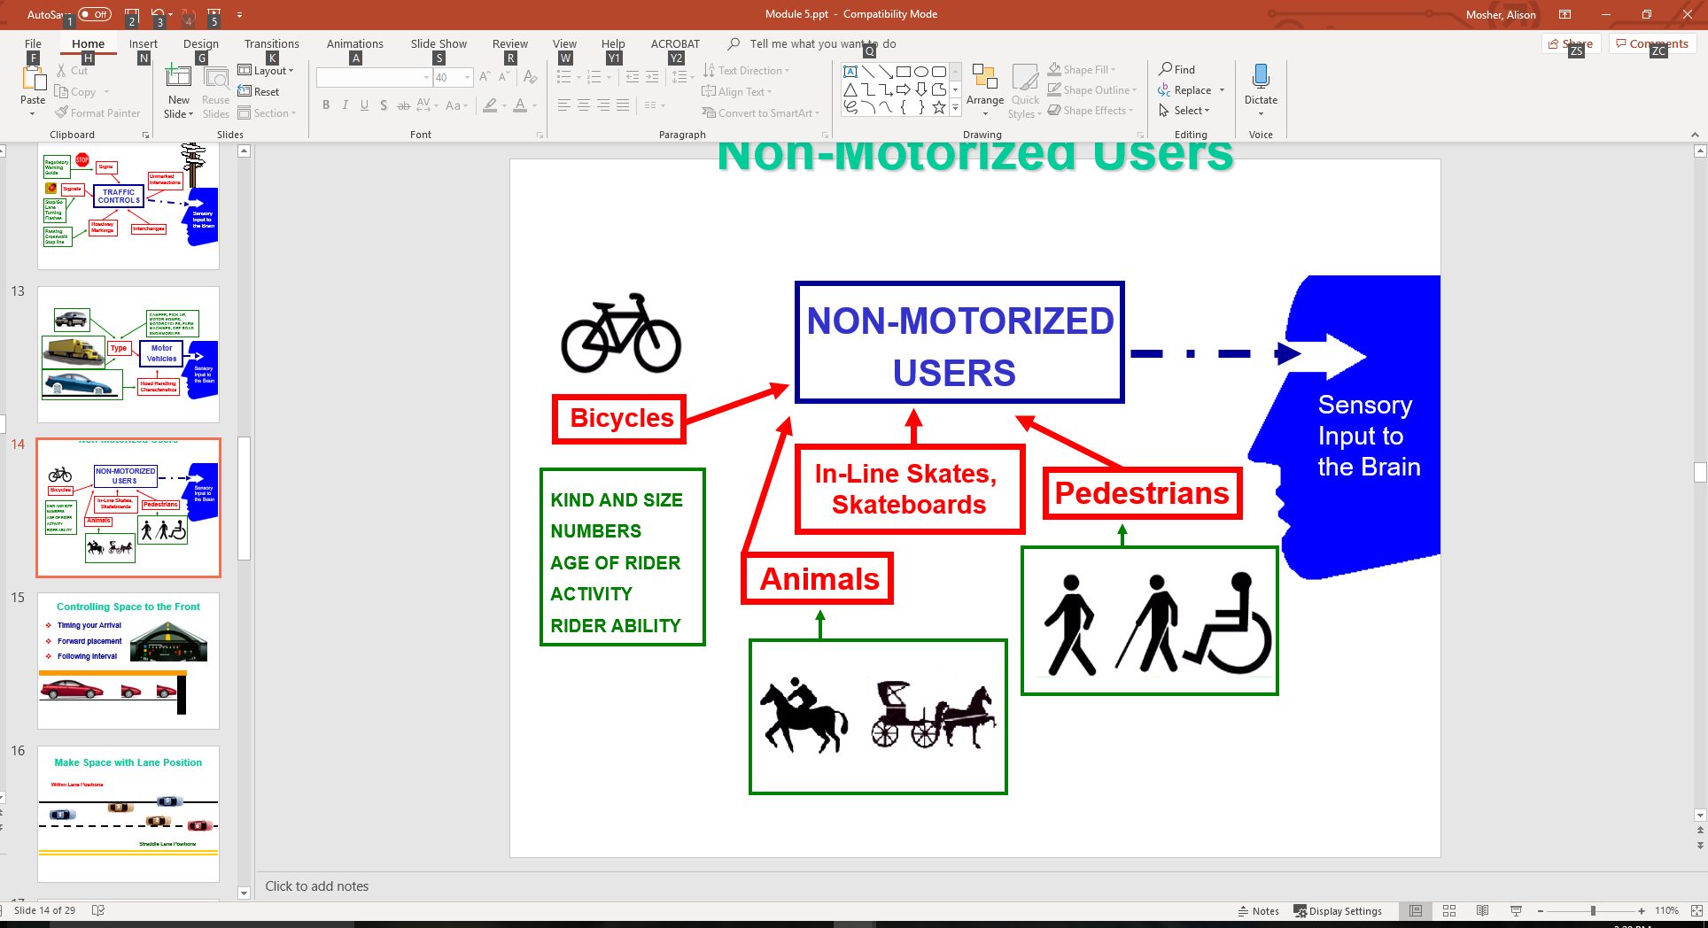
Non-Motorized Users

Slide 15
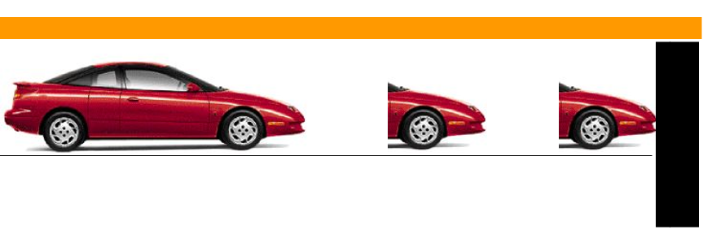
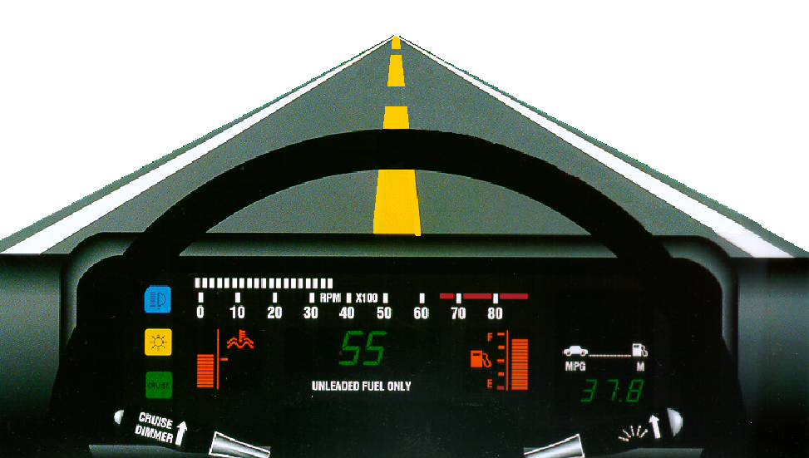
Controlling Space to the Front
Timing your Arrival
Forward placement
Following interval

Slide 16
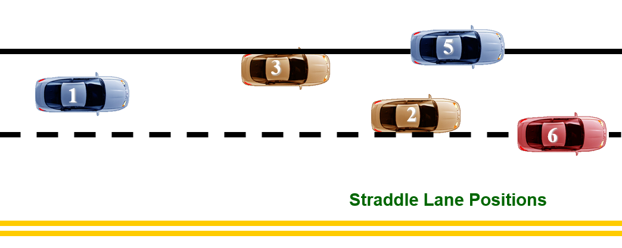
Make Space with Lane Position
Within Lane Positions

Slide 17
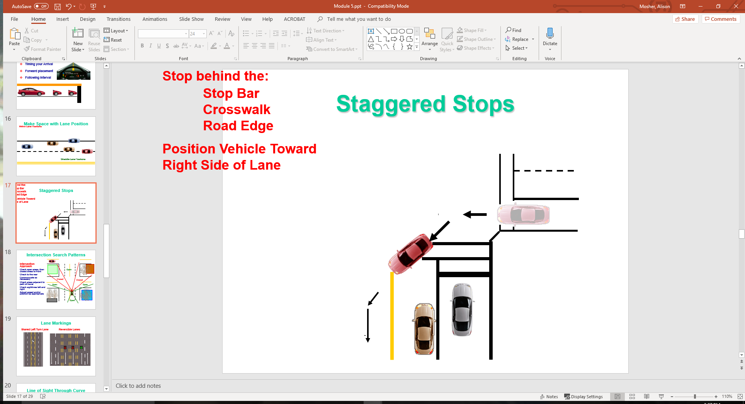
Staggered Stops
Stop behind the:
Stop Bar
Crosswalk
Road Edge
Position Vehicle Toward Right Side of Lane

Slide 18
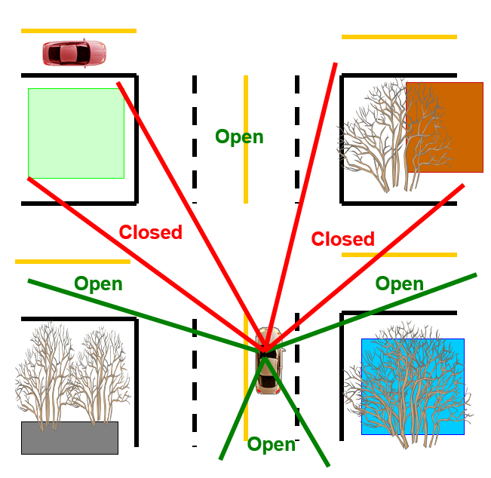
Intersection Search Patterns
Intersection Approach
Check open areas, then closed areas to front
Check to the rear
Communicate as necessary
Check areas adjacent to path of travel
Check sightlines left and right
Adjust speed and/or position as appropriate

Slide 19
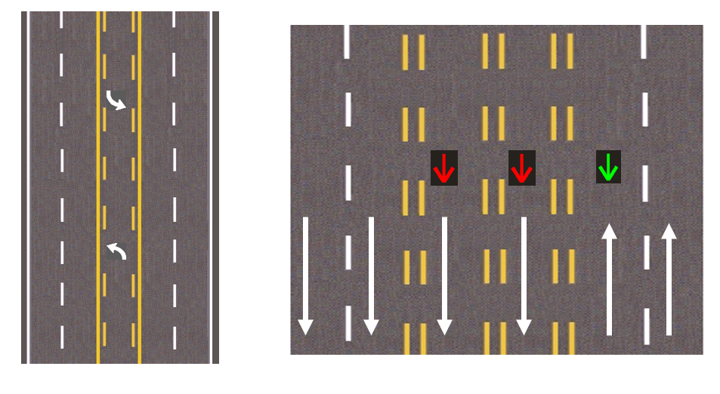
Lane Markings
Shared Left Turn Lane
Reversible Lanes

Slide 20
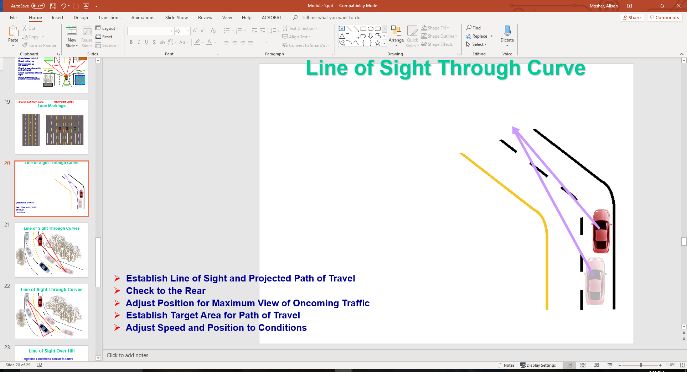
Line of Sight Through Curve
Establish Line of Sight and Projected Path of Travel
Check to the Rear
Adjust Position for Maximum View of Oncoming Traffic
Establish Target Area for Path of Travel
Adjust Speed and Position to Conditions

Slide 21
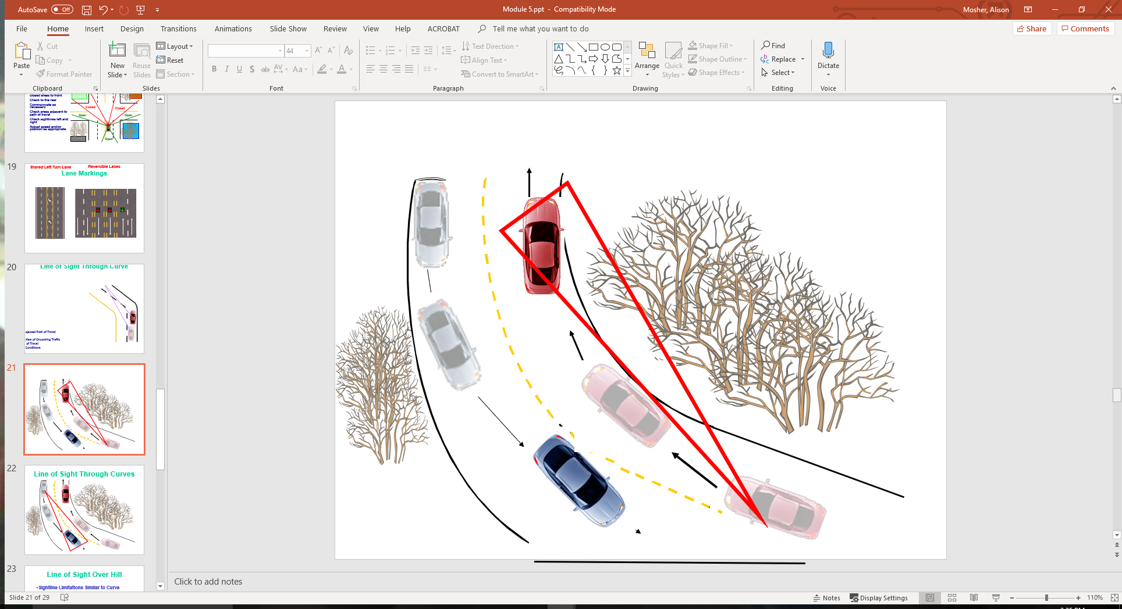
Line of Sight Through Curves

Slide 22
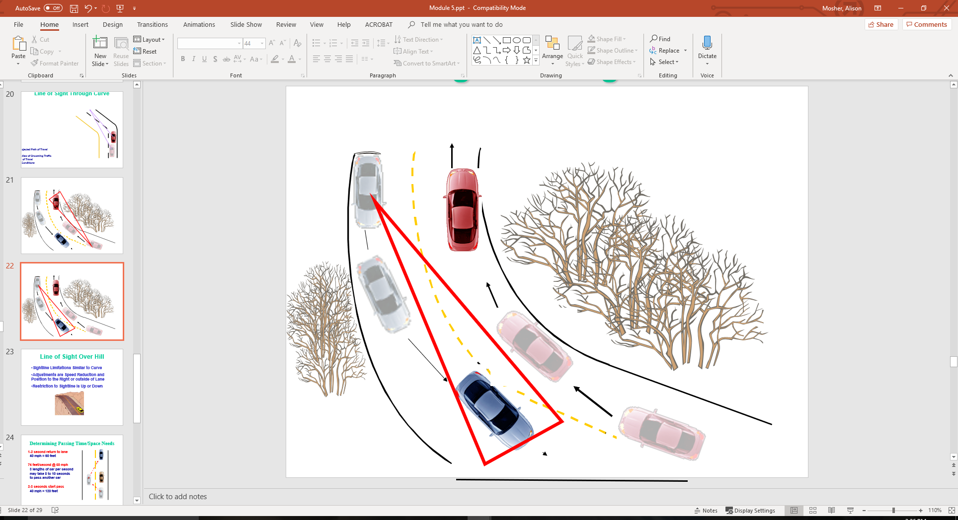
Line of Sight Through Curves

Slide 23
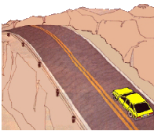
Line of Sight Over Hill
Sightline Limitations Similar to Curve
Adjustments are Speed Reduction and Position to the Right or outside of Lane
Restriction to Sightline is Up or Down

Slide 24
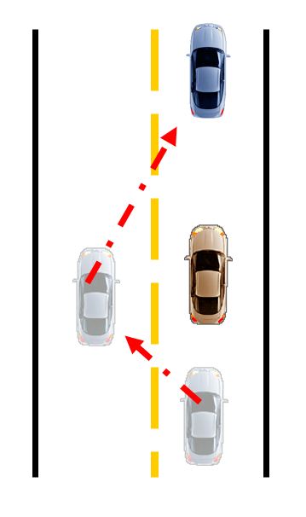
Determining Passing Time/Space Needs
1-2 second return to lane
40 mph = 60 feet
74 feet/second @ 50 mph
3 lengths of car per second
may take 8 to 10 seconds
to pass another car
2-3 seconds start pass
40 mph = 120 feet

Slide 25
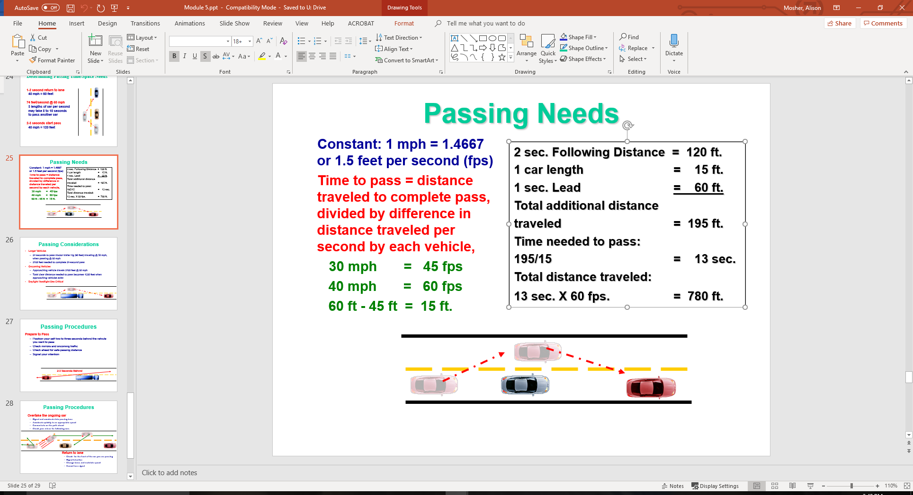
Passing Needs
Constant: 1 mph = 1.4667 or 1.5 feet per second (fps)
Time to pass = distance traveled to complete pass, divided by difference in distance traveled per second by each vehicle,
30 mph = 45 fps
40 mph = 60 fps
60 ft - 45 ft = 15 ft.
2 sec. Following Distance = 120 ft.
1 car length = 15 ft.
1 sec. Lead = 60 ft.
Total additional distance
traveled = 195 ft.
Time needed to pass:
195/15 = 13 sec.
Total distance traveled:
13 sec. X 60 fps. = 780 ft.

Slide 26
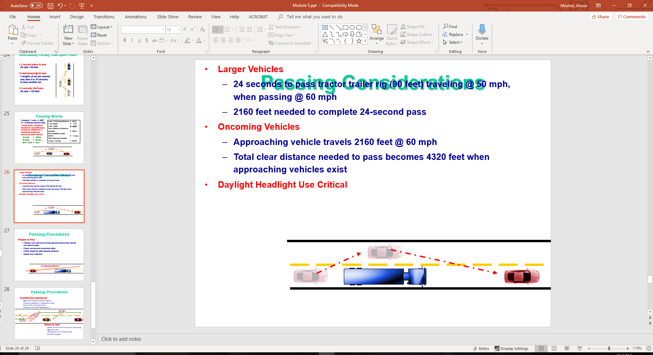
Passing Considerations
Larger Vehicles
  24 seconds to pass tractor trailer rig (90 feet) traveling @ 50 mph, when passing @ 60 mph
  2160 feet needed to complete 24-second pass
Oncoming Vehicles
  Approaching vehicle travels 2160 feet @ 60 mph
  Total clear distance needed to pass becomes 4320 feet when approaching vehicles exist
Daylight Headlight Use Critical

Slide 27
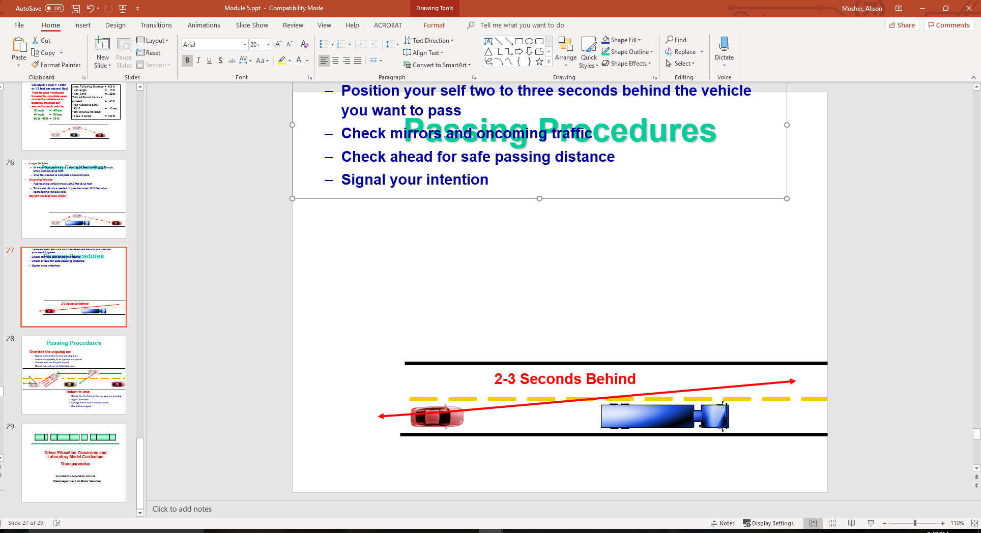
Passing Procedures
Prepare to Pass
  Position your self two to three seconds behind the vehicle you want to pass
  Check mirrors and oncoming traffic
  Check ahead for safe passing distance
  Signal your intention

Slide 28
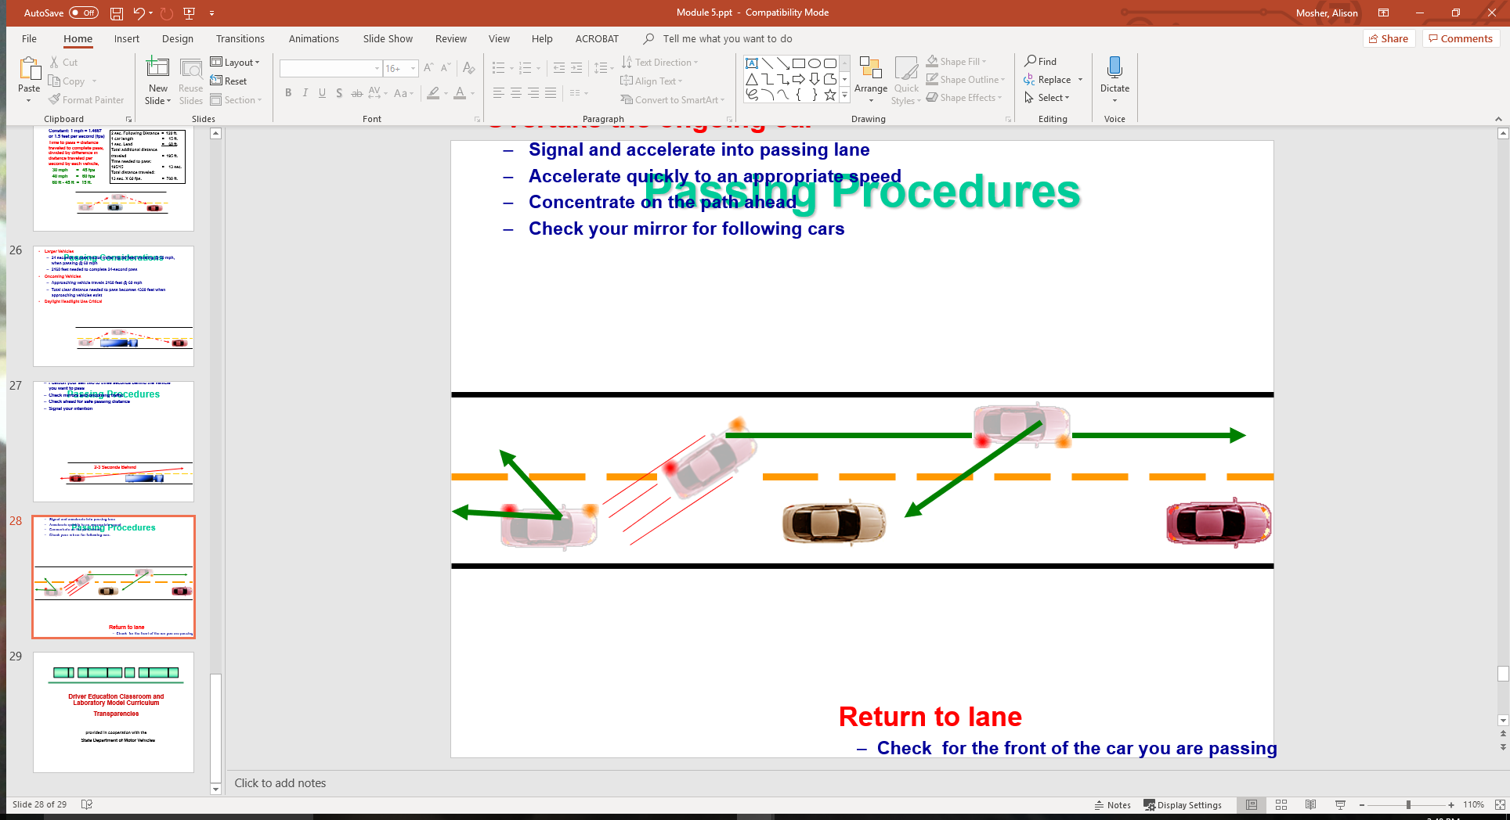
Passing Procedures
Overtake the ongoing car
  Signal and accelerate into passing lane
  Accelerate quickly to an appropriate speed
  Concentrate on the path ahead
  Check your mirror for following cars
Return to lane
  Check for the front of the car you are passing
  Signal intention
  Change lanes and maintain speed
  Cancel turn signal

Slide 29
Contact/Mission
For more information on Driver’s Education and Safety please visit PDE’s website at www.education.pa.gov
The mission of the Department of Education is to ensure that every learner has access to a world-class education system that academically prepares children and adults to succeed as productive citizens. Further, the Department seeks to establish a culture that is committed to improving opportunities throughout the commonwealth by ensuring that technical support, resources, and optimal learning environments are available for all students, whether children or adults.

