Slide 1
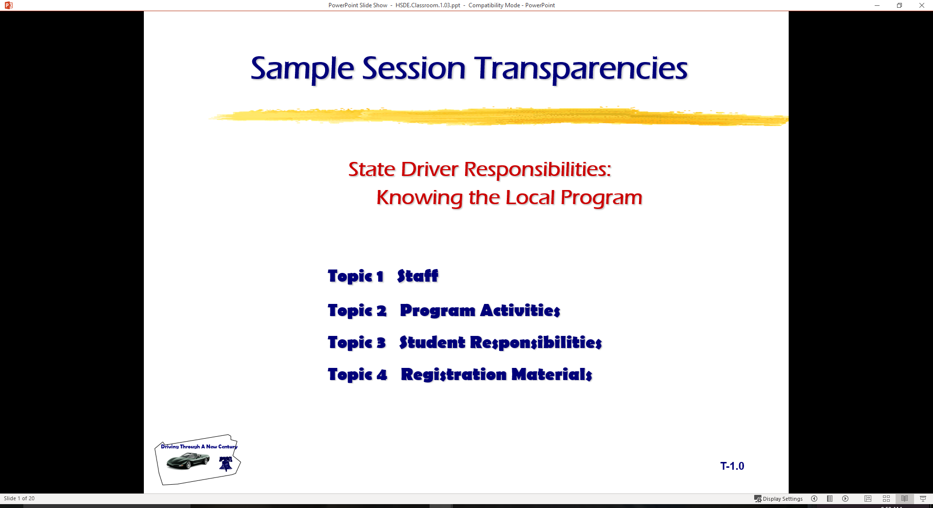
  Adverse Driving Conditions
Topic 1 Vehicle Functions/Malfunctions
Topic 2 Anti-Lock Braking System
Topic 3 Vehicle Performance
Topic 4 Highway Transportation System Agencies

Slide 2
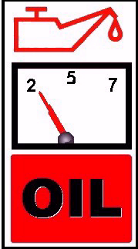
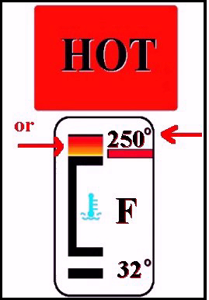



Dashboard Warning Symbols
Temperature light or gauges
Oil pressure light
or gauges
Alternator/generator light or gauges
Brake system light

Slide 3



Dashboard Warning Symbols
ABS light
Air bag light
SERVICE ENGINE SOON
“Service Engine” soon light
DOOR
AJAR
Door ajar light
Low fuel light

Slide 4
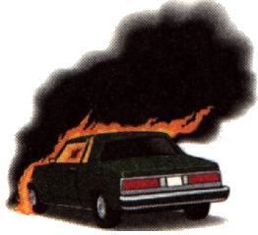
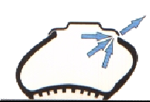
Vehicle Failures
Tire Blowout
Accelerator Failure
Engine Failure
Steering Failure
Car Catches Fire

Slide 5
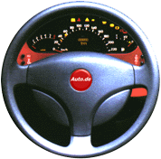

Vehicle Systems
Steering and Suspension System
Tires and Traction Control

Slide 6

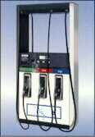
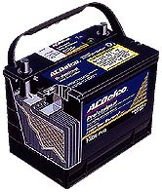
Vehicle Systems
Fuel System
  Carburetor
  Fuel Injection
  Fuel Pressure System
Electrical System
  Battery
  Alternator/Generator
  Ignition Switch
  Spark Plugs
  Distributor/Electronics

Slide 7
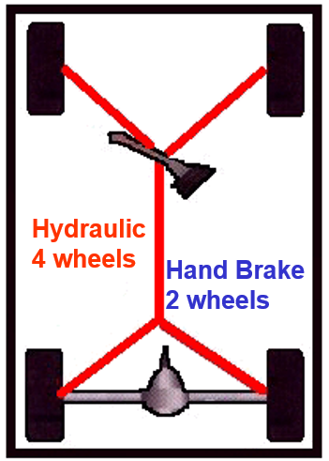
Vehicle Systems
Conventional
Brake Systems
Foot pedal (hydraulic system)
Parking brake (mechanical system)
Disc brakes
Disc and Drum combinations
Air brakes

Slide 8

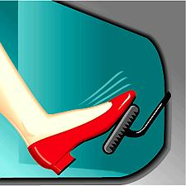
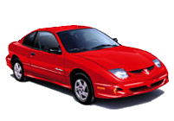
Vehicle Systems
Anti-Lock Braking System (ABS)
ABS Development
Critical Traction
ABS Advantages
With ABS…Do
With ABS… Do Not

Slide 9
ABS Development
When was the ABS technology available?
On what vehicles was the first commercial
application?
When did ABS become available for
passenger vehicles?
What road vehicles were first required to
install ABS?

Slide 10
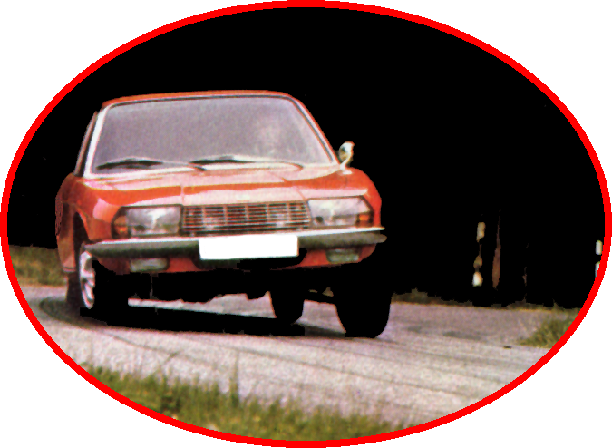
Critical Traction Needs
Road Surface
Weather Conditions
Tires
Braking Techniques
Speed

Slide 11
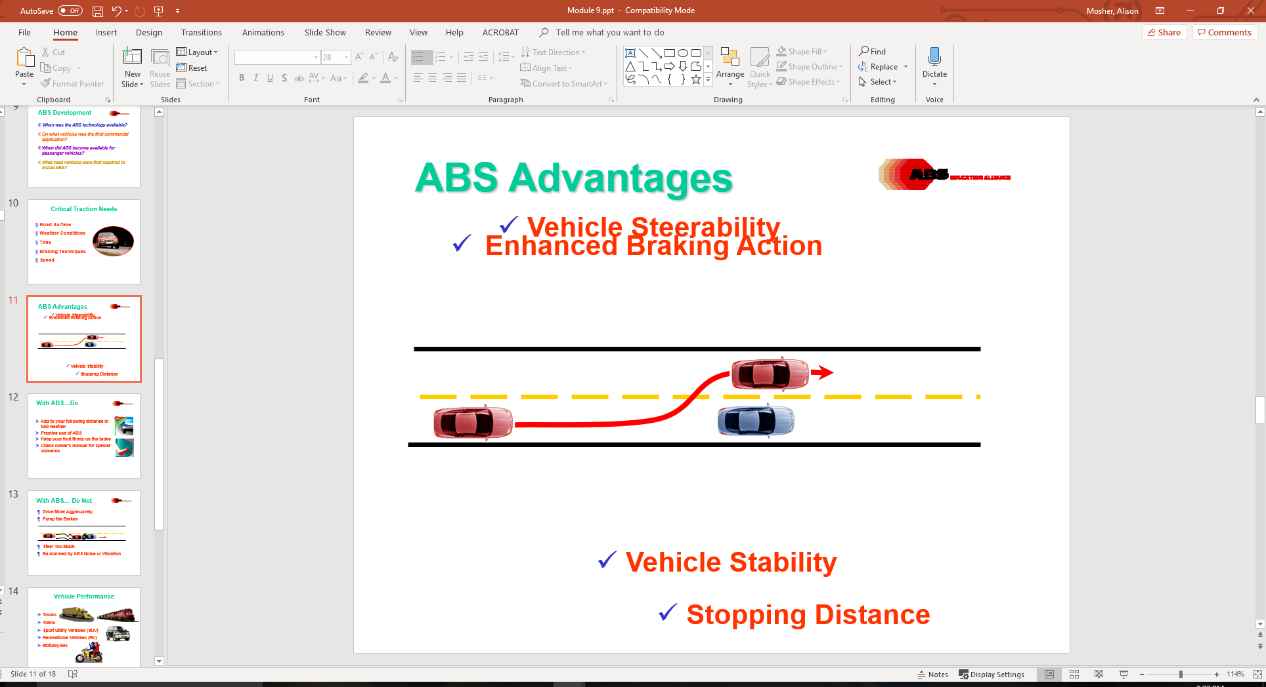
ABS Advantages
Enhanced Braking Action
Vehicle Steerability
Vehicle Stability
Stopping Distance

Slide 12
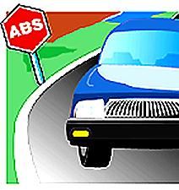
With ABS…Do
Add to your following distance in
bad weather
Practice use of ABS
Keep your foot firmly on the brake
Check owner’s manual for special
concerns

Slide 13
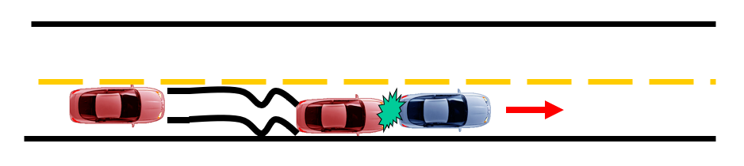
With ABS… Do Not
Drive More Aggressively
Pump the Brakes
Steer Too Much
Be Alarmed by ABS Noise or Vibration

Slide 14
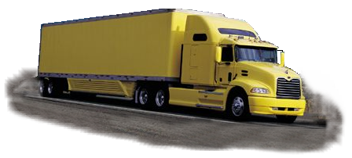
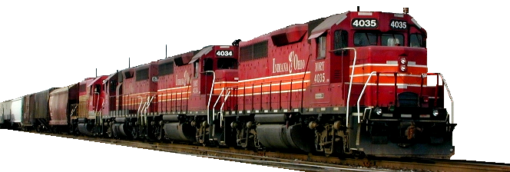
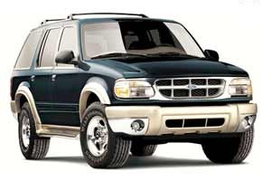
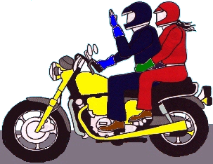
Vehicle Performance
Trucks
Trains
Sport Utility Vehicles (SUV)
Recreational Vehicles (RV)
Motorcycles

Slide 15
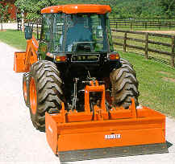
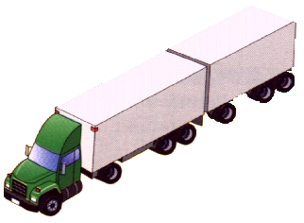
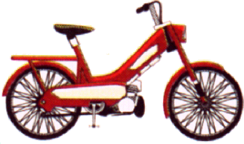
Vehicle Performance
Bicycles, Mopeds, Scooters
Construction Vehicles
Oversize Vehicles
Farm Machinery
Horse-drawn Vehicles

Slide 16
Contact/Mission
For more information on Driver’s Education and Safety please visit PDE’s website at www.education.pa.gov
The mission of the Department of Education is to ensure that every learner has access to a world-class education system that academically prepares children and adults to succeed as productive citizens. Further, the Department seeks to establish a culture that is committed to improving opportunities throughout the commonwealth by ensuring that technical support, resources, and optimal learning environments are available for all students, whether children or adults.

