Slide 1
Driver Education Theory Sample Lesson
15
Taking Personal Responsibility: Alcohol and Other Drugs

Slide 2
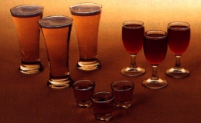
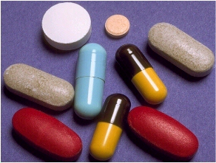
Personal Responsibility: Alcohol and Other Drugs
Making Responsible Choices
Current Alcohol and Other Drugs Laws
BAC Factors
Alcohol Affects the Body
Alcohol and Driving Task

Slide 3
Introduction
What do we know about alcohol and other drugs and driving?
How do State laws impact teens.
How does BAC make a difference.
How does alcohol and other drugs impact driving ability.

Slide 4
Assessing the Facts True or False Statements
A 12 oz regular beer has more alcohol than a 1 oz shot of 80 proof whiskey.
Regular beer and light beer have the same amount of alcohol but different amount of calories.
BAC means Blood Alcohol Content
All persons remove alcohol at the rate of 1 drink per hour.
Teenagers are at a lower risk of alcohol-related crashes than older drivers
There is a much greater risk of becoming an alcoholic if drinking begins as a teenager

Slide 5
State Alcohol/Drug Laws
Driving Under the Influence
  Page 262 of State Laws Handout
21 and older BAC Level is .08%
  Page 262 of State Laws Handout
20 and under BAC level is .02%
  Page 262… Section 189A.101 (e) in State Laws Handout
Implied Consent Law
  Page 269 of State Laws Handout
Open Container Law
  Page 269 of State Laws Handout
Purchase and Age Misrepresentation
  Page 396 of State Laws Handout

Slide 6
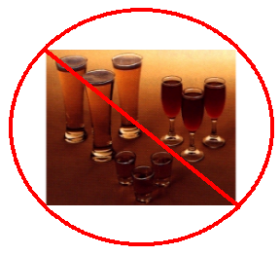

Using or Not Using?
Why do you think State has a Zero Tolerance Law for persons under age 21?
Why do some people choose not to use alcohol or other drugs?

Slide 7
Your Choices and Responsibilities
List some short-term and long-term rewards.
List some short-term and long-term consequences.
Is alcohol and other drug use short-term or long term reward?
Are consequences of alcohol use short-term or long-term?
Easiest way to avoid the consequences is?

Slide 8
BAC is:
Blood Alcohol Concentration
What is the difference between:
  Blood Alcohol Content
  Blood Alcohol Concentration?

Slide 9
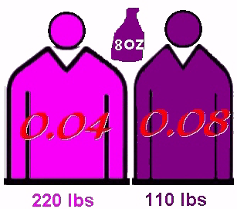
BAC Factors
Weight
Time Spent Drinking
Gender
Food
Alcohol Content
Size of Drinks

Slide 10



Are They The Same?
Beer
Whiskey
Wine
Cooler
Margarita

Slide 11
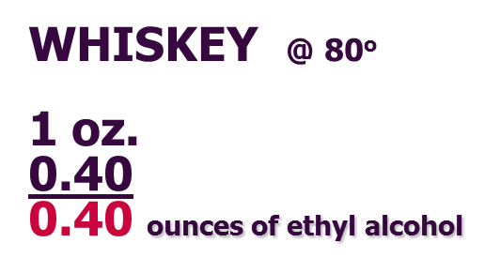
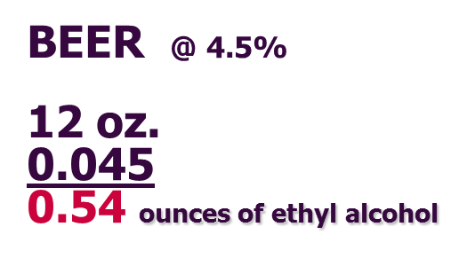
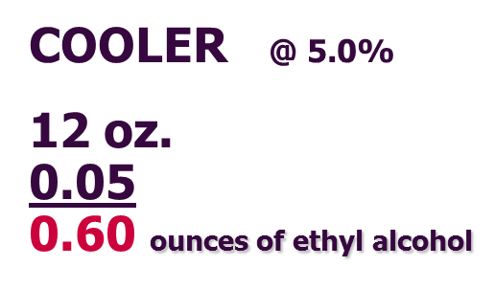
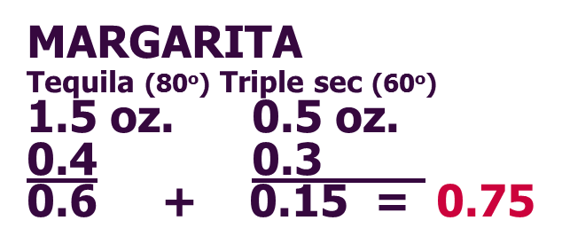

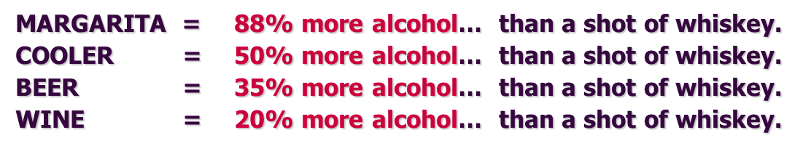
Crunching the Numbers

Slide 12
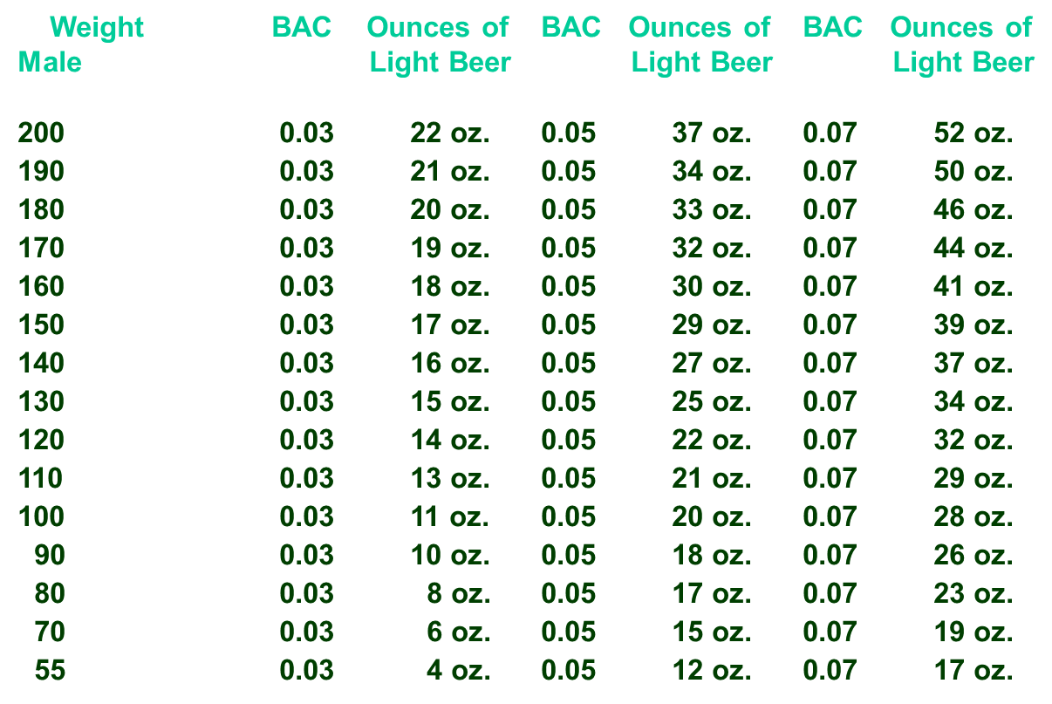
How Much Light Beer (Male)

Slide 13





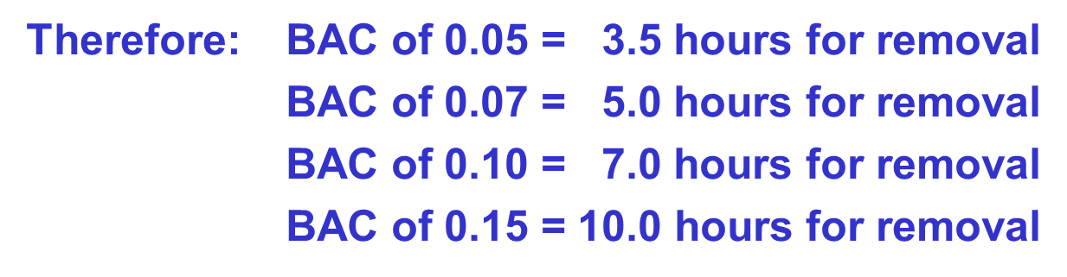
Elimination of Alcohol
PROCESS
TIME FACTORS

Slide 14


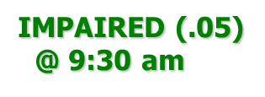




Elimination Rate
BAC STOPS DRINKING @ 12:30 A.M.
.20
.15
.10
.05
.00
9 10 11 12 1 2 3 4 5 6 7 8 9 10 11 12 1
HRS 1 2 3 4 5 6 7 8 9 10 11 12 13 14 15 16

Slide 15
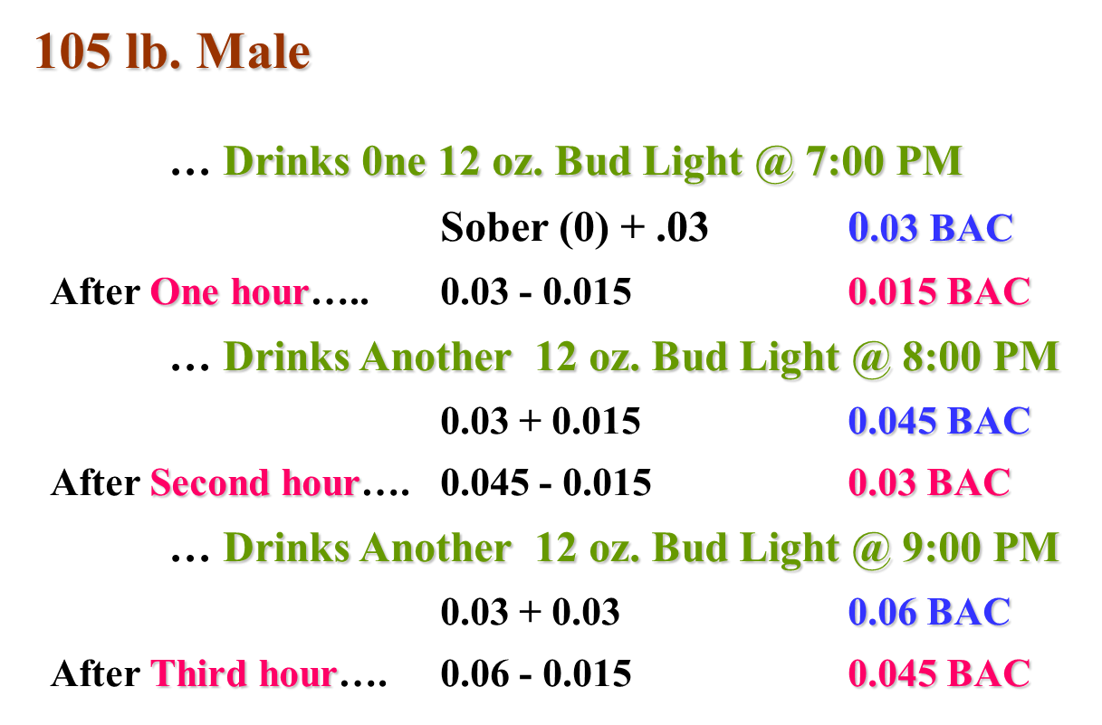
DOES THE BODY REMOVE ONE DRINK PER HOUR?

Slide 16
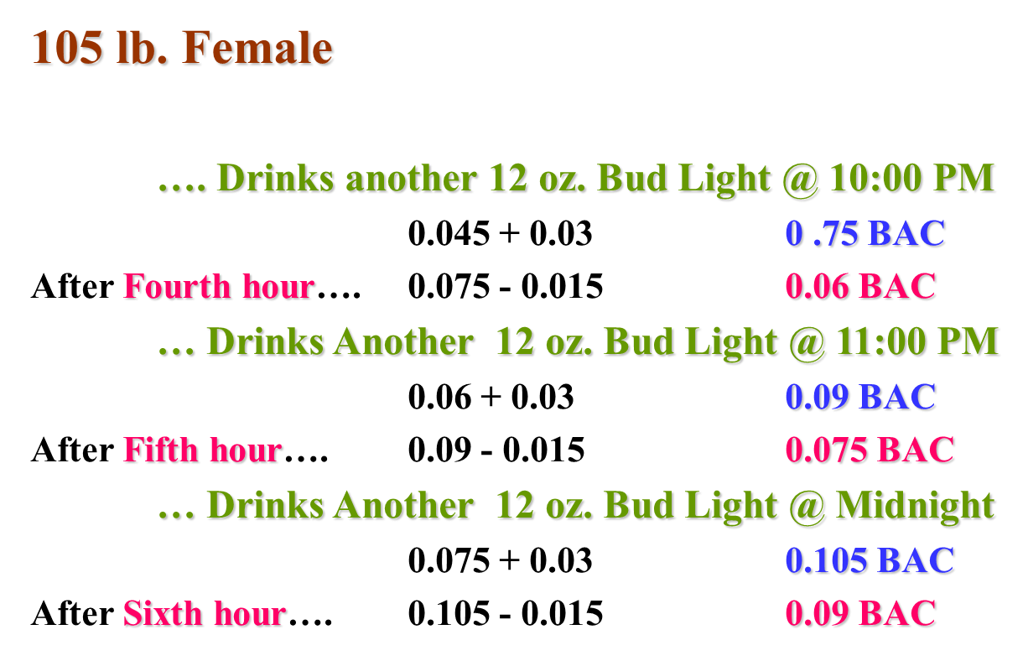

DOES THE BODY REMOVE ONE DRINK PER HOUR?

Slide 17
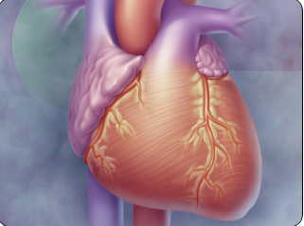
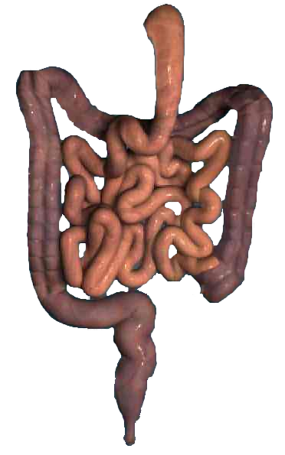

Alcohol Affects the Body
Liver
Heart
Sexuality
Sleep
Stomach
Brain

Slide 18
Contact/Mission
For more information on the (the topic of the presentation) please visit PDE’s website at www.education.pa.gov
The mission of the Department of Education is to ensure that every learner has access to a world-class education system that academically prepares children and adults to succeed as productive citizens. Further, the Department seeks to establish a culture that is committed to improving opportunities throughout the commonwealth by ensuring that technical support, resources, and optimal learning environments are available for all students, whether children or adults.

