Slide 1
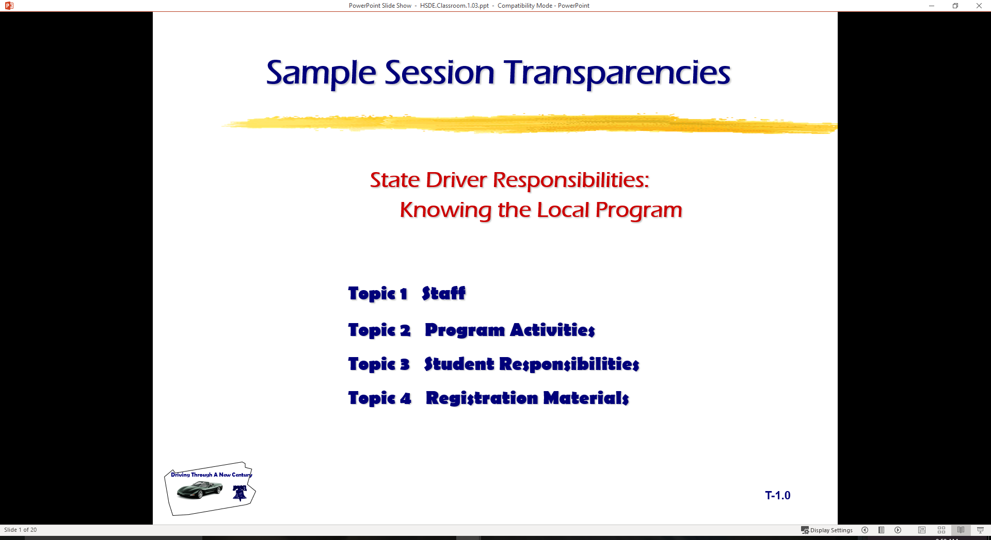
State Driver Responsibilities: Knowing Your Vehicle
  Topic 1 Getting Started
  Topic 2 Vehicle Controls
  Topic 3 Using Controls

Slide 2

Introduction
Review of Range Lab Lesson
  Central Blindzone
  BGE Mirror Method
  Need for Developing Reference Points
Vehicle Control Tasks
  Procedures
  Tasks for Car Control
S E E

Slide 3
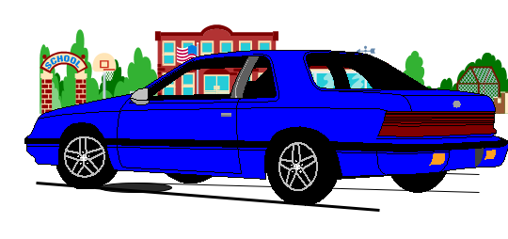
Pre-trip Inspection
Check around the outside of vehicle for:
  broken glass (windows, lights)
  body damage
  condition of tires
  fluid leaks
  direction front tires are turned
  which way will vehicle move when placed in gear?
  debris on the ground that could interfere with movement.
Check for small children or pets near vehicle.

Slide 4
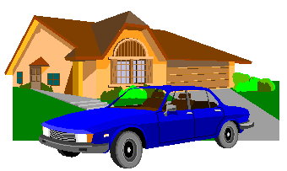
Pre-trip Inspection
Store valuables in trunk of vehicle
  books and book bags have less chance of slipping off seats
  the vehicle is a classroom with no room for
    food, candy, and sodas
    homework and inattention in the rear
When parked at the curb
  approach from front of car
  increase awareness of oncoming traffic
  approach driver’s door with key in hand

Slide 5
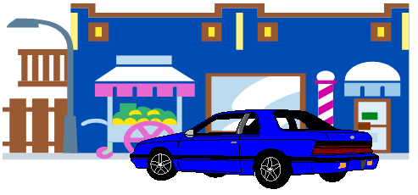
Pre-trip Inspection
When parked in parking lot
  approach from rear of car
  increase awareness of persons and objects in area
  driver’s door with key in hand
Unlock doors
Check traffic flow
Enter the vehicle

Slide 6
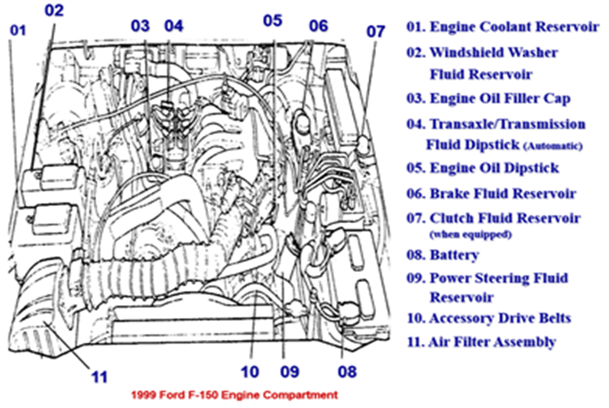
Under the Hood Checks

Slide 7

Pre-trip Readiness
Security
  Check passengers for safe entry
  Lock doors
  Place key in appropriate location
Seating Position
  Adjust for driver foot pedal and dead pedal position
  Adjust for driver steering wheel reach and hand position
  Adjust for driver visual needs

Slide 8
Pre-trip Readiness
Restraints
  Safety belt adjustment and appropriate air bag position
  Head restraint position (rear and side protection)
Mirrors
  Rear view mirror settings (200 feet to rear)
  Side view mirror settings (15 degrees out will gain side views)
    may be adjusted to view sides rather than rear view
    rear view needed when inside mirror view is blocked to rear

Slide 9
Starting Tasks
Check and set parking brake
Place foot on service brake
  Clutch required for standard shift transaxle/transmission
Place key in ignition and unlock
Place gear selector in park (P) or neutral (N)
  Automatic Transaxle/Transmission starts in (P)ark or (N)eutral
  (N)eutral recommended for standard transaxle/transmission

Slide 10
Starting Tasks
Check for choke/fuel injection needs
  does vehicle need choke (carburetor) to start?
  fuel injection (DO NOT PUSH ON ACCELERATOR BEFORE START)
Turn ignition to “on” for alert/warning lights
  airbag, seat belts, ABS, traction alerts, etc.
Turn ignition to “start”
Check alert lights and gauges
  are all systems functioning and ready to use?
Set needed accessories
  heating, ventilation, and air conditioning (HVAC), wipers, lights, etc.

Slide 11
Securing Tasks
Stop within a legal, secure parking space
  parked within appropriate distances of fire hydrant, intersection, RR crossing, legal parking zone, etc.
  keep foot on service brake
Set parking brake
  recommended in most new vehicle owner’s manuals
  protects transaxle and constant velocity joints
Place gear selector in (P)ark.
  place in recommended gear for standard shift transaxle or transmission
Turn off any vehicle accessories
  are all systems functioning and ready to use for next time?

Slide 12
Securing Tasks
Turn ignition switch to “off”
  the engine should shut off at this time with all accessories off
Lock ignition switch and remove key
  required to remove the key in most vehicles
Remove occupant restraints
  some shoulder restraints operate when the door is opened
Check traffic and exit vehicle
  check traffic flow to rear prior to opening the door
  rear child safety door locks may need to be opened from the driver’s door
Secure doors and windows
  protects valuables and unauthorized entry by others

Slide 13
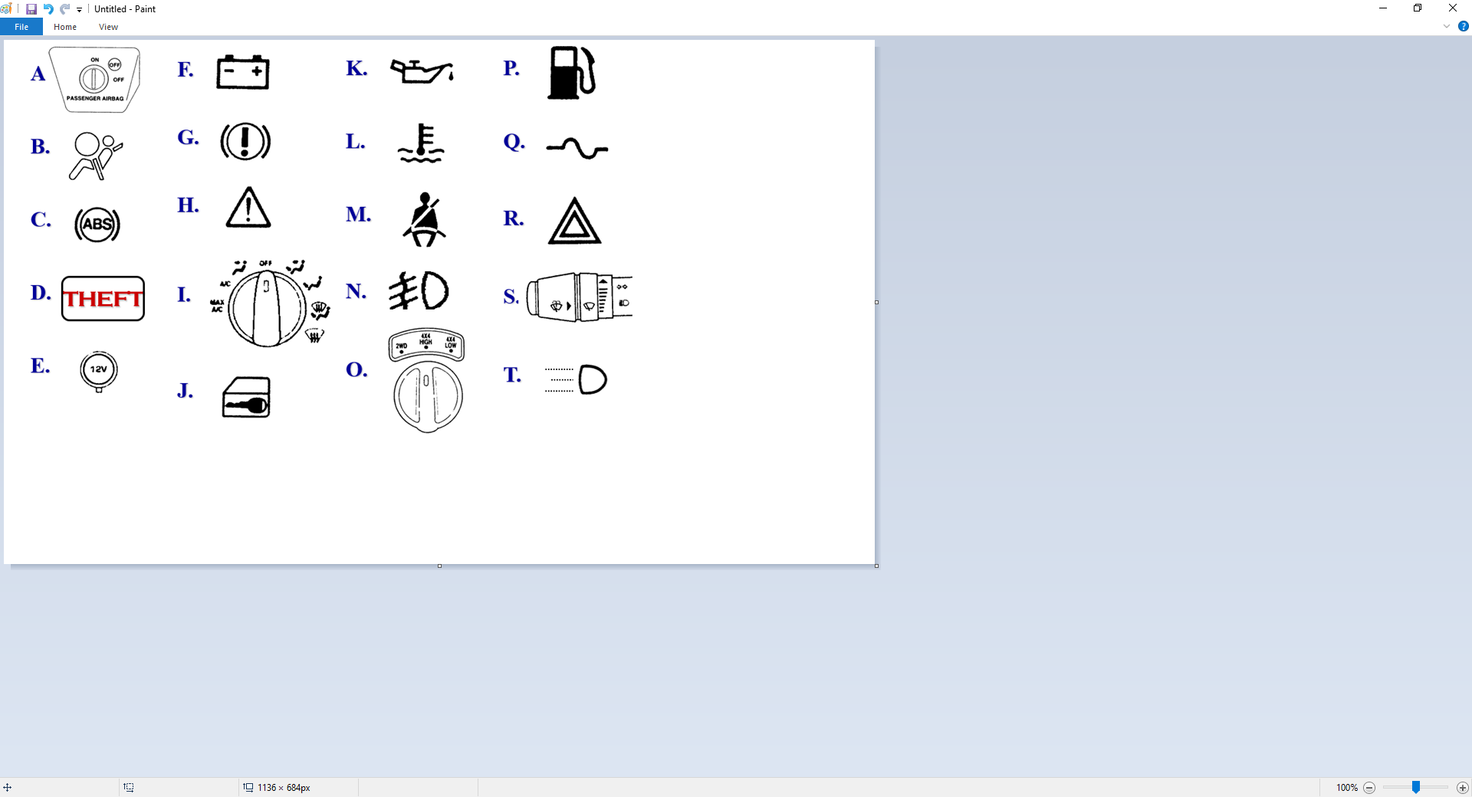
Alert/Warning Symbols and Controls

Slide 14
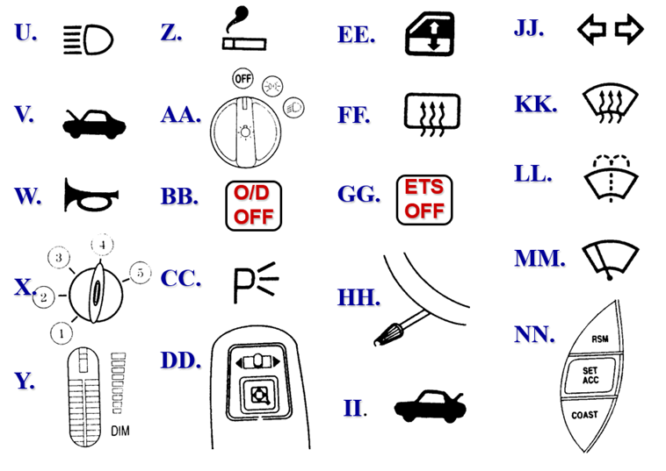
Alert/Warning Symbols and Controls

Slide 15
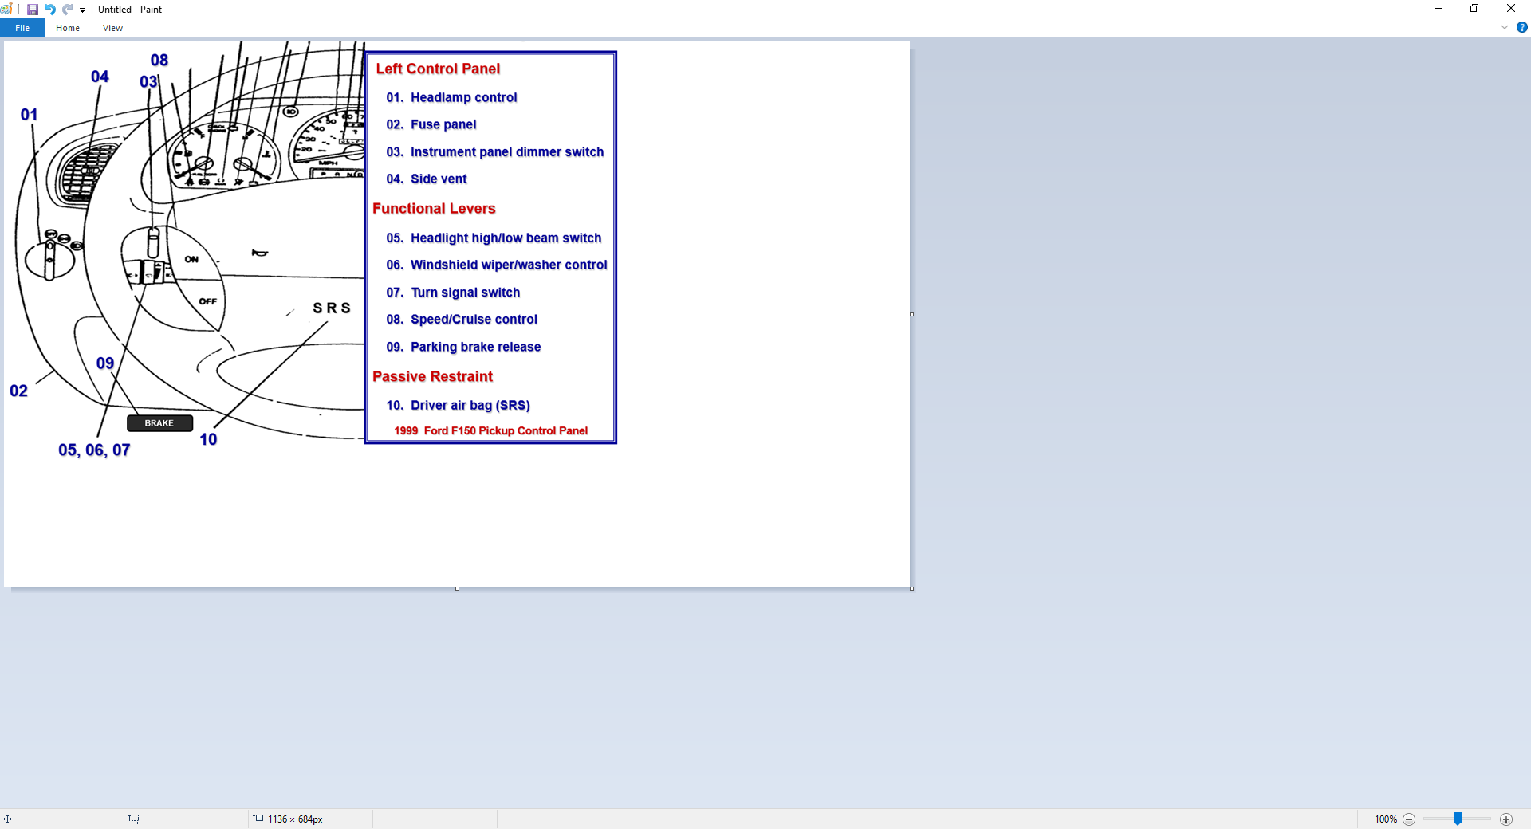
Control, Information, Comfort, and Safety Devices

Slide 16
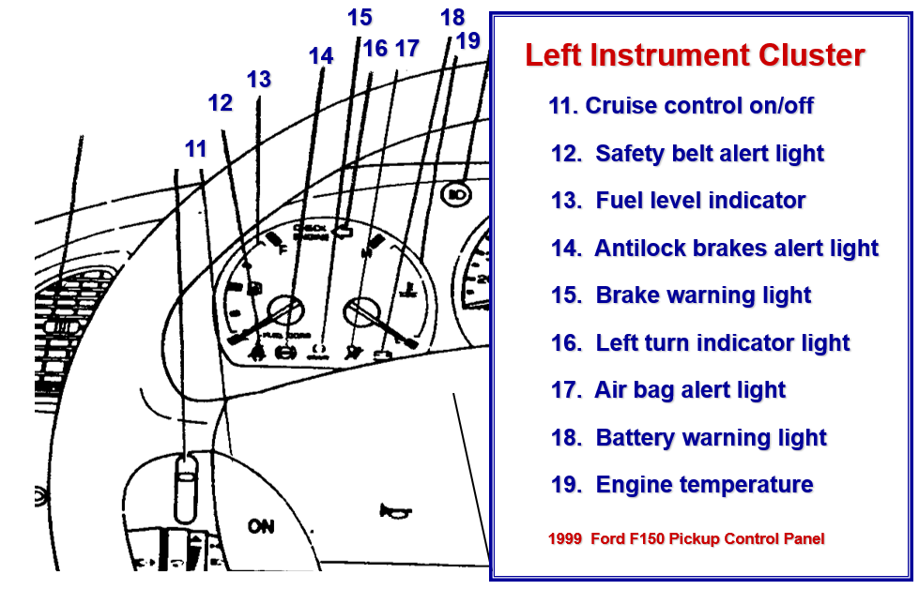
Control, Information, Comfort, and Safety Devices

Slide 17
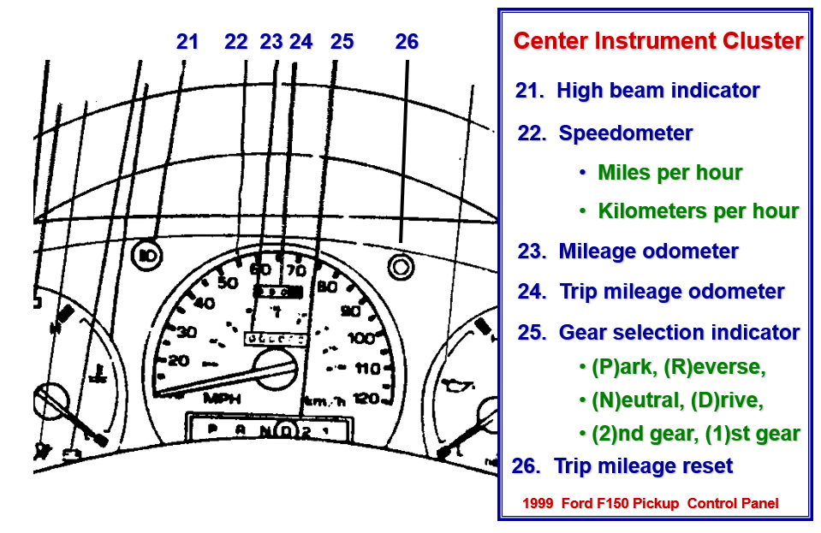
Control, Information, Comfort, and Safety Devices

Slide 18
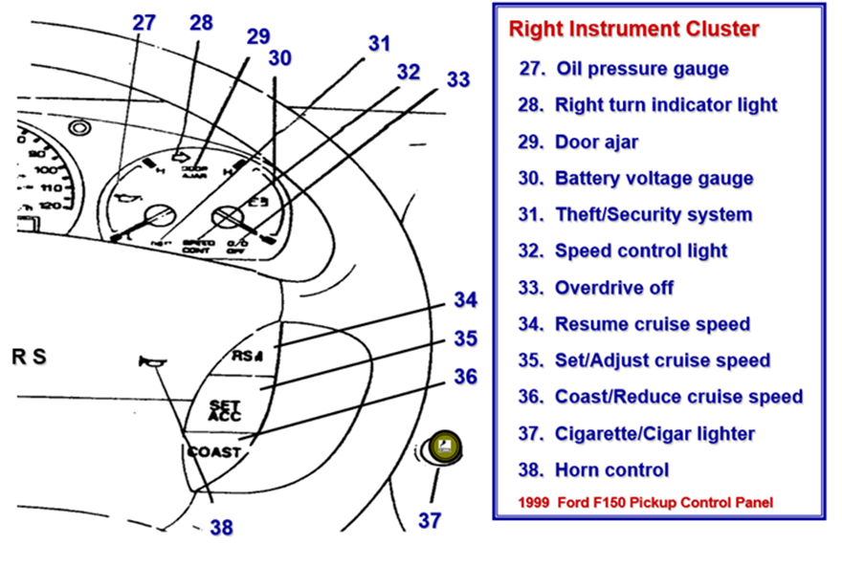
Control, Information, Comfort, and Safety Devices

Slide 19
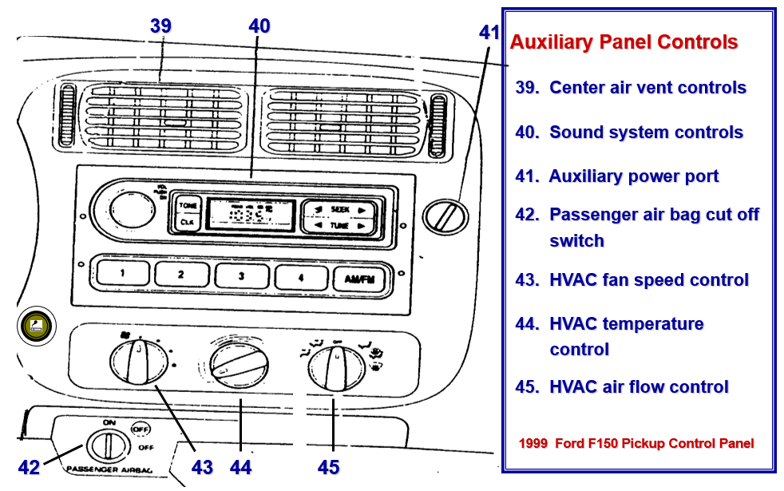
Control, Information, Comfort, and Safety Devices

Slide 20
Operating Vehicle Control Devices
Maintain Steering Position and Control
  Adjusting information devices
  Adjusting comfort devices
  Adjusting control devices
Move Steering Wheel Toward Path of Travel
  Moving forward
  Moving backward
Adjust Wheel Height/Angle
  Airbag deployment
  Hand position
  Wheel movement

Slide 21
Operating Vehicle Control Devices
Accelerator Pedal Use
  Used to stabilize, increase, and decrease speed
  The driver can
    cover accelerator, progressive acceleration, thrust acceleration, lift-off accelerator
Brake Pedal Use
  Used to stabilize, decrease, and increase speed
  The driver can
    cover brake, trail brake, controlled squeeze braking, threshold brake, lock brake, ABS, jab (stab) brake, lift-off brake

Slide 22
Operating Vehicle Control Devices
Gear Selector Lever Use
  Transaxle or Transmission type
  (O)verdrive and (D)rive gear use
Location of Parking Brake and Use
  Texas Traffic Law requires use when leaving vehicle
  Owner’s manual requests use before placing into (P)ark
Cruise / Speed Control
  Purpose of cruise control
  Danger of cruise control
Ignition Switch
  Location
  Function

Slide 23
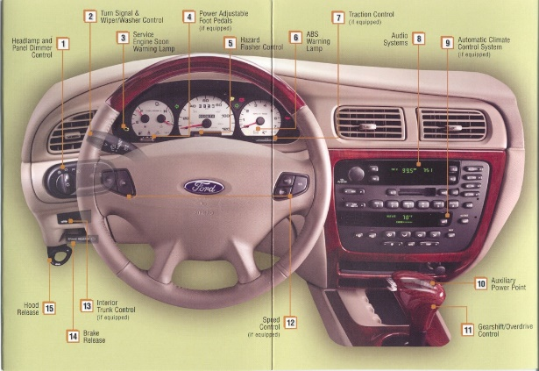
Safety, Communication, and Convenience Devices
Mirrors
  Rear view adjustments
  Side view adjustments
Safety Belts
  Adjusting for maximum effectiveness
Head Restraints
  Protecting against whiplash
Horn
  Location
  Appropriate use

Slide 24

Safety, Communication, and Convenience Devices
Turn Signals
  Location and appropriate use prior to maneuver
  Lane change device
Door Locks
  Manual / Power devices
  Child proof rear
Hazard Flashers
  Location and use
Windshield Wipers & Washers
Headlights / Running Lights
  Location and use

Slide 25

Safety, Communication, and Convenience Devices
Hood Release
  Location and use
Trunk Release
  Location and use
Fuel Door Release
  Location and alternate opening device
Heat, Ventilation, and Air Conditioner (HVAC) Controls
  Fan, temperature, and ventilation location
  Defroster/Defogger operates air conditioning system
Seat Adjustment
  Power / Manual controls

Slide 26
Assignments
Draw a figure of vehicle and identify reference points
Draw the controls on their vehicle
Bring an owner’s manual to class
Compare owner’s manuals for next class

Slide 27
Contact/Mission
For more information on Driver’s Education and Safety please visit PDE’s website at www.education.pa.gov
The mission of the Department of Education is to ensure that every learner has access to a world-class education system that academically prepares children and adults to succeed as productive citizens. Further, the Department seeks to establish a culture that is committed to improving opportunities throughout the commonwealth by ensuring that technical support, resources, and optimal learning environments are available for all students, whether children or adults.

