Slide 1
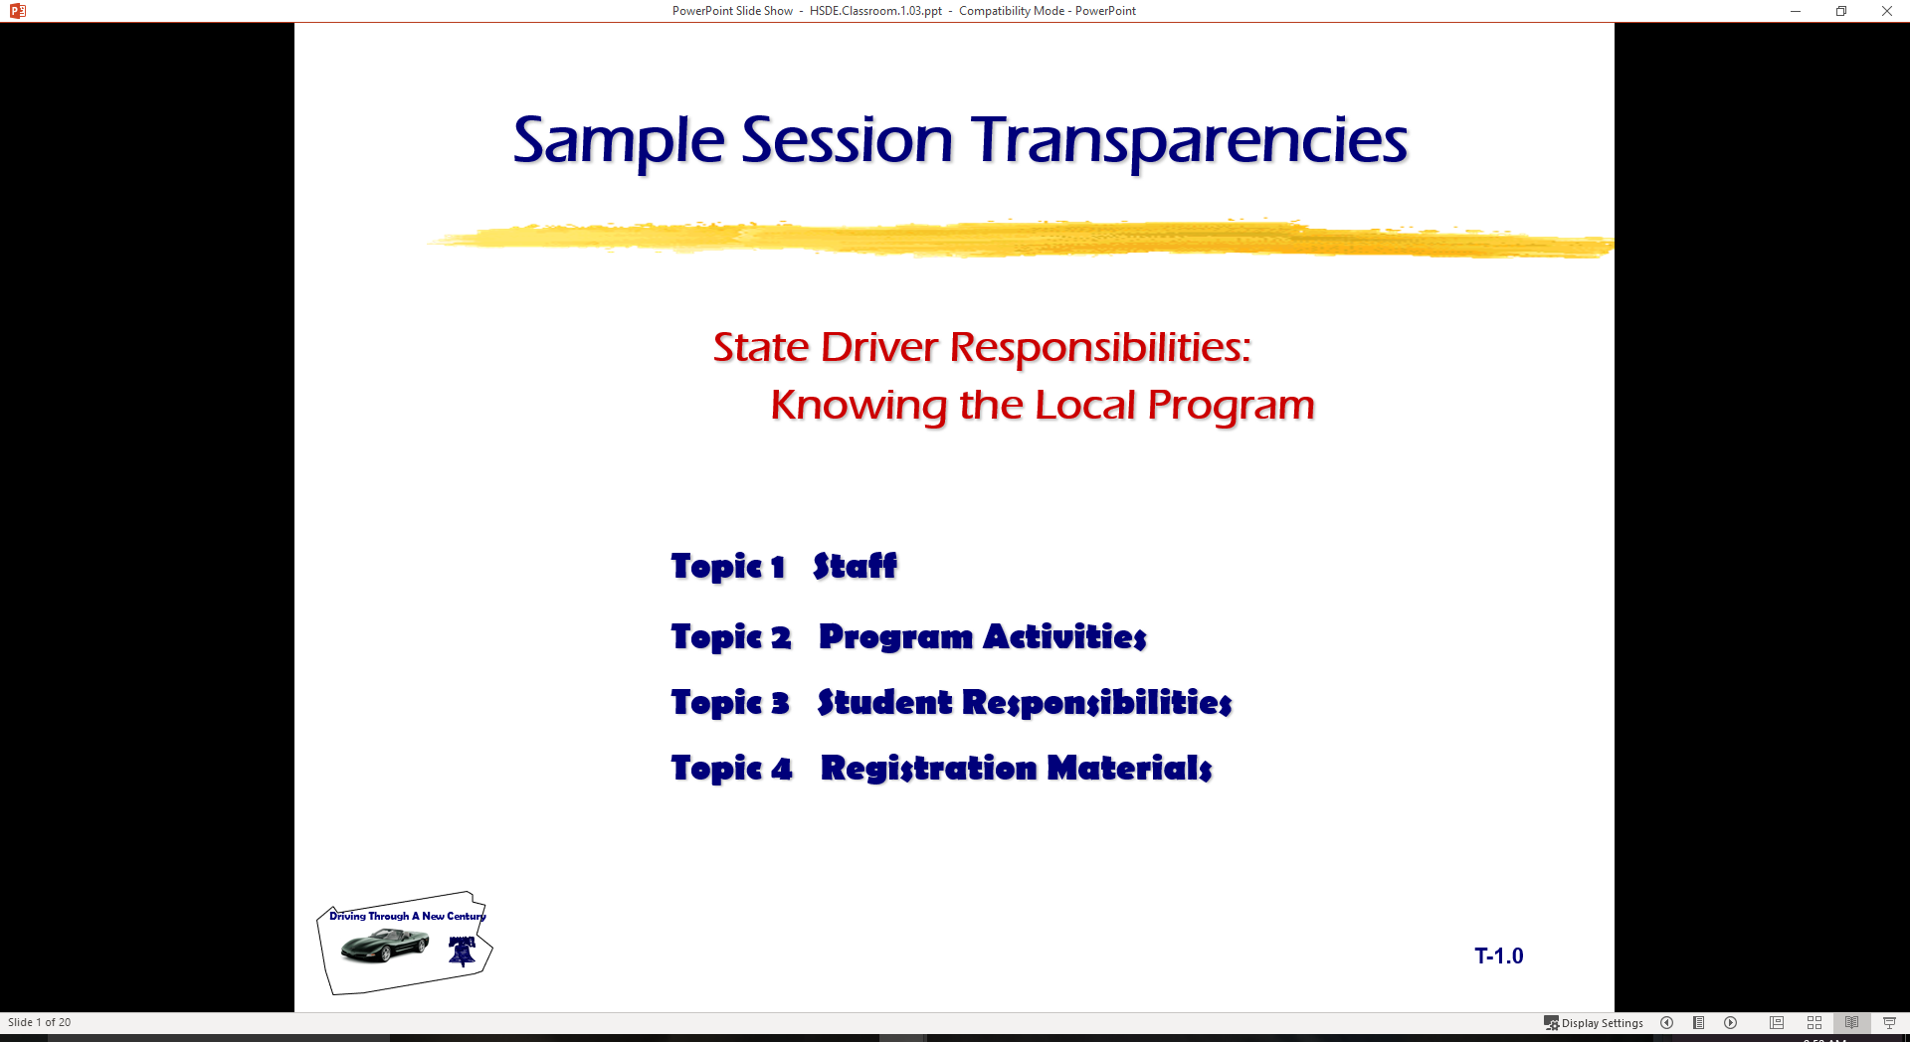
State Driver Responsibilities: Knowing Your Vehicle and Developing a Driving System
  Topic 1 Vehicle Owner’s Manual
  Topic 2 Vehicle Balance Considerations
  Topic 3 Targeting Skills
  Topic 4 Vision Requirements
  Topic 5 Introducing “SEE” Driving System

Slide 2

Introduction
Review of Range Lesson One
  Difficulty Controlling Vehicle at 8-10 mph
  Usually Too Much Steering Wheel Input
  Braking and Acceleration Helps Control
  Need for Developing Targeting Skills
Vehicle Owner’s Manual
  Familiar with Manual for Vehicles Driven
Vehicle Balance Concerns
  Next topical area with classroom and range
Vehicle Control and Targeting Skills
  Next Range activities will use Targeting skills
Need to Develop a Driving System
  Develops Visual and mental Habits for Vehicle Control
S E E

Slide 3
Vehicle Owner’s Manual Review
In small groups locate the following items:
  List the make and model of the vehicle
  Fluid capacities for vehicle
    Oil, Gasoline, Transmission Fluid, Coolant
  List five items from the glossary of vehicle alert and warning symbols
    If glossary is not available, how does the manual explain symbols
  Use of speed control device
    List when it is improper to use cruise control

Slide 4
Vehicle Owner’s Manual Review
In small groups locate the following items:
  List how and when the parking brake should be used in this vehicle
    Usually a procedure for stopping vehicle is used…
  List three items that require regular service from the Service Manual or section
    Some manuals have a separate section
  List at least three safety belt precautions
    Usually there are several precautions listed
  List the tire change procedure for this vehicle

Slide 5
Vehicle Owner’s Manual Review
In small groups locate the following items:
  List the make and model of the vehicle
  List the Fluid capacities for vehicle
  Give five examples of the glossary of vehicle alert and warning symbols
  Explain use of speed control device
  List how and when the parking brake should be used in this vehicle
  List three items that require regular service from the Service Manual or section
  List at least three safety belt precautions
  List the tire change procedure for this vehicle

Slide 6

Controlling Vehicle Balance
Vehicle Balance (Roll, Pitch, and Yaw)
  Roll: vehicle moves side to side
  Pitch: vehicle moves forward or backward
  Yaw: vehicle moves left or right
  Specific amount of weight or down force on each tire patch
  Best balance is at rest with no movement
  Based on weight/suspension/tire pressure
Vehicle Movement
  Creates Changes to vehicle balance
  Due to suspension and pressure changes

Slide 7

Controlling Vehicle Balance
Maintaining Vehicle Balance
  Steering Wheel Balance
    Smaller steering wheel
    Rack and pinion steering
  Precise Steering, Braking, and Accelerator Input
    Less steering movement
    Squeeze brakes
    Smooth acceleration/deceleration
  Changes in Steering Ratios, 1980's to Date
    Present vehicles 2 to 3 turns
    Prior to 1980 vehicles 4 to 5 turns

Slide 8
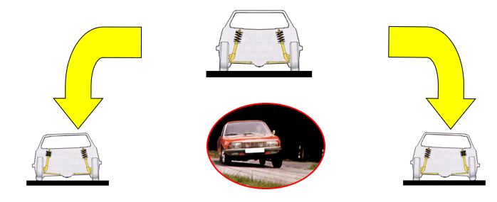
Controlling Vehicle Balance
Seating
Driver position/balance
Safety belt and dead pedal use
Changing Vehicle Load from Side to Side (Roll)
Steering Wheel Movements
Brake Application and Steering Combinations

Slide 9
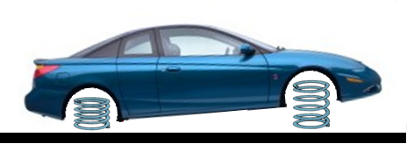
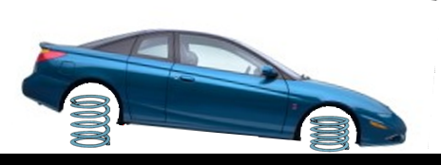
Vehicle Control – Vehicle Direction/Speed Requirements
Changing Vehicle Load from Front to Rear (Pitch)
Covering accelerator
Light accelerator pressure
Releasing brake
Progressive accelerator pressure
Thrust accelerator pressure
Changing Vehicle Load from Rear to Front (Pitch)
Similarities and differences between vehicles with which drivers must be familiar
Driver positioning for optimum brake pedal control
Releasing the accelerator
Covering the brake
Controlled braking (Squeeze on)
Threshold braking
Trail braking (Squeeze off)

Slide 10
Vehicle Control – Vehicle Direction/Speed Requirements
Changing Vehicle Balance from Left to Right (Roll)
Sudden brakes
Sudden or excessive acceleration
Sudden or excessive steering
Road tilted to right
Traction loss to right rear
Changing Vehicle Load from Right to Left (Roll)
Sudden brakes
Sudden or excessive acceleration
Sudden or excessive steering
Road tilted to left
Traction loss to left rear

Slide 11
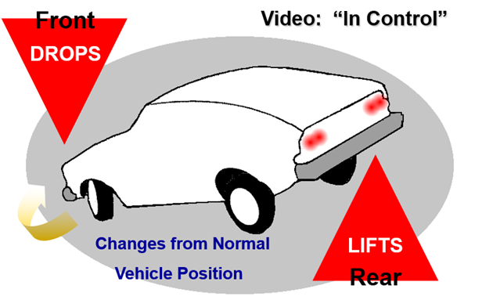
Vehicle Control

Slide 12
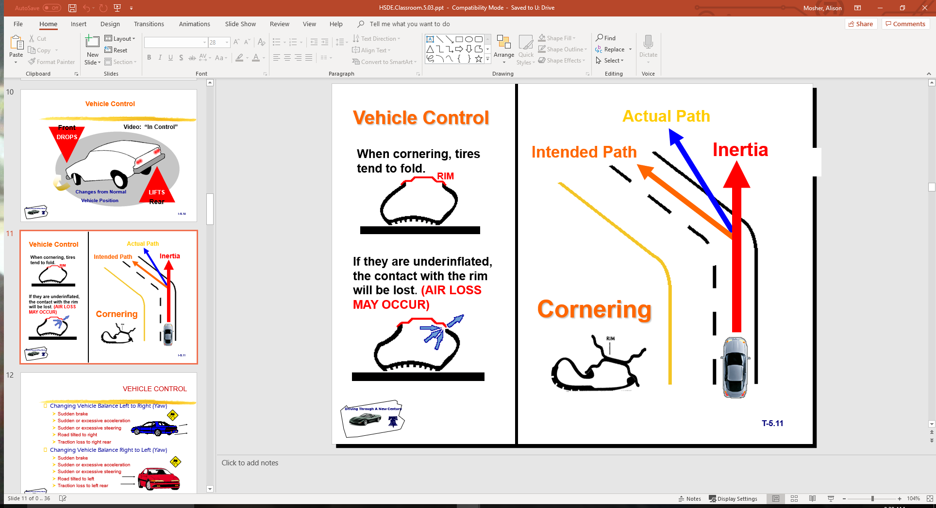
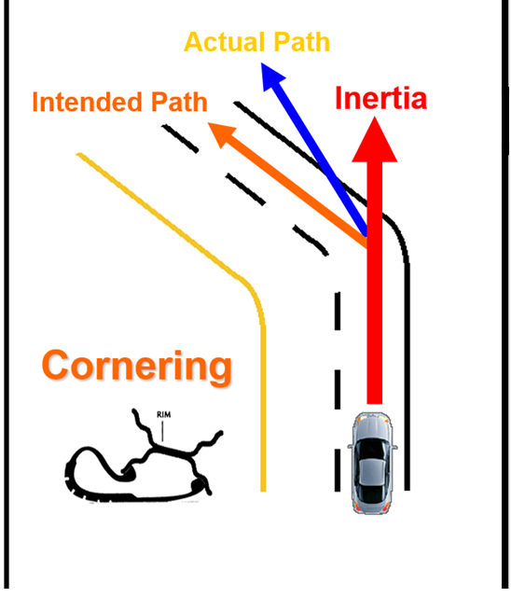
Vehicle Control

Slide 13
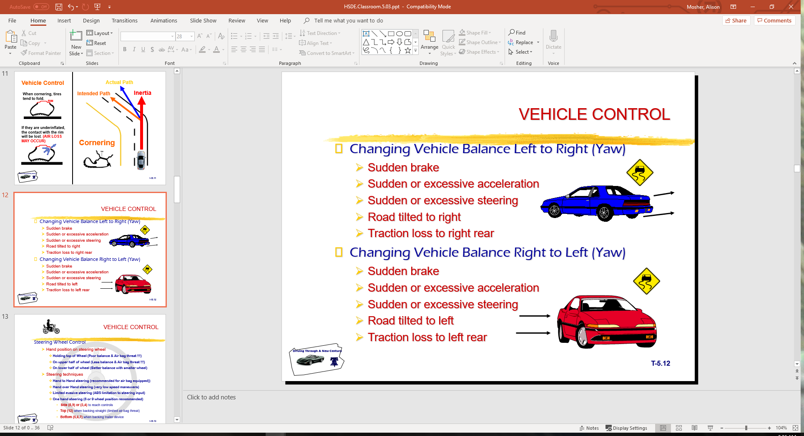
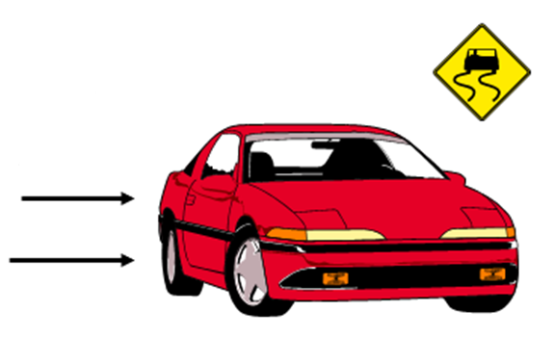
Vehicle Control
Changing Vehicle Balance Left to Right (Yaw)
  Sudden brake
  Sudden or excessive acceleration
  Sudden or excessive steering
  Road tilted to right
  Traction loss to right rear
Changing Vehicle Balance Right to Left (Yaw)
  Sudden brake
  Sudden or excessive acceleration
  Sudden or excessive steering
  Road tilted to left
  Traction loss to left rear

Slide 14
Vehicle Control
Steering Wheel Control
  Hand position on steering wheel
    Holding top of Wheel (Poor balance & Air bag threat !!!)
    On upper half of wheel (Less balance & Air bag threat !!!)
    On lower half of wheel (Better balance with smaller wheel)
  Steering techniques
    Hand to Hand steering (recommended for air bag equipped))
    Hand over Hand steering (very low speed maneuvers)
    Limited evasive steering (ABS limitation to steering input)
    One hand steering (8 or 9 wheel position recommended)
      Side (8,9) or (3,4) to reach controls
      Top (12) when backing straight (limited air bag threat)
      Bottom (5,6,7) when backing trailer device

Slide 15
Targeting and Visual Requirements
Targeting is visual function
  Directed use of focus vision
Maintaining an open line of sight
  From target to front of vehicle
  Use of fringe vision (central vision)
Targeted path of travel
  Determines projected path of vehicle travel
Referencing vehicle to roadway position
Using standard references
  Vehicle placement within lane
  Vehicle placement to front and rear
  Vehicle placement to the side

Slide 16

Vision and Perception Requirements
Gaining Visual Information
  Focus Vision (Focal/Foveal)
  Central Vision (Limited Fringe Area)
  Peripheral Vision
Maintaining an Open Line of Sight
Developing Searching Skills

Slide 17

Vision and Perception Requirements
Targeting, Line of Sight, Path of Travel
Referencing Vehicle to Path of Travel
Using Visual References
Using Turn Points to Start Turning Process
  Forward visual turning points
  Rear visual turning points

Slide 18
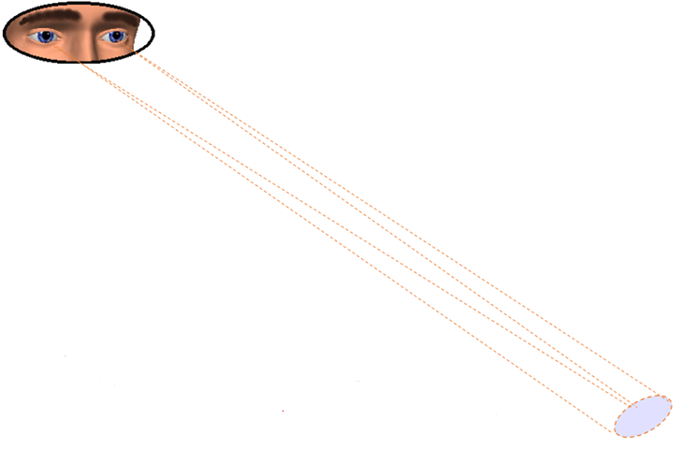
Driver’s Useful Vision Areas
Gathering Useful Visual Information
Focus Vision Area (Focal)
3 to 5 degrees of useful information
Targeting Skills
Establishing Visual Lead
Reading Signs and Interpreting Signals

Slide 19
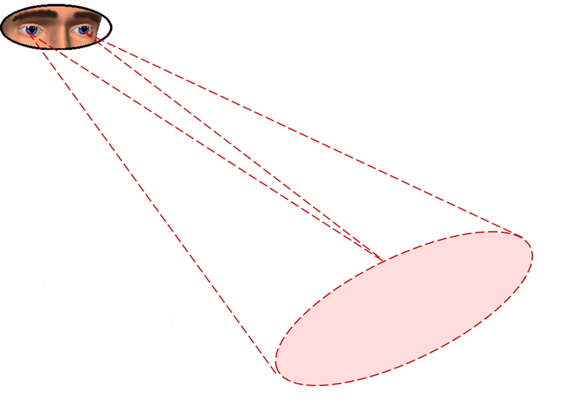
Driver’s Useful Vision Areas
Gathering Useful Visual Information
Central Vision Area (Inner Fringe)
30 to 36 degrees of useful information
Vehicle to Roadway Reference
Viewing Path of Travel
Viewing Line of Sight to Target Area

Slide 20
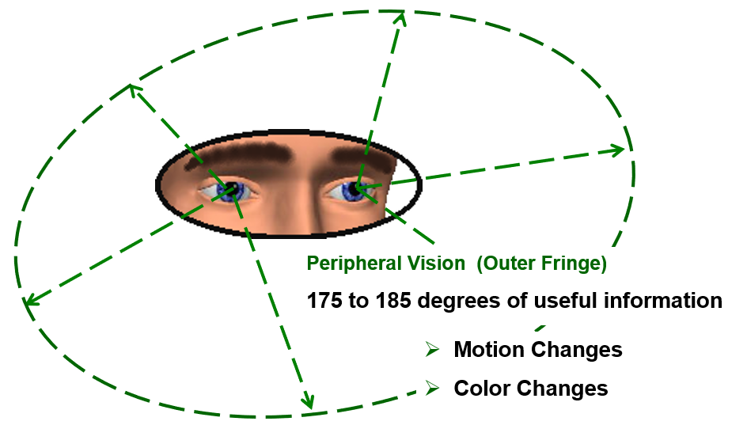
Driver’s Useful Vision Areas
Gathering Useful Visual Information

Slide 21
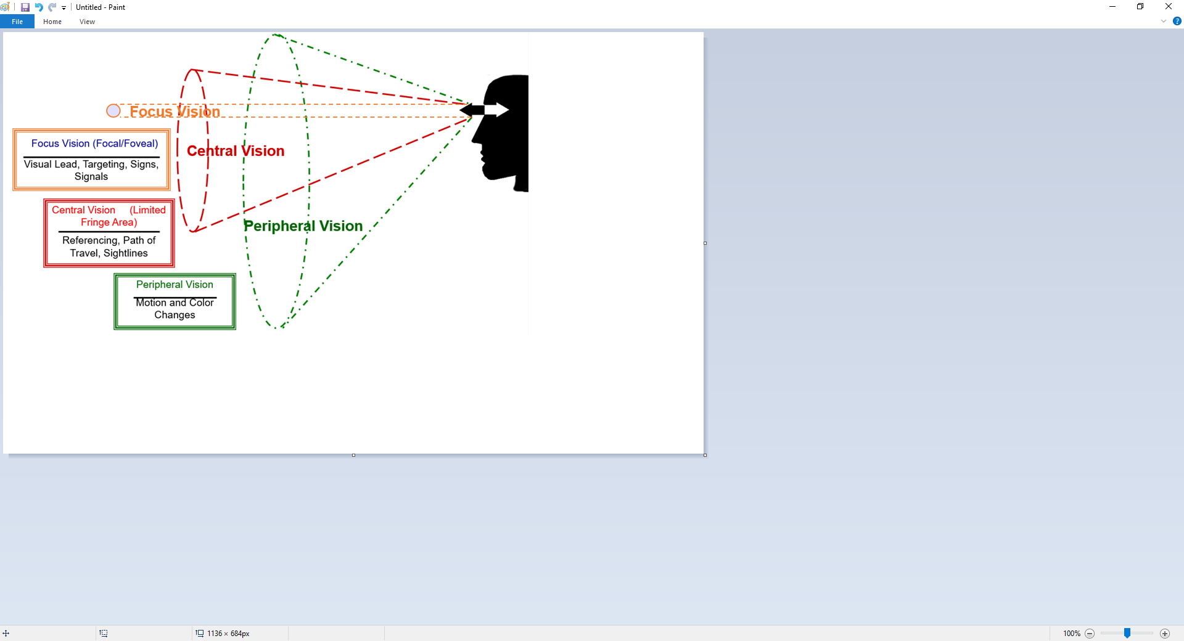
Visual Fields in Operation
Vision Characteristics

Slide 22
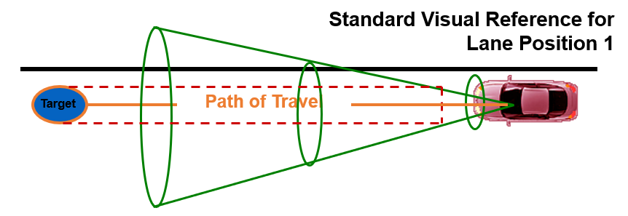
Visual Fields in Operation
When focus vision is on the target at the end of the path of travel, the central or inner fringe vision will allow the driver to see the placement of vehicle in the roadway...

Slide 23
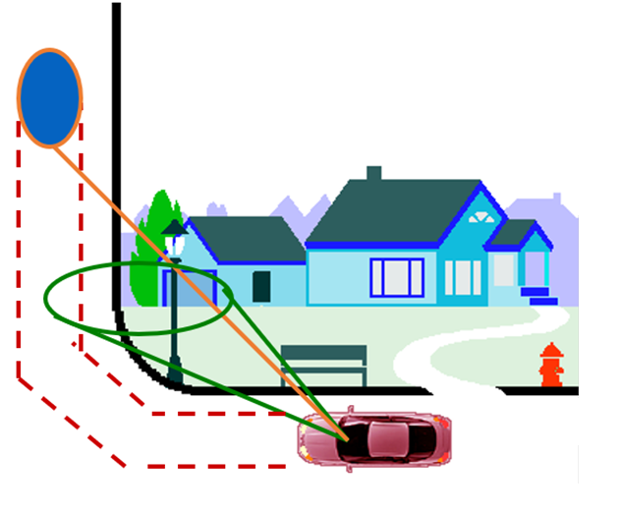
Vision Sightlines/Travel Paths
Line of Sight Limitations or Restrictions
When line of sight is restricted or blocked, a speed adjustment is needed until visual lead, target area, and the line of sight are restored...

Slide 24
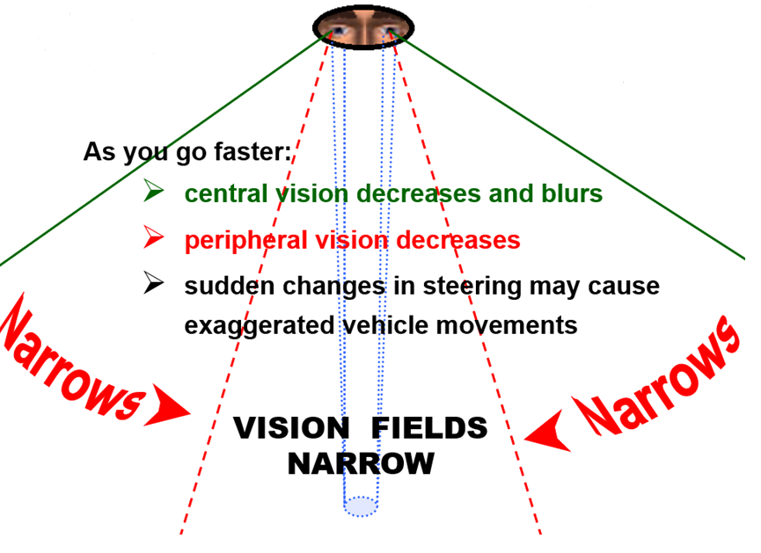
Speed’s Effect on Vision

Slide 25
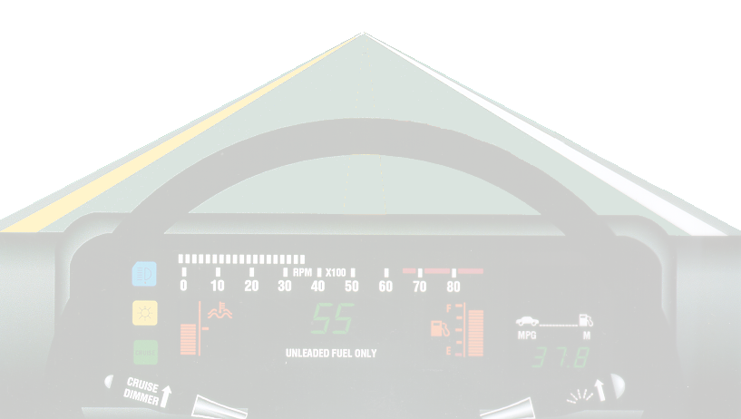
Speed and Effect on Vision
Looking farther away from your vehicle lengthens or increases line of sight (LOS) and path of travel (POT) areas which:
  allows more time to get information;
  increases peripheral vision field, giving time for adequate response; and
  places more space between other users and your vehicle, so sudden steering changes are held to a minimum.

Slide 26
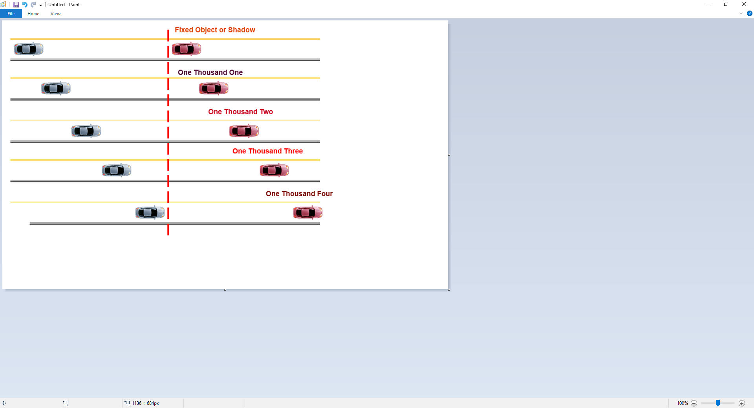
Determining Following Intervals

Slide 27
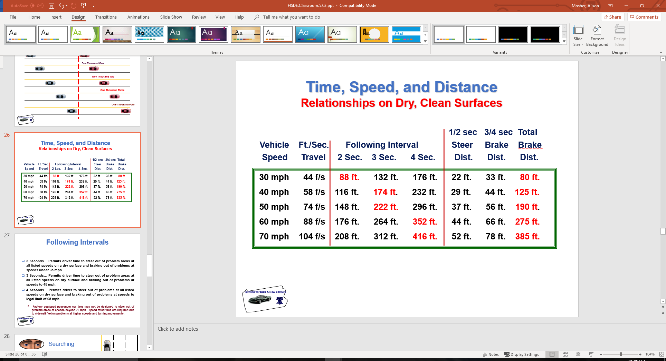
Time, Speed, and Distance
Relationships on Dry, Clean Surfaces

Slide 28
Following Intervals
2 Seconds… Permits driver time to steer out of problem areas at all listed speeds on a dry surface and braking out of problems at speeds under 35 mph.
3 Seconds… Permits driver time to steer out of problem areas at all listed speeds on dry surface and braking out of problems at speeds to 45 mph.
4 Seconds… Permits driver to steer out of problems at all listed speeds on dry surface and braking out of problems at speeds to legal limit of 65 mph.
  * Factory equipped passenger car tires may not be designed to steer out of problem areas at speeds beyond 75 mph. Speed rated tires are required due to sidewall flexion problems at higher speeds and turning movements.

Slide 29
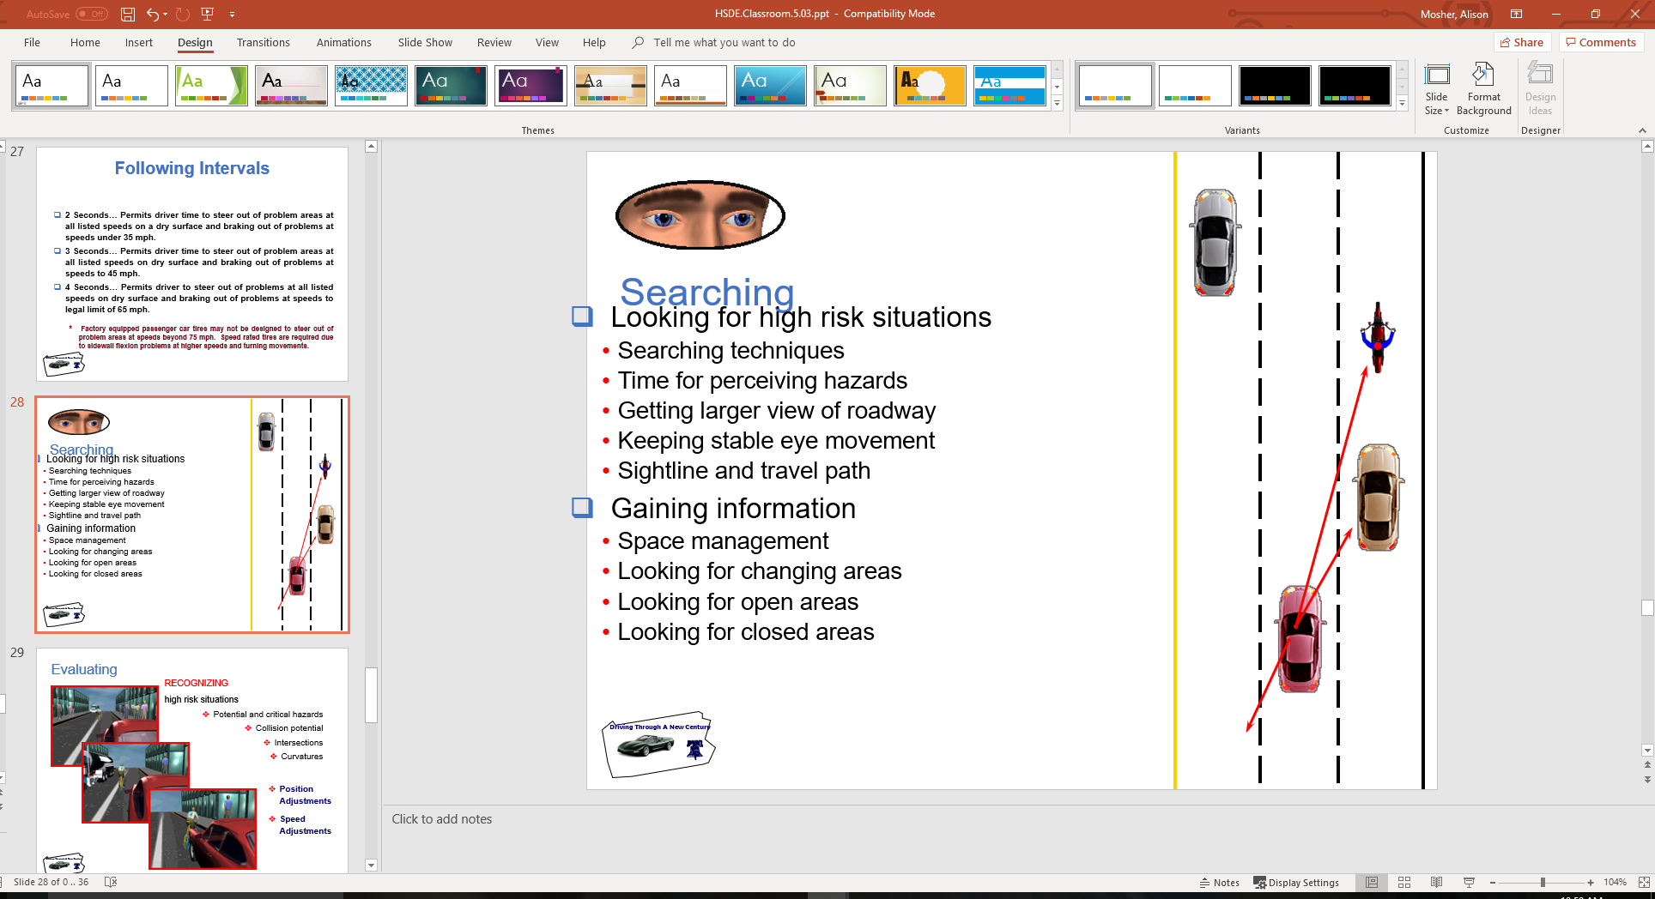
Searching
Looking for high risk situations
  Searching techniques
  Time for perceiving hazards
  Getting larger view of roadway
  Keeping stable eye movement
  Sightline and travel path
Gaining information
  Space management
  Looking for changing areas
  Looking for open areas
  Looking for closed areas

Slide 30
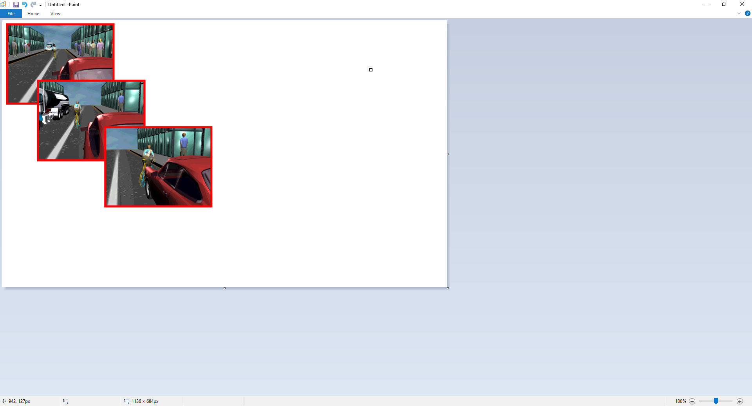
Evaluating
RECOGNIZING
high risk situations
  Potential and critical hazards
  Collision potential
  Intersections
  Curvatures
  Position Adjustments
  Speed Adjustments

Slide 31
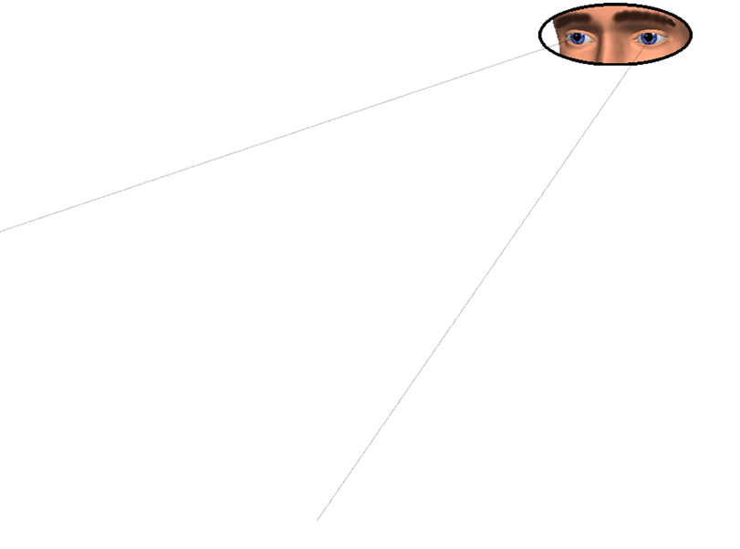
Evaluating
Preventing high risk situations
Open LOS and POT & proper lane position
Time and space control
Controlling high risk situations
Open line of sight (LOS) and path of travel (POT)
Motion control
Controlled/threshold braking
Progressive acceleration
Steering control
Hand to hand
Evasive action

Slide 32
Executing
in response to:
  risk or danger
  traffic conditions
  roadway conditions
  vehicle balance

Slide 33
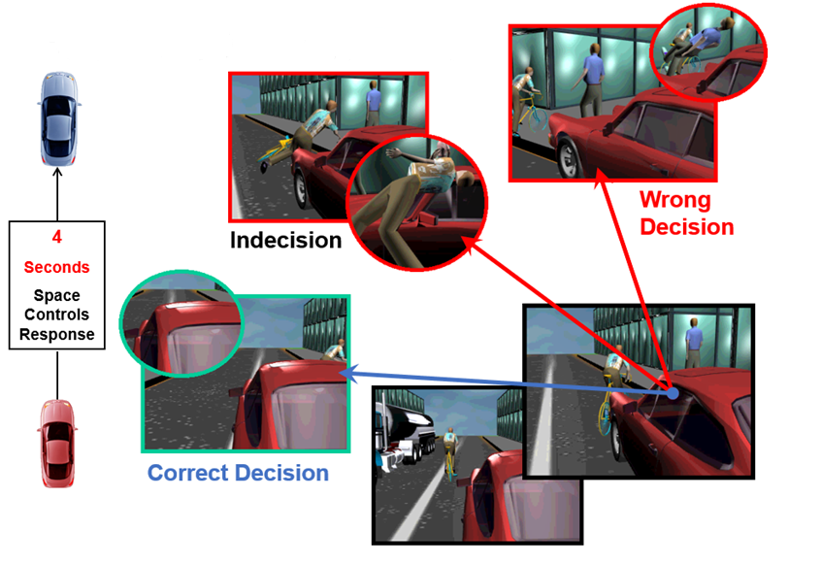
Decision Making – Evaluate/Execute

Slide 34
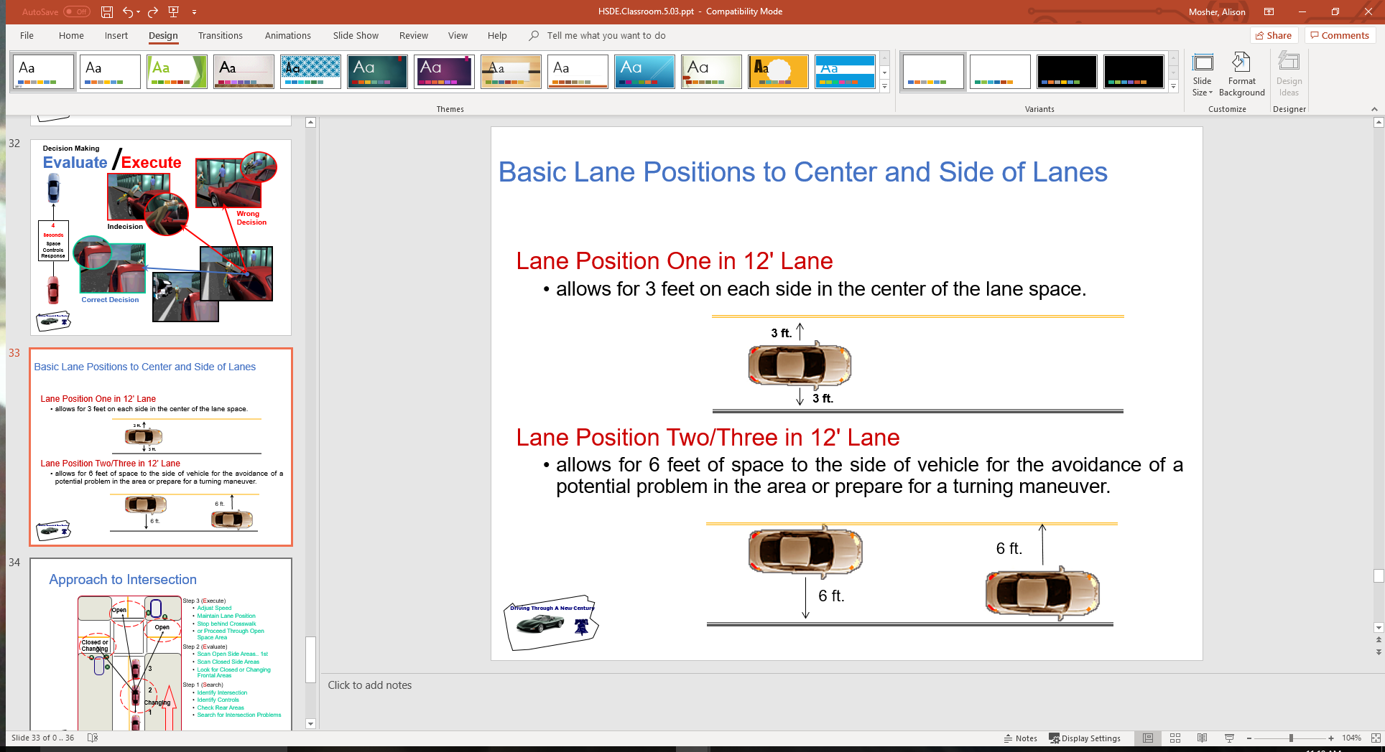
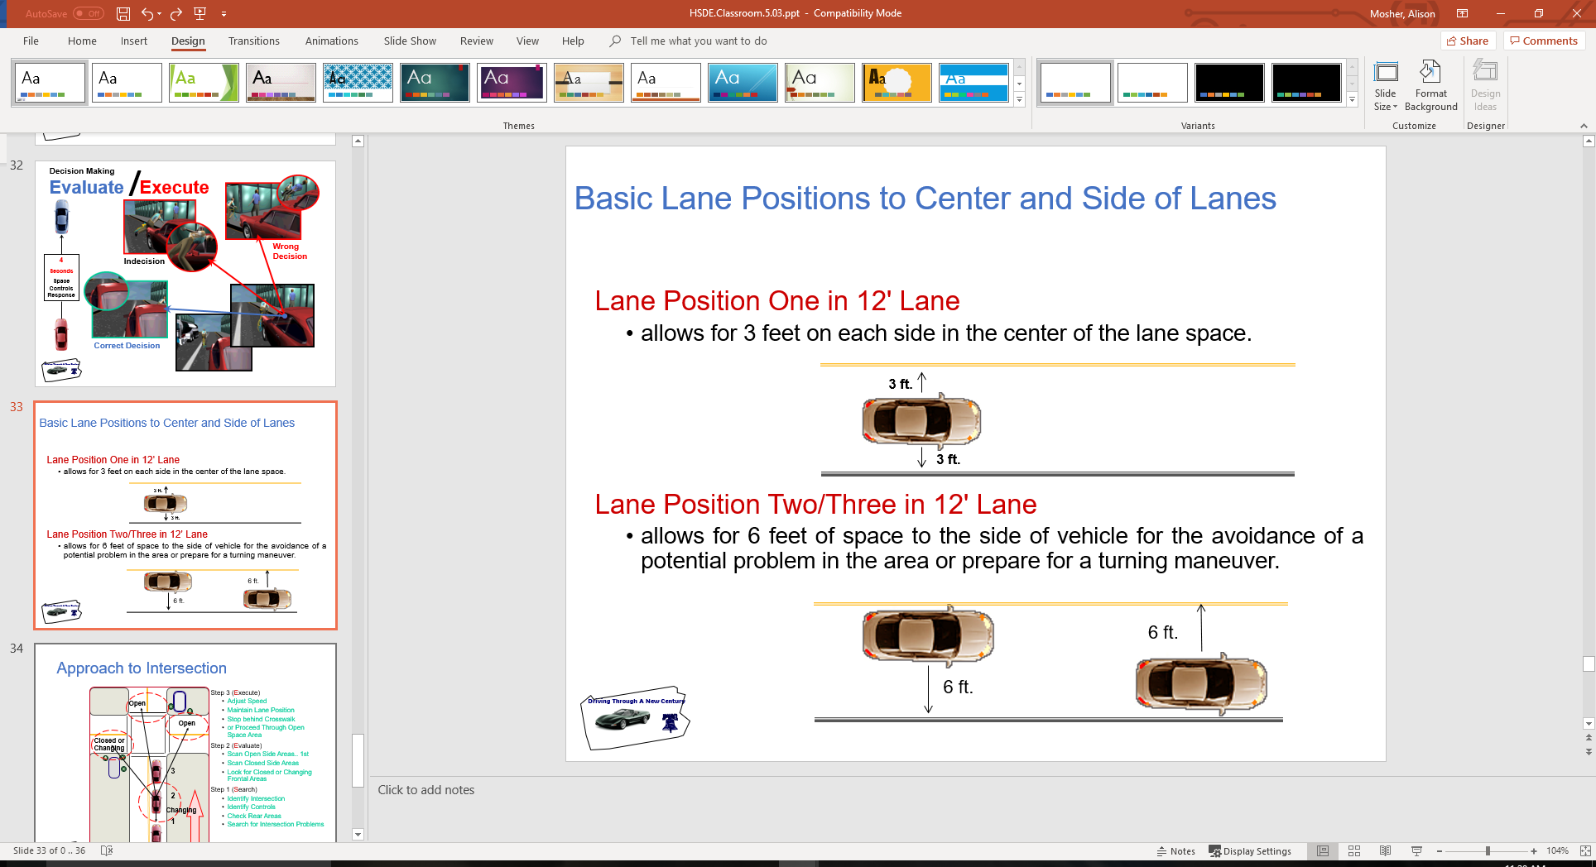
Basic Lane Positions to Center and Side of Lanes
Lane Position One in 12' Lane
  allows for 3 feet on each side in the center of the lane space.
Lane Position Two/Three in 12' Lane
  allows for 6 feet of space to the side of vehicle for the avoidance of a potential problem in the area or prepare for a turning maneuver.

Slide 35
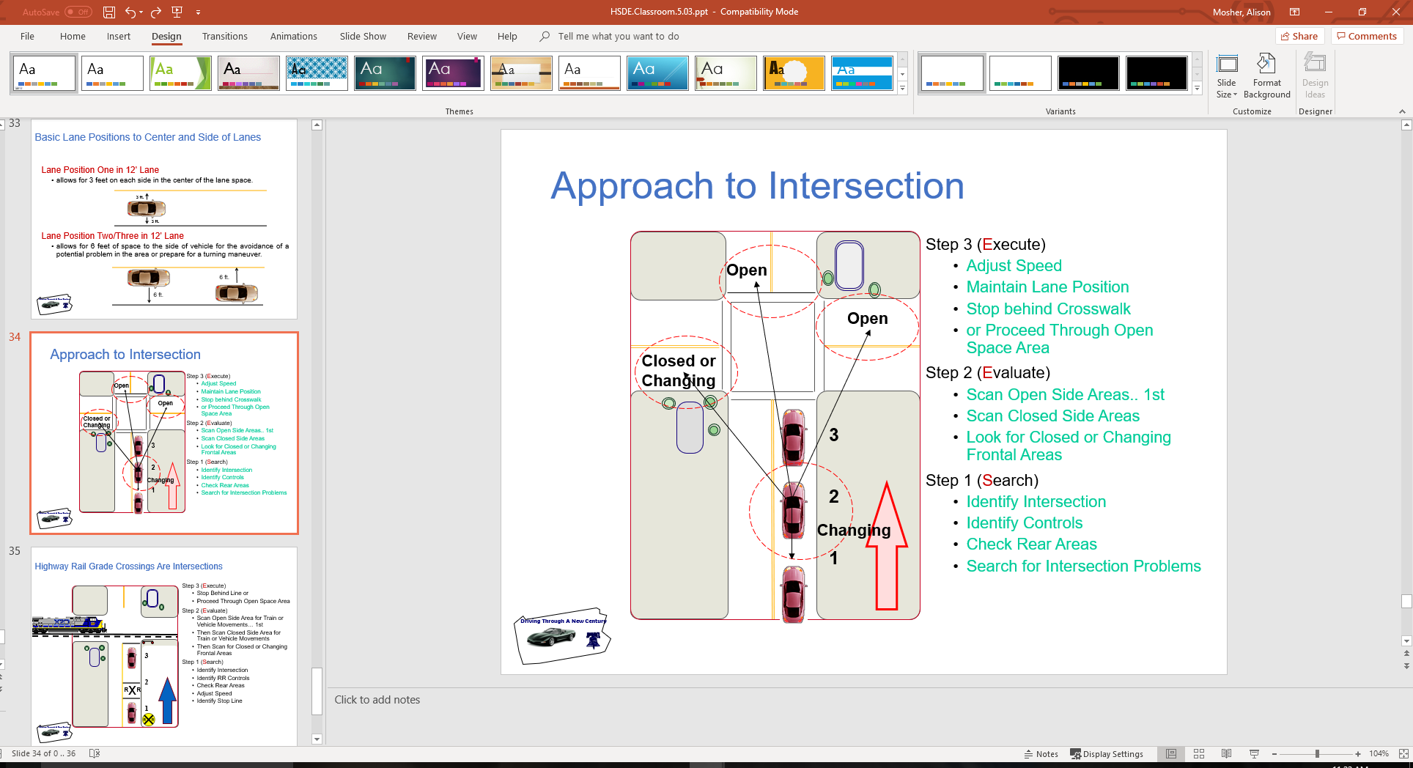
Approach to Intersection

Slide 36
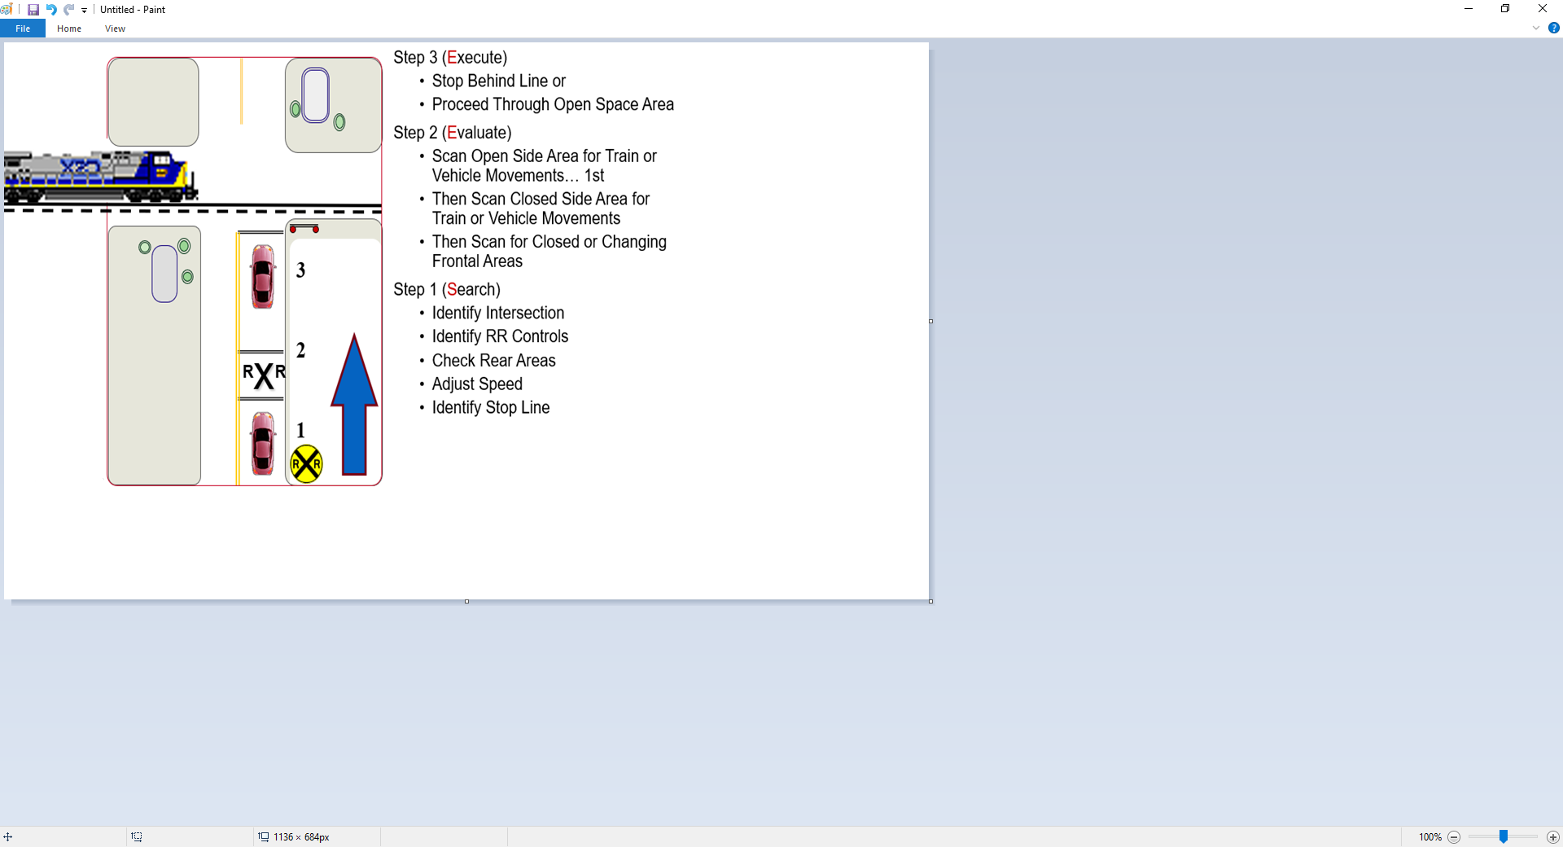
Highway Rail Grade Crossings Are Intersections

Slide 37
Assignment
Range Activity Group
  Auto Control Monster
  Take activity sheets to vehicle
Simulation Activity Group
  Sign in on attendance sheet
  Place grade on your sheet
  Note your simulator number

Slide 38
Contact/Mission
For more information on Driver’s Education and Safety please visit PDE’s website at www.education.pa.gov
The mission of the Department of Education is to ensure that every learner has access to a world-class education system that academically prepares children and adults to succeed as productive citizens. Further, the Department seeks to establish a culture that is committed to improving opportunities throughout the commonwealth by ensuring that technical support, resources, and optimal learning environments are available for all students, whether children or adults.

