Slide 1
PDE PIMS Administrator
Resources

Slide 2
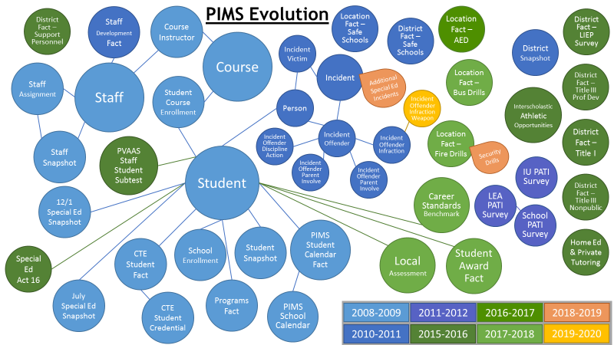
PIMS has Grown!

Slide 3
3 Questions!
How do I get Started?
What Resources are out there?
Where can I reach out for Help?

Slide 4
Question #1
How do I get Started?

Slide 5
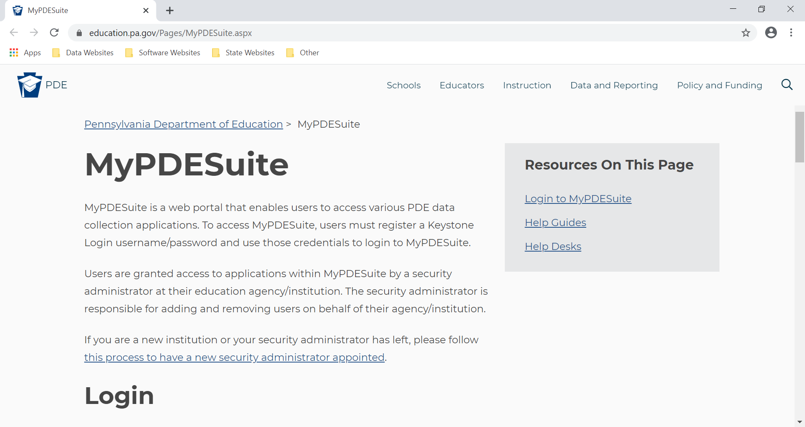
MyPDESuite
http://education.pa.gov > Data & Reporting > MyPDESuite

Slide 6
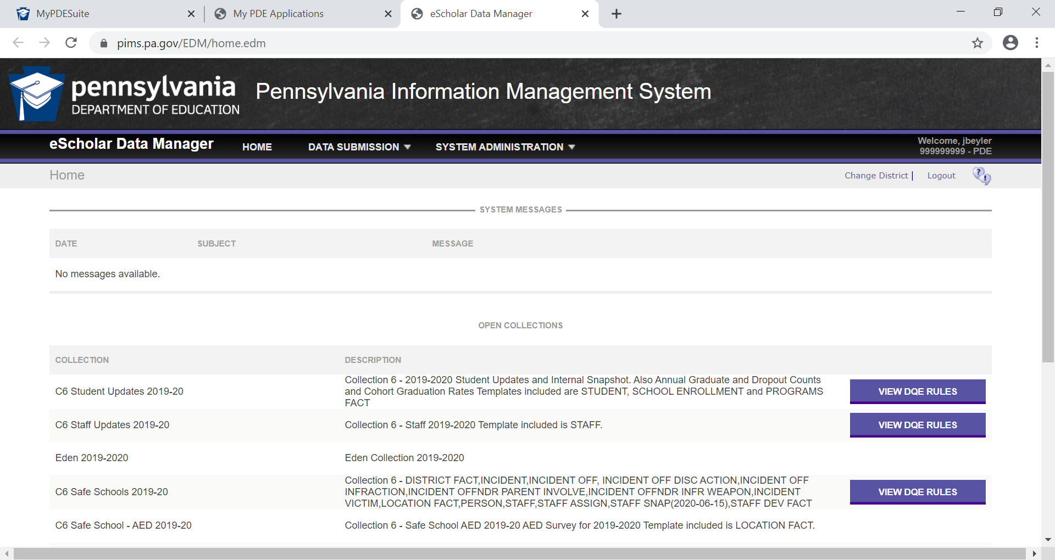
Learn the Application Basics – PIMS & Sandbox

Slide 7
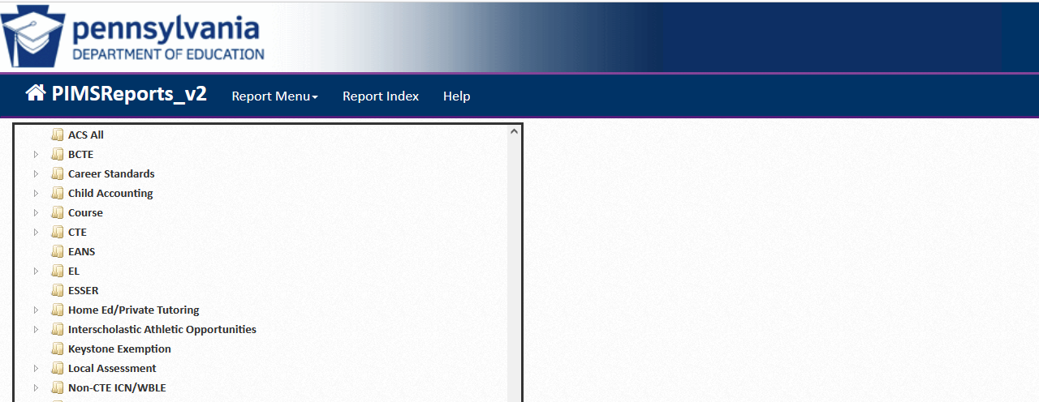
Learn the Application Basics – PIMS Reports V2
PIMS Reports V2_Part 1
PIMS Reports V2_Part 2

Slide 8
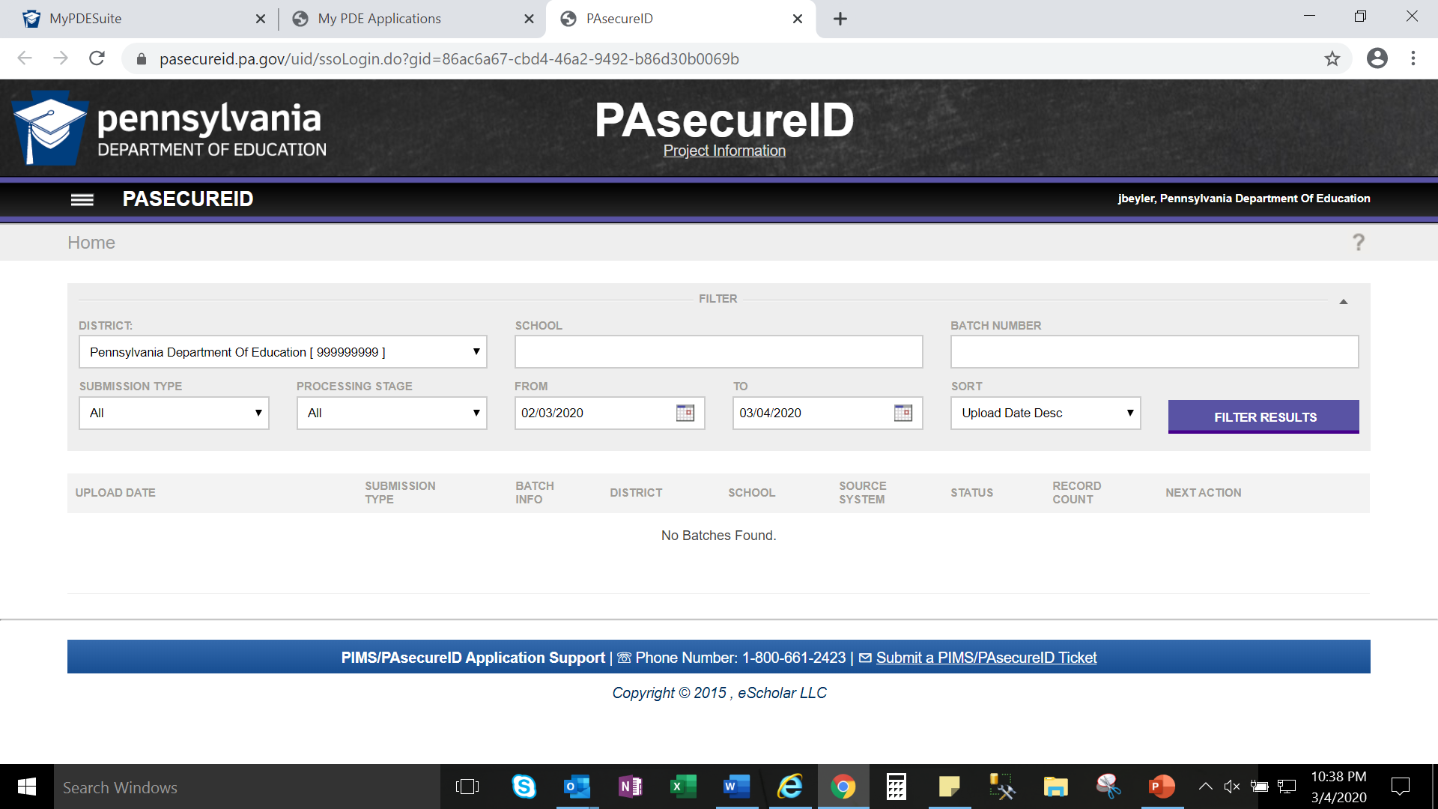
Learn the Applications Basics - PAsecureID
http://education.pa.gov > Data & Reporting > PIMS > PAsecureID and PPID > PA secure ID Email: ra-PAsecureID@pa.gov

Slide 9
Data Manipulation
Export Excel Files from SIS
Sorting & Filtering
Modifying & Saving CSV Files

Slide 10
It Takes a Team!
Administrators
Program Supervisors & Coordinators
Building Principals
Business Managers
HR Directors
Teachers
Support Staff
Data Staff

Slide 11
Your LEA Team!
Who on your team is responsible for these tasks?
Inputs, Maintains & Exports Data in Local System
Prepares & Uploads PIMS Files
Runs & Reviews PIMS Reports
Confirm Accuracy Certification Statements?
Provide IT Technical Assistance?
Other Roles?
Don’t forget your SIS Vendor resources!

Slide 12
ACTIVITY!
Write down each member of your team you know!
Point of Contact | Name
IT
SIS Vendor
Data Entry Staff
Program Area Coordinators (Special Education, Child Accounting, Assessment, English Learners, Homeless)
Building Principals
Chief School Administrator
Human Resources
Student Services / Registrar
IU / Data Quality Network
EdNA
PAsecureID

Slide 13
Question #2
What Resources are out there?

Slide 14
Data Quality Office
The Data Quality team manages data collections such as Career & Tech, Graduation Cohort, Staff and Student, Course and PVAAS.
Email for the Data Quality Office:
ra-DDQDataCollection@pa.gov

Slide 15
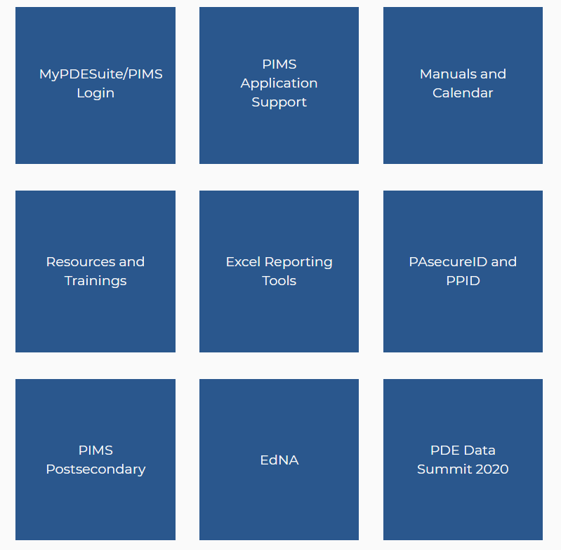
PDE PIMS Website!
http://education.pa.gov > Data & Reporting > PIMS

Slide 16
PDE PIMS Website
PIMS Manuals & Calendars
Collection Webinars & How-to Guides
PIMS Q&A Webinars!
  Always keep up-to-date!
Excel Reporting Tools

Slide 17
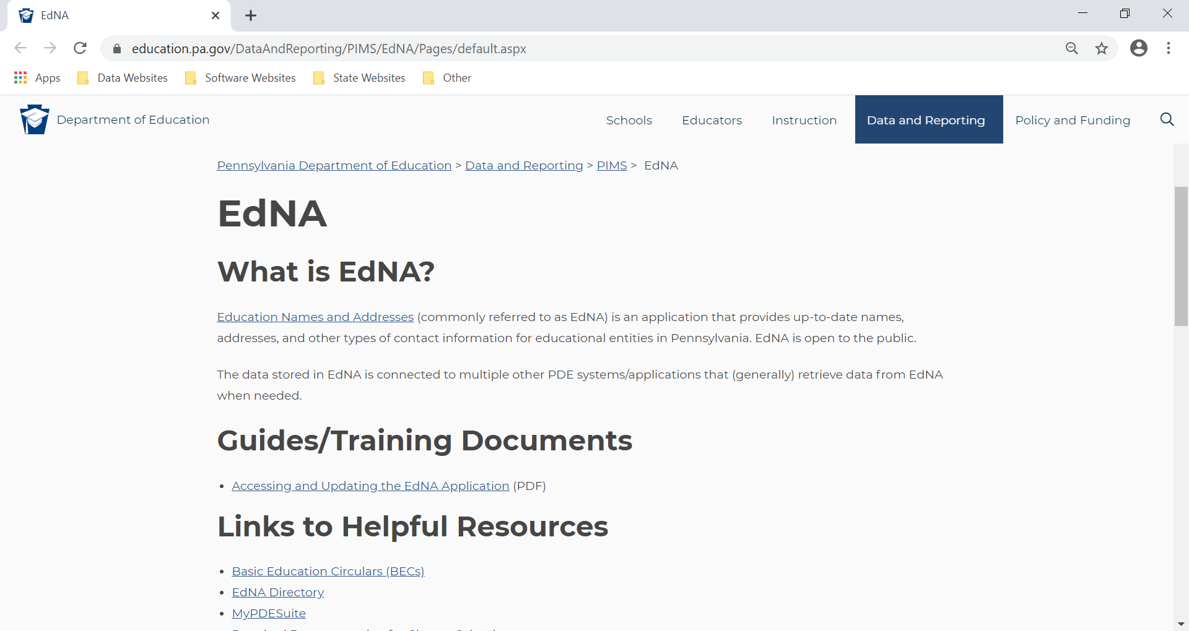
EdNA
http://www.education.pa.gov > Data and Reporting > PIMS > EdNA

Slide 18
Other PIMS Resources
PDE Webinars
http://www.youtube.com/user/PADeptofEd

Slide 19
Data Quality Curriculum (DQC)
Training for PIMS administrators:
The DQC is a tool for local education agencies (LEAs) to increase the quality of data submitted to PDE, thereby reducing costly data errors and staff time. Contact your IU DQN PoC for training opportunities in your area.
http://www.padqc.org/learn/
*Passing the Experienced PIMS Administrator Track and Delete Utility Specialty Module will give you access to the PIMS deletion utility.

Slide 20
Opportunities
The DQC tracks and modules provide LEA’s and Staff an opportunity to:
Build or enhance a culture of quality data
Reduce the negative effects of inaccurate or missing data (i.e. loss of funding, public perception, press/media)

Slide 21
Benefits
Who Benefits from the Tracks and Modules?
Tracks:
Principals
Building administrators
Superintendents
Those responsible for:
  building/district reports, data accountability, funding and information sharing among staff
Modules:
PIMS Administrators
those responsible for data accountability:
  CTE, Child Accounting, PVAAS, Educator Effectiveness, Student Enrollments, PASecureIDs, and At-Risk Students

Slide 22
Tracks
DQC Tracks
    Entry Level PIMS Administrator Track
    Experienced PIMS Administrator Track
    Data Entry Track
    LEA Administrator Track*
    Building Level Administrator Track*
    LEA Best Practices Track
    Special Education Track
Upon successful completion of the tracks, participants will be PDE certified, and will earn Act 45* or Act 48 credits.

Slide 23
Modules
DQC Specialty Modules
    Career and Technology Education
    Child Accounting
    Data Quality Engine
    Educator Effectiveness
    PAsecureID
    School Enrollment Template
    Delete Utility
    Internal Snapshot
Upon successful completion of the tracks, participants will be PDE certified, and will earn Act 48 credits.

Slide 24
Question #3
Where can I reach out for Help?

Slide 25
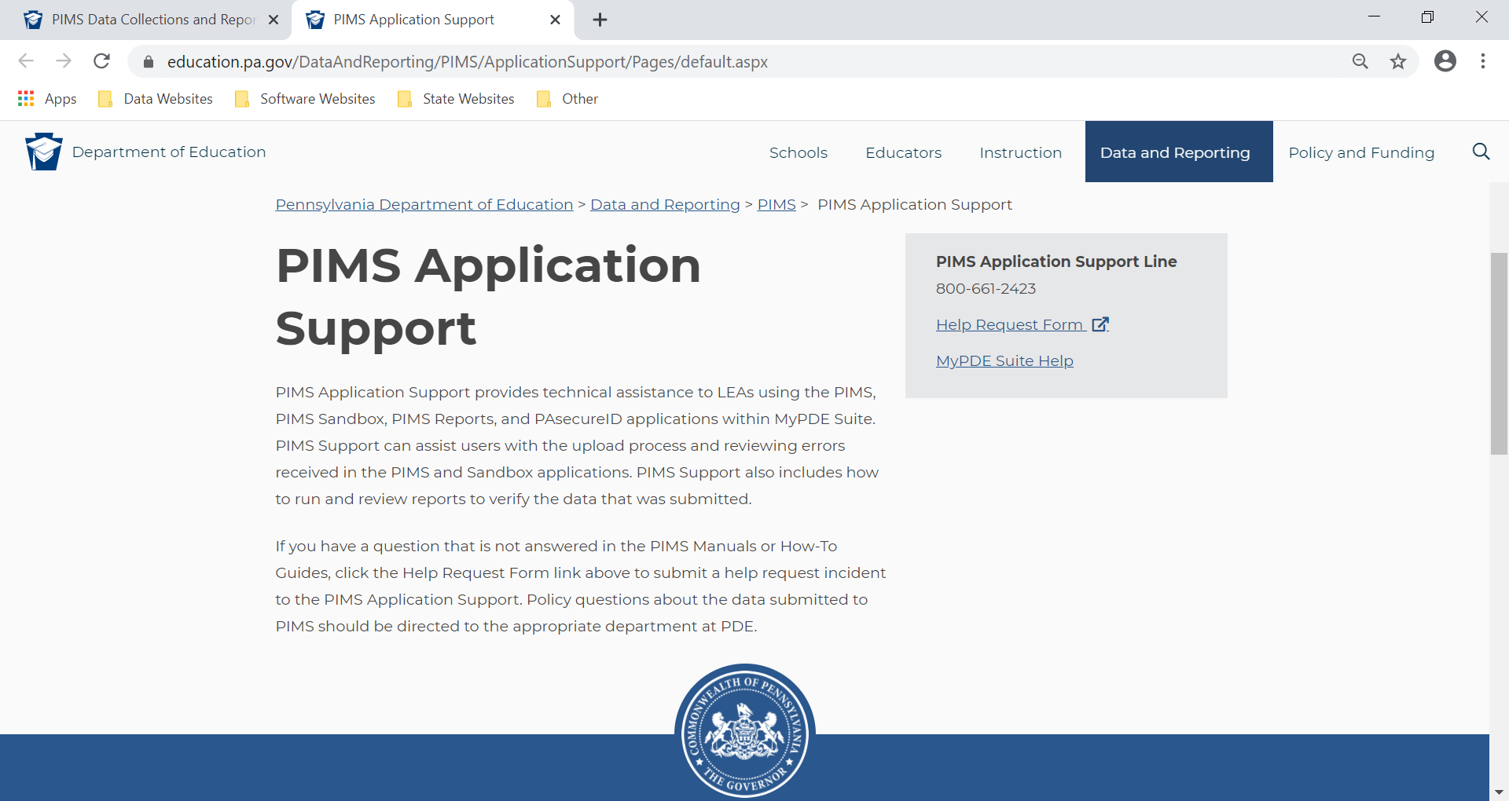
Applications Support
https://www.education.pa.gov > Data and Reporting > PIMS > PIMS Application Support

Slide 26
Data Quality Network
Monthly Meetings at your Local IU to receive and discuss current topics surrounding Data Governance, Quality, and its Use. Target audience includes LEA Administrators, PIMS Administrators and any other members of the Data Team!
Great Opportunity for Networking and Collaborating with your other LEAs!
www.dataqualitynetwork.net

Slide 27
Program Office Communications & Updates
ARP ESSER ra-edarpesser@pa.gov
Assessment ra-pas@pa.gov
Career & Technical Education ra-CATSDATA@pa.gov
Certification/Staffing ra-edcertstaff@pa.gov
Charter Schools ra-charterschools@pa.gov
Child Accounting ra-cad@pa.gov
Data Collection Team ra-EDDDQNoReply@pa.gov
ra-ddqdatacollection@pa.gov
EdNA ra-edna-admin@pa.gov
EL (formally LEP) ra-edeld@pa.gov
Every Student Succeeds Act ra-edessa@pa.gov
FRCPP ra-edfrcpp@pa.gov
Future Ready PA Index ra-edfuturereadypa@pa.gov
Home Education ra-home-education@pa.gov
Interscholastic Athletic Opportunity ra-athleticoppreport@pa.gov
Safe Schools Reporting ra-EDSafeSchoolsRep@pa.gov
School Services (Ward of State) ra-PDE-SchoolService@pa.gov
School Grade Configurations ra-School-Configs@pa.gov
Special Education ra-pdespecialed@pa.gov
Special Education – Act 16 ra-edseact16@pa.gov

Slide 28
Child Accounting
The Division of Subsidy Data and Administration collects attendance and membership data from Pennsylvania’s 500 school districts and other educational entities. The membership data is used in the calculation of state subsidies, including Basic Education Funding, Special Education Funding, Secondary Career and Technical Education Subsidy, and Tuition for Orphan’s Subsidy. Membership data is also used in the calculation of each school district’s tuition rate.
http://education.pa.gov > Teachers & Administrators > Learn More About Teachers & Administrators > Child Accounting
Email: ra-cad@pa.gov
Basic Education Circulars (BECS)
https://www.education.pa.gov/Policy-Funding/BECS/Pages/default.aspx

Slide 29
Safe Schools
Office for Safe Schools coordinates school safety and security programs, collection of the annual school violence statistics, coordination of antiviolence efforts, and development of policies and strategies to combat school violence. The office supports and provides technical assistance and professional development programs in the following areas and security-related activities to support school safety: crisis intervention, school police training, violence prevention, and social/emotional wellness and safety provides services to all local school entities.
https://www.education.pa.gov/Schools/safeschools/Pages/default.aspx
Email: ra-EDSafeSchoolsRep@pa.gov

Slide 30
English Learners
The goal of language instruction educational programs (LIEPs) is to facilitate the development and attainment of English proficiency and academic achievement of students whose native or first language is not English. Without instruction in social and academic English and appropriate support for learning academic content, these students are at risk of losing the educational opportunities provided to non-EL students.
http://education.pa.gov > Teachers & Administrators > Learn More about Teachers & Administrators > Curriculum > English as a Second Language
Email: ra-edeld@pa.gov

Slide 31
Assessment
The Pennsylvania state assessment system is composed of assessments and the reporting associated with the results of those assessments. The assessment system includes the Pennsylvania System of School Assessment (PSSA), the Pennsylvania Alternate System of Assessment (PASA), the Pennsylvania Accountability System (PAS), the Pennsylvania Value-Added Assessment System (PVAAS), the Keystone Exams (end-of-course), Classroom Diagnostic Tools (CDT) and the National Assessment of Educational Progress (NAEP).
http://education.pa.gov > K-12 > Assessment & Accountability
http://www.education.pa.gov/pas
Email: ra-pas@pa.gov

Slide 32
PVAAS
PVAAS is one of the tools in the cadre of tools provided each fall to local education agencies (LEAs)/districts and schools from the Pennsylvania Department of Education.
LEAs/districts, schools, and teachers are using PVAAS (growth and projection data), in conjunction with achievement data, to make sure students are on a path to proficiency and beyond. Utilizing all the data available (growth and achievement), educators are able to make data-informed instructional decisions to ensure the academic growth and achievement of all students.
https://www.education.pa.gov/K-12/Assessment%20and%20Accountability/PVAAS/Pages/default.aspx

Slide 33
Special Education
The Bureau of Special Education works collaboratively with educators, schools, agencies, and other stakeholders across Pennsylvania to ensure students have access to quality and meaningful education supports, services, and opportunities.
http://education.pa.gov > K-12 > Special Education
Special Education Penn Data Reporting
http://penndata.hbg.psu.edu
Special Education Forms
https://www.pattan.net/forms/
Email
ra-pdespecialed@pa.gov

Slide 34
Athletic Opportunity
Effective July 1, 2012, the Pennsylvania General Assembly passed Act 82 of 2012, which requires schools to disclose Interscholastic Athletic Opportunities Disclosure Form athletic opportunities for students in grades 7-12.
http://education.pa.gov > Teachers & Administrators > Learn More About Teachers & Administrators > Interscholastic Athletic Opportunity
Email: ra-athleticoppreport@pa.gov

Slide 35
Thank You!
For more information on PIMS, please visit PDE’s website at www.education.pa.gov
The mission of the Department of Education is to ensure that every learner has access to a world-class education system that academically prepares children and adults to succeed as productive citizens. Further, the Department seeks to establish a culture that is committed to improving opportunities throughout the commonwealth by ensuring that technical support, resources, and optimal learning environments are available for all students, whether children or adults.

