Slide 1
Guidelines for Selection and Use of Accommodations on State Assessments
PSSA and Keystone Exams
2023-24
Notes:
Welcome to the training on guidelines for selection and use of accommodations on state assessments.

Slide 2
Overview
Understanding the Accommodations Guidelines for PSSA/Keystone Exams
Updates for 2024
Unique Accommodations Assurance Process
Frequently Used Accommodations
Online Testing and Accommodations
Supplemental Resources for PSSA/Keystone Accommodation Selection
PASA DLM Accommodation Resources
Notes:
The topics covered today will include an overview of the accommodations guidelines manual. Updates made to the guidelines for 2024 will be highlighted in this training. We will review the unique accommodations assurance process and updates to the form, as well as frequently used accommodations. Information on online testing and accommodations will be provided. We will also review the supplemental resources available in the accommodations guidelines for the PSSA and Keystone Exams. Lastly, we will provide some basic information on the state alternate assessment (PASA DLM) accommodation resources. This training will not cover PASA information in depth, as PASA Acs may find additional information specific to the PASA on the BSE and PaTTAN web pages.

Slide 3
Accommodation Considerations
Effective decision making about the provision of appropriate accommodations begins with making good instructional decisions.
Every IEP team member and student instructional team member must be knowledgeable about the state and district academic content standards and assessments.
Accommodations should always be chosen based on individual student need and what works for the student during typical instruction and assessment.
More is not always better.
Notes:
Effective decision making about providing students with appropriate accommodations really starts with instruction and making good instructional decisions. Every IEP team member and student instructional team member must be knowledgeable about state and district academic content standards and assessments.
Accommodations should always be chosen based upon the student’s individual needs and what works for the student during typical instruction and assessment. Remember, more is not always better. It’s really about choosing the right accommodations.

Slide 4
Test Features vs. Accommodations
All state assessments are universally designed.
Teams must understand what accessibility features are built-in to the test and what may be needed as an accommodation.
If the IEP/504 team determines an accommodation is needed for the student to participate, it must be documented, typically in the student’s IEP or 504 Plan.
Notes:
Teams should understand the difference between test features and accommodations. All state tests are universally designed which means there will be some accessibility features embedded in the test. Student teams need to understand what accessibility features are built-in and what may be needed as an accommodation.
If the IEP or 504 team determines an accommodation is needed for the student to participate, it must be documented in the student’s IEP or 504 Plan.

Slide 5
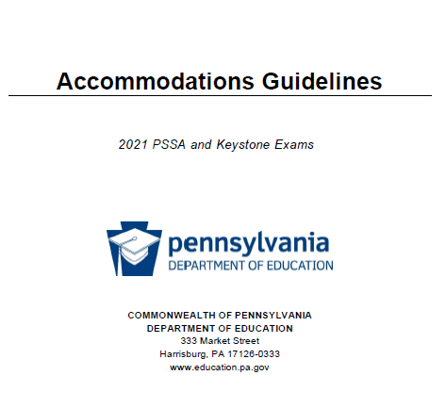
Accommodations Guidelines Guidelines Manual
Schools must use the Accommodations
Guidelines for full information and details
on allowable accommodation options
for the PSSA/Keystone Exams
2024 Accommodations Guidelines
Notes:
We will focus on the Accommodations Guidelines manual, which is available on the PDE website. Schools must use the accommodations guidelines for full information and details on allowable accommodations for the PSSA and Keystone exams. As mentioned, The guidelines have recently been updated. The 2024 updated manual can be accessed at the link on this slide.

Slide 6
2024 Accommodations Guidelines What’s New?
New/Updated Content | Page
Updated Tables: Tables were consolidated for easier reading | pg. 18
Glucose/Medical Monitoring: A unique accommodations form is now required for students who use smart devices for medical monitoring during testing. | pg. 33
Read Aloud for Full ELA PSSA/Literature Keystone for Visual Impairment ONLY: A full read aloud of the ELA PSSA and Literature Keystone may be used for students who are visually impaired or blind and unable or not yet able to read Braille. A unique accommodations form is required. | pg. 45
Updates to Unique Accommodations Assurance Process: See minor changes to streamline the process. | pg. 57
Notes:
There are a few changes to the accommodations guidelines for 2024. This table gives an overview of changes made to the accommodations guidelines for 2024. This table can be found before the Table of Contents in the guidelines. We will provide more detail about each of these changes throughout the presentation.

Slide 7
Accommodation Tables
Table A
Table B
A quick guide to allowable accommodations, who can use them, and in which format
Details of the accommodation and directions for use
Notes:
The accommodations tables have been consolidated into two tables: Table A and Table B. Table A is meant to act as a quick guide to all accommodations, and Table B goes into detail about each accommodation use. Each accommodation in Table A links to Table B.

Slide 8
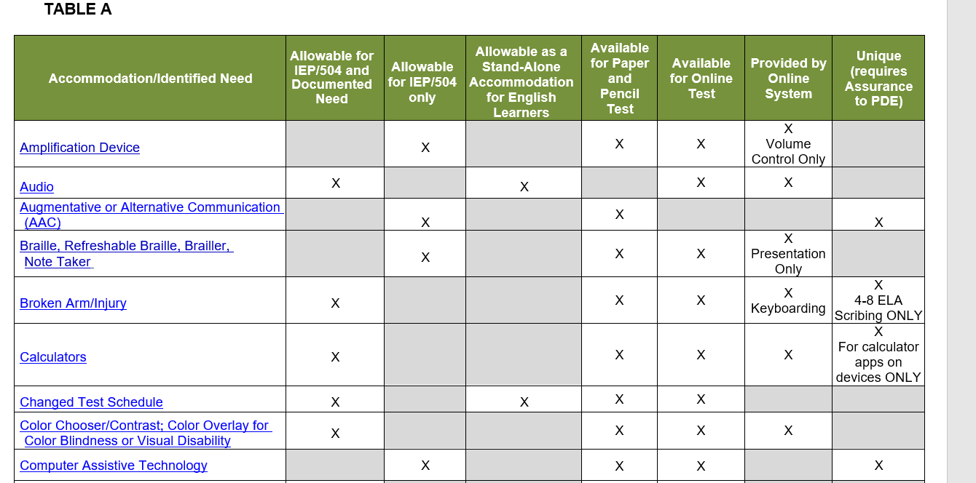
Table A
Notes:
Here is a screenshot of the new Table A in the accommodations manual. As you can see, the allowable accommodations are listed in alphabetical order. The table also outlines if the particular accommodation is only allowable for a student with an IEP or 504 Plan. The third column notes if the accommodation can be a stand-alone accommodation for English learners.
The chart also specifies if the accommodation is available for paper and pencil and/or the online version of the test. Many of the accommodations available for the online version are provided by the online test engine as outlined in the second to last column.
The last column identifies if and when the accommodation requires an electronic assurance to be submitted to PDE.

Slide 9
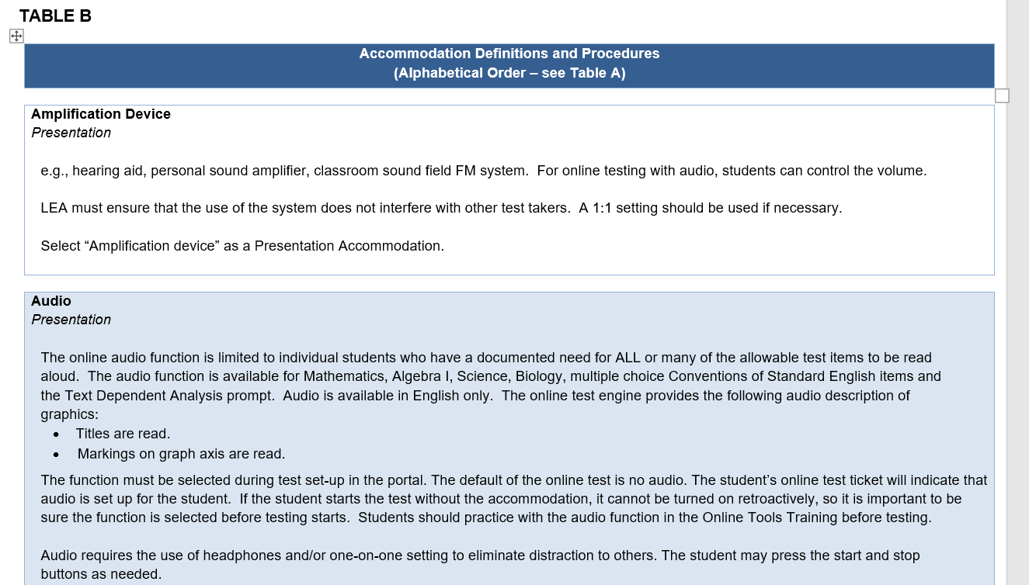
Table B
Notes:
This slide provides a screenshot from Table B. As you can see, each allowable accommodation is listed in alphabetical order and can also be accessed by the direct link provided in table A. This table provides definitions of each accommodation and procedures for use, including how to document the accommodation, if necessary.

Slide 10
New for 2024: Medical Device requires a Unique Accommodation submission to PDE
Some medical devices, such as blood glucose monitors and medical alert devices, are synchronized and/or accessed through a smartphone that is always in the student’s possession for medical reasons.
SAC must be notified of student’s need.
The student’s phone or device may remain on the student’s desk on silent mode, in plain view of the TA.
TA must ensure the student does not access the device for any other reason. The TA should work with the student to ensure all other notifications are off so as not to distract the student or other test takers.
Medical Plan and/or documentation regarding this accommodation is retained by the school.
Requires an assurance submission to PDE. See Unique Accommodation Assurance
Select “Smartphone or smartwatch for medical/glucose monitoring” as a Setting Accommodation.
Notes:
As in years past, students may retain their cell phones when they are being used to monitor glucose or as other medical alert devices. The SAC must be notified of the student’s need. The student may keep their cell phone on their desk. The student must be seated in plain view of the TA, who must monitor the student closely to be sure they do not access their phone unless medically necessary. The TA should work with the student to ensure all other notifications are off so as not to distract the student or other test takers in the room. The school should retain the documentation or medical plan regarding this accommodation. New for 2024, a unique accommodation assurance should be submitted, and the use of the smartphone should be documented in the test booklet or online dashboard.

Slide 11
New for 2024: Full ELA Read Aloud for Visual Impairment ONLY
The purpose of this accommodation is to provide access to students who have blindness or a visual impairment and have not yet learned (or are unable to use) braille.
This accommodation requires documentation in a 504 or IEP plan.
This accommodation must be administered by a human reader in a one-to-one setting. There is no Audio available for the online ELA PSSA or Literature Keystone.
Readers may not clarify, elaborate, paraphrase, assist, or cue a student through uneven voice inflection. All test readers must follow the Read Aloud and Scribing Guidelines for Operational Assessments
Read aloud for all ELA items for Visually Impaired Students requires an assurance submission to PDE. See Unique Accommodation Assurance
Select “All test items read aloud” on the ELA or Literature exam as a Presentation Accommodation.
Notes:
Also new for 2024: A Read Aloud of the full ELA test is intended for a very limited population of students who have blindness or visual impairment and have not yet learned or are unable to use braille. This accommodation requires documentation in a 504 or IEP. There is no audio available for the online ELA PSSA or Literature Keystone – This accommodation must be provided by a human reader in a 1:1 test setting. Readers must follow the Read Aloud and Scribing Guidelines for Operational Assessments and be sure not to clarify, elaborate, paraphrase, assist, or cue a student through uneven voice inflection. This accommodation requires documentation in the test booklet or online dashboard, and it requires a unique accommodations assurance form.
Note that students with a documented need may have the Math or Science PSSA, Biology Keystone, Algebra Keystone, and the Conventions and TDA portions of the ELA PSSA read aloud WITHOUT submitting a Unique Accommodations Assurance Form. The form is only needed for a Full Read Aloud of the ELA PSSA or Keystone Literature Exams for Visual Impairment. More information about read-alouds can be found in the accommodations guidelines.

Slide 12
Unique Accommodations
Notes:
This section will review unique accommodations and the procedure for submitting a unique accommodation assurance to PDE

Slide 13
Unique Accommodations
What is a unique accommodation?
Allowable only for a student who would not otherwise be able to access the test material
Intended for students with an IEP/504 Plan or in the formal evaluation process
In order to implement a unique accommodation, the school must follow specific procedures to ensure test security is maintained and the construct of what the test is measuring is not altered or modified
Examples: voice to text, AAC, use of a separate device
Notes:
The use of unique accommodations were mentioned with table A. We sometimes get the question what is considered a unique accommodation. As inferenced in the name, these would be accommodations that are typically used for students who are not otherwise able to access the test material in the traditional way. They are intended for students with an IEP or 504 plan or those who may be in the formal evaluation process.
In order to implement a unique accommodation, the school must follow specific procedures to ensure test security is maintained and the construct of what the test is measuring is not altered or modified.
An example might be use of voice to text or speech to text, use of an assistive communication device or the need for scribing on TDA responses.
Unique Accommodations are easily identified by looking at the last column of Table A.

Slide 14
Unique Accommodation Assurance
Where do I access the form/process?
The 2024 Keystone/PSSA Unique Accommodation Assurance
2024 Unique Accommodation Assurance
How do I submit to PDE?
The form contains a link to submit the information electronically to PDE. The information required in the electronic submission is exactly what is on the form. The electronic submission serves as the official submission to PDE. You will have the option to print/save the electronic submission instead of completing the PDF form.
When must the assurance be submitted to PDE?
At least 6 weeks prior to the opening of the test window
Exceptions can be made for scribing requests due to recent student injury
Notes:
The Keystone/PSSA Accommodation Assurance form can be accessed on the PDE website under Accommodations. The direct link to the form is provided on this slide. It can also be found in the accommodations guidelines.
The form contains a link to submit the information electronically to PDE through a survey monkey submission. The information required in the electronic submission is exactly what is on the form. Your official submission to PDE is through entering the information in the survey link. New this year, you can either keep the electronic submission or complete the PDF form for your records.
We expect the assurances to be submitted at least 6 weeks prior to the opening of the testing window. (This was previously 8 weeks). Exceptions to the timeline are made for scribing requests due to recent student injury.

Slide 15
Unique Accommodation Assurance
How do I know if the form is approved?
PDE does not ‘approve’ IEP accommodations. Rather, it is the role of PDE/BSE to ensure that accommodations are carried out in a manner that maintains test security and test construct. Information submitted in the assurance is subject to further PDE/BSE review.
What documentation must be kept by the school?
The completed and signed Unique Accommodation Assurance form
The Unique Accommodation Confidentiality Agreement (located right after the assurance form in the Accommodations Guidelines manual) completed by the school administrator and TA.
Any other relevant confidentiality agreements (e.g., sign language interpreter agreement)
Copy of the student’s current IEP/504 Plan with the unique accommodation included
Notes:
This process is an assurance rather than an approval. The role of PDE is not to approve or disapprove accommodations that are deemed appropriate by the student’s IEP or 504 team. Rather, PDE and BSE ensure that accommodations are carried out in a manner that maintains test security and test construct. Information submitted in the assurance is subject to further review by PDE and or BSE.
The school should complete the form located on the PDE website and obtain all necessary signatures. The assurance form with signatures must be kept on file at the school along with any relevant signed confidentiality agreements, as well as a copy of the student’s current IEP or 504 plan with the unique accommodation documented. You do not need to submit signatures or the student’s IEP/504 Plan to PDE as with the previous process. You will have the option to save the submitted survey monkey form as documentation of your Unique Accommodation Assurance.

Slide 16
Unique Accommodation Assurance
To determine if an accommodation is a unique accommodation, see the last column of Table A. To use any unique accommodation, an LEA must submit the PSSA/KEYSTONE EXAM UNIQUE ACCOMMODATION ASSURANCE to PDE no less than 6 weeks in advance of the testing window.
Complete the Unique Accommodation Assurance form.
Submit the responses to PDE via the link provided within the form. Note: the electronic submission via this link serves as the official submission to PDE. New for 2024: after submission, the submitter will have the opportunity to print the Survey Monkey response, eliminating the need to complete the form twice.
PDE will not provide a response unless there are questions on the contents of the electronic submission. If more information is needed about the use of the proposed unique accommodation, a PDE/BSE representative will contact the individual listed as the contact on the submission.
Schools MUST keep a copy of the completed assurance form and required signatures on file at the LEA.
Before testing, the school administrator and test administrator should read and sign the Unique Accommodation Confidentiality Agreement for each student receiving a unique accommodation. These should be kept with the completed Unique Accommodation Assurance Form.
Notes:
This slide shows the directions for the Unique Accommodations Assurance as they appear in the Accommodations Guidelines.

Slide 17
Frequently Used Accommodations
Notes:
The next portion of this training will include details about frequently used accommodations. This is not an exhaustive list, so please refer to the accommodations guidelines for a complete list of accommodations.

Slide 18
Read Aloud
Test Feature
Accommodation
(not a pre-planned small group accommodation)
student must request (test taker’s initiative)
intended to ensure that the measurement of non-reading content is not influenced by a student’s inability to decode words
In other words, the student knows how to do the math, but cannot decode the word “perpendicular”
permissible to read aloud a word, phrase, sentence or test item(s) for the Mathematics, Algebra I, Science, and Biology tests; multiple choice Conventions of Standard English items, and the TDA prompt (as requested)
student is evaluated and accommodation is documented
Read Aloud and Scribing Guidelines manual provides detailed guidance
readers may not clarify, elaborate, paraphrase, assist, or cue a student through uneven voice inflection
May include reading of ‘All Allowable’ parts by a human reader or the audio feature enabled in the online test.
Notes:
The first accommodation we will review is the read aloud accommodation. Read aloud can be used as a test feature or an accommodation. When used as a basic test feature, it is not a pre-planned small group accommodation. The student may ask the teacher to read aloud a word or phrase during the test. It’s intended to ensure the measurement of non-reading content is not influenced by a student’s inability to decode a word. For example the student may know how to do the math, but cannot decode the word ‘perpendicular’. It is permissible to read aloud a word, phrase, sentence or test item for the Math, Algebra 1, Science, and Biology tests, as well as multiple choice conventions of standard English items, and the TDA prompt as requested by the student.
Read aloud becomes an accommodation when the student has a documented need. The read aloud and scribing guidelines manual provides detailed guidance. Of note, readers may not clarify, elaborate, paraphrase, assist, or cue a student through their voice inflection.
A read aloud accommodation may include reading of all allowable parts by a human reader or the audio feature enabled in the online test.

Slide 19
Read Aloud Considerations
Test directions only
Some allowable items at student request (may need a small group)
All allowable items- no more than 5 in a group if using a human reader. Consider enabling the audio function of the online test and allow the student to use headphones to avoid the need for small grouping
Read aloud of full ELA test- for visually impaired students who are not yet proficient in Braille ONLY. This requires testing in a one-on-one setting and a unique accommodation assurance submission.
Notes:
Let’s review the various types of read aloud and some considerations the team should make for each:
Test directions only: All students will have the test directions read aloud. Any student may ask for the directions to be repeated.
Some Allowable Items at Student Request: All students may ask for a word, phrase, or question to be read aloud on the math and science PSSAs, biology and algebra Keystones, and on the TDA or Conventions of Standard English sections of the ELA PSSA. If a student is anticipated to use this accommodation frequently, it may be helpful to place the student in a small group.
All Allowable items: A student with documented need may have the entire math and science PSSAs, biology and algebra Keystones, and the TDA or Conventions of Standard English sections of the ELA PSSA read aloud. There should be no more than 5 students in a group if using a human reader. In this case, test booklets need to be despiraled. Students testing online may use headphones for audio and may not need to test in a small group.
Read Aloud for Full ELA Test – this accommodation is available for students who are visually impaired and not yet proficient in Braille ONLY. 1:1 testing and a unique accommodation assurance form are required.
Read Aloud for the Full ELA Test for Visual Impairment is the only read-aloud accommodation that requires a Unique Accommodations Assurance Form.

Slide 20
Read Aloud
Allowable
Keystone Algebra and Biology, PSSA Mathematics and Science
MC conventions questions (on individual basis) found in Sections 1 & 3 of the PSSA ELA
TDA prompt found at the end of Section 2 & Section 3 of the PSSA ELA for grades 4–8
NOT Allowable
Keystone Literature
PSSA ELA reading passage, MC, EBSR or short answer question(s)
Exceptions for students with visual impairment who are not yet able to read braille – see the accommodations guidelines and slides above.
Notes:
This slide indicates the subject areas and grades for which read aloud is allowable and not allowable. This information is also contained in the read aloud and scribing guidelines.
Remember, exceptions for Keystone Literature and PSSA ELA Reading passages will be made for students with visual impairment who are not yet able to read braille ONLY. See the accommodations guidelines or the slides above for more information.

Slide 21
Scribing Accommodation
Must follow Read Aloud and Scribing Guidelines for Operational Assessments
Allowable for students with a physical disability that severely limits motor process of writing, typing, or recording responses, including pain and/or fracture
Allowable for students who have a documented disability in written expression which results in significant interference in their ability to express their knowledge in writing/keyboarding, even after varied and repeated attempts to teach the student to do so
Student uses scribing on day-to-day basis for instruction & assessment
IEP team, Section 504 Services Plan team, or educational team determines that scribing (dictation) is essential for student access to test
The online test version is recommended to allow students as much independence as possible.
Notes:
Another accommodation students use is scribing. Schools must follow the read aloud and scribing guidelines when using a scribing accommodation of any kind. Scribing is allowable for students with physical disability or injury that severely limits the motor process of writing, typing, or recording responses.
Scribing is also allowable for students who have a documented disability in written expression which interferes with their ability to write or key responses. In these cases, if the student is using scribing on the state assessment, they must also use scribing on a day to day basis for instruction and assessment. The IEP, 504 or educational team determine that scribing or dictation is essential for student access to the test.
The online test version is recommended as this allows students the greatest level of independence. Individual students can take the online test, even if the rest of the school population is testing paper/pencil.

Slide 22
Scribing as a Unique Accommodation
When to submit Unique Accommodation Assurance to PDE
Only submit a Unique Accommodation Assurance for:
grades 4-8 PSSA ELA TDA response(s)
Do not submit Unique Accommodation Assurance for:
Keystone Literature, Algebra, and Biology
PSSA Mathematics and Science
grade 3 PSSA ELA multiple choice and short answer(s)
For any usage of scribing, the appropriate bubble or online checkbox must be marked to indicate the student received a scribing accommodation.
Notes:
Not all scribing accommodations are considered a unique accommodation that requires an assurance submission to PDE. You only need to submit the unique accommodation assurance for grades 4-8 ELA TDA responses.
It is not necessary to submit a unique accommodation assurance for Keystone Literature, Algebra and Biology, PSSA Math and Science, or the grade 3 PSSA ELA. As a reminder, TDA scribing is now included in the new unique accommodation assurance submission. Historically, this was a separate form from the unique accommodation assurance form.
With any scribing accommodation (unique or not) , the appropriate bubble or online checkbox must be marked to indicate the student receives a scribing accommodation.

Slide 23
Read Aloud and Scribing Guidelines
Test administrators reading aloud any allowable part of the test or scribing any open-ended part of the test must following the Read Aloud and Scribing Guidelines for Operational Assessments
Notes:
Test administrators reading aloud any allowable part of the test or scribing any open-ended part of the test must follow the Read Aloud and Scribing Guidelines for Operational Assessments

Slide 24
Voice-to-text Accommodation
Requires submission of unique accommodation assurance
Request only when student is not able to complete the assessment by any other means
Ensure that the necessary technology parameters can be met by the LEA
Use a school-issued or school-approved device during testing
Follow PDE’s transcribing guidelines in the Accommodations Guidelines manual
Lock down the device during the assessment, allowing no connectivity to the internet, cloud, or other device
Consult school or district technology personnel to restrict devices using the provided supplemental guidelines for iPads and Chromebooks in the Accommodations Guidelines manual
Notes:
One unique accommodation that we often receive questions on is the voice to text or speech to text accommodation. This is when the student can say their answer aloud and the app or software dictates their response into text. This is often used for students who have difficulty writing their responses due to a disability or injury. The use of a voice to text accommodation does require submission of the unique accommodation assurance. It should only be used in cases where the student is not able to complete the assessment by any other means.
The school team must ensure the technology parameters to lock down the student laptop or device are followed. This often times necessitates working with your IT department ahead of time to ensure the laptop or tablet can be locked down properly during assessment.
The device used must be school-issued or school approved.
When using a voice to text app or software, the test administrator must transcribe the student’s response verbatim into the test booklet or type it into the online version of the test.
Again, the device must be properly locked down during testing.
As mentioned, you may need your IT department to assist with restricting the device according to the guidelines in the Accommodations manual.

Slide 25
Concussion Policy
Medical documentation within two weeks of the start of the current testing window stating the student may not participate in standardized testing
code as Recent Medical Emergency
documentation must be kept in student record
No current medical documentation involving concussive injuries and student nonparticipation
the student should be coded as Other
marking Other has a negative impact on participation rate
Notes:
Next, we will review the state concussion policy. The school must have medical documentation within 2 weeks of the start of the current testing window stating the student may not participate. In these cases, the student would be coded as a recent medical emergency with the proper documentation kept in the student record.
If the school does not have medical documentation, the student should be coded as other. However, marking ‘other’ will have a negative impact on the school’s participation rate.

Slide 26
English Learner Accommodations
Word-to-word translation dictionaries, without definitions and without pictures for PSSA Mathematics, Keystone Algebra I, PSSA Science, and Keystone Biology only; not for any part of the PSSA ELA and Keystone Literature Exam
Qualified interpreters/sight translators for PSSA Mathematics, Keystone Algebra I, PSSA Science, and Keystone Biology only; not for any part of the Keystone Literature Exam or PSSA ELA test (except for the TDA prompts).
Spanish versions of PSSA Mathematics, PSSA Science, Keystone Algebra I, and Keystone Biology Exams
For more information on EL participation in state assessments, please see the current Accommodations Guidelines for ELs.
Notes:
This slide outlines English Learner accommodations. It is allowable to use word to word translation dictionaries, without definitions and without pictures for the PSSA Math, Keystone Algebra I, PSSA Science and Keystone Biology only. The word to word translation dictionaries are not be used for any part of the PSSA ELA and Keystone Literature exam.
A qualified interpreter/sight translator may be used for PSSA Math, Keystone Algebra I, PSSA Science, and Keystone Biology only. Not for any part of the PSSA ELA test (except for the TDA prompts) or Keystone Literature exam.
Spanish versions of the PSSA Math and Science, Keystone Algebra 1, and Keystone Biology exams can be used.
Other accommodations may be used for English learners. See the column in Table A in the accommodations guidelines.
For more information on English Learner participation in state assessments, please see the Accommodations Guidelines for ELs.

Slide 27
Small Groups
Small group of 1-5 must be used for read aloud, signing, or translation of ALL Mathematics, Algebra, Science, Biology, multiple-choice Conventions of Standard English items and TDA prompt.
A human read aloud of all allowable test items sets an artificial pace and some students may be reluctant to ask the TA to slow down or repeat the question in a group setting
If the student is using the online version, this accommodation can be implemented through the audio feature selected ahead of time. The student can simply use a set of headphones and navigate the read aloud themselves. They do not need to be in a small group if using this option.
De-spiraling the test forms is a special exception that must be documented and may NOT be done by the test administrator (i.e., the classroom teacher). Only test coordinators are permitted to de-spiral any test booklets. De-spiraling is only appropriate when all test items must be read aloud, and only in a small group (no more than 5 students) setting.
Small groups of 1-12 can be used for students who require a separate setting to reduce distractions, provide scheduled extended time, or provide a read aloud for SOME allowable test items
For any accommodation where a student’s responses are verbalized aloud, a one-to-one setting must be used. This includes scribing, use of AAC, voice-to-text, etc
Notes:
Small groups of 1-5 students must be used for read aloud, signing, or translation of ALL Mathematics, Algebra, Science, Biology, multiple-choice Conventions of Standard English items and the TDA prompt.
Remember, a human read aloud of all allowable test items sets an artificial pace and some students may be reluctant to ask the TA to slow down or repeat the question in a group setting.
If the student is using the online version, this accommodation can be implemented through the audio feature selected ahead of time. The student can simply use a set of headphones and navigate the read aloud themselves. They do not need to be in a small group if using this option.
When read alouds are conducted in small groups, test books may need to be de-spiraled. De-spiraling the test forms is a special exception that must be documented and may NOT be done by the test administrator. Only test coordinators are permitted to de-spiral test booklets. De-spiraling is only appropriate when all test items must be read aloud, and only in a small group setting under 5 students.
Small groups of 1-12 students can be used for students who require a separate setting to reduce distractions, provide scheduled extended time, or provide a read aloud for SOME allowable test items
For any accommodation where a student’s responses are verbalized aloud, a one-to-one setting must be used.

Slide 28
Enlarged Print/Magnification
The enlarged print test can be ordered from DRC for the paper/pencil PSSA/Keystone Exams. They appear at an 18 pt. Arial font
CCTV, handheld, and desk models of magnifiers are allowable to use with the paper/pencil exams.
For online, everything appears at 12 pt. Arial font. The test automatically enlarges to fit an oversized monitor screen. The zoom function on a student’s device still functions with the test engine. In addition, the online tools include a magnifier. Use the online test tutorial posted on eDirect to determine if the online test items are suitable for your student.
Notes:
The next accommodation is enlarged print and magnification. The enlarged print test can be ordered from DRC for the paper/pencil PSSA/Keystone Exams. They appear at an 18 pt. Arial font.
CCTV, handheld, and desk models of magnifiers are allowable to use with the paper/pencil exams.
For online, everything appears at 12 pt. Arial font. The test automatically enlarges to fit an oversized monitor screen. The zoom function on a student’s device still functions with the test engine. In addition, the online tools include a magnifier. Use the online test tutorial posted on eDirect to determine if the online test items are suitable for your student.

Slide 29
Online Testing
Notes:
Next, we will review some supplemental resources included in the Accommodations Guidelines Manual.

Slide 30
Online vs. Paper
A school can choose to utilize the online version of the test for some students and the paper/pencil for others.
Many supports a student may need are available in the online version, including audio, magnification, highlighting, keyboarding, and color contrast.
Notes:
A school can choose to utilize the online version of the test for some students and the paper/pencil for others.
Many supports a student may need are available in the online version, including audio, magnification, highlighting, keyboarding, and color contrast.

Slide 31
Online Testing Benefits
enables independent test taking
provides online tools
guarantees standardized provision of some accommodations
provides a digital format which appeals to many students
enlarges test page to fit an oversized monitor
does support refreshable Braille
reduces the number of test administrators
eliminates managing two booklets
allows access for individuals, small groups, or entire class/school
Notes:
As outlined on some of the previous slides, there are many benefits to using the online version of the test especially for students who may require certain accommodations. The online version enables more independence. For example a student who needs a read aloud can simply use a set of headphones at a computer using the audio feature of the online test rather than having a person read aloud to them in a small group or one on one testing situation.
The online version provides tools such as highlighters, contrast, and sticky notes.
The online version guarantees the standardized provision of some accommodations and provides a digital format that may be more appealing to some students.
The online version is able to enlarge the test page to fit an oversized monitor, therefore the font can more easily be adjusted to the exact size the student needs.
It reduces the number of test administrators.
It eliminates managing 2 booklets.
You can choose to use the online version for individuals, small groups, or your entire class or school.

Slide 32
Using Accommodations Online
When an online accommodation (such as audio, color contrast, etc.) is selected for a student in eDirect, the accommodation will appear on the student’s test ticket.
If the student starts the test without the accommodation, you will not be able to go back and turn the accommodation on.
Always be sure the required accommodations appear on the student’s test ticket before beginning the exam.
Notes:
When an online accommodation (such as audio, or color contrast) is selected for a student in eDirect, the accommodation will appear on the student’s test ticket. If it doesn’t appear on the ticket, it is not turned on.
If the student starts the test without the accommodation, you will not be able to go back and turn the accommodation on.
Always be sure the required accommodations appear on the student’s test ticket before beginning the exam.

Slide 33
Supplemental Resources
Tools for selecting appropriate accommodations on the PSSA and Keystone Exams
Notes:
Next, we will review some supplemental resources included in the Accommodations Guidelines Manual.

Slide 34
Supplemental Tools and Resources
Tools are located in the Appendix of the Accommodations Guidelines:
Tool 1: Guidelines for Selecting Accommodations
Tool 2: Guidelines for Using Accommodations
Tool 3: Accommodations from the Student’s Perspective
Tool 4: Parent Input in Accommodations
Tool 5: Accommodations Use in the Classroom
Tool 6: After-Test Accommodations Questions
Tool 7: Assessment Accommodation Plan
Notes:
The last section of the Accommodations Guidelines contains several useful tools for teachers and teams to use when determining appropriate accommodations for their students. Schools are encouraged to use these tools to better help students, parents and school team members to select appropriate accommodations that will be most meaningful to the student. Some of these tools can be used as documentation of accommodations for students who are in the process of being evaluated for an IEP or 504.

Slide 35
Low Incidence Resources/Options
Accommodated Item Samplers
UEB Item Samplers
contact Julie Breneman jbreneman@pattan.net
Item Samplers
the VSL online tutorial is accessed through eDirect
Refreshable Braille Option
online test engine is compatible with a refreshable Braille device that works with Job Access With Speech (JAWS)
contact for information regarding enrollment for this option:
Data Recognition Corporation: Customer Service
1-800-451-7849
pacustomerservice@datarecognitioncorp.com
Notes:
There are resources available for low incidence disabilities such as blind and visually impaired and deaf and hard of hearing. Access the links on this slide for Braille Item Samplers. Also, a refreshable braille option is available for the online test engine, which is compatible with JAWS. You may contact DRC for more information.

Slide 36
PASA DLM
Accommodation resources for the PA Alternate System of Assessment
Notes:
The last section of today’s module will touch upon accommodation resources specific to the state alternate assessment, or the PASA DLM. Again, this will be a high level overview as PASA Assessment Coordinators can access more specific information on the PaTTAN and PASA DLM sites.

Slide 37
PASA DLM
Who Participates in the PASA DLM?
Only students with the most significant cognitive disabilities who meet all six of the state’s eligibility criteria
Participation determination is made by the student’s IEP team
ESSA regulations continue to stipulate no more than 1% of an LEA’s total tested population should participate in the PASA
PASA Eligibility Criteria
Notes:
As a reminder, only students with the most significant cognitive disabilities who meet all six of the state’s PASA eligibility criteria can participate in the PASA. A link to the state’s PASA eligibility criteria is provided on this slide.

Slide 38
PASA DLM
Dynamic Learning Maps (DLM) serves as the PASA assessment and vendor
PA DLM Homepage
Notes:
Dynamic Learning Maps continues to serve as the state alternate assessment and vendor. A link to the Pennsylvania DLM homepage is provided here.

Slide 39
PASA DLM
Unique accessibility tools and supports are available. Some online testing accommodations include:
Magnification
Use of Assistive Technology
Spoken Audio
Color Overlays
See the Accessibility Manual for more details.
Notes:
The PASA DLM provides unique accessibility tools and supports embedded in the test. Use of magnification, assistive technology, spoken audio and color overlays can be used. A link to the PASA DLM accessibility manual is provided on this slide.

Slide 40
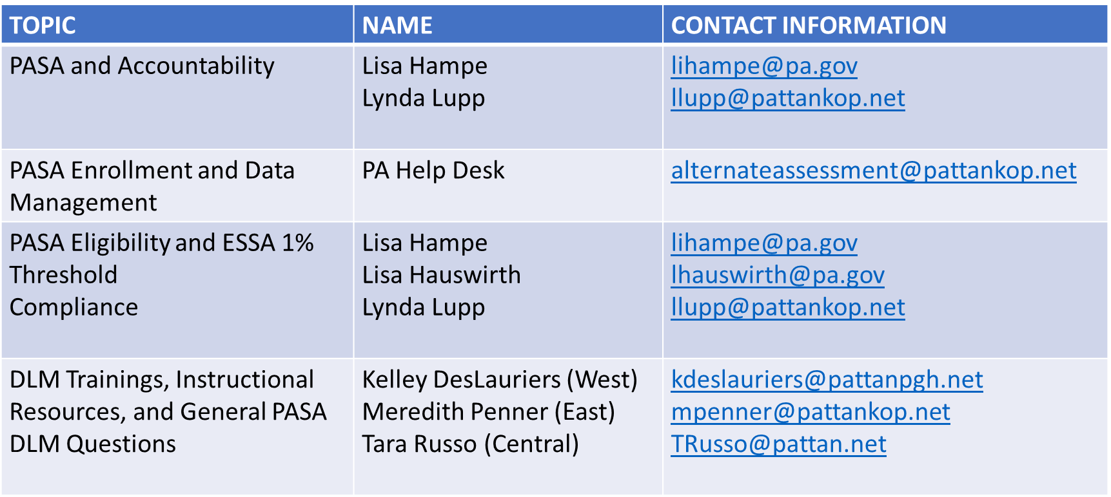
PASA DLM Directory
Notes:
This slide contains a directory of contacts specific to the PASA DLM and the team members who work with the PASA.

Slide 41
PSSA/ Keystone Directory
Data Recognition Corporation: Customer Service 800-451-7849
pacustomerservice@datarecognitioncorp.com
PDE: Unique Accommodations
RA-EDUNIQUEACCOM@pa.gov
Dr. Beth Gannon, ELA Assessment and Assessment Accommodations Advisor: egannonrit@pa.gov
Lisa Hampe, Special Education Adviser: lihampe@pa.gov
Brian Truesdale: Chief, Division of Assessment and Accountability; btruesdale@pa.gov
Notes:
Now, we will switch back over to information specific to the PSSA and Keystone Exams. Please use the contacts on this slide for any questions regarding testing accommodations. Note the email address for unique accommodations should be used for any questions about state assessment accommodations or unique accommodations. Please do not submit your unique accommodation assurance to this address, as these must be submitted through the link provided on the form.

Slide 42
Contact/Mission
For more information on testing accommodations, please visit PDE’s website at www.education.pa.gov
Notes:
Thank you for your participation in this training.

