Slide 1
Session One Improving Perceptual Skills
Masters P-A through P-I

Slide 2
Session One Objectives
Identify those parts of the Highway Transportation System (HTS) that must be quickly perceived
Define perception as a mental process that is selective and can be improved
Define the concept “Projected Path of Travel”
Identify the three general habits for improving perception of the HTS events
Identify three eye habits for car control and common errors associated with poor eye habits
Identify three eye habits for searching the traffic scene and common errors associated with poor searching habits

Slide 3
HTS EVENTS
Own Vehicle Highway
Gauges - Roadway
Sounds - Shoulders
Motions - Obstructions
Unrelated Traffic Controls Other Users
Music - Markings - Vehicles/Driver
Scenic Views - Signs & Signals - Pedestrians
Advertisements - Other Laws - Bicyclists
Our Complex Highway Transportation System

Slide 4
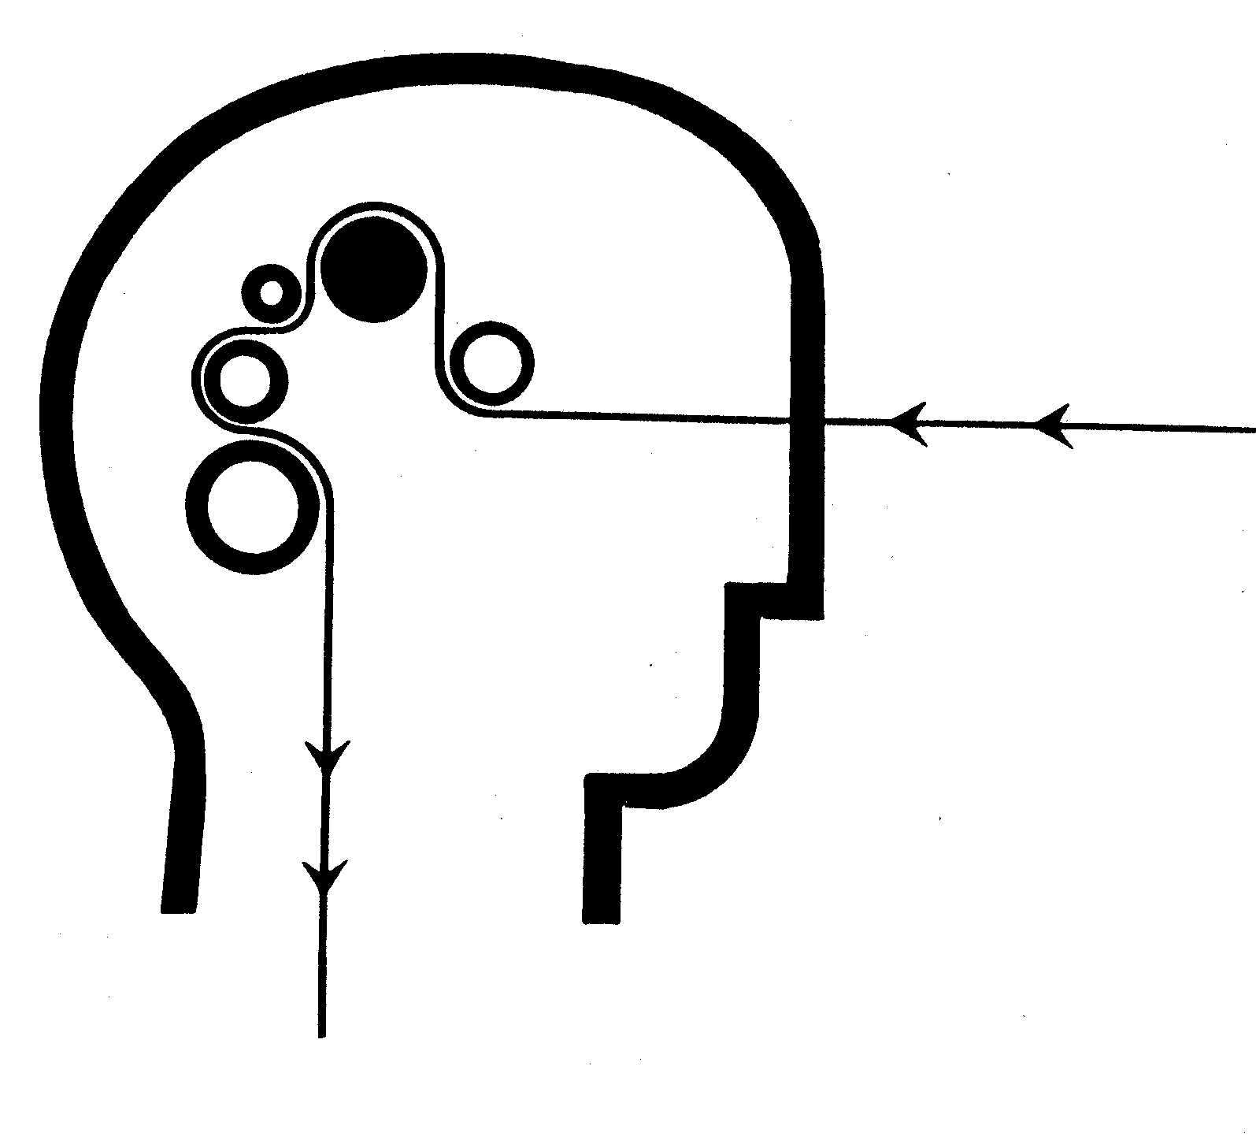
Nature of Perceptions
Involves our Senses and Brain
Takes Time- Must Be Selective Process
Can Be Improved With Directed Practice

Slide 5
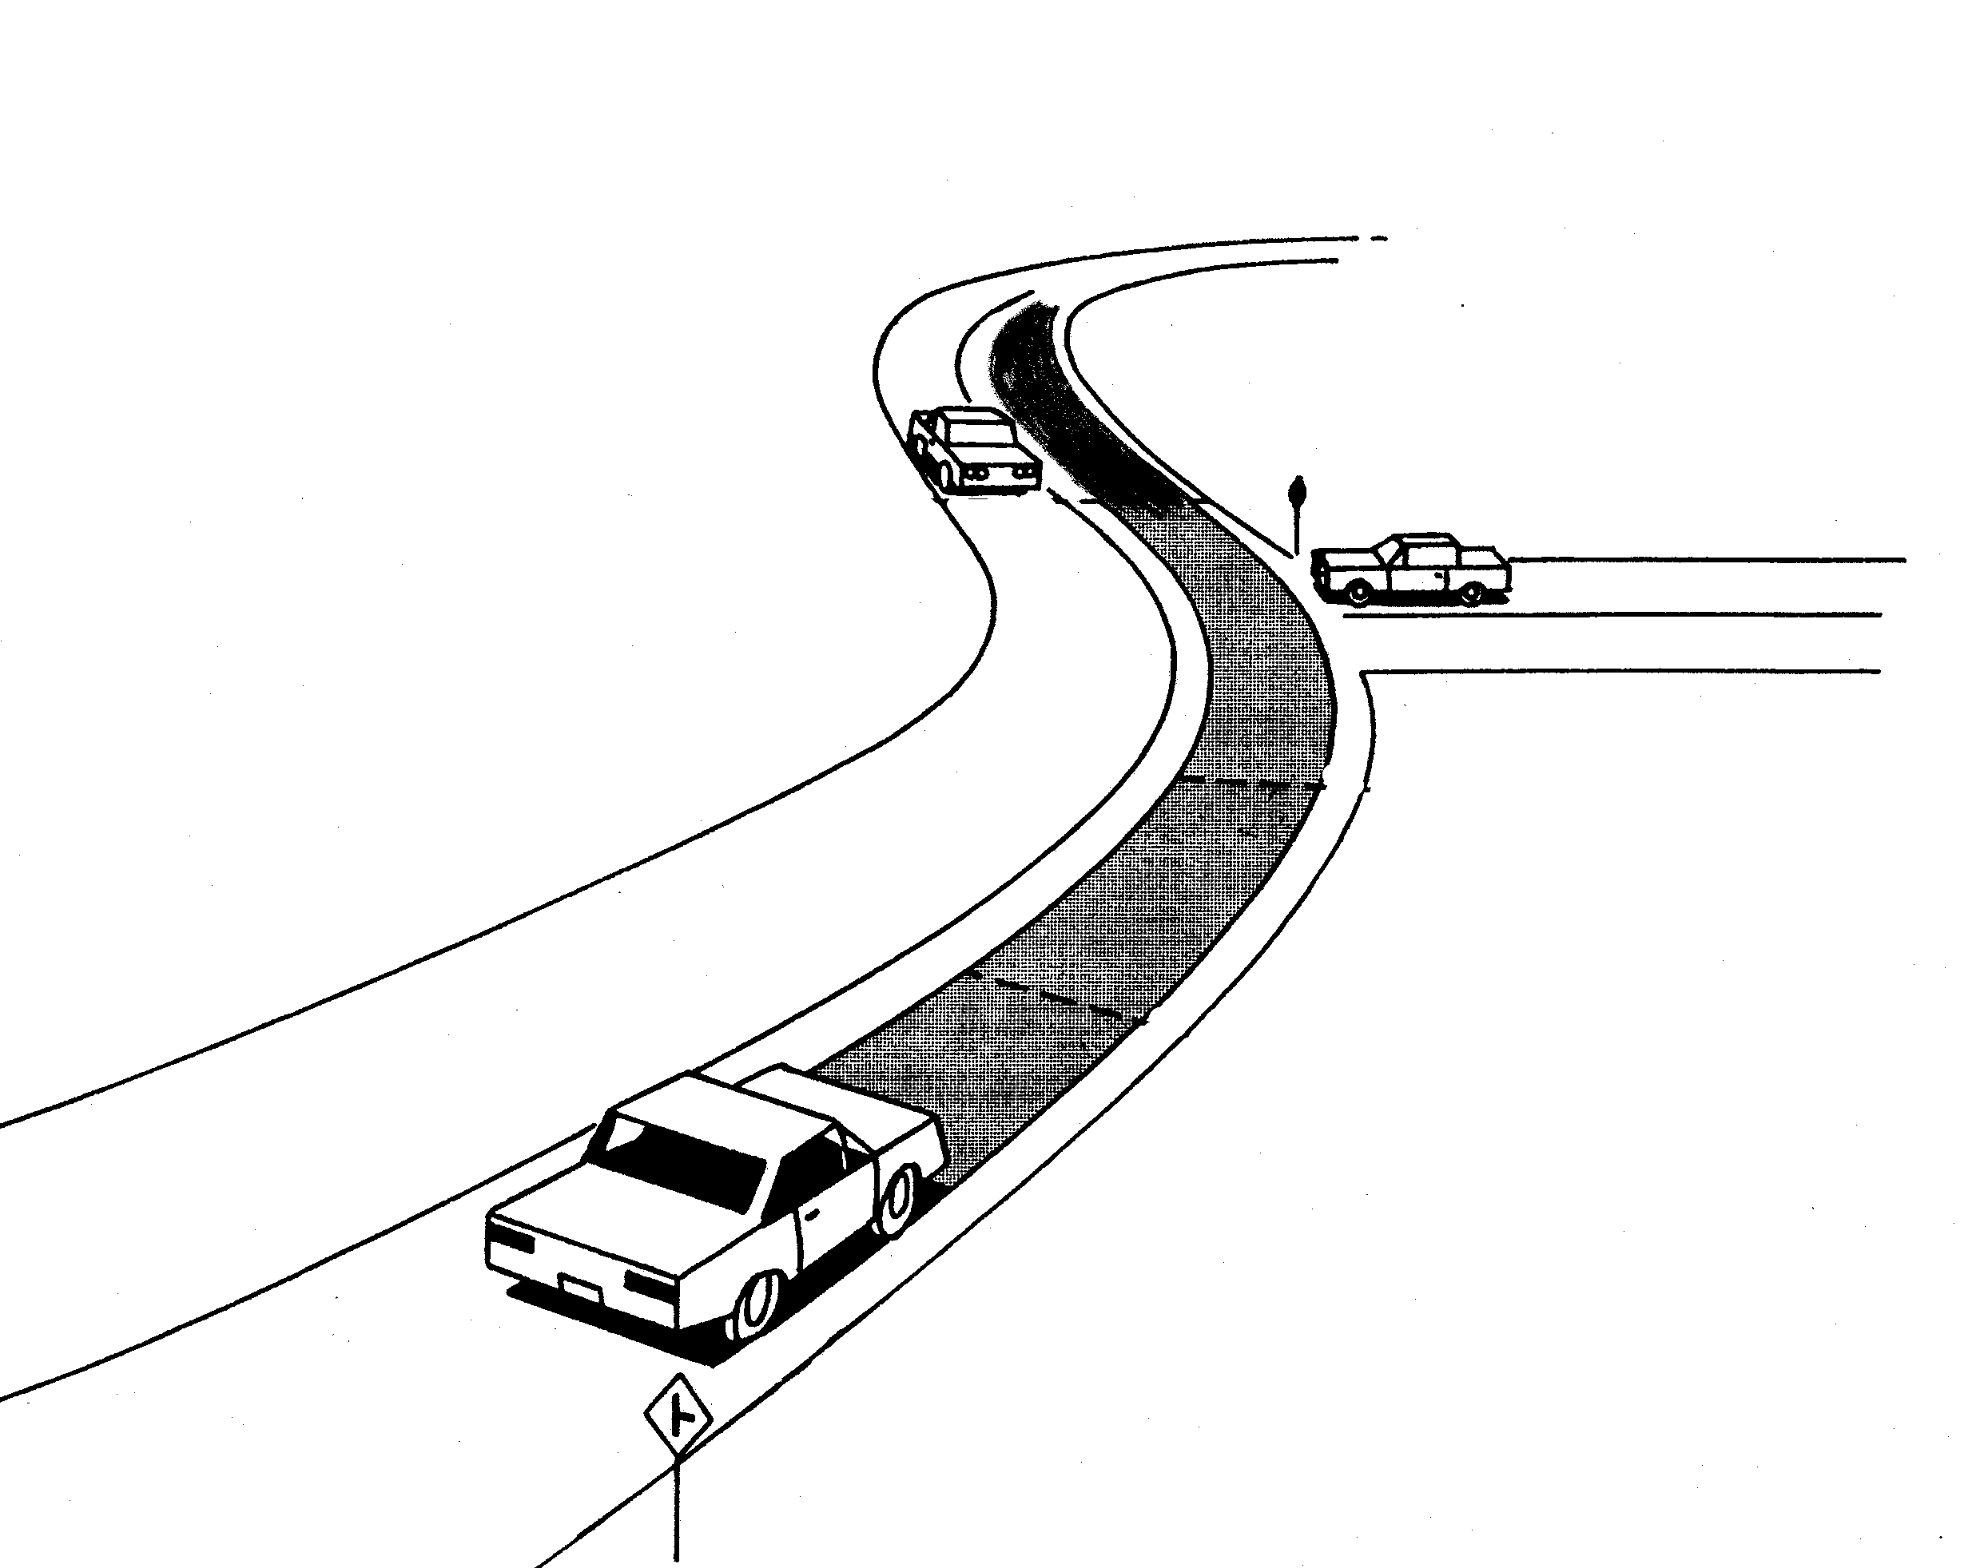
Projected Path of Travel

Slide 6
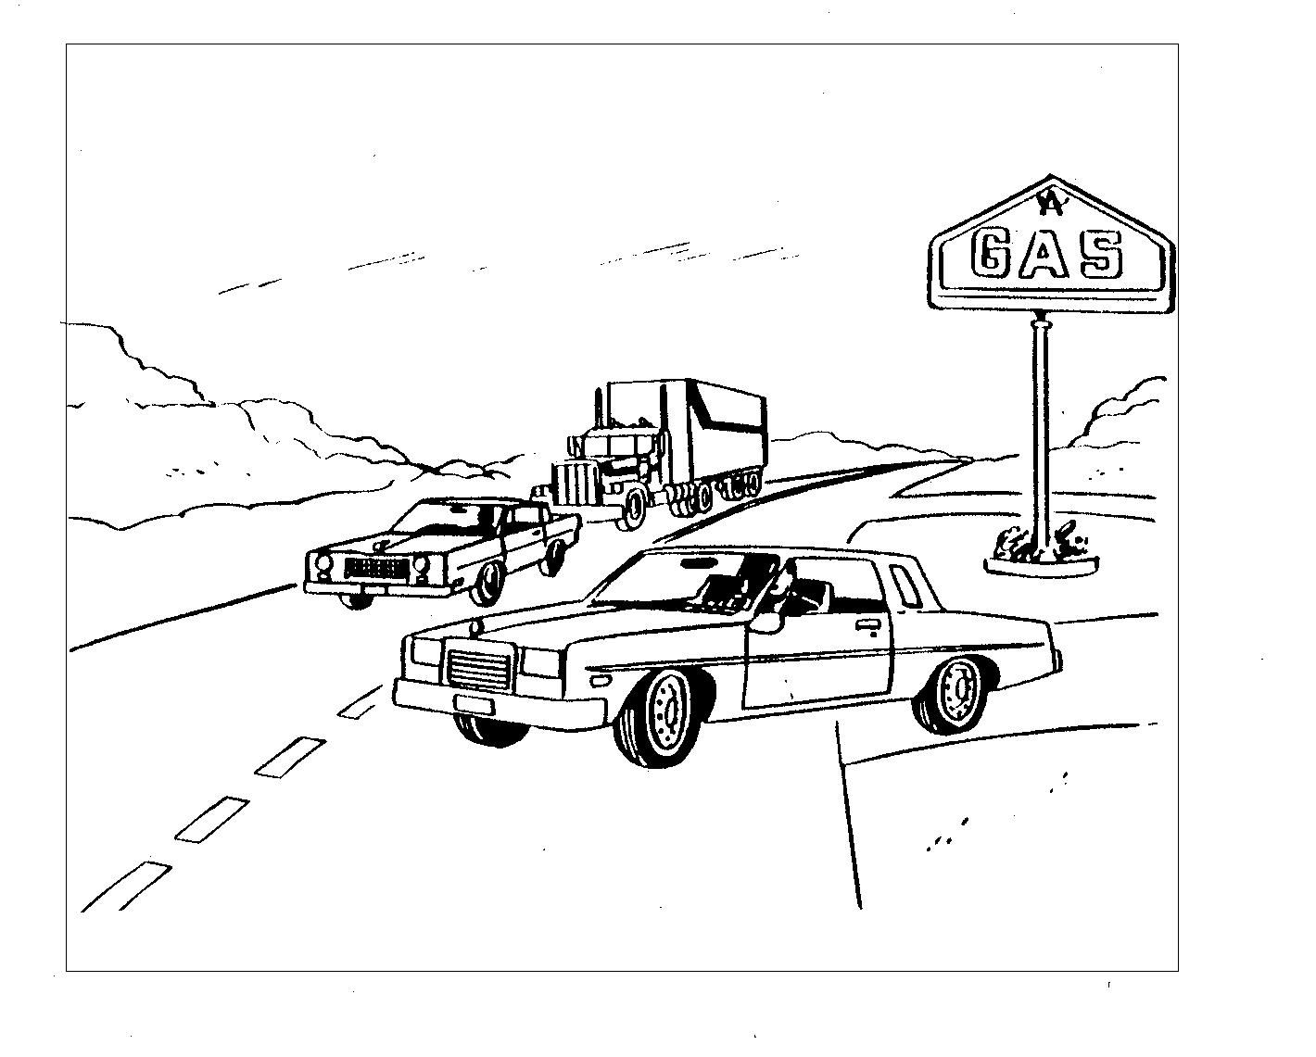
Habits for Improving Perception
-Use Efficient Eye Habits
-Use Systemic Search
Patterns
- Search for Conflict
Situations
Know What To Look For

Slide 7
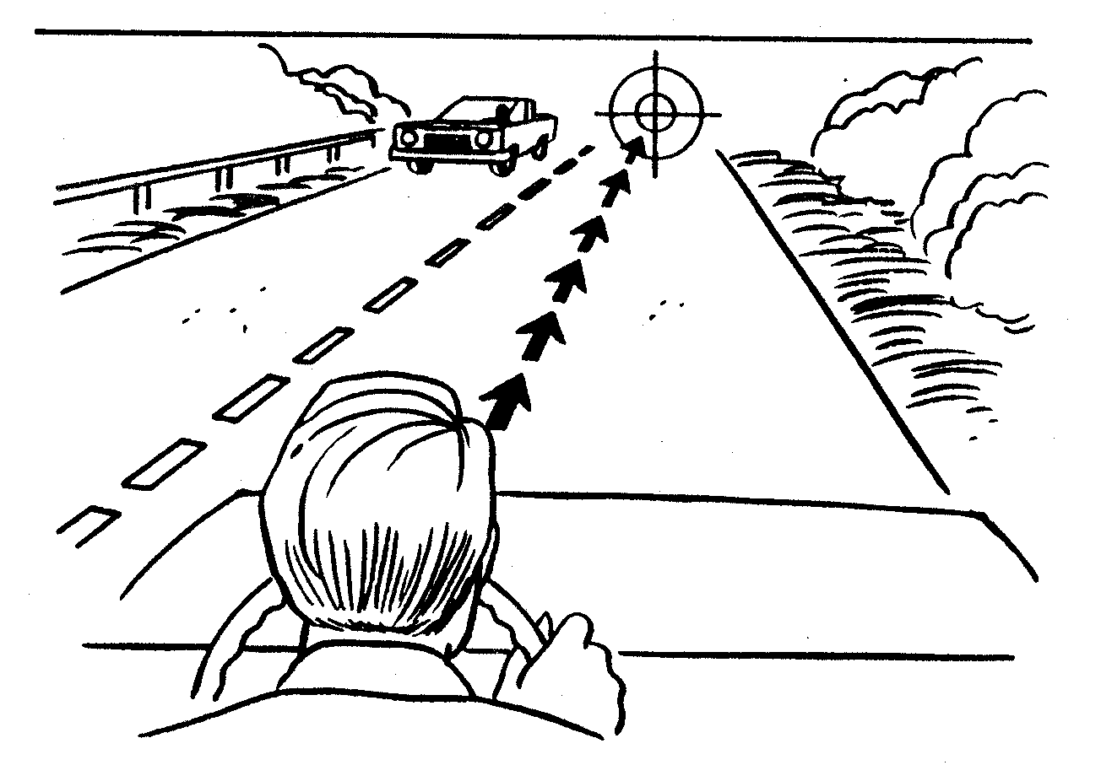
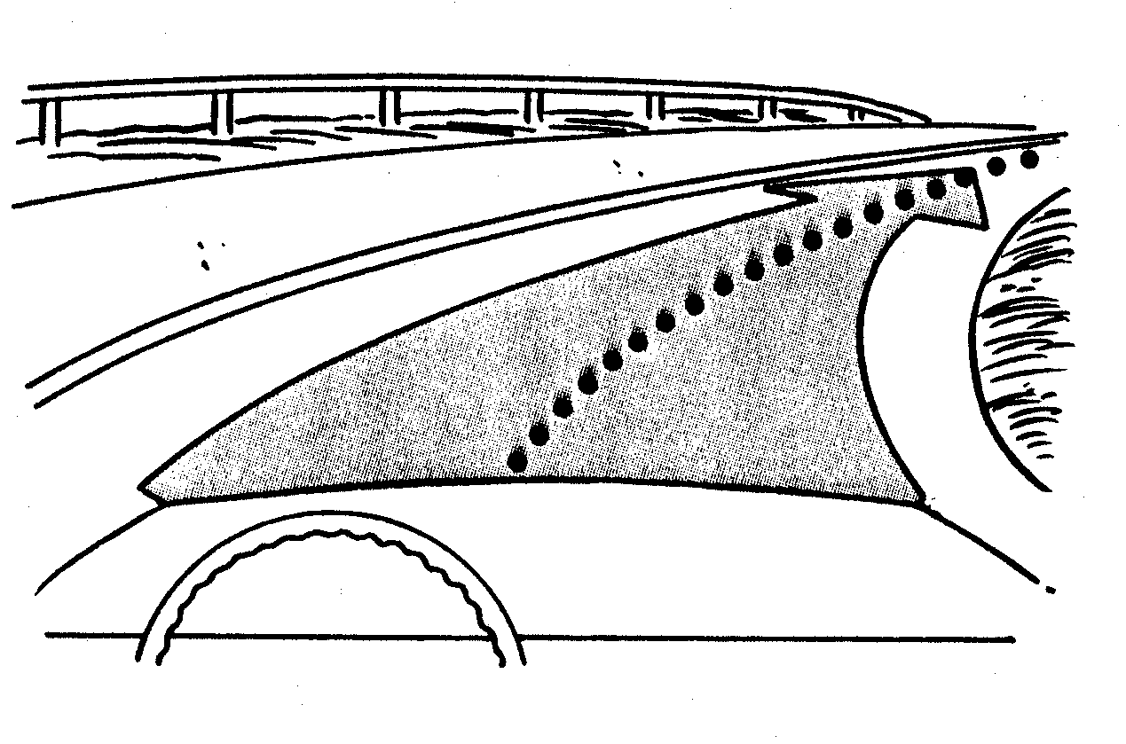
Eye Habits for Vehicle Control
Picture Path of Travel
Look Down Middle
Look Far Ahead

Slide 8
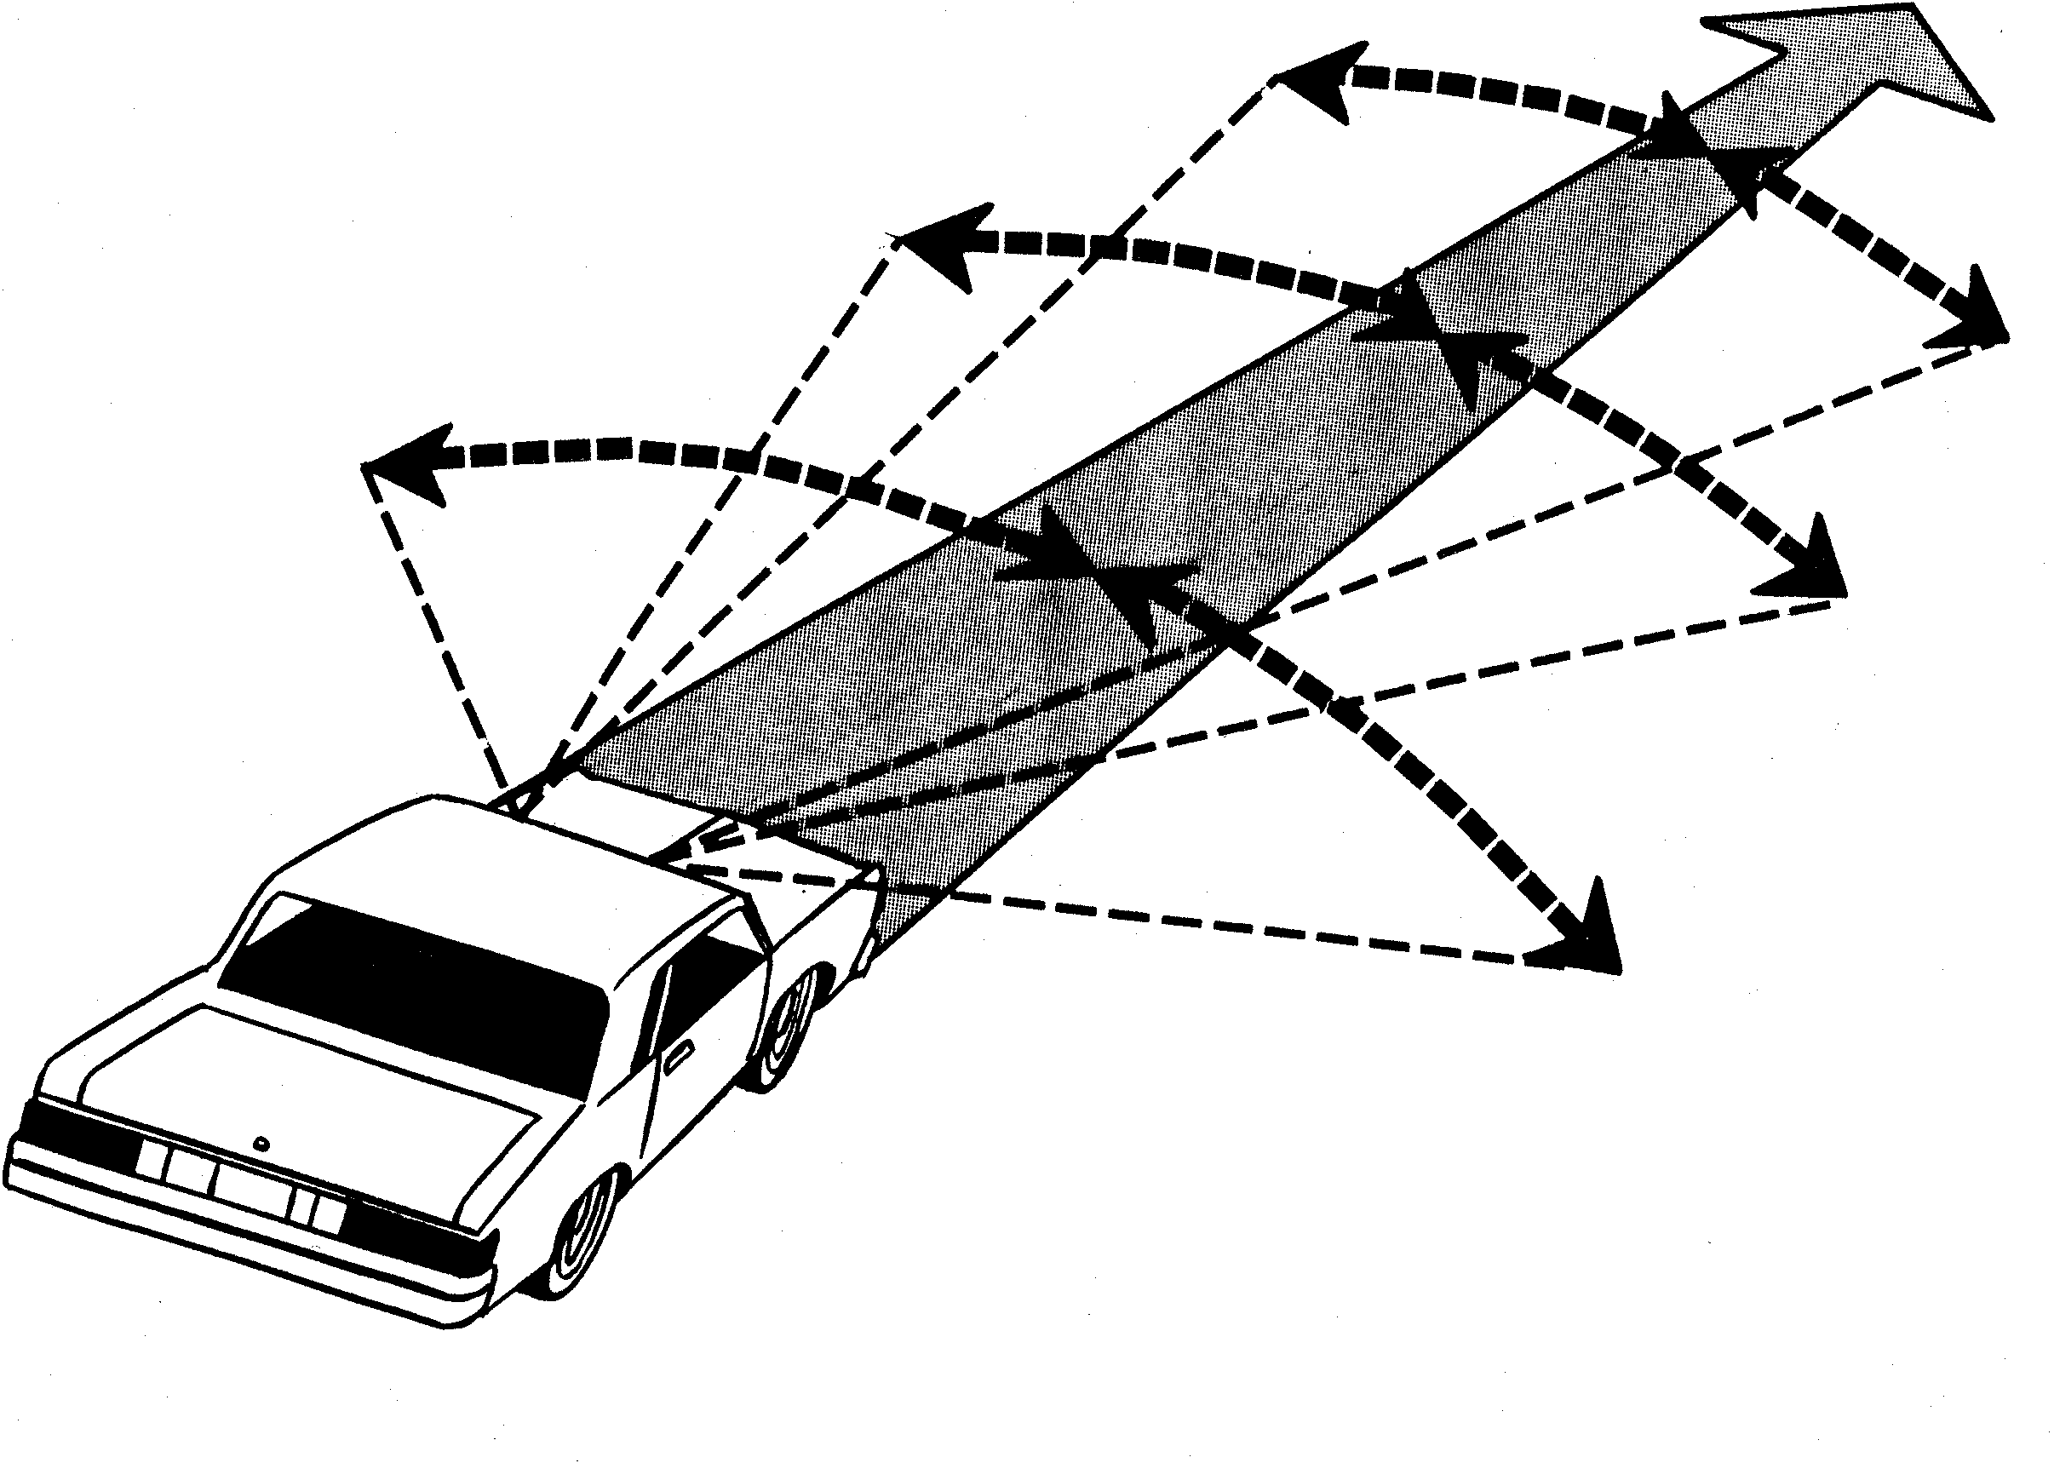
Search the Scene Ahead
Search 20 to 30 Seconds Ahead
Search from Side to Side

Slide 9
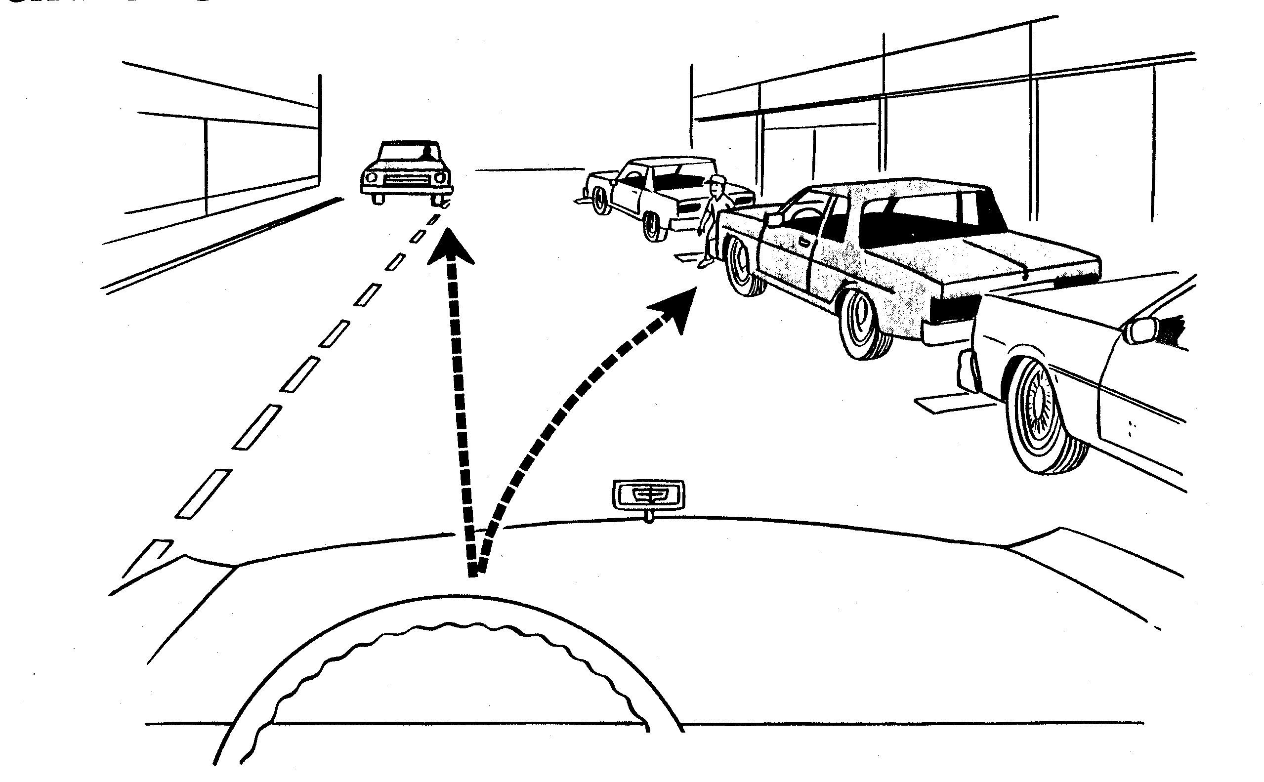
Search the Road Surface
To Detect Changes in Direction
To assess Speed of Other Cars
To Check for Pedestrians Between Parked Cars

Slide 10
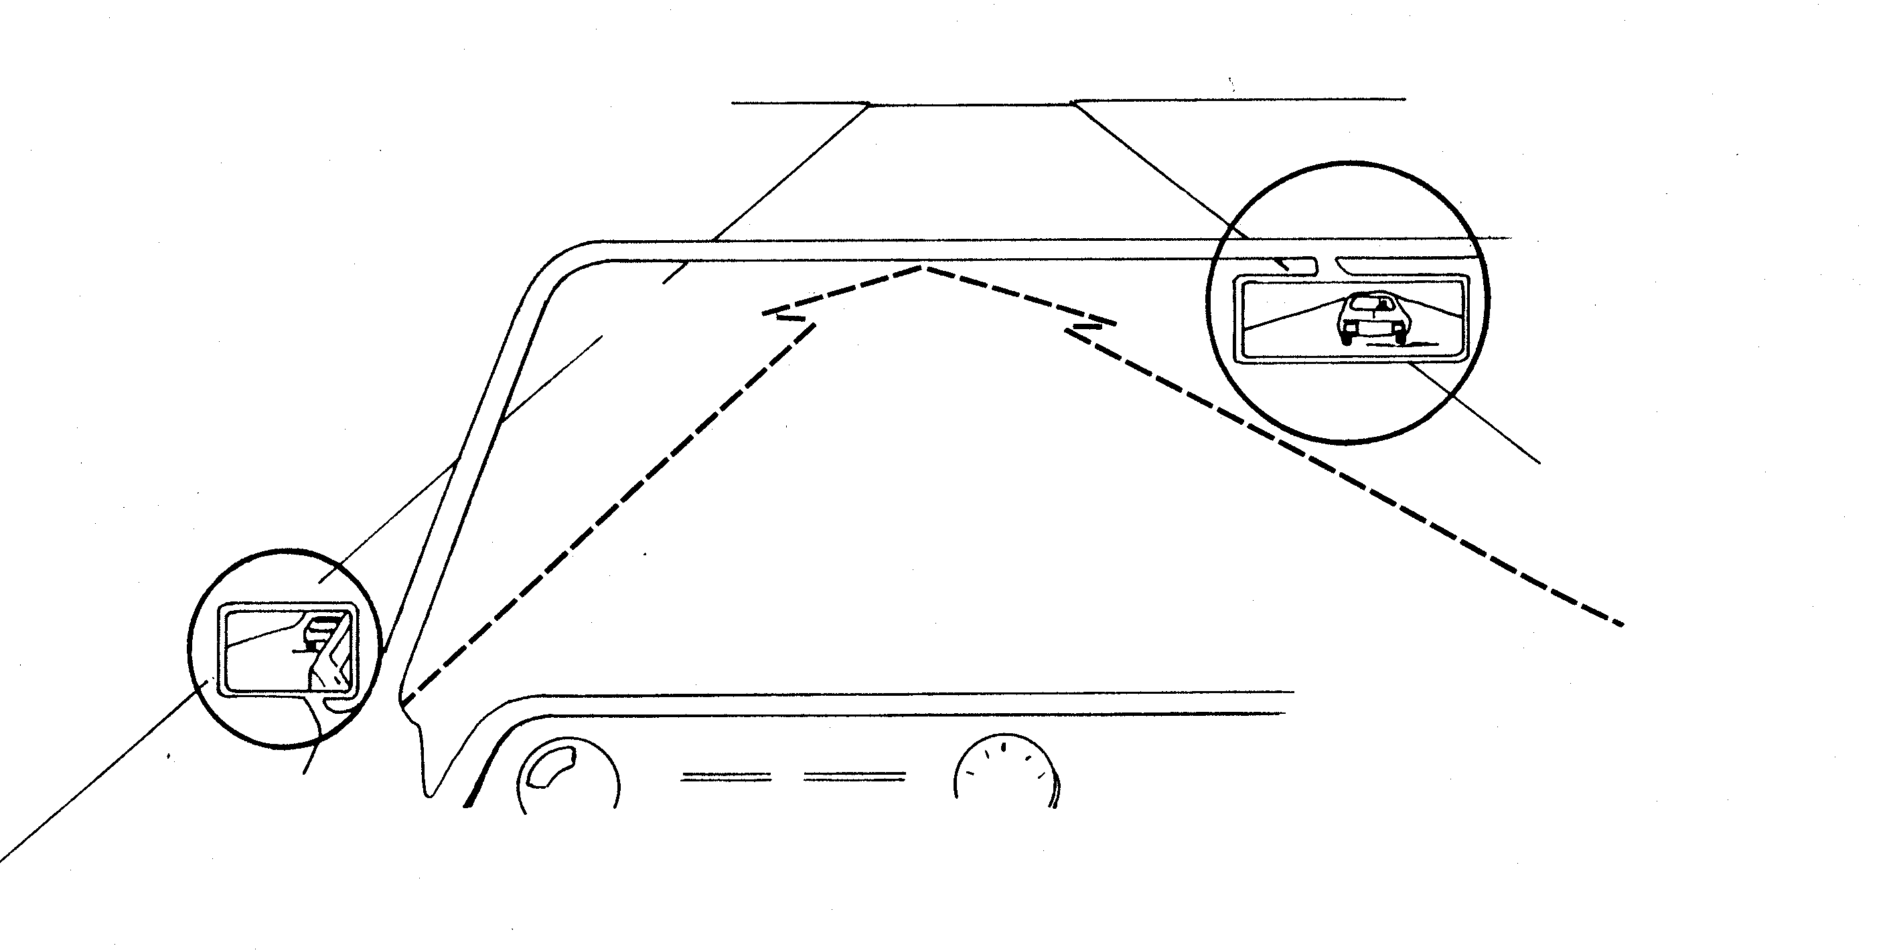
Search Mirrors and Dash
Check Inside and Outside Mirrors
Check Dash Regularly

Slide 11
Contact/Mission
For more information on the (the topic of the presentation) please visit PDE’s website at www.education.pa.gov
The mission of the Department of Education is to ensure that every learner has access to a world-class education system that academically prepares children and adults to succeed as productive citizens. Further, the Department seeks to establish a culture that is committed to improving opportunities throughout the commonwealth by ensuring that technical support, resources, and optimal learning environments are available for all students, whether children or adults.

