Slide 1
Perception
Signs, Signals, & Lane Markings

Slide 2
Instructions
A traffic scene will be quickly flashed on the screen. You will have approximately 3-5 seconds to observe the driving scene.
Three questions about the driving scene will then be asked. All of the answers are true or false. Please write your answer on the answer sheet. Please keep track of your correct answers. We will add these up at the end.
All scenes are taken from “behind the wheel.”
Do not “shout out” your answers.
In this first session, concentrate your efforts on signs, signals, and lane markings.

Slide 3
Practice
The first scene is a practice scene.
Just look at the scene and answer the questions either true or false.
Ready, here we go.

Slide 4
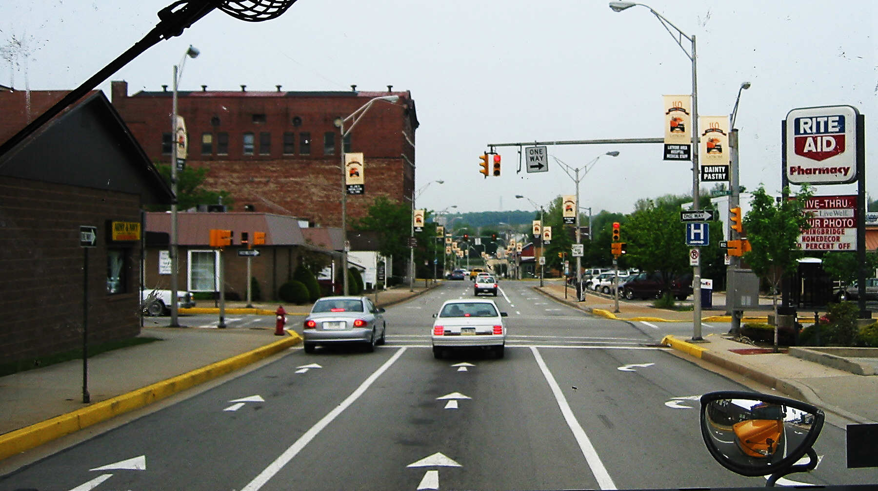

Slide 5
Practice
The traffic light is “red.”
We are traveling in the right turn lane.
We will be crossing a one-way street.

Slide 6
Practice Answers
The traffic light is red. True
We are traveling in the right turn lane. False
We will be crossing a one way street. True

Slide 7
Here We Go
We are ready to begin.
Please write your answers on the answer sheet.
Ready?

Slide 8
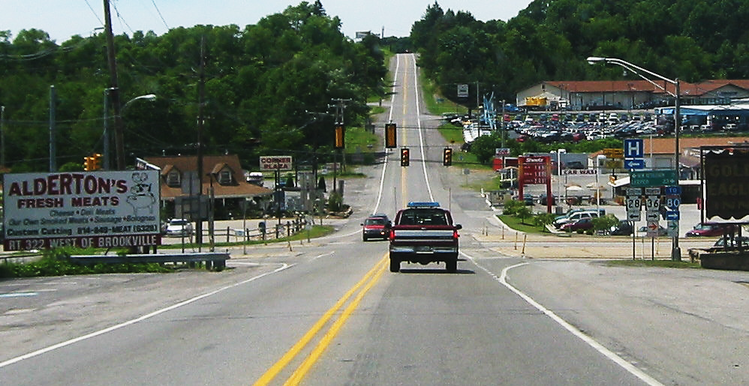

Slide 9
Scene 1
To go to Interstate 80, turn right.
The local hospital is also a right turn.
We are in a “no passing” zone.

Slide 10
To go to Interstate 80, turn right. True
The local hospital is also a right turn. False
We are in a “no passing” zone. True

Slide 11
Scene 2
Are you ready?

Slide 12
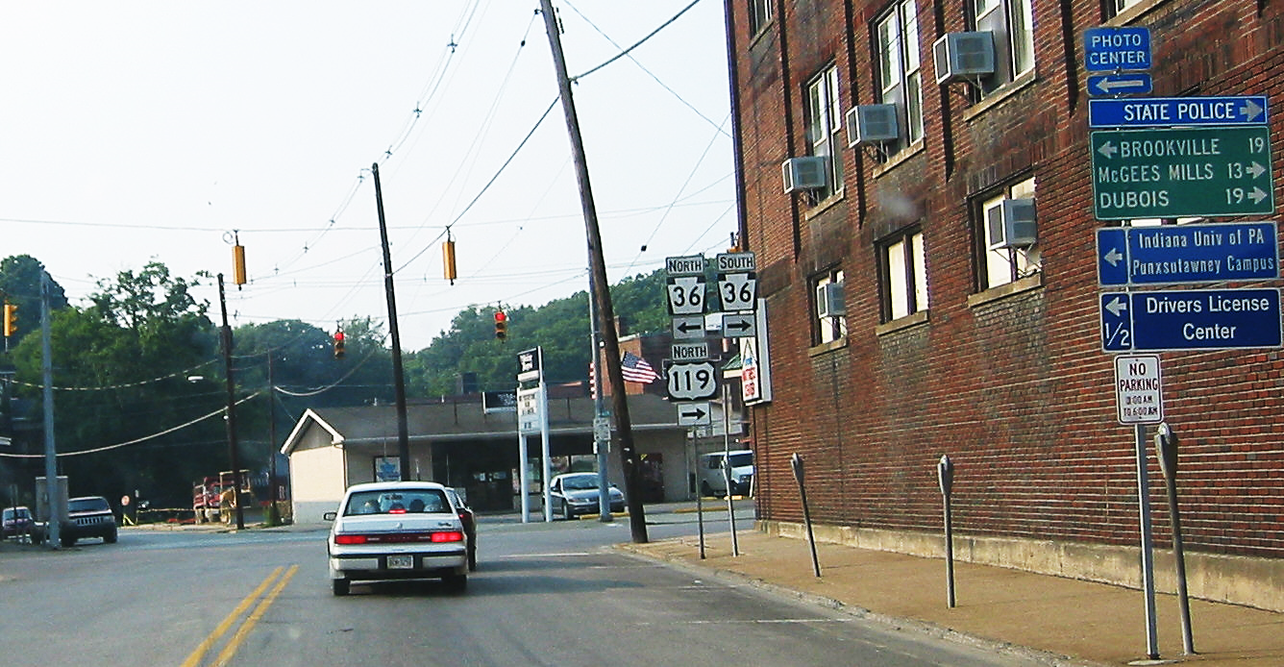

Slide 13
Scene 2 Questions
To take your driver’s test, make a right turn.
To travel on 119 North, make a left turn.
The city of Dubois is 19 miles away.

Slide 14
To take your drivers test, make a right turn. False
To travel on 119 North, make a left turn. False
The city of Dubois is 19 miles away. True

Slide 15
Slide 3
Ready?

Slide 16
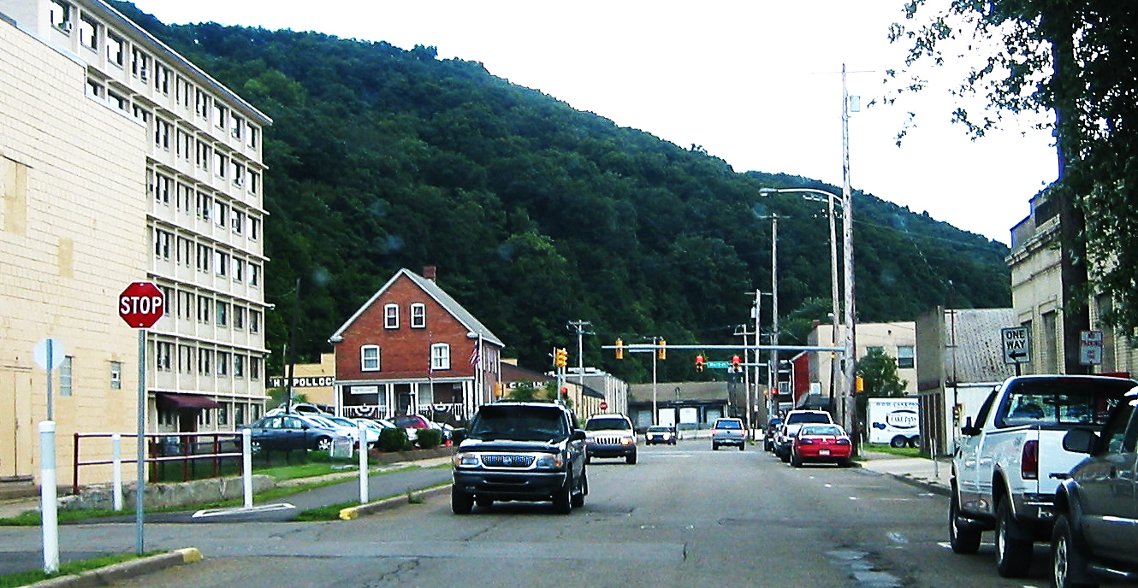

Slide 17
Slide 3 Questions
We must stop at the next stop sign.
We are traveling next to a special access lane.
We will be crossing a one-way street.

Slide 18
We must stop at the next stop sign. False
We are traveling next to a special access lane. True
We will be crossing a one-way street. True

Slide 19
Scene 4
Ready?

Slide 20
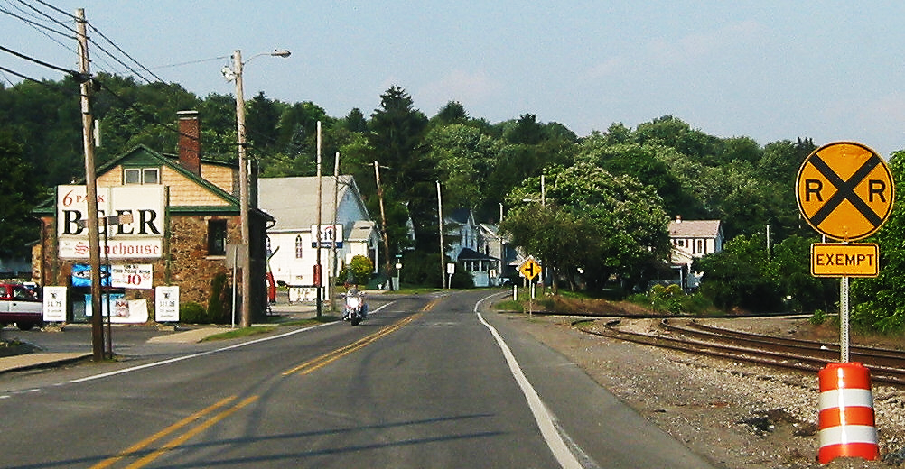

Slide 21
Scene 4 Questions
We must expect a train at the next railroad crossing.
We are then approaching a T-intersection.
We are in a passing zone.

Slide 22
We must expect a train at the next crossing. False
We are then approaching a T-intersection. True
We are in a passing zone. False

Slide 23
Scene 5
Here We Go
½ way there

Slide 24
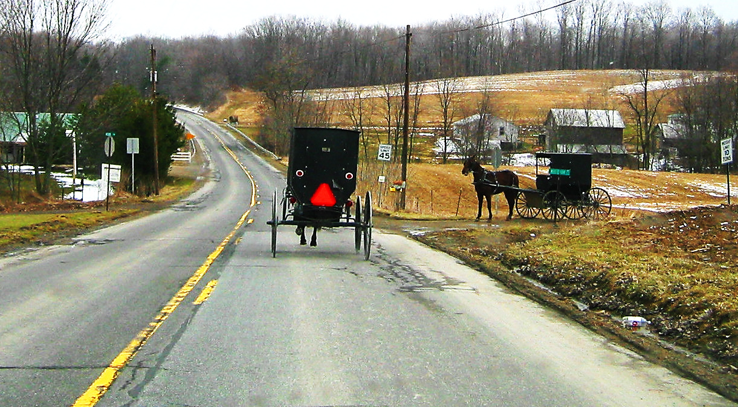

Slide 25
Scene 5 Questions
The speed limit is 40 mph.
We are in a passing zone.
There are two stop signs in the driving scene.

Slide 26
The speed limit is 40 mph. False
We are in a passing zone. True
There are two stop signs in the scene. True

Slide 27
Scene 6
You’re Doing Great!

Slide 28
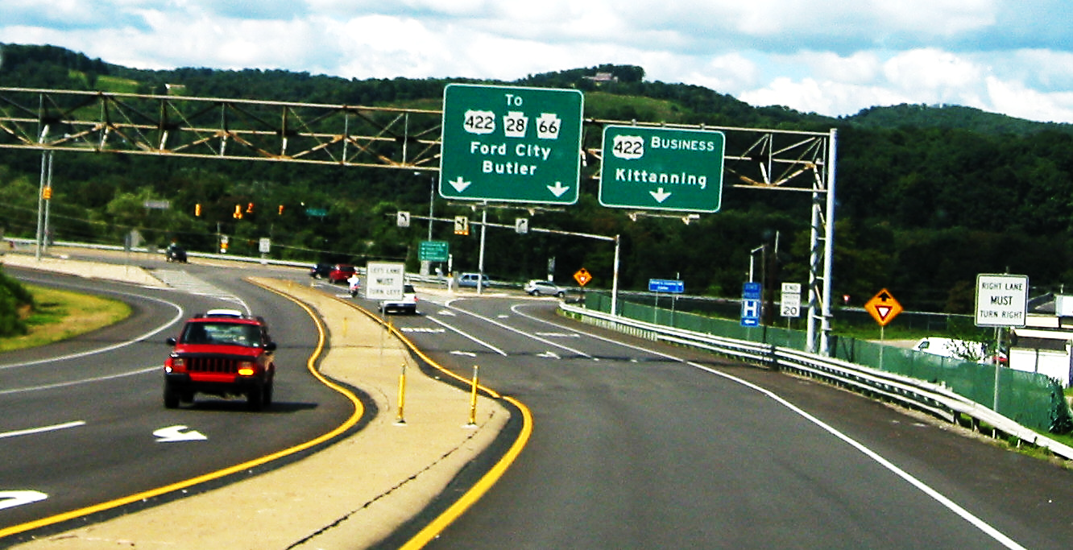

Slide 29
Scene 6 Questions
A “yield” sign is just ahead.
Left turns can be made from the center lane.
To go to the business district of Kittanning, we will be using a “right turn merge.”

Slide 30
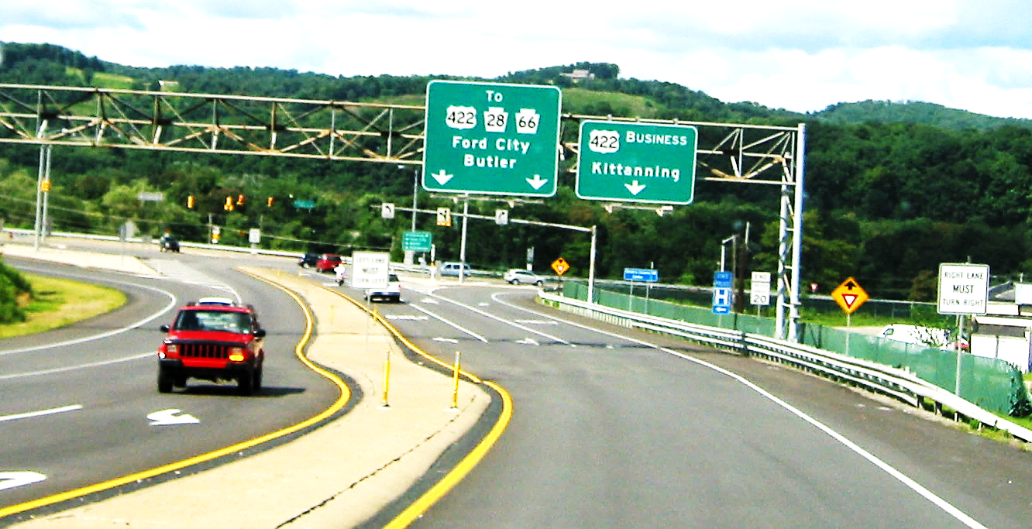
A “yield” sign is just ahead. True
Left turns can be made from the center lane. True
To go to the business district of Kittanning, we must use a “right turn merge.” True

Slide 31
Scene 7
Get Ready

Slide 32
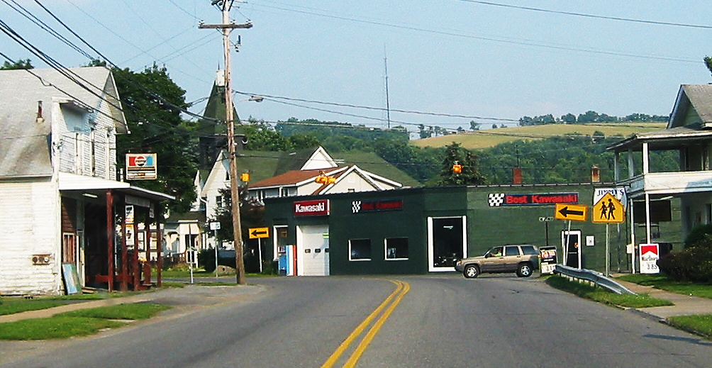

Slide 33
Scene 7 Questions
A pedestrian crossing is approaching.
The traffic light is changing to red.
A sharp turn in the road is approaching.

Slide 34
A pedestrian crossing is approaching. False
B. The traffic light is changing to red. False
C. A sharp curve in the road is approaching. True

Slide 35
Scene 8
Almost There

Slide 36
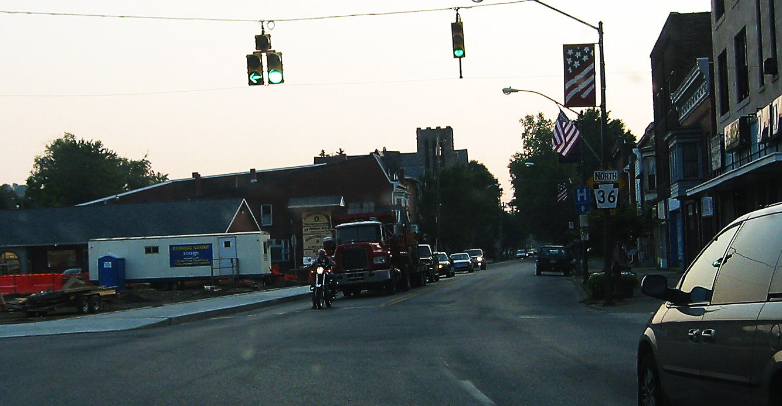

Slide 37
Scene 8 Questions
To make a left turn, we must yield “right of way” to oncoming traffic.
There is a “No Turn on Red” sign.
North 36 is a “PA state” route.

Slide 38
To make a left turn, we must yield “right of way” to oncoming traffic. False
There is a “No Turn on Red” sign. False
C. North 36 is a “PA state route.” True

Slide 39
Scene 9
Hang in there

Slide 40
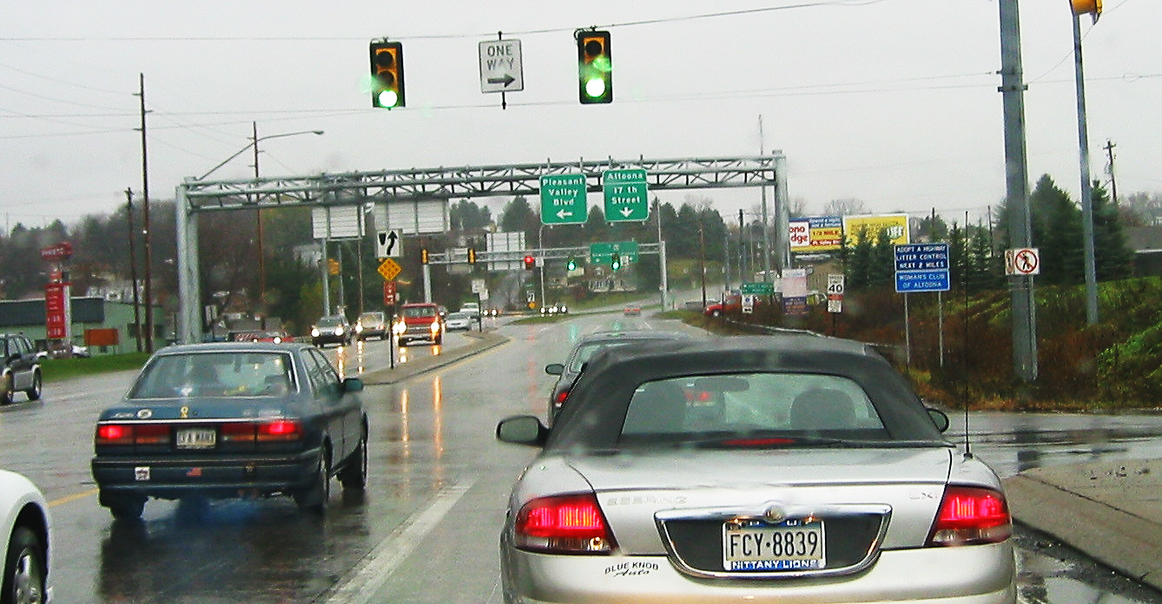

Slide 41
Scene 9 Questions
The speed limit ahead is 45 mph.
The cross street is a one-way street to the right.
The highway is divided ahead.

Slide 42
The speed limit ahead is 45 mph. False
The cross street is one-way to the right. True
The highway is divided ahead. True

Slide 43
Scene 10
Last one

Slide 44
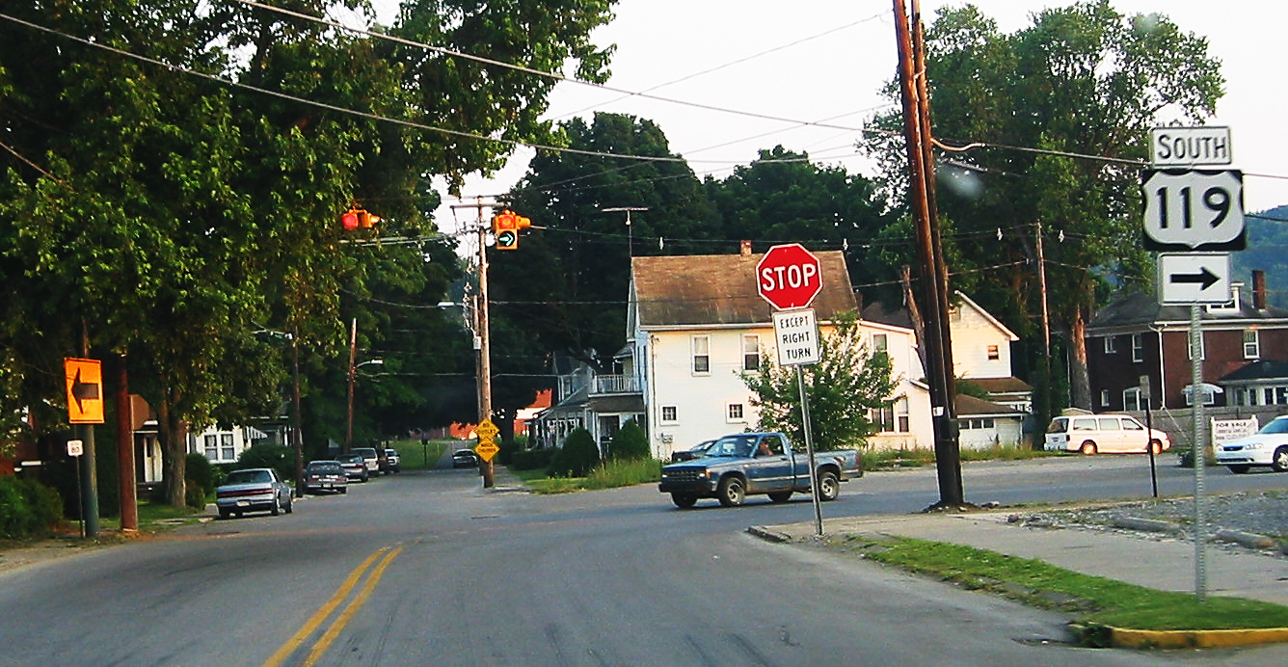

Slide 45
Scene 10 Questions
To make a right turn, we must stop at the stop intersection.
B. To continue straight, we must stop at the stop intersection.
C. There are two warning signs on the other side of the intersection.

Slide 46
To make a right turn, we must stop at the stop intersection. False
B. To continue straight, we must stop at the stop intersection. True
C. There are two warning signs straight ahead. True

Slide 47
Add up your correct answers
30-27 = Excellent
26-24 = Good
23-21 = Average
20 and below – Needs Improvement

Slide 48
Contact/Mission
For more information on the (the topic of the presentation) please visit PDE’s website at www.education.pa.gov
The mission of the Department of Education is to ensure that every learner has access to a world-class education system that academically prepares children and adults to succeed as productive citizens. Further, the Department seeks to establish a culture that is committed to improving opportunities throughout the commonwealth by ensuring that technical support, resources, and optimal learning environments are available for all students, whether children or adults.

