Slide 1
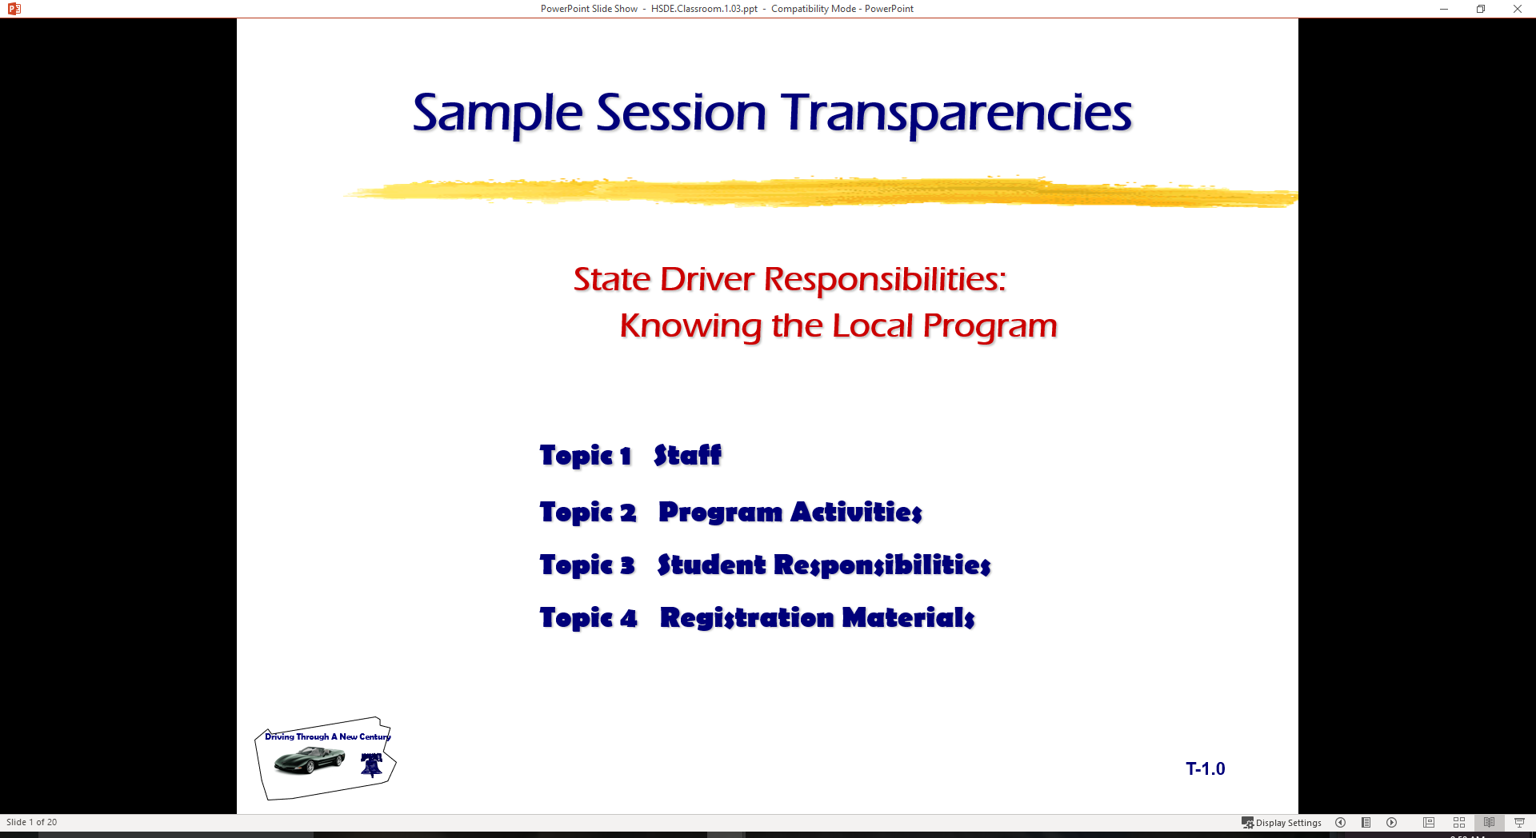
Driver Responsibilities: Knowing Your Vehicle
  Topic 1 Standard Visual Reference Points
  Topic 2 Getting Started
  Topic 3 Vehicle Controls
  Topic 4 Using Controls

Slide 2
Introduction
Review of Range Lesson One
  Central Blind zone
  BGE Mirror Method
  Need for Developing Reference Points
Standard Vehicle Reference Points
  Next topical area with classroom and range
  How can you tell where your front bumper is?
Vehicle Controls

Slide 3
Purpose
Relate part of the vehicle to some part of the roadway
Helpful visual relationship of your vehicle within operating space
Will know your vehicle placement within a lane at all times
Will allow for reduced-risk lane placements

Slide 4
Establishing Reference Points
Set up Positions Outside Vehicle
Sit Behind Wheel
Look for Reference to Car
Use Targeting Principles

Slide 5
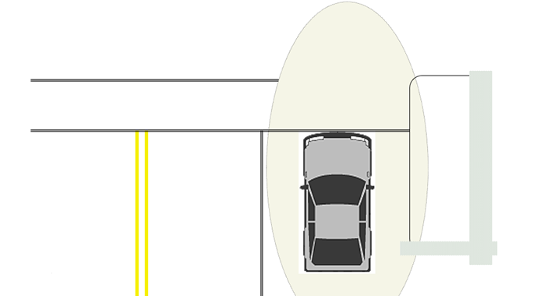
FRONT LIMITATION
Knowing where the front end of your vehicle is
when you are:
AT INTERSECTIONS
IN A STOPPING POSITION
PERPENDICULAR PARKING

Slide 6
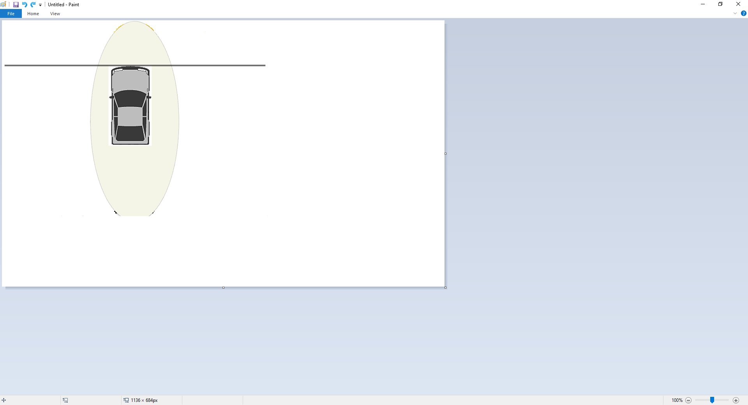
Front Limitation
WHERE ARE YOUR VISUAL REFERENCE POINTS FOR FRONT LIMITATION?

Slide 7
Front Limitation
Target the line to the side of the vehicle and look from the line under the side view mirrors to the curb.
Together they will help you determine where the front limitation of your vehicle is.

Slide 8
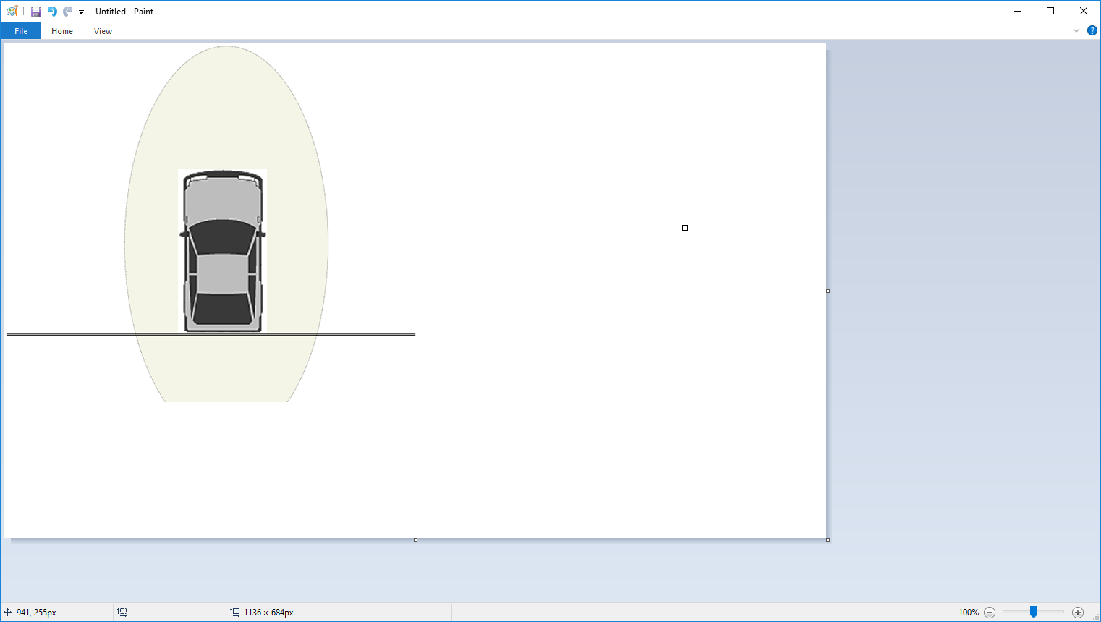
Rear Limitation
Knowing where the rear end of your vehicle is
when you are:
BACKING POSITION
PERPENDICULAR PARKING

Slide 9
Rear Limitation
WHERE ARE YOUR VISUAL REFERENCE POINTS FOR REAR LIMITATION?

Slide 10
Rear Limitation
Target the line to either side of the vehicle and look from the line through the windows to the left and right rear.
Together they will help you determine where the rear limitation of your vehicle is.

Slide 11
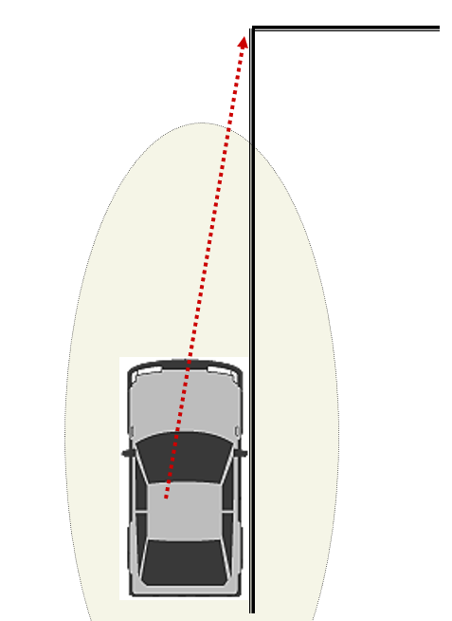
Right Side Limitation
ROADWAY LANE POSITION # 3
RIGHT SIDE CURB PARKING
  Parallel to the curb (0-6 inches away)

Slide 12
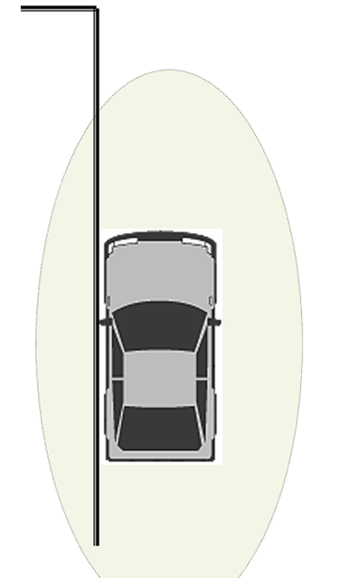
Left Side Limitation
ROADWAY LANE POSITION # 2
LEFT SIDE CURB PARKING like on a one-way street).
  (0-6 INCHES)

Slide 13
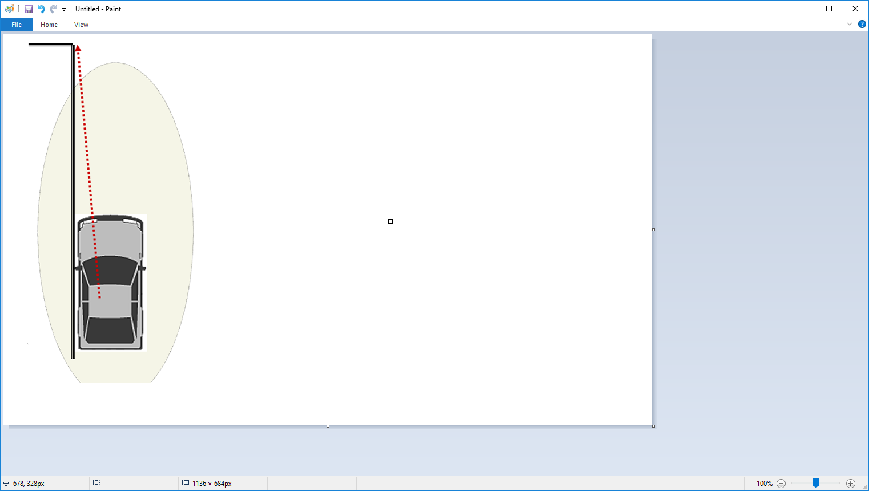
Left Side Limitation
Your line of sight reference is about 1 foot from left side or may be the crack line between your left fender and hood of your vehicle to the curb.

Slide 14
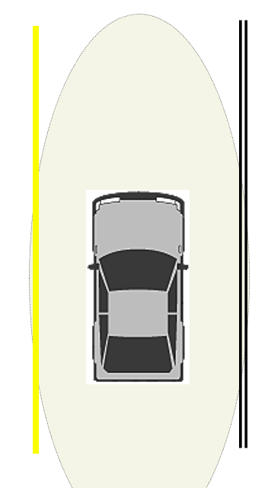
Lane Position # 1
CENTER OF YOUR ROADWAY LANE.
CAR IS 3 FEET AWAY FROM LINE TO RIGHT OR LEFT

Slide 15
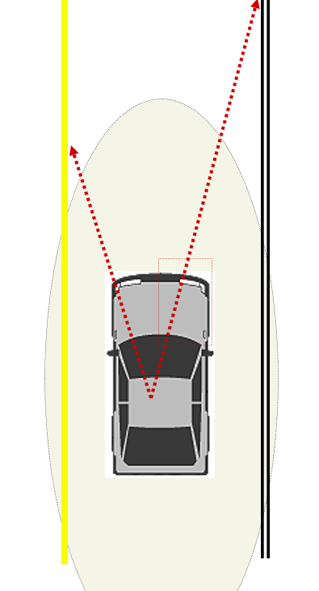
Lane Position # 1
Your line of sight through the driver’s side left fender to the center line.
Your line of sight through the center of passenger’s side right half of the hood to the edge or edge line of the roadway.

Slide 16
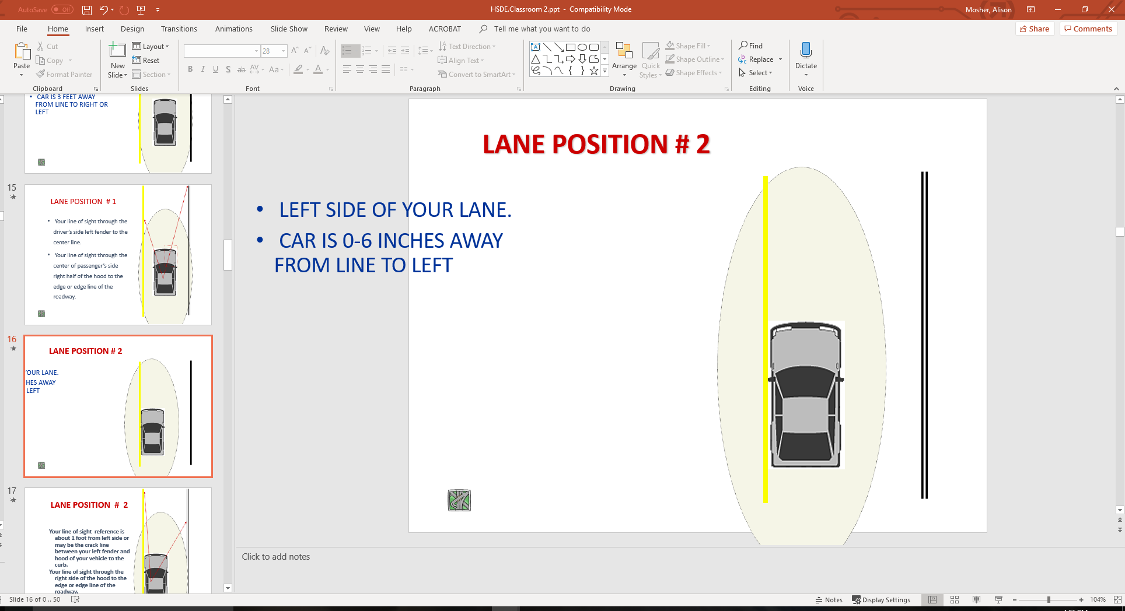
Lane Position # 2
LEFT SIDE OF YOUR LANE.
CAR IS 0-6 INCHES AWAY FROM LINE TO LEFT

Slide 17
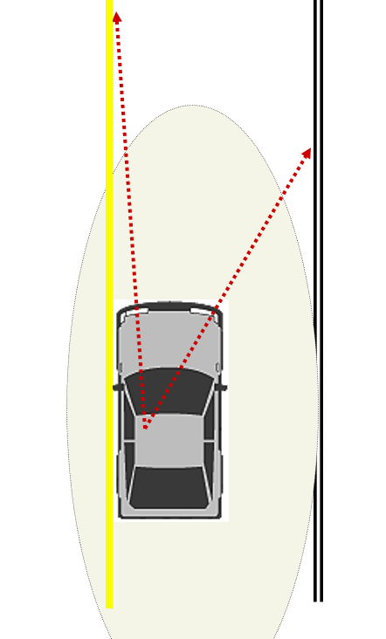
Lane Position # 2
Your line of sight reference is about 1 foot from left side or may be the crack line between your left fender and hood of your vehicle to the curb.
Your line of sight through the right side of the hood to the edge or edge line of the roadway.

Slide 18
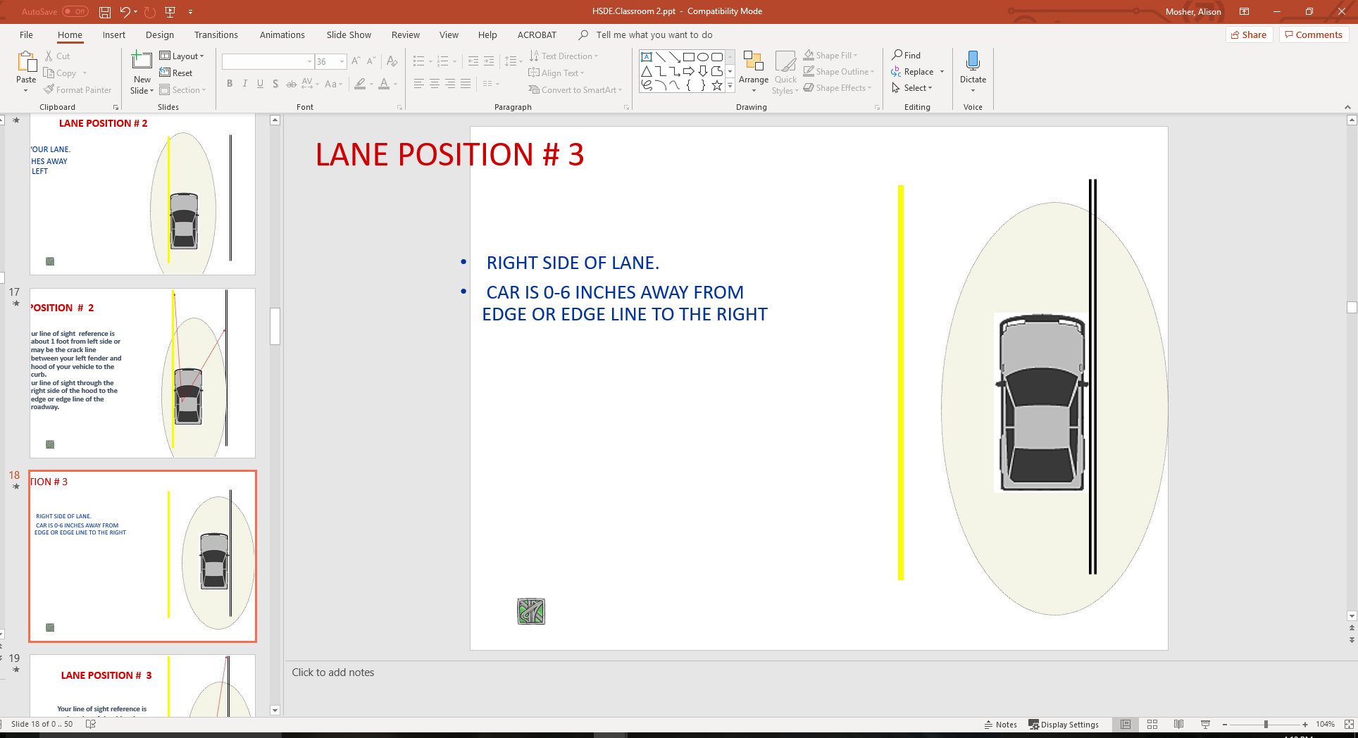
Lane Position # 3
RIGHT SIDE OF LANE.
CAR IS 0-6 INCHES AWAY FROM EDGE OR EDGE LINE TO THE RIGHT

Slide 19
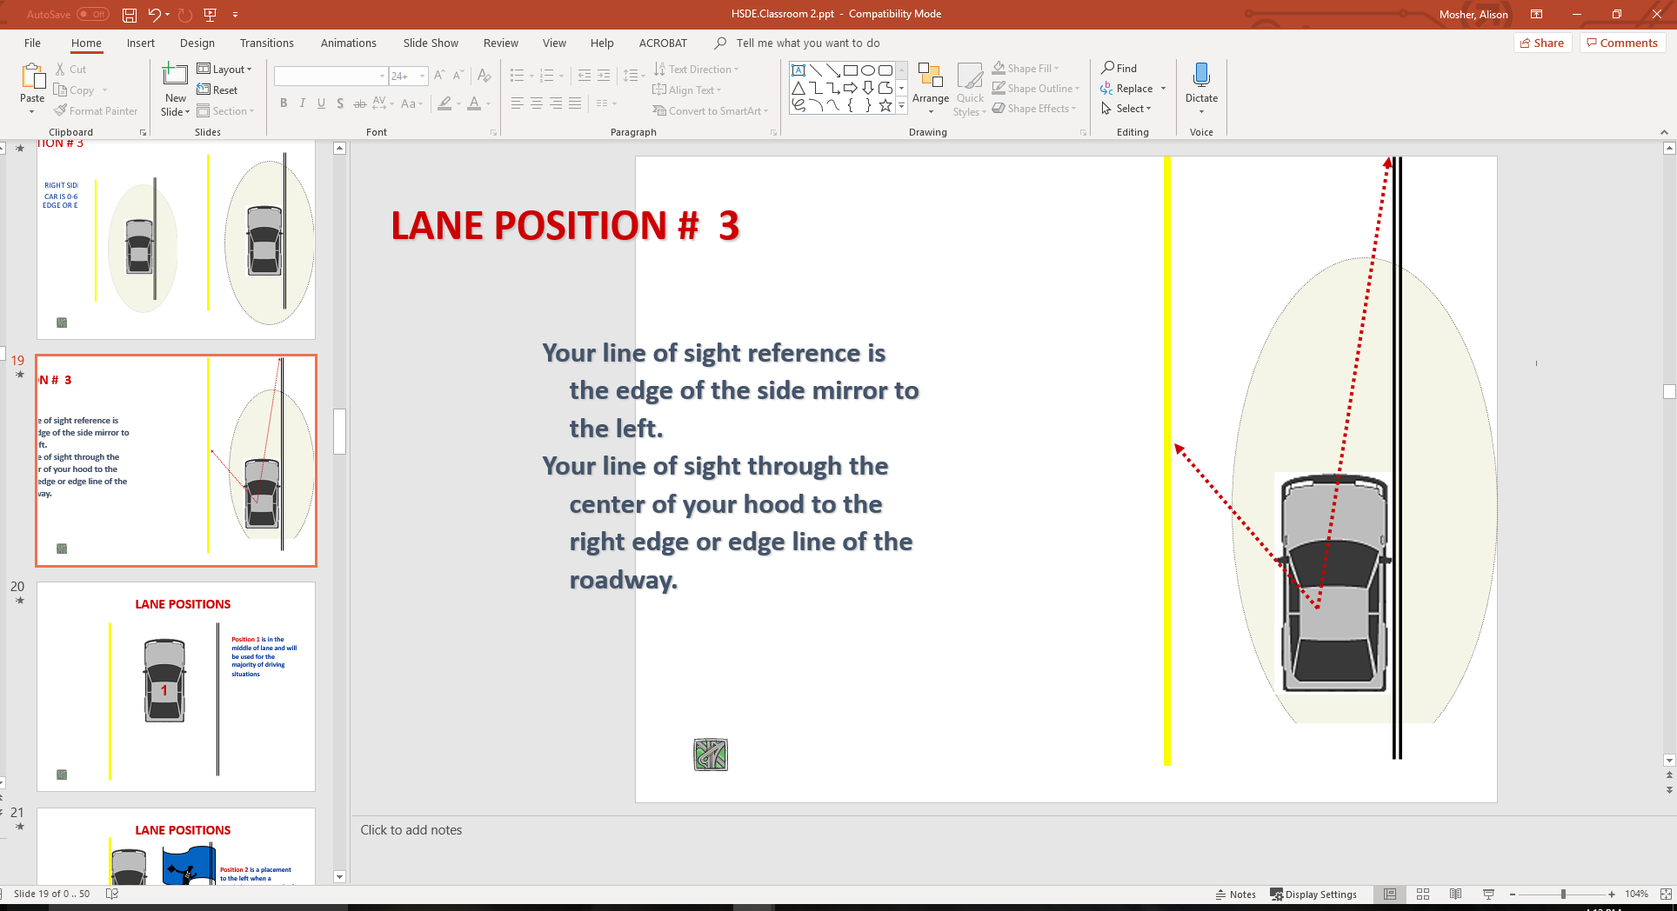
Lane Position # 3
Your line of sight reference is the edge of the side mirror to the left.
Your line of sight through the center of your hood to the right edge or edge line of the roadway.

Slide 20
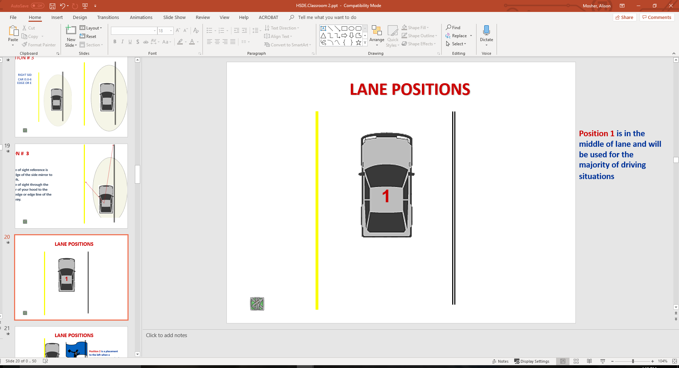
Lane Positions
Position 1 is in the middle of lane and will be used for the majority of driving situations

Slide 21
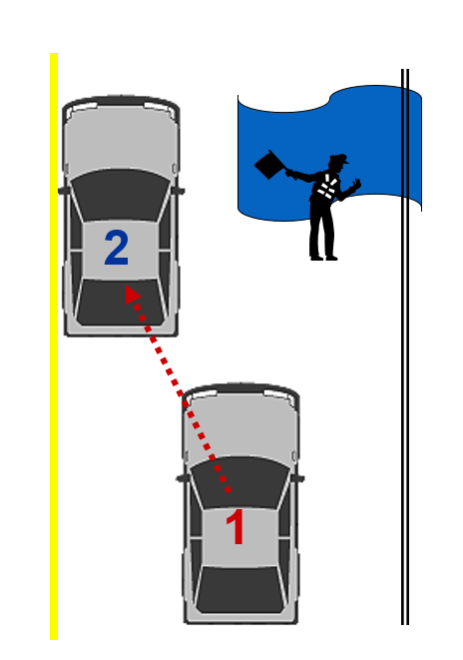
Lane Positions
Position 2 is a placement to the left when a restriction to your path of travel or your line of sight exists, without having to move out of the lane of travel.

Slide 22
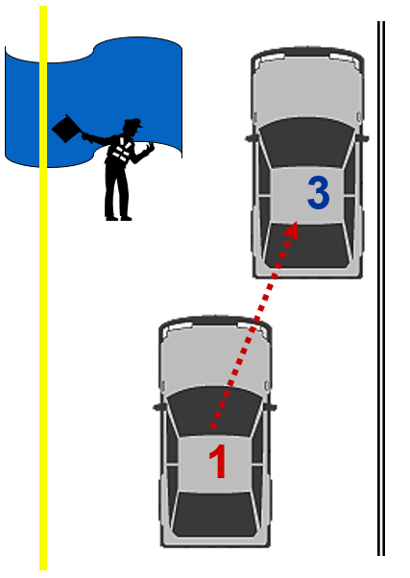
Lane Positions
Position 3 is a vehicle placement to the right when a restriction to your path of travel or your line of sight exists, without having to move out of the lane of travel.

Slide 23
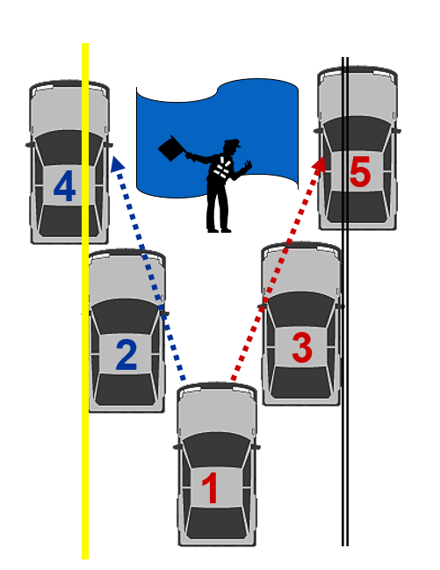
Possible Lane Positions
Lane positions or placement will allow the driver to make adjustments to potential problems and create more space between the car and problem situations.

Slide 24
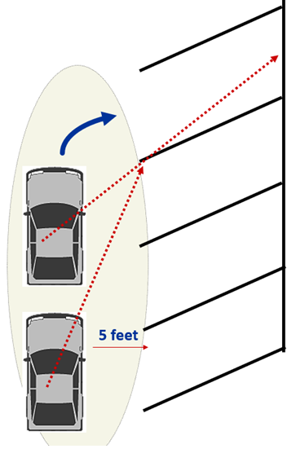
Angle Parking: Position and Turning Point
Place vehicle 5 feet from right side, target the middle of the parking space, and use right front turn point to initiate steering into middle of space.

Slide 25
Standard Reference Points
View “Reference Points”
Relates part of the vehicle to some part of the roadway.
Helpful visual relationship of your vehicle within the operating space.
Will know your vehicle placement within a lane at all times.
Will allow for reduced-risk lane placements

Slide 26
Getting Started With Your Vehicle

Slide 27
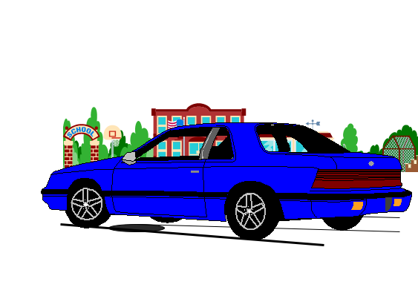
Pre-Drive Tasks
Check around the outside of vehicle for:
  broken glass (windows, lights)
  body damage
  condition of tires
  fluid leaks
  direction front tires are turned
  which way will vehicle move when placed in gear?
  debris on the ground that could interfere with movement.
Check for small children or pets near vehicle.

Slide 28
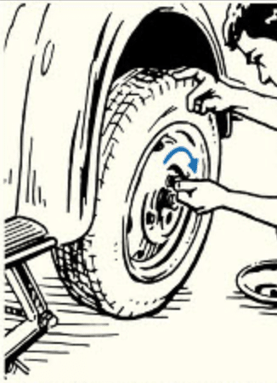
Pre-Drive Tasks – Safety Items for Trunk
Check to ensure that the following safety items are in the trunk of the vehicle:
  Spare tire
  Wheel wrench
  Tripod jack
  Jumper cables
  Toolkit
  Flashlight and extra batteries
  Reflective triangles and brightly colored cloth to make vehicle visible by side of the road
  Compass
  Nonperishable, high-energy foods, such as unsalted nuts, dried fruits, and hard candy
  Drinking water
  Reflective vest in case you need to walk for help
  Car charger for your cell phone
  Fire extinguisher
  Duct tape
  Rain poncho

Slide 29

Pre-Drive Tasks – Safety Items for Trunk
  First aid kit with the following items:
    Gauze
    Tape
    Bandages
    Antibiotic ointment
    Aspirin
    Blanket
    Nonlatex gloves
    Scissors
    Hydrocortisone
    Thermometer
    Tweezers
    Instant cold compress

Slide 30

Pre-Drive Tasks – Safety Items for Trunk
  — For winter, include the following items:
    Snow brush
    Shovel
    Windshield washer fluid
    Warm clothing
    Cat litter for traction
    Blankets

Slide 31
Pre-Drive Tasks
Store valuables in trunk of vehicle
  books and book bags have less chance of slipping off seats
  the vehicle is a classroom with no room for
    food, candy, and sodas
    homework and inattention in the rear
When parked at the curb
  approach from front of car
  increase awareness of oncoming traffic
  approach driver’s door with key in hand

Slide 32
Pre-Drive Tasks
When parked in parking lot
  approach from rear of car
  increase awareness of persons and objects in area
  driver’s door with key in hand
Unlock doors
Check traffic flow
Enter the vehicle

Slide 33
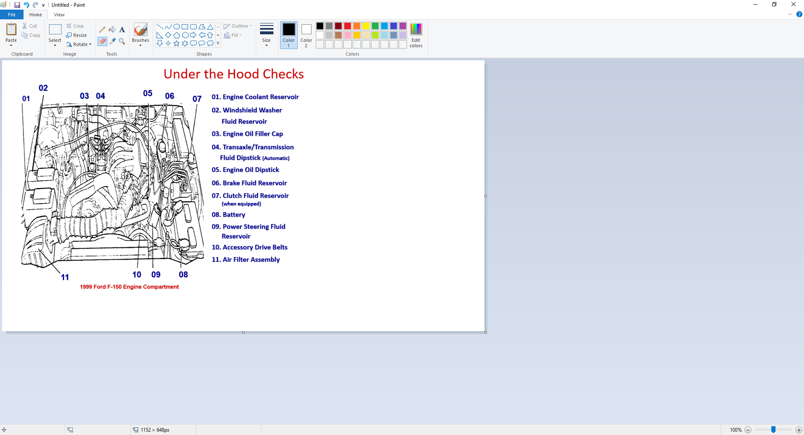
Under the Hood Checks

Slide 34

Driver Readiness Tasks
Security
  Check passengers for safe entry
  Lock doors
  Place key in appropriate location
Seating Position
  Adjust for driver foot pedal and dead pedal position
  Adjust for driver steering wheel reach and hand position
  Adjust for driver visual needs

Slide 35
Driver Readiness Tasks
Restraints
  Safety belt adjustment and appropriate air bag position
  Head restraint position (rear and side protection)
Mirrors
  Rear view mirror settings (200 feet to rear)
  Side view mirror settings (15 degrees out will gain side views)
    may be adjusted to view sides rather than rear view
    rear view needed when inside mirror view is blocked to rear

Slide 36
Starting Tasks
Check and set parking brake
Place foot on service brake
  Clutch required for standard shift transaxle/transmission
Place key in ignition and unlock
Place gear selector in park (P) or neutral (N)
  Automatic Transaxle/Transmission starts in (P)ark or (N)eutral
  (N)eutral recommended for standard transaxle/transmission

Slide 37
Starting Tasks
Check for choke/fuel injection needs
  does vehicle need choke (carburetor) to start?
  fuel injection (DO NOT PUSH ON ACCELERATOR BEFORE START)
Turn ignition to “on” for alert/warning lights
  airbag, seat belts, ABS, traction alerts, etc.
Turn ignition to “start”
Check alert lights and gauges
  are all systems functioning and ready to use?
Set needed accessories
  heating, ventilation, and air conditioning (HVAC), wipers, lights, etc.

Slide 38
Securing Tasks
Stop within a legal, secure parking space
  parked within appropriate distances of fire hydrant, intersection, RR crossing, legal parking zone, etc.
  keep foot on service brake
Set parking brake
  recommended in most new vehicle owner’s manuals
  protects transaxle and constant velocity joints
Place gear selector in (P)ark.
  place in recommended gear for standard shift transaxle or transmission
Turn off any vehicle accessories
  are all systems functioning and ready to use for next time?

Slide 39
Securing Tasks
Turn ignition switch to “off”
  the engine should shut off at this time with all accessories off
Lock ignition switch and remove key
  required to remove the key in most vehicles
Remove occupant restraints
  Some shoulder restraints operate when the door is opened
Check traffic and exit vehicle
  check traffic flow to rear prior to opening the door
  rear child safety door locks may need to be opened from the driver’s door
Secure doors and windows
  protects valuables and unauthorized entry by others

Slide 40
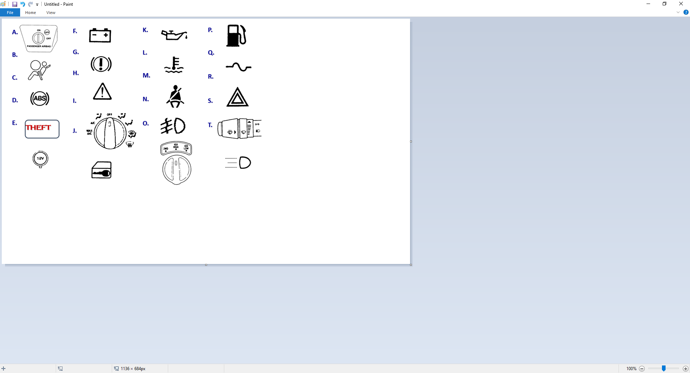
Alert/Warning Symbols and Controls

Slide 41
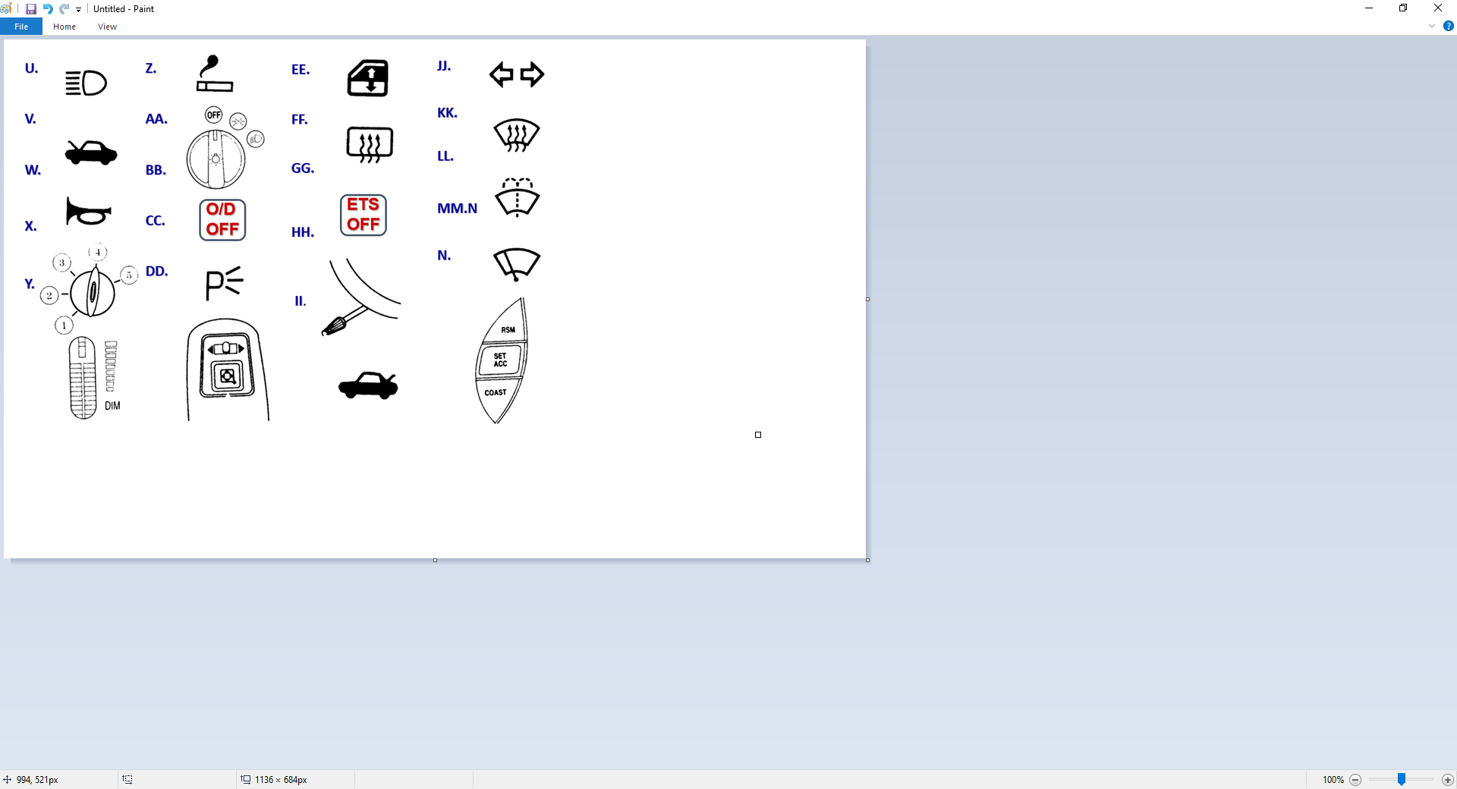
Alert/Warning Symbols and Controls

Slide 42
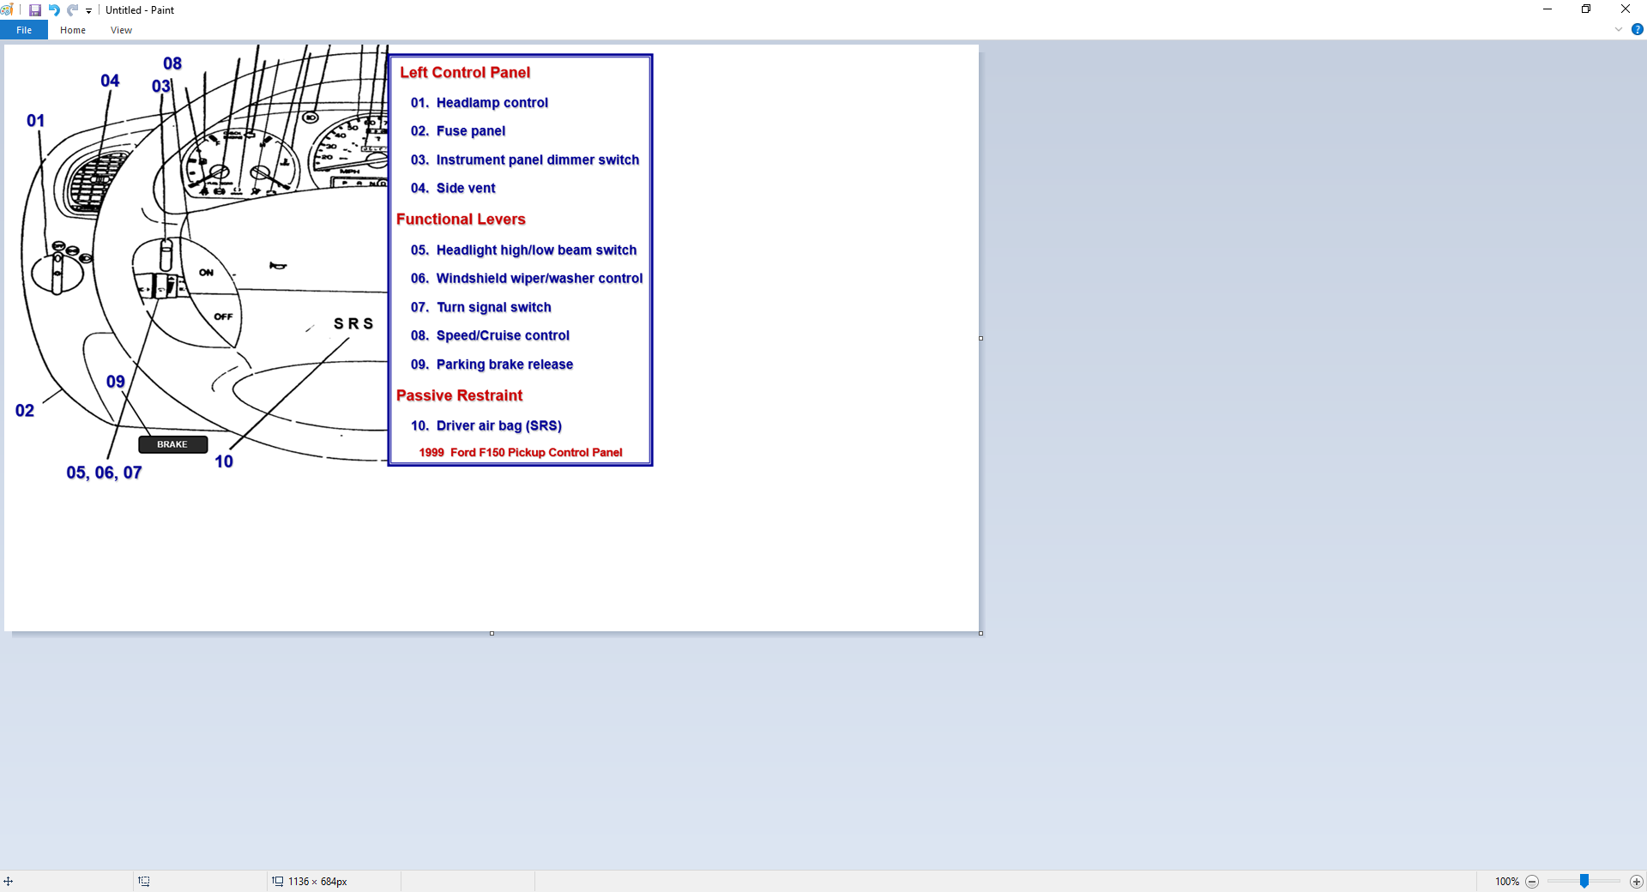
Control, Information, Comfort, and Safety Devices

Slide 43
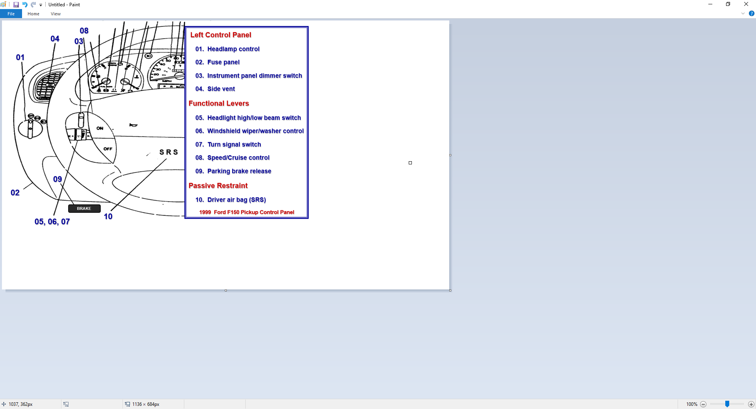
Control, Information, Comfort, and Safety Devices

Slide 44
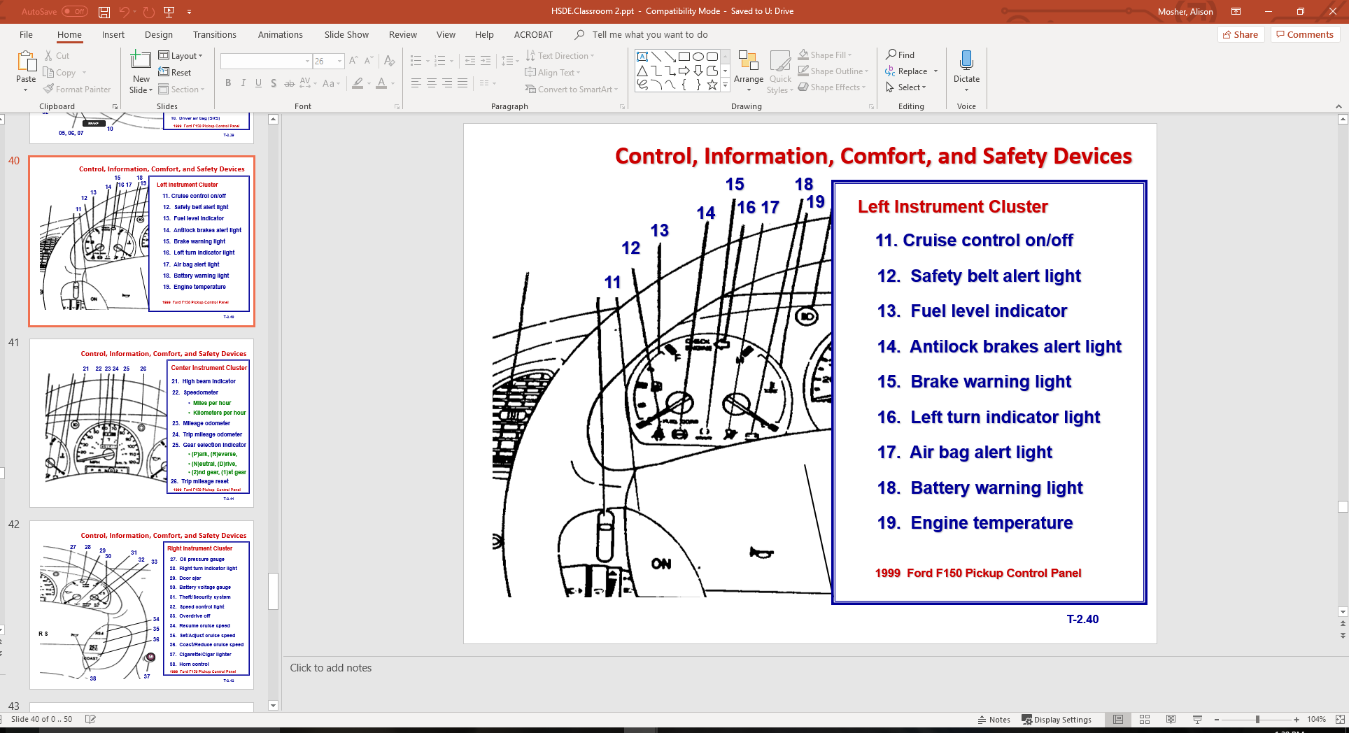
Control, Information, Comfort, and Safety Devices

Slide 45
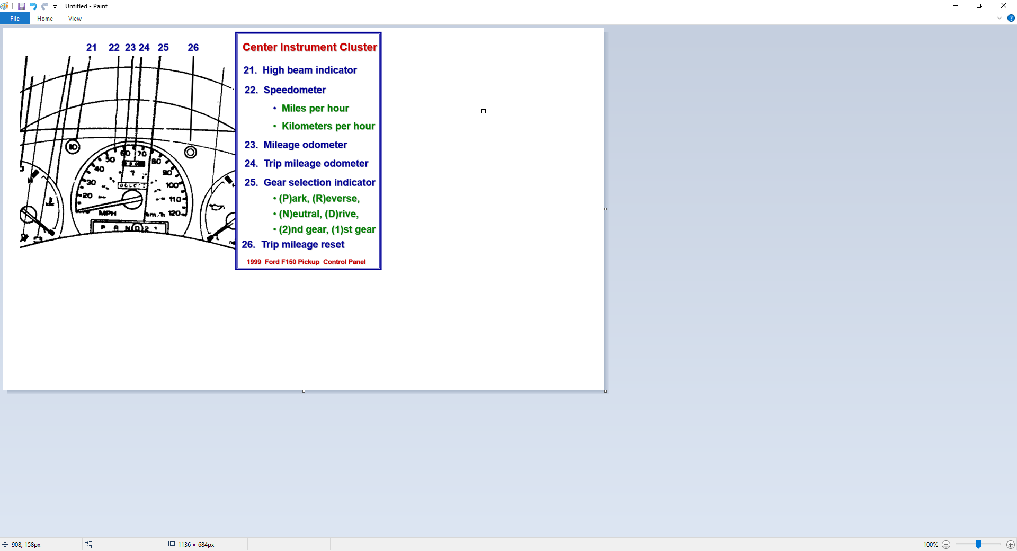
Control, Information, Comfort, and Safety Devices

Slide 46
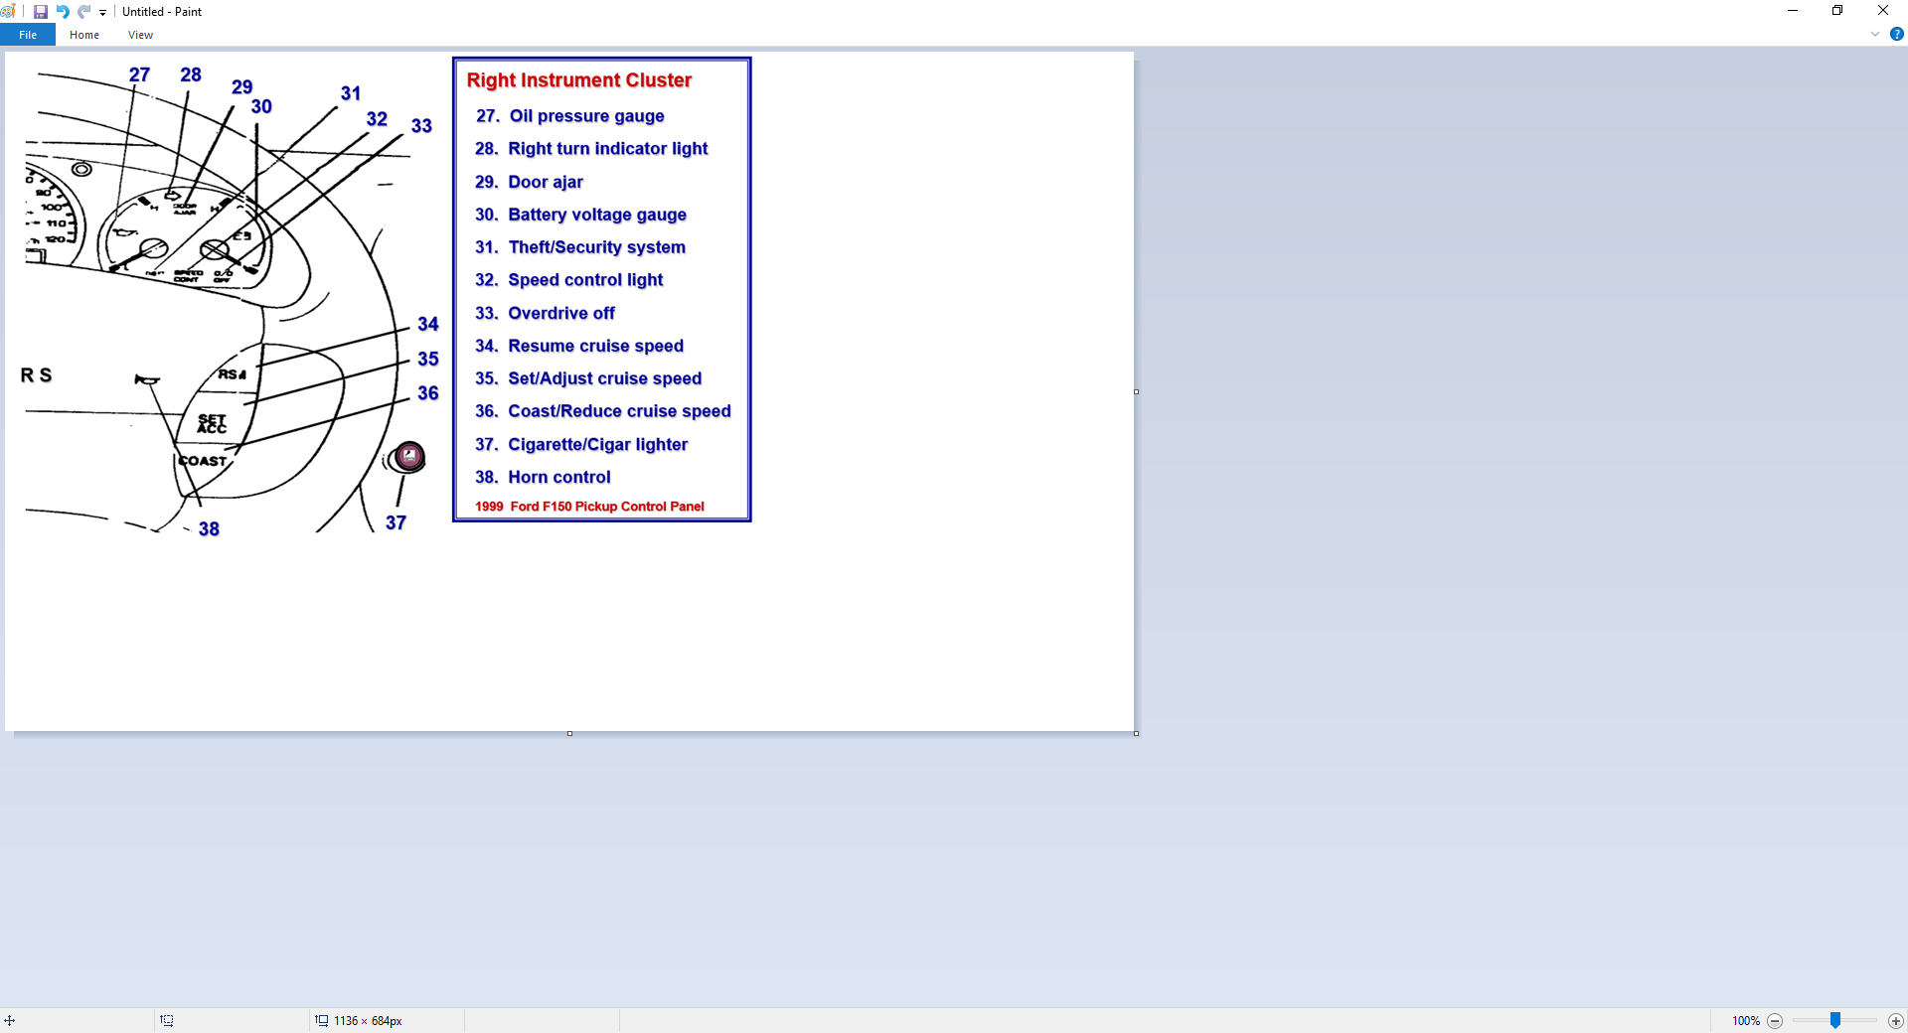
Control, Information, Comfort, and Safety Devices

Slide 47
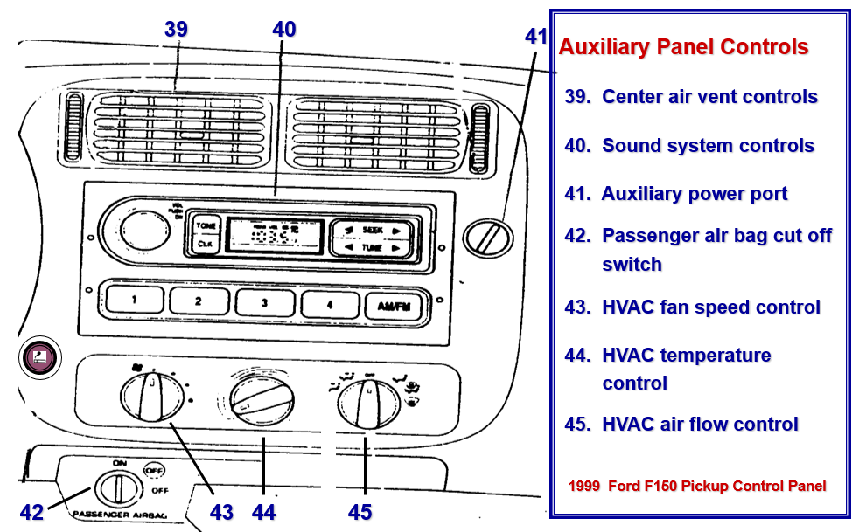
Control, Information, Comfort, and Safety Devices

Slide 48
Operating Vehicle Control Devices
Maintain Steering Position and Control
  Adjusting information devices
  Adjusting comfort devices
  Adjusting control devices
Move Steering Wheel Toward Path of Travel
  Moving forward
  Moving backward
Adjust Wheel Height/Angle
  Airbag deployment
  Hand position
  Wheel movement

Slide 49
Operating Vehicle Control Devices
Accelerator Pedal Use
  Used to stabilize, increase, and decrease speed
  The driver can
    cover accelerator, progressive acceleration, thrust acceleration, lift-off accelerator
Brake Pedal Use
  Used to stabilize, decrease, and increase speed
  The driver can
    cover brake, trail brake, controlled squeeze braking, threshold brake, lock brake, ABS, jab (stab) brake, lift-off brake

Slide 50
Operating Vehicle Control Devices
Gear Selector Lever Use
  Transaxle or Transmission type
  (O)verdrive and (D)rive gear use
Location of Parking Brake and Use
  Texas Traffic Law requires use when leaving vehicle
  Owner’s manual requests use before placing into (P)ark
Cruise / Speed Control
  Purpose of cruise control
  Danger of cruise control
Ignition Switch
  Location
  Function

Slide 51
Safety, Communication, and Convenience Devices
Mirrors
  Rear view adjustments
  Side view adjustments
Safety Belts
  Adjusting for maximum effectiveness
Head Restraints
  Protecting against whiplash
Horn
  Location
  Appropriate use

Slide 52
Safety, Communication, and Convenience Devices
Turn Signals
  Location and appropriate use prior to maneuver
  Lane change device
Door Locks
  Manual / Power devices
  Child proof rear
Hazard Flashers
  Location and use
Windshield Wipers & Washers
Headlights / Running Lights
  Location and use

Slide 53
Safety, Communication, and Convenience Devices
Turn Signals
  Location and appropriate use prior to maneuver
  Lane change device
Door Locks
  Manual / Power devices
  Child proof rear
Hazard Flashers
  Location and use
Windshield Wipers & Washers
Headlights / Running Lights
  Location and use

Slide 54
Safety, Communication, and Convenience Devices
Turn Signals
  Location and appropriate use prior to maneuver
  Lane change device
Door Locks
  Manual / Power devices
  Child proof rear
Hazard Flashers
  Location and use
Windshield Wipers & Washers
Headlights / Running Lights
  Location and use

Slide 55
Safety, Communication, and Convenience Devices
Hood Release
  Location and use
Trunk Release
  Location and use
Fuel Door Release
  Location and alternate opening device
Heat, Ventilation, and Air Conditioner (HVAC) Controls
  Fan, temperature, and ventilation location
  Defroster/Defogger operates air conditioning system
Seat Adjustment
  Power / Manual controls

Slide 56
Assignment
Find the controls on three vehicles
Bring an owner’s manual to class
Compare owner’s manuals for next class

Slide 57
Contact/Mission
For more information on Driver’s Education and Safety please visit PDE’s website at www.education.pa.gov
The mission of the Department of Education is to ensure that every learner has access to a world-class education system that academically prepares children and adults to succeed as productive citizens. Further, the Department seeks to establish a culture that is committed to improving opportunities throughout the commonwealth by ensuring that technical support, resources, and optimal learning environments are available for all students, whether children or adults.

