Slide 1
Driver Education Theory Sample Lesson 17
Developing Reduced-risk Behaviors: Factors that can Influence Behaviors

Slide 2
Developing Reduced-risk Behaviors: Factors that can Influence Behaviors
Topic 1 Forever A Child
Topic 2 Session Assessment
Topic 3 Fatigue and Driver Behavior
Topic 4 Recognizing Poor Driver behavior
Topic 5 Anger Management and Driver Behavior
Topic 6 Unusual Roadway Conditions

Slide 3
Introduction
Alcohol Review…Forever A Child
Managing Fatigue
Managing Anger
Managing Roadway Conditions

Slide 4
Definition of Fatigue
Fatigue is
  A Body Response
  Follows a Period of:
    Extended mental activity
    Extended bodily activity
  Characterized by:
    Reduced capacity for work
    Reduced efficiency of accomplishment

Slide 5
Causes of Fatigue
Extended Physical Activity
  Disruption of Circadian Rhythm
  Sleep period danger: 12 a.m. to 6 a.m.
  Sleep period danger: 1 p.m. to 3 p.m.
Emotional Stress
Sleep Disorders

Slide 6
Physical Symptoms of Fatigue
Tired Muscles
General Body Sensation of Tiredness
Sleepiness
A Tired Feeling in the Head

Slide 7
Physical Symptoms of Fatigue continued
Localized Pain in the Back of the Head
Pain and Soreness in Muscles
Stiffness in Joints
Swelling of Hands and Feet

Slide 8
Mental Symptoms of Fatigue
Inability to Keep Fixed Attention
Impaired Memory
Failure to Grasp New Ideas
Difficulty/Slowness in Reasoning

Slide 9
Delaying Fatigue Onset
Avoid Long Drives Unless Fit
Avoid Leaning Forward
Avoid Driving Long Stretches
Keep Your Eyes moving
Let in Fresh Air

Slide 10
Delaying fatigue Symptoms
Change Drivers at Regular Intervals
Wear Your Safety Belt
Avoid Getting Angry
Proper Adjustment of HVAC

Slide 11
Formula for Road Rage
Cultural Norms of Disrespect Condoning Hostility
+
More Cars Less Space More Driver Interactions
=
Aggressive Driving and Road Rage Battery

Slide 12
Three Types of Aggressive Driving
Aggressive Driving and Road Rage Battles
Quiet Road Rage:
  Complaining, rushing, competing, resisting
Verbal Road Rage:
  Yelling, cussing, staring, honking, insulting
Epic Road Rage:
  Cutting off, blocking, chasing, fighting, shooting

Slide 13
Driving Errors May Include…
Braking suddenly to scare a tailgater
Exceeding speed limits by more than 10 mph
Changing lanes without signaling
Cruising in the passing lane
Criticizing other drivers

Slide 14
Other Driving Errors May Include….
Students List Other Driving Errors

Slide 15
Do You Drive Aggressively?
Learning how to evaluate your driving space area is critical.

Slide 16
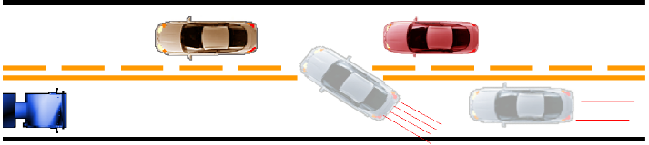
The “Rush In” Area
Constant rushing and lane jumping is your style.
Others are just in your way. Get ahead
Ignore road signs and regulations, they’re for other drivers.
Driving with distractions, low alertness, inattention.

Slide 17
The “Total Aggression” Area
Constantly ridiculing and coitizing other drivers to self or passengers
Closing gap to deny entry into your lane
Give the “look” to show your disapproval
Speeding past another car, revving engine

Slide 18
The “Total Aggression” Area continued
Preventing others from passing you
Tailgating to pressure a driver to go fast or get out of your way
Fantasizing physical violence
Honking, yelling through window
Making visible insulting gestures

Slide 19
The “Violence” Area
Carrying a weapon, just in case…
Deliberately bumping or ramming
Trying to run a car off the road to punish
Getting out of the car, beating or battering someone
Trying to run someone down
Shooting at another car
Thoughts of killing someone

Slide 20
Aggressive Driving
IRRATIONAL ACTIONS WHILE DRIVING
CREATE ANGER

Slide 21
Self-Imposed Anxieties
“I’m going to be late if I don’t hurry up.”
“Why are these cars going so slow?”
“We’ll never make it.”
“If only I had gone a little faster, I could’ve made it.”
“Oh no! Red light!”

Slide 22
Dangerous Maneuvering
“All of these cars are trying to squeeze in!”
“I have a lead foot.”
“Ha! I’ll speed up and show him a lesson.”
“Everyone else is speeding!”
“Let’s tailgate this car in front of me.”
‘He’s driving too slow!”

Slide 23
Anger Containment Techniques
Don’t respond
Don’t engage
Don’t up the ante
Swallow your pride
Choose the road “less traveled”

Slide 24
Anger Management
Making errors
Responding to errors
Controlling emotions
Responding to problems

Slide 25
Managing Anger
How would you like others to act if you did something dangerous like this?
React the same way you would like them to react to your mistakes

Slide 26
Changing Visibility at Night
Limitations of gathering information
Limitations placed on processing information
Night driving facts:
  Reduced illumination
  Ability of the eyes to adjust to glare

Slide 27
Changing Visibility at Night continued
Distance you can see ahead is limited
Headlights provide limited illumination of off-road areas
Loss of contrast and impaired distance judgement
Glare from lights or oncoming and following vehicles
Glare recovery time

Slide 28
Headlight Alignment and Speed
Properly aligned low beams:
Beam hits roadway 100 to 150 feet ahead
Illumination area 300 to 500 feet ahead
Load, load distribution, and vehicle height affect light beam distance
Maximum safe speed 40 to 45 mph based on ability to stop within lighted area

Slide 29
Headlight Alignment and Speed continued
Properly aligned high beams:
Beams hit roadway 350 to 500 feet ahead
Illuminate area of road 500 to 1800 feet ahead
Load, load distribution, and vehicle height affect light beam distance
Maximum safe speed 65 to 70 mph, based on ability to stop within lighted area

Slide 30
Nighttime Precautionary Measures
Clean windshield inside and out
  Special problem of windblown sand/dirt particles
  Diffused light gives appearance of halo around headlights of oncoming vehicle. Clean all lights
  50 % to 90 % loss of headlight efficiency due to road grime
Reduce daytime speed
Increase following distance
Look to right of oncoming vehicle

Slide 31
Nighttime Precautionary Measures continued
Turn off interior convenience lights
Proper use of high/low headlight beams
Use parking lights only when parked
If stopped beside road, take appropriate safety measures
Use day/night switch on rear-view mirror

Slide 32

Visibility Limitations in Fog
Driving in Drifting Fog
Reduce speed
Make sure headlights are on
low beam to reduce reflective
glare
Turn on windshield wipers
Turn on defroster or air conditioner

Slide 33
Visibility Limitations in Fog
Driving in Heavy Fog
Reduce Speed, but do not stop in a trvel lane
Turn on emergency flashers
Look for an exit from the highway
If impossible to heave highway
  Stop beyond end of guard rail
  Back up to outboard of guard rail
  Turn off all lights
  Wait for fog to lift

Slide 34



Visibility Limitations in Bad Weather
Reduce speed imposed by ability to stop
Do not stop in travel lane or shoulder
Turn headlights to low beams
Turn on emergency flashers when
below speed limit
Maintain appropriate lane position
It your stopping distance is longer
than your range of visibility, you are at risk
Stopping
Distance
Visibility
Range

Slide 35
Precautions in Bad Weather
Turn on windshield wipers
Be alert for vehicles stopping in roadway
Be prepared for effects of guesting or strong steady crosswinds
Make steering, acceleration and braking actions gently and smoothly

Slide 36
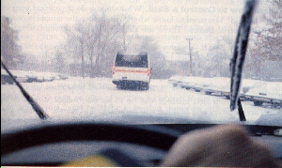
Precautions in Bad Weather continued
In severe snow conditions, look for exit from highway and turn on radio for weather reports
If impossible to leave highway, stop beyond the outbound end of guard rail
Use cell phone or radio to check conditions
Smoke, ice, and snow require use of windshield wipers
When windshield wipers are turned on, headlights must be turned on

Slide 37
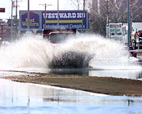
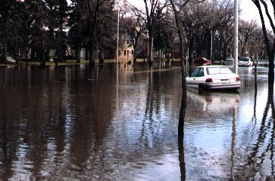
Low Water Crossings
Flash Flooding Conditions
Not Specific to Time of year
Dangerous Conditions

Slide 38
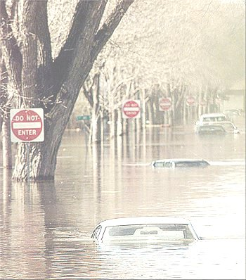
Low Water Crossings
Nearly 50% of flash flood fatalities are vehicle
related
Search for flood prone areas:
  highway dips
  bridges
  low areas
Largest and heaviest of vehicles will float
Six inches of water may cause loss of control

Slide 39
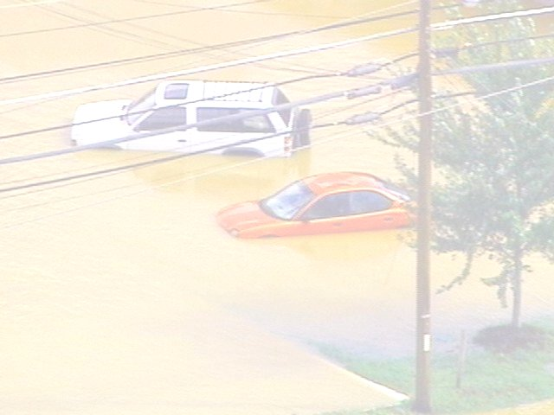
Low Water Crossings continued
Two feet of water carries most cars
Hidden danger awaits most motorists
Visibility is limited at night
Heed all flood warnings
Heed all flash flood watches and warnings
Keep aware of road conditions through news media

Slide 40
Extreme Hot or Cold Temperatures
Additional Demands on Vehicle System
    High temperatures of summer +120
    Low temperatures of winter
  If not addressed, then
    Impairs your ability to assess conditions +32°
    Impairs your ability to respond
    in a timely manner
    Creates conditions of increased risk -40°
O

Slide 41
Cold Weather Precautions
Tires for balance, alignment, appropriate type and depth of tread
  Minimum legal 2/32 of an inch tread depth inadequate on all wet surfaces
Tire inflation
  Keep track of cold tire pressure (noted inside driver door)
  Maximum tire pressure indicated on tire sidewalls
Radiator coolant, hoses, and connections

Slide 42
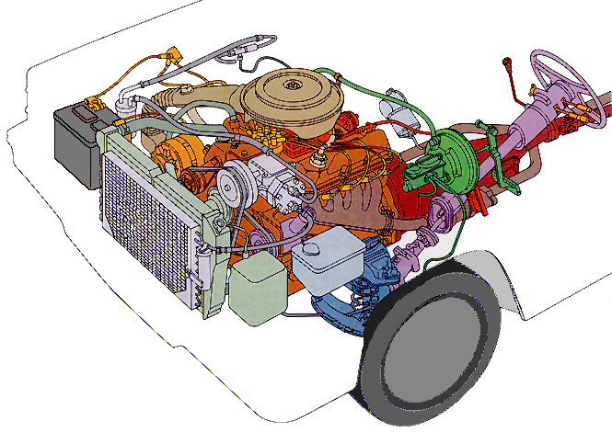
Cold Weather Checks
Heater, defroster and air conditioner systems
Drive belts for tension and wear
Winterized windshield wiper fluid
Winterized wiper blades
Lights and glass areas are clear and clean

Slide 43
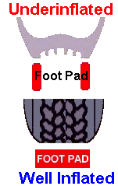
Hot Weather Checks
Tire inflation needs special attention
  Under-inflated tires are subject to heat and pressure buildup
  Especially when driving for extended distances at higher speed
The air conditioner, radiator coolant, hoses, connections, and drive belts need special attention
  Due to the extra load placed on the engine
  Due to the extra load placed on the cooling system

Slide 44
Next Session…..
Classroom assessment seven
Vehicle malfunctions
Traction loss
Controlling unusual situations

Slide 45
Contact/Mission
For more information on the (the topic of the presentation) please visit PDE’s website at www.education.pa.gov
The mission of the Department of Education is to ensure that every learner has access to a world-class education system that academically prepares children and adults to succeed as productive citizens. Further, the Department seeks to establish a culture that is committed to improving opportunities throughout the commonwealth by ensuring that technical support, resources, and optimal learning environments are available for all students, whether children or adults.

