Slide 1
Driver Education Theory Sample Lesson 18
Developing Driver Responsibility
Reducing Risk Involvement

Slide 2
Developing Driver Responsibilities & Reducing Risk Involvement
Topic 1 Using Occupant Restraints Effectively
Topic 2 Understanding Vehicle Traction Loss Concepts
Topic 3 Recognizing Vehicle Traction Loss
Topic 4 Responding to Vehicle Traction Losses
Topic 5 Traction Loss Technology
Topic 6 Responding to Vehicle Malfunction

Slide 3
Introduction
Session Assessment Seven…
Last session
  Dealing with distractions, unusual driving situations
In-Car assessments continuing
This session
  Reducing risk situations
  Restraints, traction loss, off-road recovery

Slide 4
Session Assessment Seven…
Prove that a 16 oz. beer @ 4.5 %, a jigger (1.5 oz. ) of whiskey @ 80 proof, and a 4 oz. wine @12% do not have the same amount of alcohol content…
How is the best way to avoid a DUI violation in the Commonwealth?
How does food help slow down Blood Alcohol Concentration?
Name four ways that alcohol affects the body…
Do all persons remove alcohol at the rate of 1 drink per hour. Explain why…
List four ways that alcohol impairs vision…
List four ways that night time changes your driving ability…

Slide 5
Session Assessment Seven…
Define Fatigue in relation to driving…
How can a driver delay fatigue symptoms?
List three types of aggressive driving…
List four ways to control visual limitations in fog…
List four concerns at low Water crossings…

Slide 6
Assessment Seven Answers…
Prove that a 16 oz. beer @ 4.5 %, a jigger (1.5 oz. ) of whiskey @ 80 proof, and a 4 oz. wine @12% do not have the same amount of alcohol content…
  Beer is 16 X .045 = .72 oz; Whiskey is 1.5 X .40 = .60 oz; and Wine is 4 X .12 = .48 oz.
How is the best way to avoid a DUI violation in the Commonwealth?
  Do not use alcohol or other drugs while operating a motor vehicle.
How does food help slow down Blood Alcohol Concentration?
  The food slows down the action of the stomach for digestion, closes the pyloric valve for periods of time; therefore slowing down the time it takes to get into the duodenum or small intestine.

Slide 7
Assessment Seven Answers
Name four ways that alcohol affects the body…
  Liver, Heart, Sexuality, Sleep, Stomach, Brain
Do all persons remove alcohol at the rate of 1 drink per hour. Explain why…
  No, as it depends on how much one drink increases your BAC. A person with less weight may have a .03 after one drink, whereas the liver and body only removes about .015 each hour.
List four ways that alcohol impairs vision…
  Side vision, visual Acuity, Color Distinction, Eye Focus, Double Vision, and Distance Judgement

Slide 8
Assessment seven Answers…
List four ways that night time changes your driving ability…
  Distance you can see ahead is limited, Headlights provide limited illumination of off-road areas, Loss of contrast and Impaired distance judgement, Glare from lights of oncoming and following vehicles, and Glare recovery time
Define Fatigue in relation to driving…
  A Body Response that follows a period of extended mental activity and/or extended bodily activity that is characterized by reduced capacity for work and /or reduced efficiency of accomplishment.
How can a driver delay fatigue symptoms?
  Change Drivers at regular Intervals, Wear your Safety Belt, Avoid Getting Angry, and Proper Adjustment of HVAC.

Slide 9
Assessment Seven Answers…
List three types of aggressive driving…
  Quiet Road Rage, Verbal Road Rage, and Epic Road Rage
List four ways to control visual limitations in fog…
  Reduce sped, Keep headlights on low beam to reduce reflective glare, turn on windshield wipers, turn on defroster or air conditioning, reduce speed but do not stop in travel lane, Pull off roadway beyond a guardrail, turn on emergency flashers, Look for an exit from the highway.
List four concerns at low Water crossings…
  Nearly 50% of flash flood fatalities are vehicle related. Search for flood prone areas like highway dips, bridges, and low areas. All vehicles will float away. Six inches of water can cause loss of control, Two feet of water will carry off most cars, Hidden dangers awaits most motorists. Visibility is limited at night. Heed all flood warnings. Heed all flash flood watches and warnings. Keep aware of road conditions through news media.

Slide 10
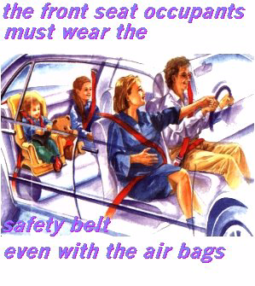
Occupant Restraints
Passive Restraints
  Front Driver and Passenger Air Bags
  Side Impact Restraints
  Knee Bumpers/Restraints
  Anti-pedestrian Windshield
  Rear Seat Passenger Air Bags
  Automated Shoulder Safety Belts
  Automated Head Restraints
Active Restraints
  Safety Belts
  Head Restraint
  Child Booster Seats
  Child Safety Seats

Slide 11
Adjusting Occupant Restraints
Snug lap belt after fastening across hips or thighs
Adjust center post mounting for height if vehicle is equipped with device
Belt over top of shoulder and across chest distributes force in event of crash
  Do not place shoulder harness behind shoulder or back
  Serious injury in crash occurs

Slide 12
Adjusting Occupant Restraints
Check frequently for snug fit
Keeping seat back in more
upright position avoids
submarine effect in frontal
crash
Expect movement of belted
occupants in a crash
Different types of locking
devices

Slide 13
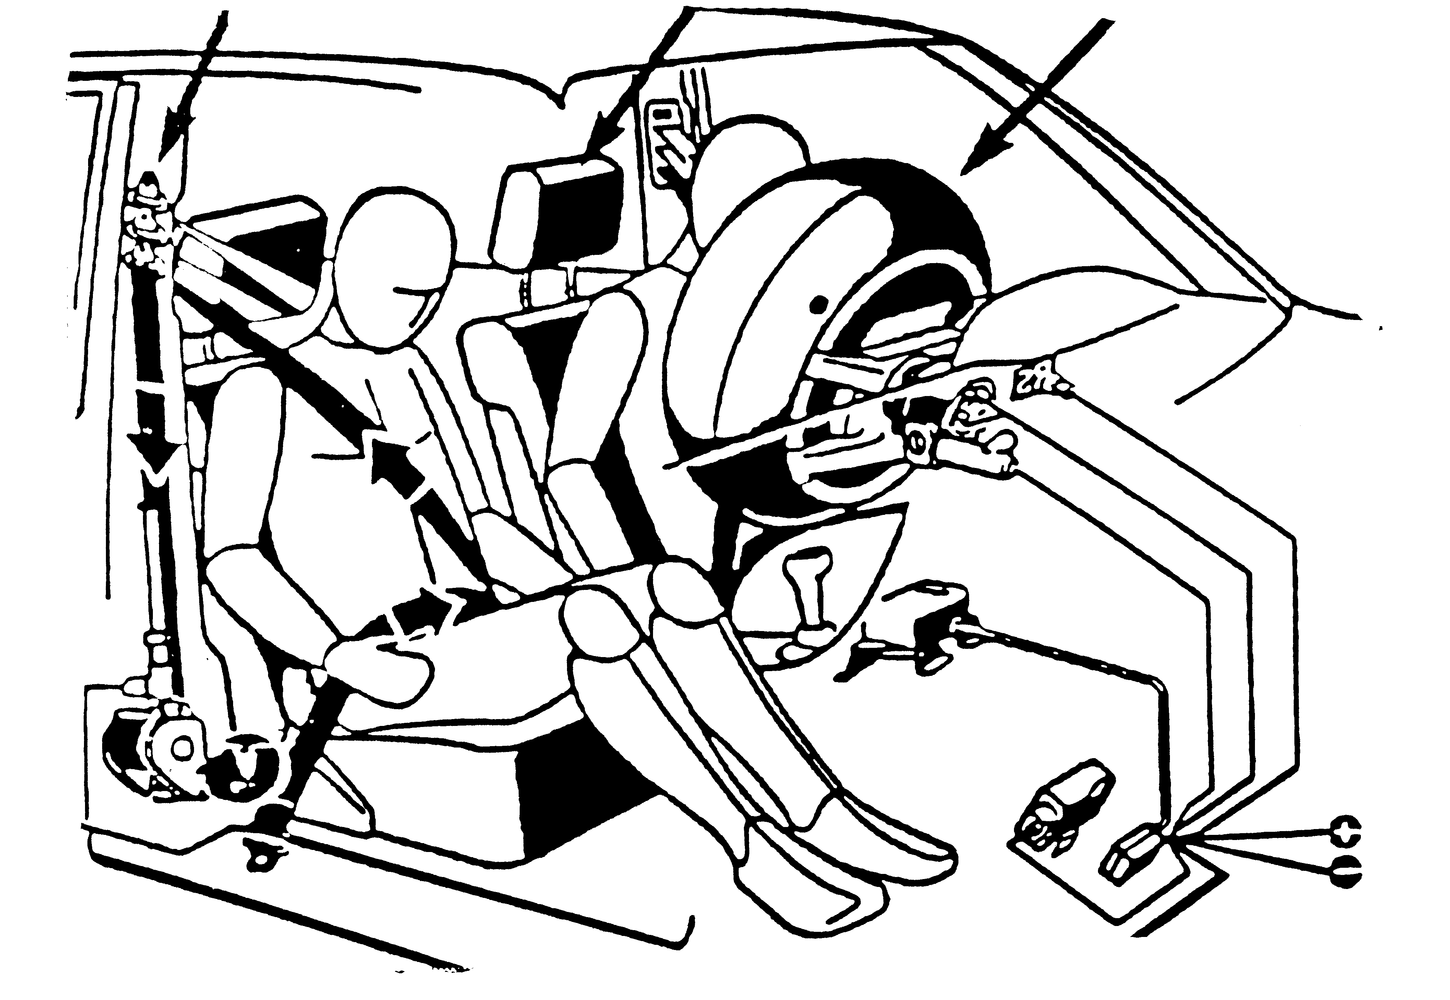
Supplemental Restraints…Air Bags
No passenger under 12 years of age in front seat
Protects against head and chest injuries
Speed of inflation is critical
Driver should adjust seat for minimum of 10 inches clearance between chest and steering wheel

Slide 14
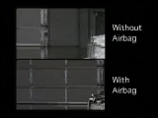
Crash With v Without Airbags

Slide 15

Supplemental Restraints…Head Restraints & Side Air Bags
Head Restraints
  Proper adjustment at least to ear level to avoid neck injury
  Allows driver to stay in seat position to aid in vehicle control
  Some newer vehicles have device to bring headrest in position during crash
Air Bags for Side Impact Protection
Upper door frame
Seat edge/door panel

Slide 16
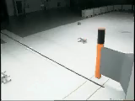
Side Impact Protection

Slide 17
Youth Occupant Protection
Recommended Belt & Seat Restraint
  Safest if seated in back seat
  Infant seats/rear facing/birth to 20 lbs.
  Child seats up to 40 lbs.
  Booster seats up to 60 lbs.
Head restraints
  Proper adjustment to avoid neck injury
  Seat position

Slide 18
Occupant Protection System
Adjustable
Shoulder-Belt Mount Head Restraint Air Bag
Gases Vent
Opening
Crash Sensors

Slide 19
Occupant Restraints Protect
Against Ejection from Vehicle
Against Fire and water Immersion
Protects Child from Impact instead of holding child on your lap
Protects Occupants at Point of Impact

Slide 20
Movement of Belted occupant
Head = 1.9 feet
Chest = 1.3 feet
Pelvis = 1.2 feet

Slide 21
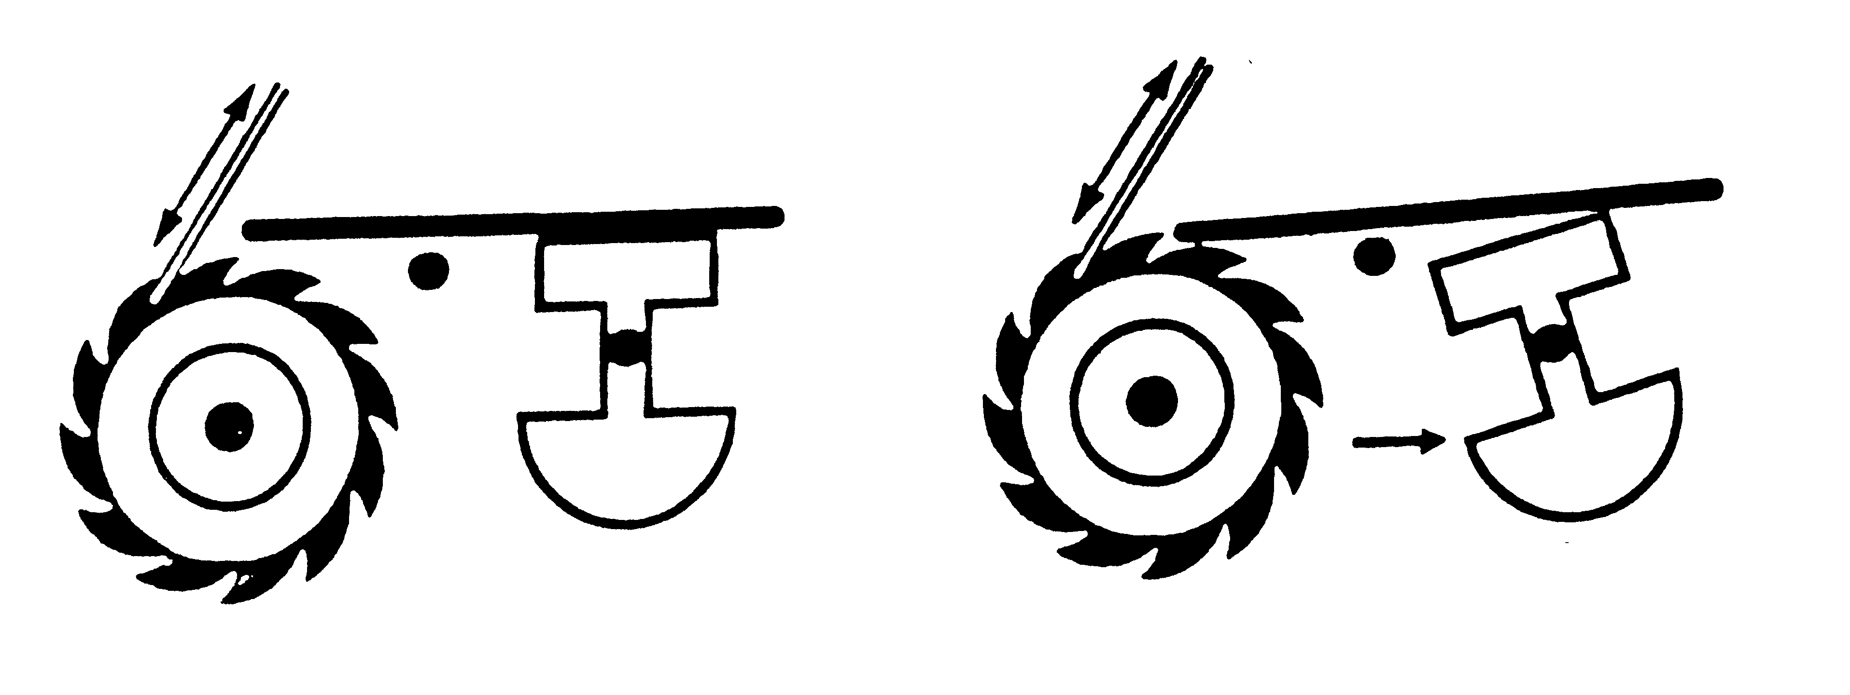
Belt-Locking System
Sudden Car Movement
Normal Conditions Emergency Conditions
Seat Belt Seat Belt
Bar Bar
Pendulum Pendulum
Ratchet Mechanism Ratchet Mechanism
Seat Belt
Bar
Seat Belt
Bar
Pendulum
Pendulum

Slide 22
Adjusting Belts for Proper Fit
Lap Belt
  Low across hips
  Snug across hips
  Avoids internal injuries
Shoulder Belt
  Over collar bone and chest
  Avoids shoulder dislocation
  Avoids rib cage damage

Slide 23

Seat Belt Video Clip

Slide 24




Reducing Crash Risk and Consequences
Avoid Head-On Collisions
Drive off road rather than skid off road
Hit something soft rather than something hard
Hit something going your way rather than something stationary
Hit stationary objects with glancing blow
Hit stationary objects rather than an approaching object
Steer to avoid oncoming traffic

Slide 25
Notice Unusual Roadway Conditions
Roadway changes due to ice, snow, or frost
Wet surfaces, particularly first 15 minutes of rain after long dry periods when drops of oil and rubber particles have collected on roadways
Hard rain or water standing on road
Mud near farm entrances, construction sites, and truck crossings

Slide 26
Notice Unusual Roadway Conditions
Wet leaves
Broken or uneven road surface
Sand or gravel frequently found on curves in rural areas
Look for flat curve, banked the wrong way, or loss of traction which can occur on dry sruface but more likely when slippery

Slide 27
Modern Automotive Technology
Anti-Lock Brakes
Traction Control Devices
Electronic Handling & Stability Programs
Suspension Control Devices
Electro-Hydraulic Brakes
Electronic Steering Assist
Tire Technology
Crumple Zone
Forward Collision Warning (FCW)
Lane Departure Warnings (LDW)

Slide 28
Modern Automotive Technology continued
Lane Assist
Blind Spot Warnings (BSW)
Back Up Cameras
Self Parallel Parking
Automatic Emergency Braking (AEB)
Adaptive Cruise Control (ACC)
Lane Keep Assist (LKA)

Slide 29
ABS Advantages
Enhanced Braking Action
Vehicle Steering Ability
Vehicle Stability
Stopping Distance on Wet Surfaces

Slide 30
With ABS….Do
Add to your following distance in bad weather
Practice use of ABS
Keep your foot firmly on the brake pedal
Check owner’s manual for special concerns

Slide 31
With ABS…. Do Not
Drive more aggressively
Pump the Brakes
Steer Too Much
Be Alarmed by ABS Noise or Vibration

Slide 32
Causes of Loss Traction
Vehicle Conditions
  Brakes unevenly adjusted
    Brakes pulling in one direction or the other can cause a skid, as can wheels out of alignment when brakes are applied
  Tires with worn tread
    Front and rear pairs not matched to size
    Front and rear tread depth or type
  Different pressure on opposite sides have effect similar to uneven brake adjustment since one tire will drag more than the others

Slide 33
Causes of Loss Traction
Driver Actions
Sudden steering action on a slippery surface
Abrupt or sudden changes in vehicle speed
Panic stop or applying brakes too hard on hill, curves or slippery surfaces
Sudden engagement of clutch on slippery surface
Most driver-induced skids are caused by:
  Excessive speed
  Coupled with excessive steering input
  Or improper braking when turning
  Same actions as normal speed on ice/snow or on roadways covered by sand, gravel, or water

Slide 34
Traction Loss Considerations
Sudden shift of vehicle causes traction loss
  To the Left, Right, Forward or Backward
Simultaneous steering, braking and/or acceleration creates sudden shifts in vehicle balance
Traction loss compounds crash consequences

Slide 35
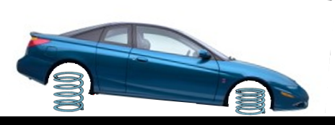
Traction Loss Considerations
When Brakes are Applied… Too hard or Too Quickly
  Weight Moves to Front of the Car
  Weight Movement or Brake Force Causes
    Noticeable drop of the hood
    Noticeable rise of the rear deck
    Forward movement of driver and passengers
Vehicle Movements
Hard/Quick Braking Force or Weight Movement
Direction of Travel

Slide 36
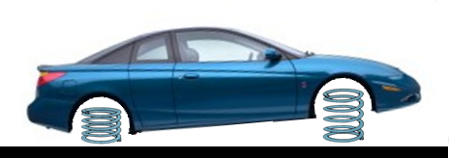
Traction Loss Consideration
When Acceleration is Applied Too Hard or Quickly
  Weight Moves to the Rear of the Car
  Weight Movement or Acceleration Force Causes
    Noticeable rise of the hood
    Noticeable drop of the rear deck
    Rearward movement of driver and passengers
Hard/Quick Acceleration Force or Weight Movement
Vehicle Movements
Direction of Travel

Slide 37
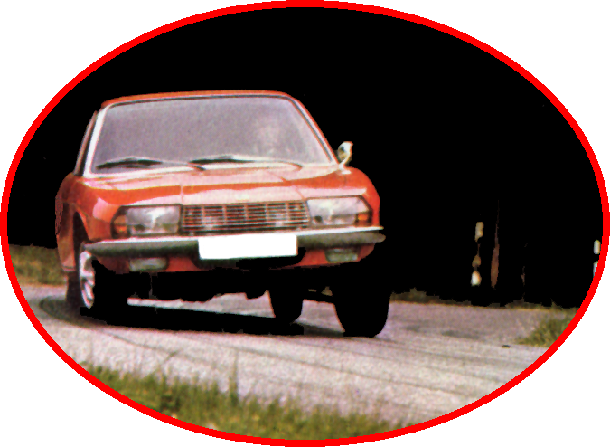

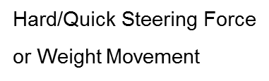


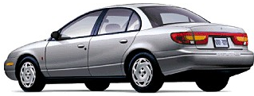
Traction Loss Consideration
When Steering is Applied Too Hard or Quickly
  Weight Moves to the Opposite Corner of the Car
  Weight Movement causes as
    Noticeable drop and tilt of the hood
    Noticeable rise and tilt of the rear deck
    Driver and passenger movement to the car’s corner

Slide 38




Traction Loss to Front Tires
A Vehicle Keeps Moving straight Ahead Despite Steering Efforts Means Traction is Lost
Technical Term is “Understeer”
Driver Must Visually Identify Unusual Movement
Vehicle Weight Tends to Push Front Wheels Straight Ahead Regardless of Steering Input

Slide 39


Front Traction Loss Correction
Direct Vision to Targeted Path of Travel
Activate ABS, if equipped
  Ease off Conventional Brake System
  Reestablish Rolling Traction
Ease of Steering Input
  Quick Steering Creates More Traction Loss
  Allows Tire tread to Point toward Path of Travel
If Not Equipped with ABS, Jab/Stab Brake to Move Weight Forward (ABS performs this function automatically)

Slide 40


Traction Loss to Rear Tires
Identified visually as front of vehicle moves left to right of travel path without steering input in that direction
Technical term is “Oversteering”
Reduced Traction Rear Tires Assume Steering Position
Vehicle Weight Tends to Push Rear Wheels Left or Right Without Steering Input

Slide 41


Rear Traction Loss Correction
Direct Vision to Targeted Path of Travel
Activate Traction Control System if Equipped:
  Ease off brake or accelerator if not equipped
  Reestablish Rolling Traction
Steer towards Targeted Path of Travel
Adjust Steering Input as Needed to Maintain Targeted Path of Travel to Open Space Area
Light Progressive Acceleration (2 mph is the goal) will Move Weight to rear, (Traction Control System will adjust the speed of brakes automatically while activated)

Slide 42

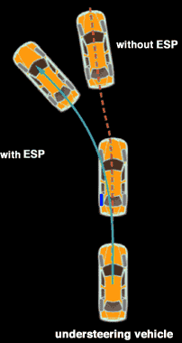
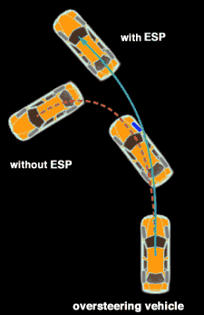
Critical Traction Needs
Road Surface
Weather Conditions
Tires
Braking Techniques
Speed
Technology

Slide 43
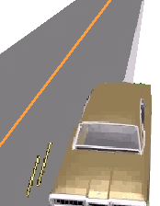
Off-Road Recovery
Do not panic and steer too much
Ease off accelerator and activate ABS
Align edge line of roadway to middle of car
Check traffic to front and rear
If traffic is clear, return to roadway with
one wheel at a time to prevent crossing roadway
Limit steering input to less than ½ turn of wheel
Use less input when the edge of road is high
Target center of lane to avoid crossing over other lanes

Slide 44
Common Vehicle Failures
Tire Blowout
Accelerator Failure
Engine Failure
Hood Flies Up
Steering Failure
Car Catches Fire

Slide 45
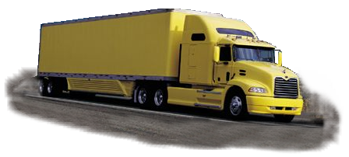
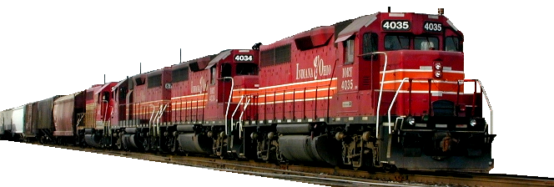
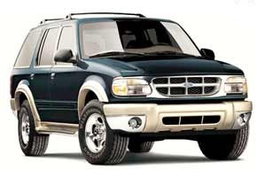
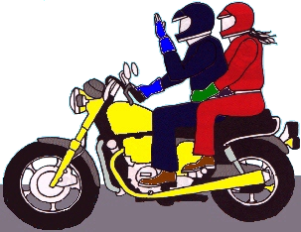
Vehicle Performance
Trucks
Trains
Sport Utility Vehicles (SUV)
Recreational Vehicles (RV)
Motorcycles

Slide 46
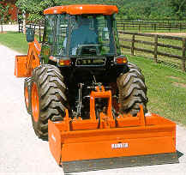
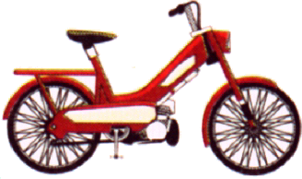
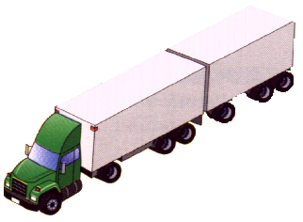
Vehicle Performance
Bicycles, Mopeds, scooters
Construction Vehicles
Oversize Vehicles
Farm Machinery
Horse-drawn vehicles

Slide 47
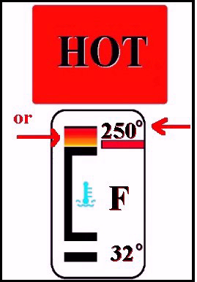

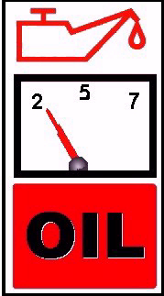
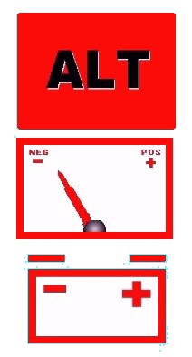

Dashboard Warning Symbols
Temperature light or gauges
Oil pressure light or gauges
Alternator/generator lights or gauge
Brake system light

Slide 48








Dashboard Warning Symbols
ABS light
Air Bag light
“Service Engine” soon light
Door Ajar light
Low Fuel light

Slide 49
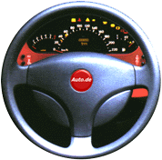

Vehicle Systems
Steering and Suspension System
Tire and Traction Control

Slide 50

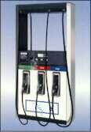
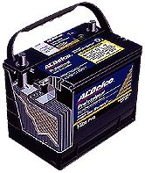
Vehicle Systems
Fuel System
  Carburetor
  Fuel Injection
  Fuel Pressure System
Electrical System
  Battery
  Alternator/Generator
  Ignition switch
  Spark Plugs
  Distributor/Electronics

Slide 51
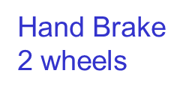
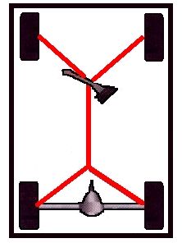
Conventional Brake System
Service brake (Foot pedal)
  Hydraulic system
Parking brake
  Mechanical system
Disc brakes
Disc and Drum combination
Air brakes
Hydraulic
4 wheels

Slide 52
Contact/Mission
For more information on the (the topic of the presentation) please visit PDE’s website at www.education.pa.gov
The mission of the Department of Education is to ensure that every learner has access to a world-class education system that academically prepares children and adults to succeed as productive citizens. Further, the Department seeks to establish a culture that is committed to improving opportunities throughout the commonwealth by ensuring that technical support, resources, and optimal learning environments are available for all students, whether children or adults.

