Slide 1
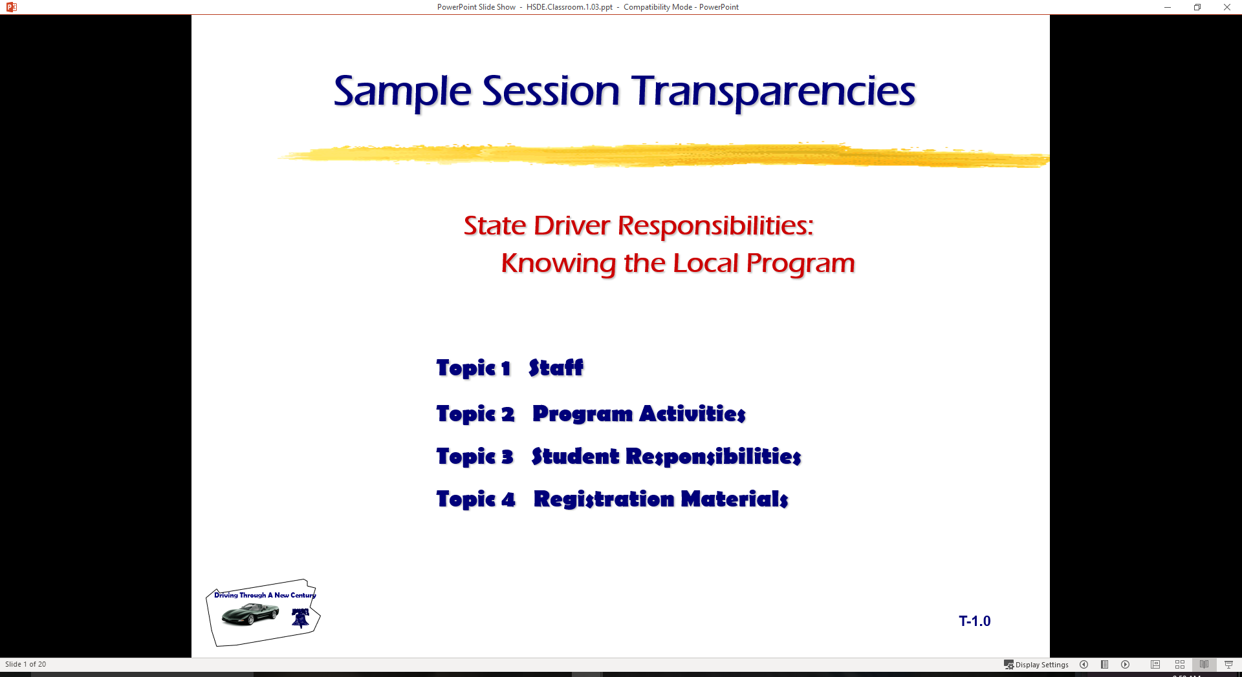
Driver Responsibilities:
Developing a Good Driving System
  Topic 1 Crashes Can Happen to Anyone
  Topic 2 Good Driving Characteristics
  Topic 3 Common Teen Driver Errors
  Topic 4 Good Driving Habits
  Topic 5 Young Drivers and Risk Introduction

Slide 2
Introduction
Review of Range Lesson Two
  Targeting Skills lead Vision Control
  Brake and Acceleration based on transition Points
  Braking and Acceleration is Motion Control
  Steering Control is last part of control sequence
Vehicle Owner’s Manual
  Complete exercise and Hand in for credit
Vehicle Balance Concerns
  Show video… “In Control… Technical Aspects Section”
Simulation is Foundation of Good Habit Development
  Develops Visual and mental Habits for Vehicle Control

Slide 3
Classroom Assessment…2
In Small groups locate the following items:
  List the make and model of the vehicle
  List the Fluid capacities for vehicle
  Give five examples of the glossary of vehicle alert and warning symbols
  Explain use of speed control device
  List how and when the parking brake should be used in this vehicle
  List three items that require regular service from the Service Manual or section
  List at least three safety belt precautions
  List the tire change procedure for this vehicle

Slide 4
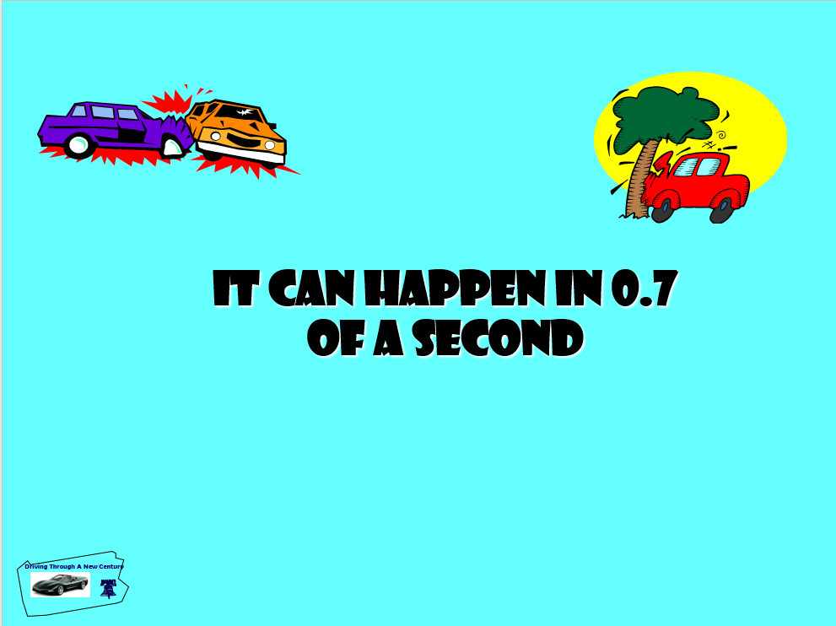

Slide 5
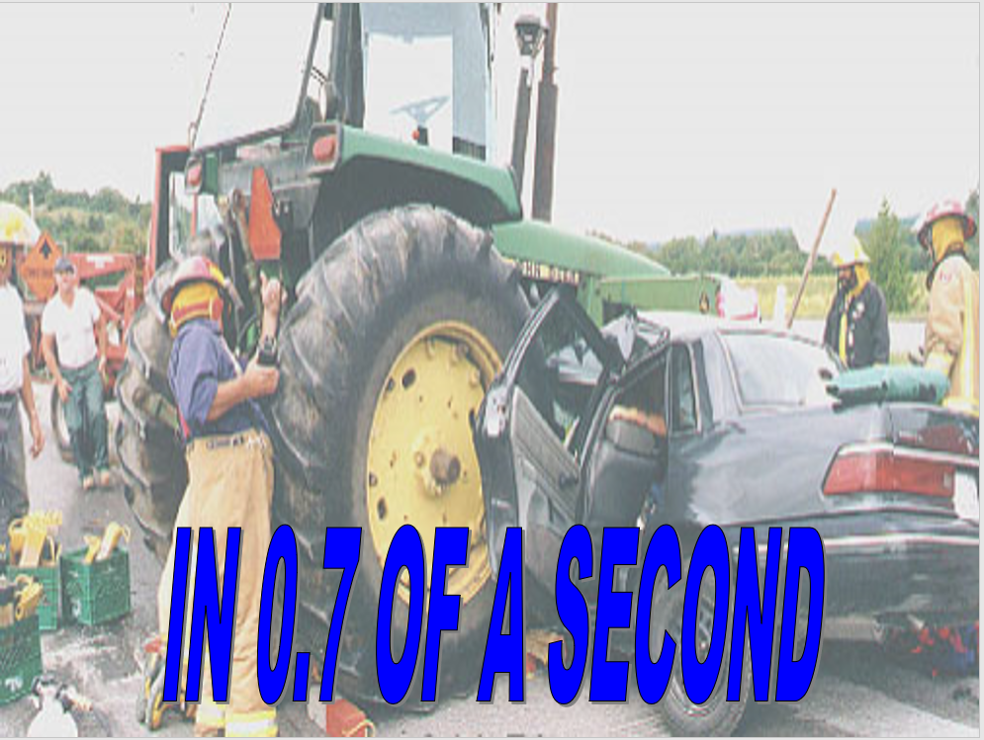

Slide 6
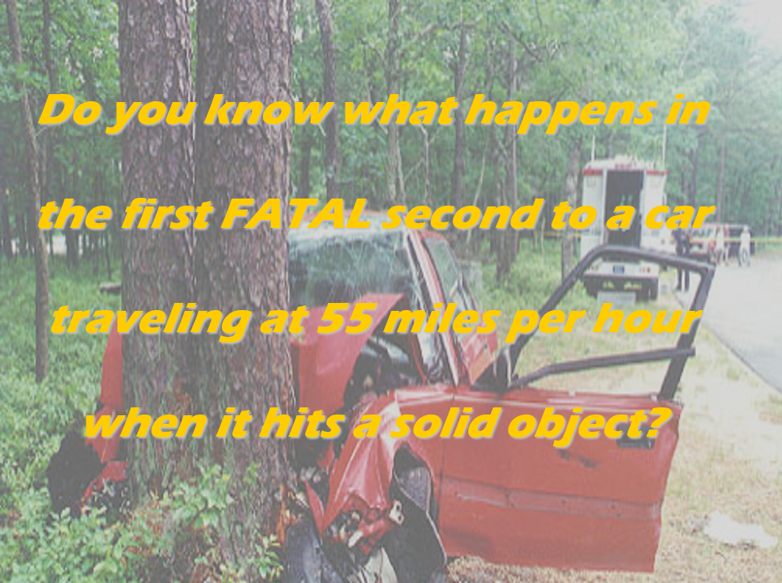

Slide 7
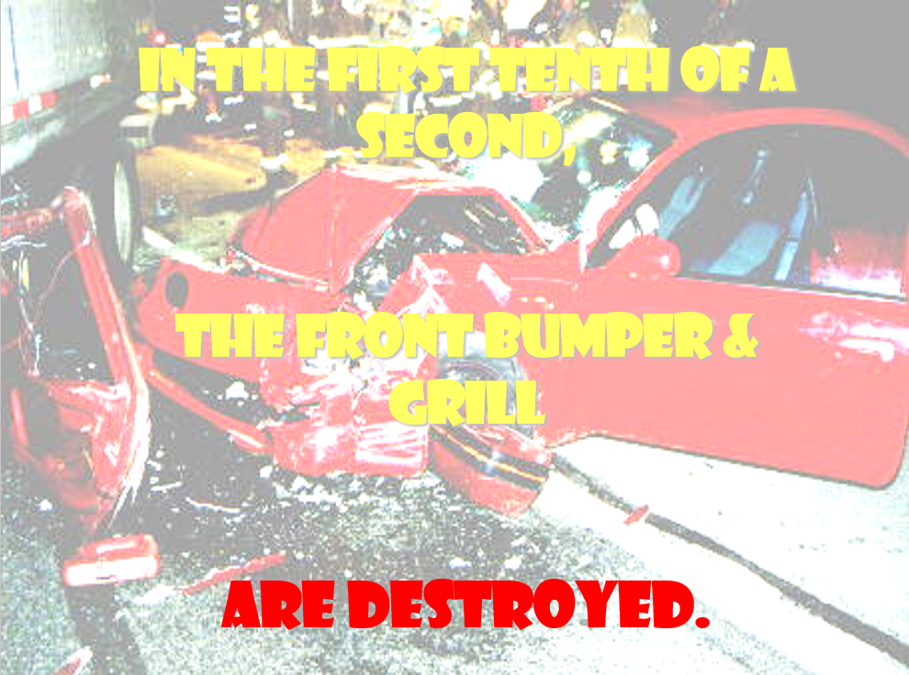

Slide 8
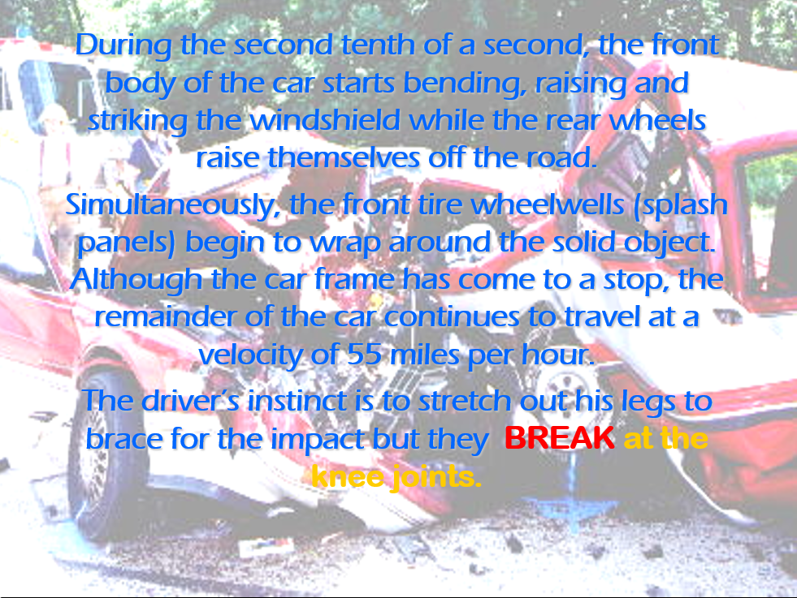

Slide 9
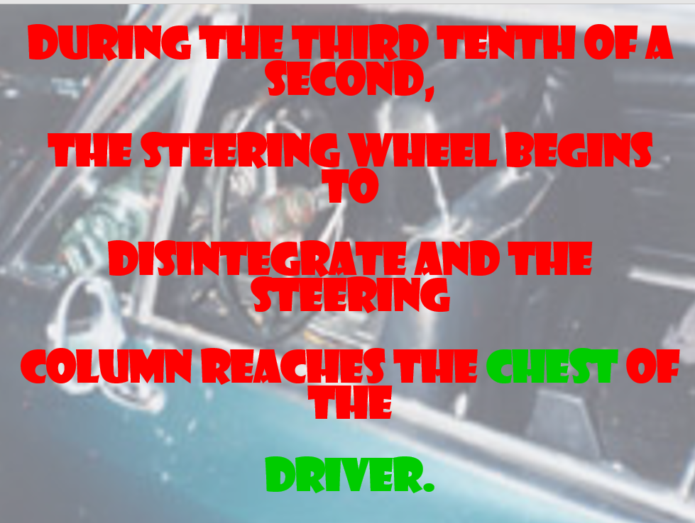

Slide 10
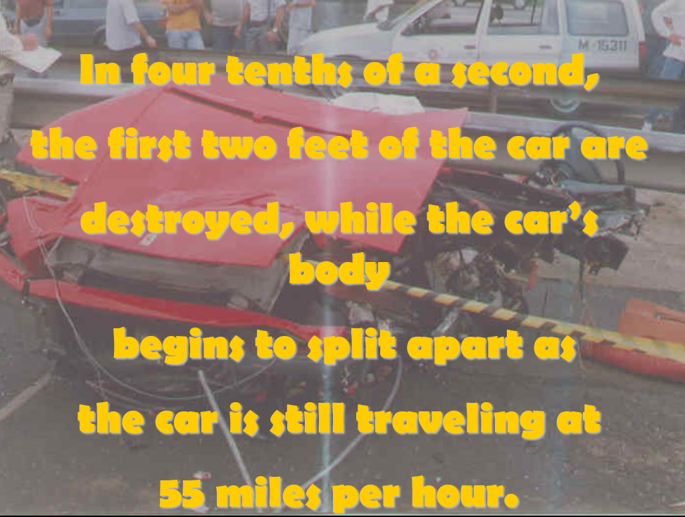

Slide 11
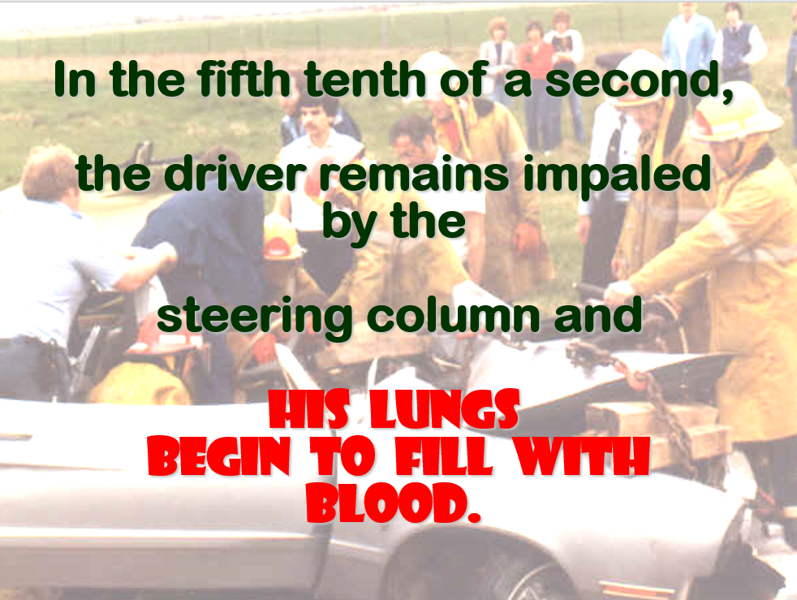

Slide 12
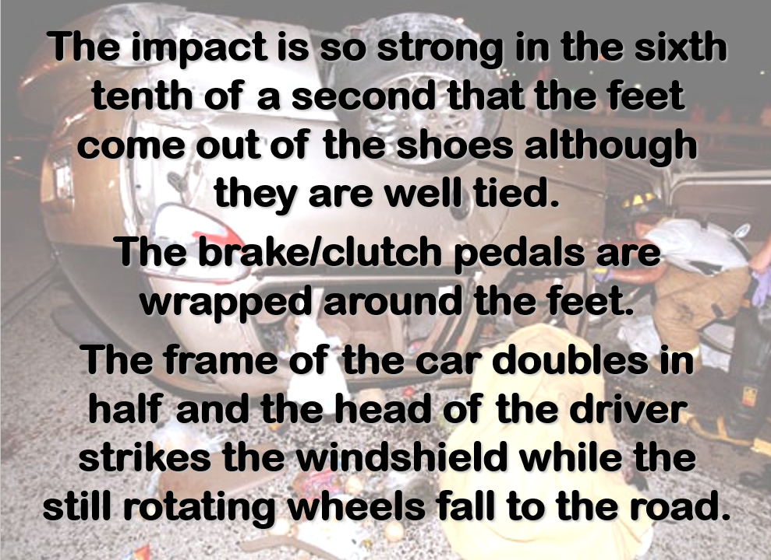

Slide 13
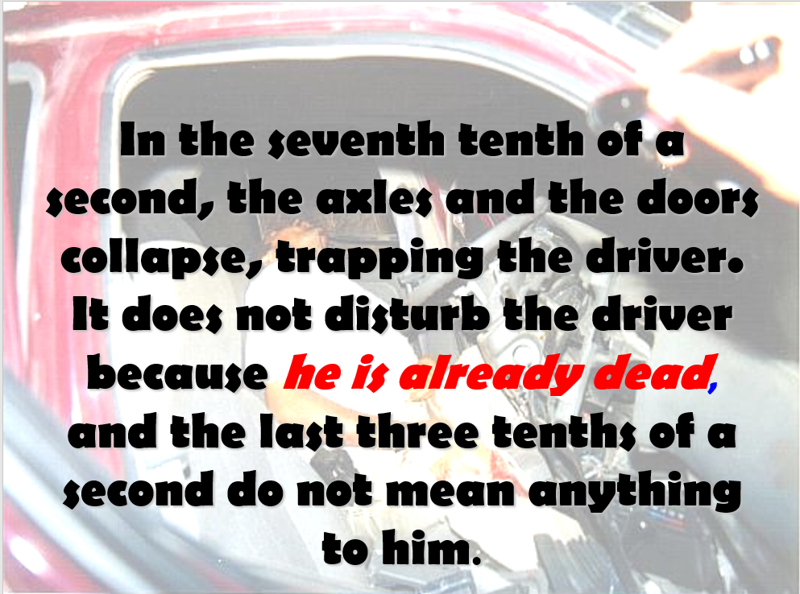

Slide 14
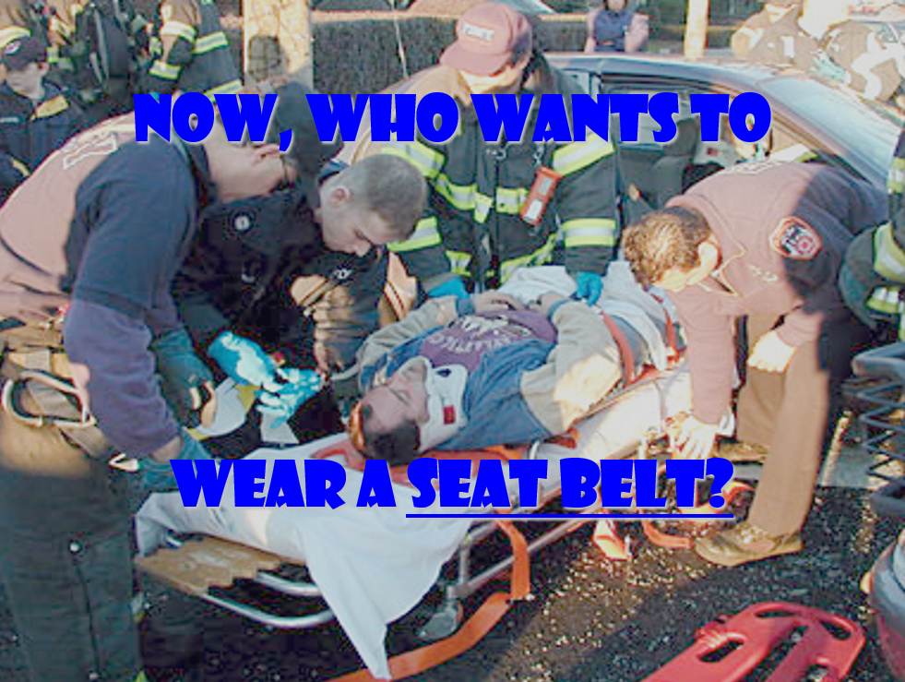

Slide 15
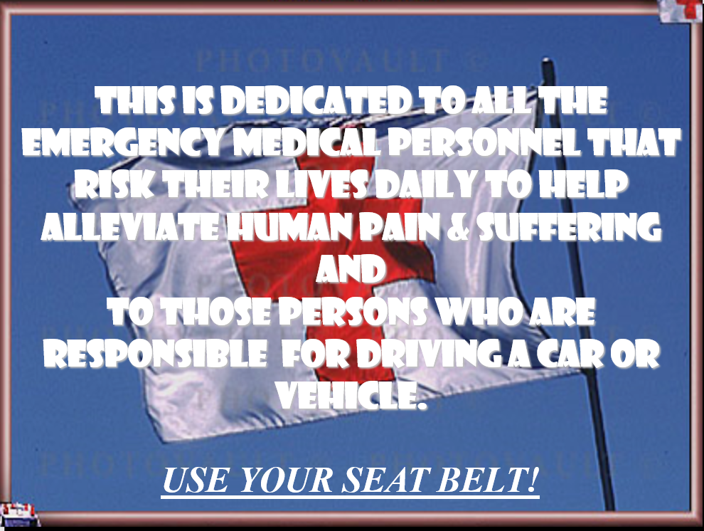

Slide 16
What Is Good Driving?
?
Habit Level
  Procedures for operational tasks
Judgment Level
  Well thought out strategy of action
  Become efficient and precise
  Correct response with least amount of evaluation
Process Level
  Search for problems
  Evaluate options
  Execute decisions
  For modifying speed and position
  Communication reduces risk of collision
C+
A+

Slide 17
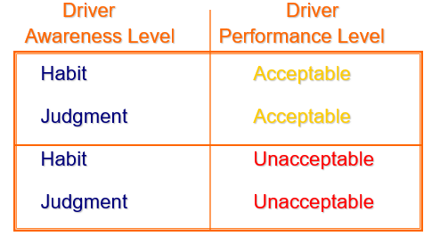
Levels of Performance

Slide 18
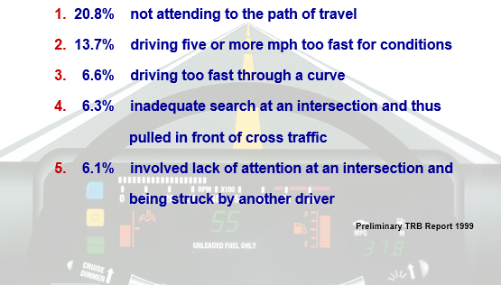
The Top Eleven Errors

Slide 19
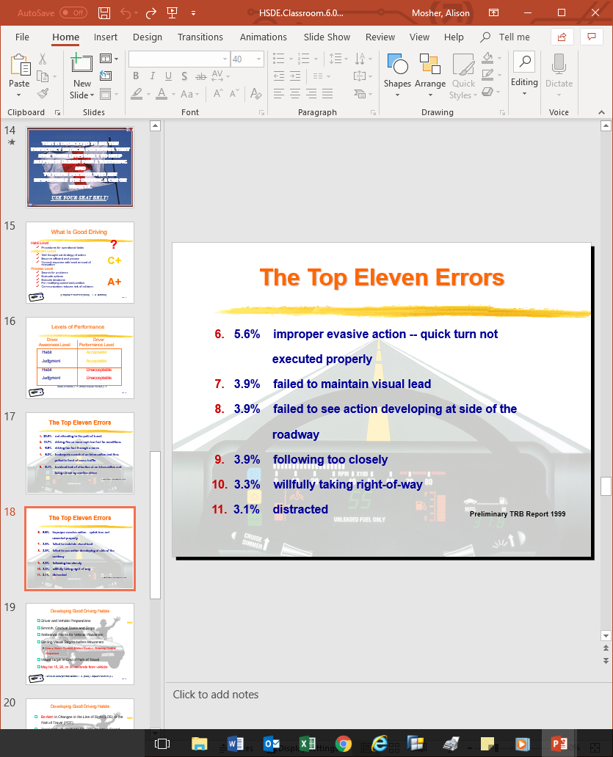
The Top Eleven Errors

Slide 20
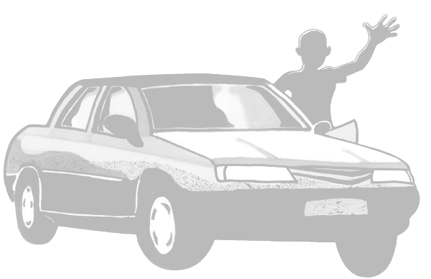
Developing Good Driving Habits
Driver and Vehicle Preparations
Smooth, Gradual Starts and Stops
Reference Points for Vehicle Placement
Getting Visual Targets before Movement
  Use a Vision Control, Motion Control, Steering Control Sequence
Visual Target to End of Path of Travel
May be 15, 20, or 30 seconds from vehicle

Slide 21
Developing Good Driving Habits
Be Alert to Changes to the Line of Sight (LOS) or the Path of Travel (POT)
Restrictions or Blocked LOS-POT causes a Speed Reduction
Adjust Speed and Lane Position to Increase Space to Front, Side, or Rear
Approaching Red Light, Adjust Speed to Time Your Arrival to Green Light

Slide 22
Developing Good Driving Habits
Prior to Intersection Entry, Clear the Left, Front, and Right Zones or Areas
  Try to check the area that can be viewed best first so that more time can be used to see the obstructed area
When Foot Goes to Brake or Accelerator, Check the Rear View Mirror
Prior to Moving to the Left or Right,
Check Side View Mirror or Mirror Blind Space

Slide 23
Developing Good Driving Habits
Make Goal to Maintain Four Seconds of Following Interval from the Vehicle in Front or to the Rear
  Protect yourself from the unexpected actions of other drivers to the front and rear
When stopped behind vehicle, leave space to move around in case of an emergency
Reduce stress by being courteous rather than competitive while driving

Slide 24
Young Drivers Take Risks
Crash rates are higher than older drivers
Driver license means freedom
Freedom does not come without Responsibility
View video… “Young Drivers…High-Risk Years”
Handout… “Please God…I’m Only Seventeen”

Slide 25
Next Classroom Time….
Session Assessment… 2
Driver Risk Index II
Driver Risk-taking

Slide 26
Assignment
Range Lesson
  Vehicle Space
  Reference points
  Both groups on Range
State Rules and Regulations
  Guest Speaker
  Signs, Signals, and Markings is next topic

Slide 27
Contact/Mission
For more information on Driver’s Education and Safety please visit PDE’s website at www.education.pa.gov
The mission of the Department of Education is to ensure that every learner has access to a world-class education system that academically prepares children and adults to succeed as productive citizens. Further, the Department seeks to establish a culture that is committed to improving opportunities throughout the commonwealth by ensuring that technical support, resources, and optimal learning environments are available for all students, whether children or adults.

