Slide 1
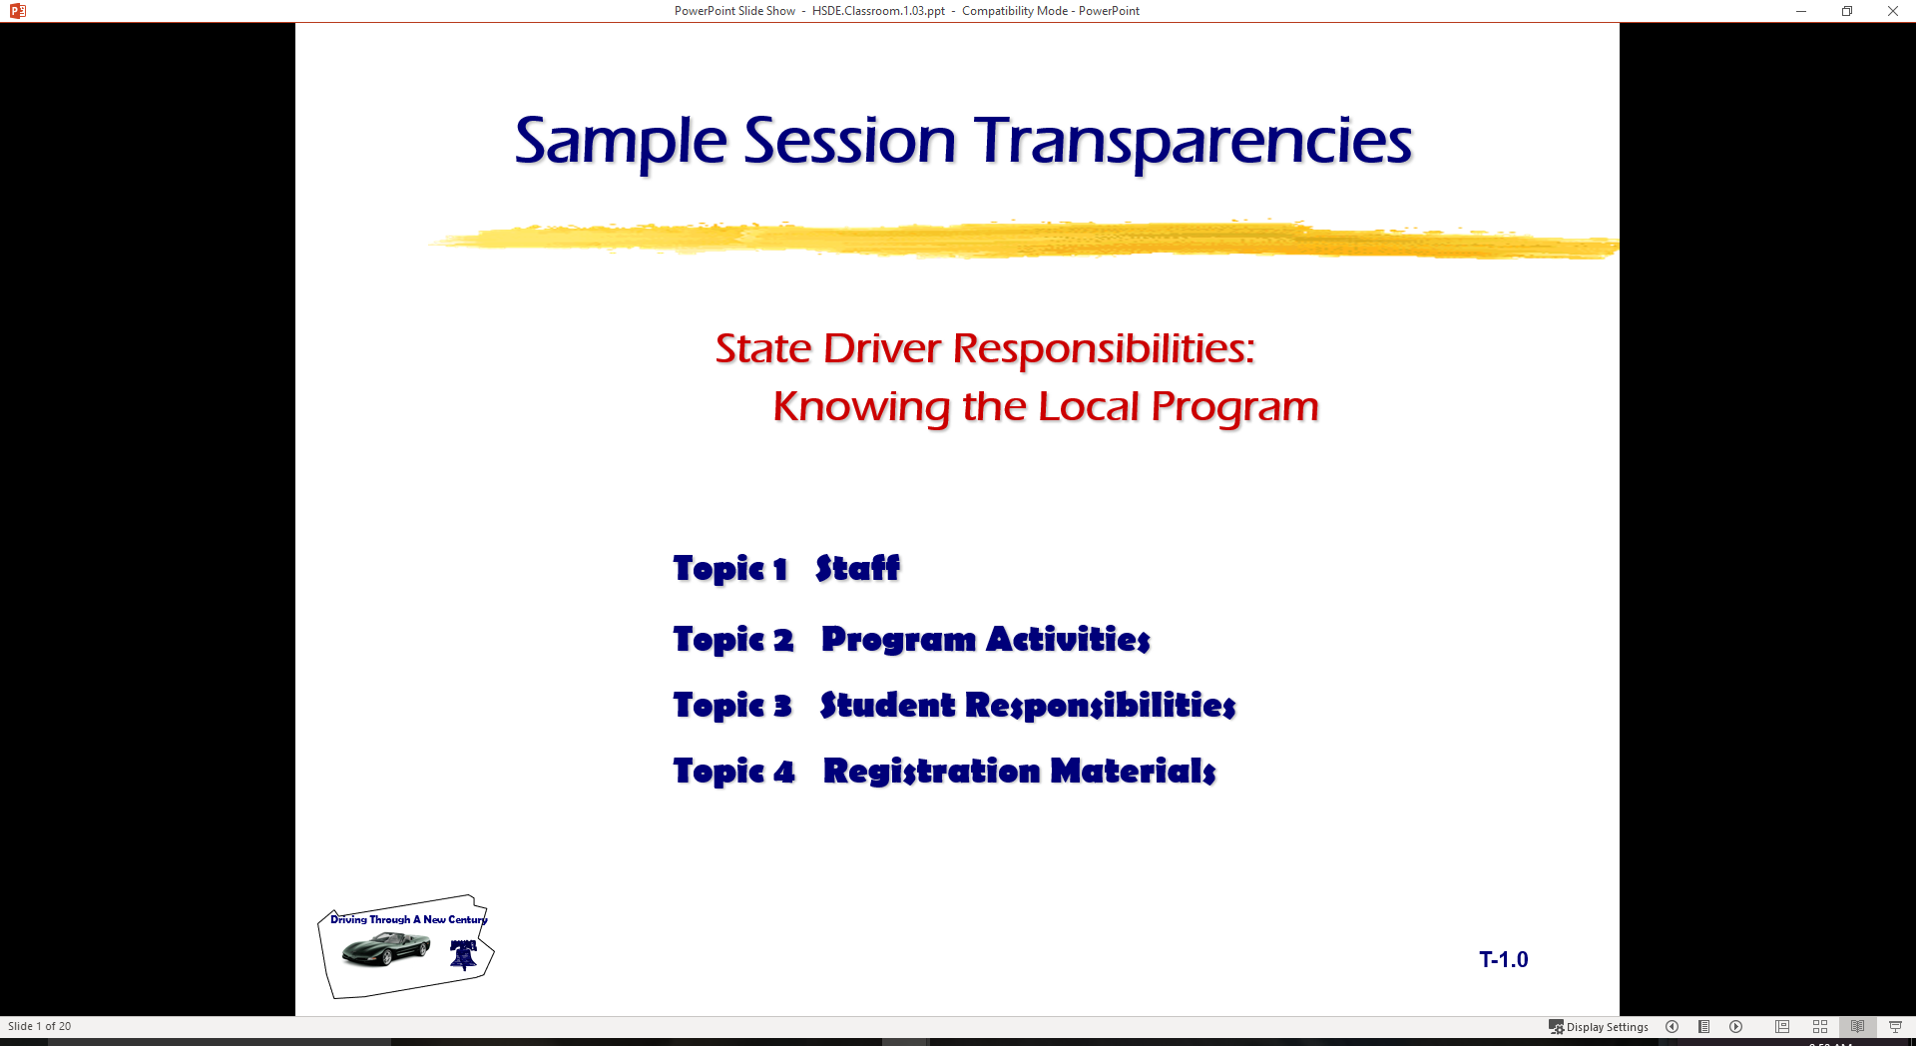
Basic Maneuvering Tasks: Understanding Risk Assessment
  Topic 1 Taking Risk as Driver
  Topic 2 Determining Risk Level
  Topic 3 Risk Assessment

Slide 2
Introduction
Last session
  AutoControl Monster
  Simulation Intro
Classroom
  What is a good driver
  Young drivers take risk
Quiz Preparation

Slide 3
Classroom Assessment…2
Define a target used in driving.
List three characteristics of a good driver.
Describe how a driver can make a care roll to the left.
Describe how a driver can make a car pitch forward.
Explain what the term ‘yaw’ describes.
Describe how to put your car in Lane Position Two.
Describe what happens in .7 of a second in a car crash.
List and identify each of the three steps used in the Driving System introduced in class.

Slide 4
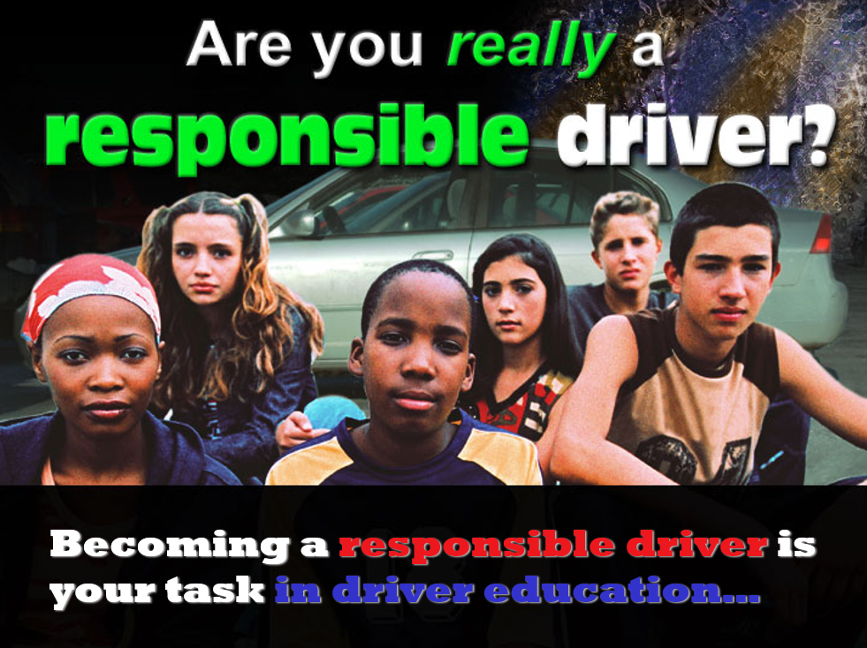

Slide 5

Benefits of Driving
independence
convenience
freedom
job

Slide 6
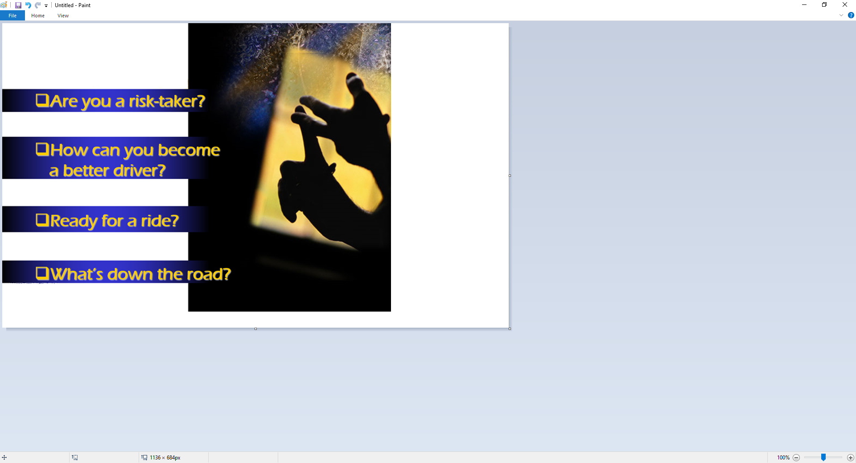
Agenda

Slide 7
Driver Risk Assessment
Have students take “Driver Risk Index II” from ADSI or continue…
RISK ASSESSMENT
Risk is the Chance of Injury, Damage, or Loss
Chance is the Likelihood of a Crash
Injury, Damage, or Loss Are the Consequences of a Crash
Risk Involves Chance of Reward or Consequence

Slide 8
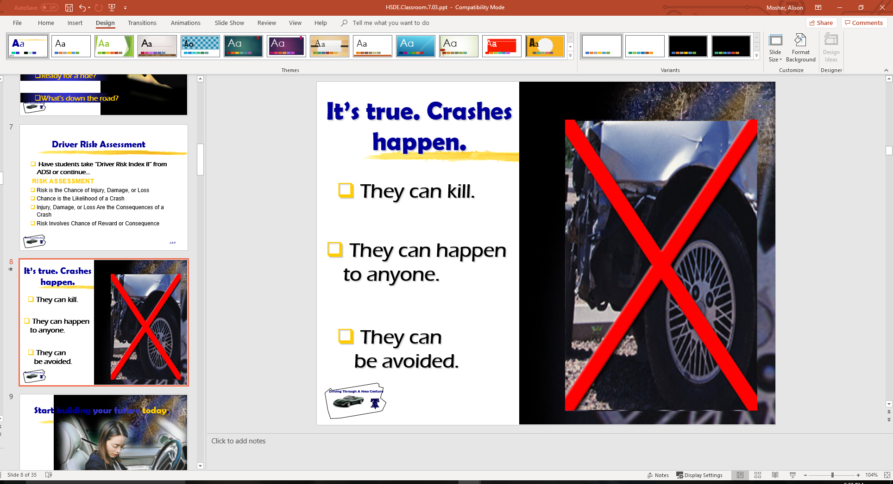
It’s true. Crashes happen.
They can kill.
They can happen to anyone.
They can be avoided.

Slide 9
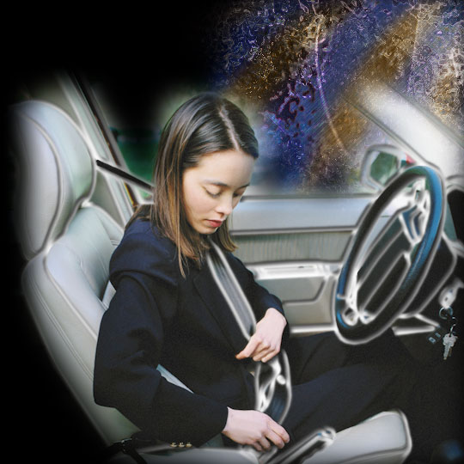
Start building your future today.
Know Your Driving Responsibilities
Legal
Social
Moral

Slide 10
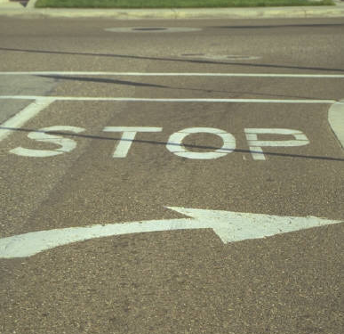
Driver Responsibilities
Legal
  Commonwealth of State
  Local governments
Social
  Family
  Community
  Other Roadway Users
Moral
  Treat others as you want to be treated
  Choosing reduced-risk decisions

Slide 11
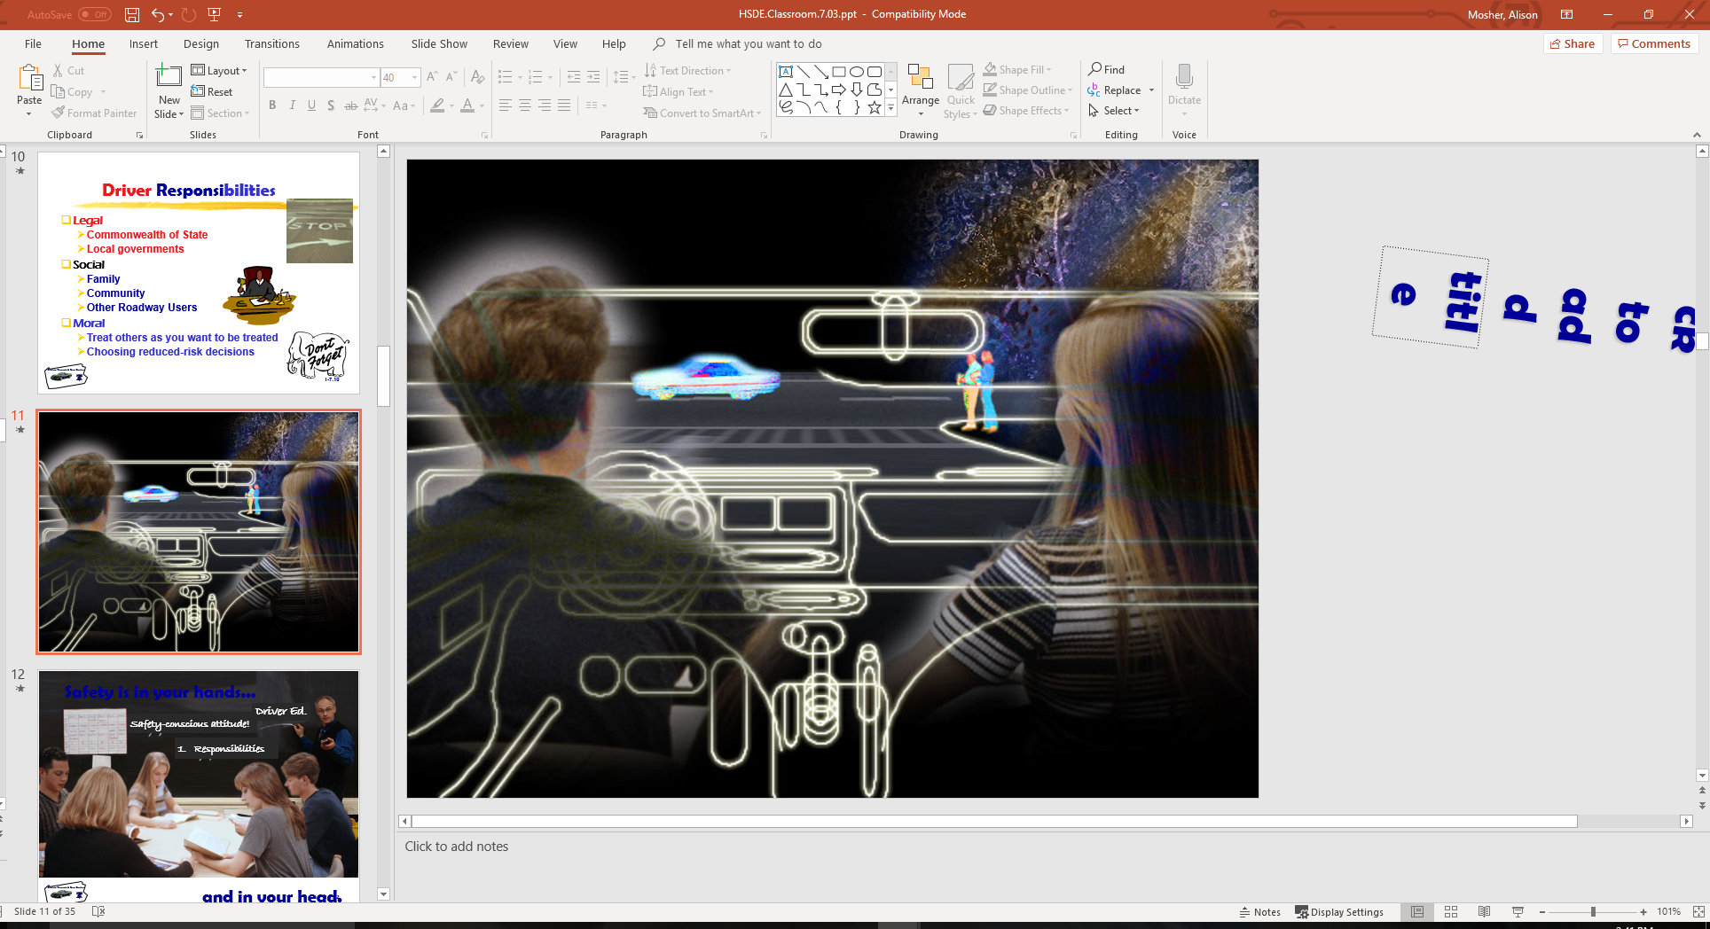
It’s your future…and everyone’s future.

Slide 12
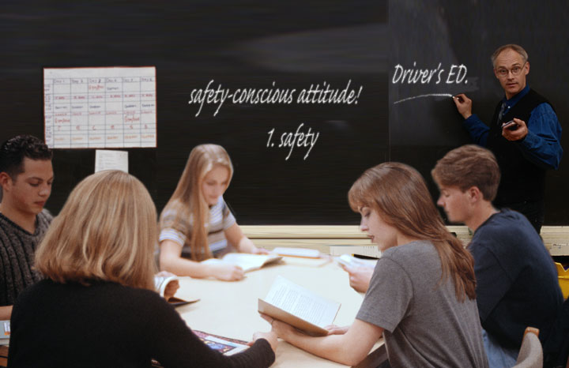
Safety is in your hands…and in your head.

Slide 13
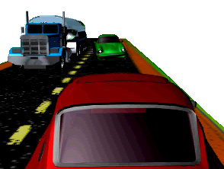
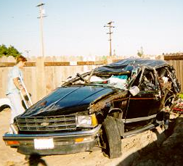
RISK ASSESSMENT
Elements of Risk are:
  Risk Assessment
  Risk Acceptance
  Risk Compensation

Slide 14
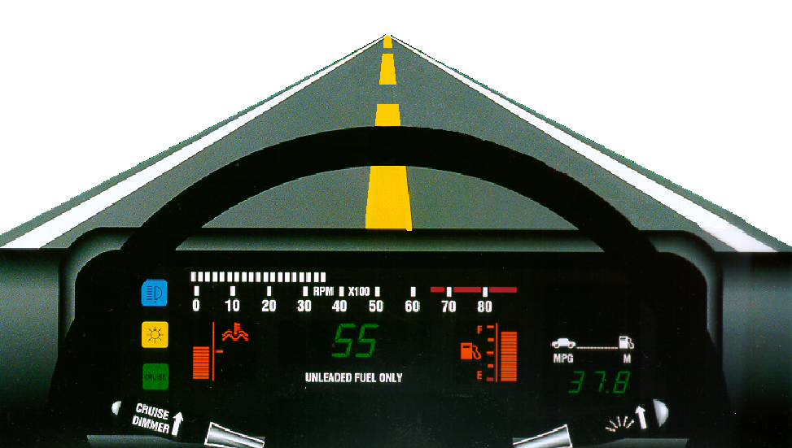
RISK ASSESSMENT
Risk Assessment Involves Knowing:
  The Number or Frequency of Risks
  The Chance that an Error Can Occur
  The Consequences of Errors Committed

Slide 15
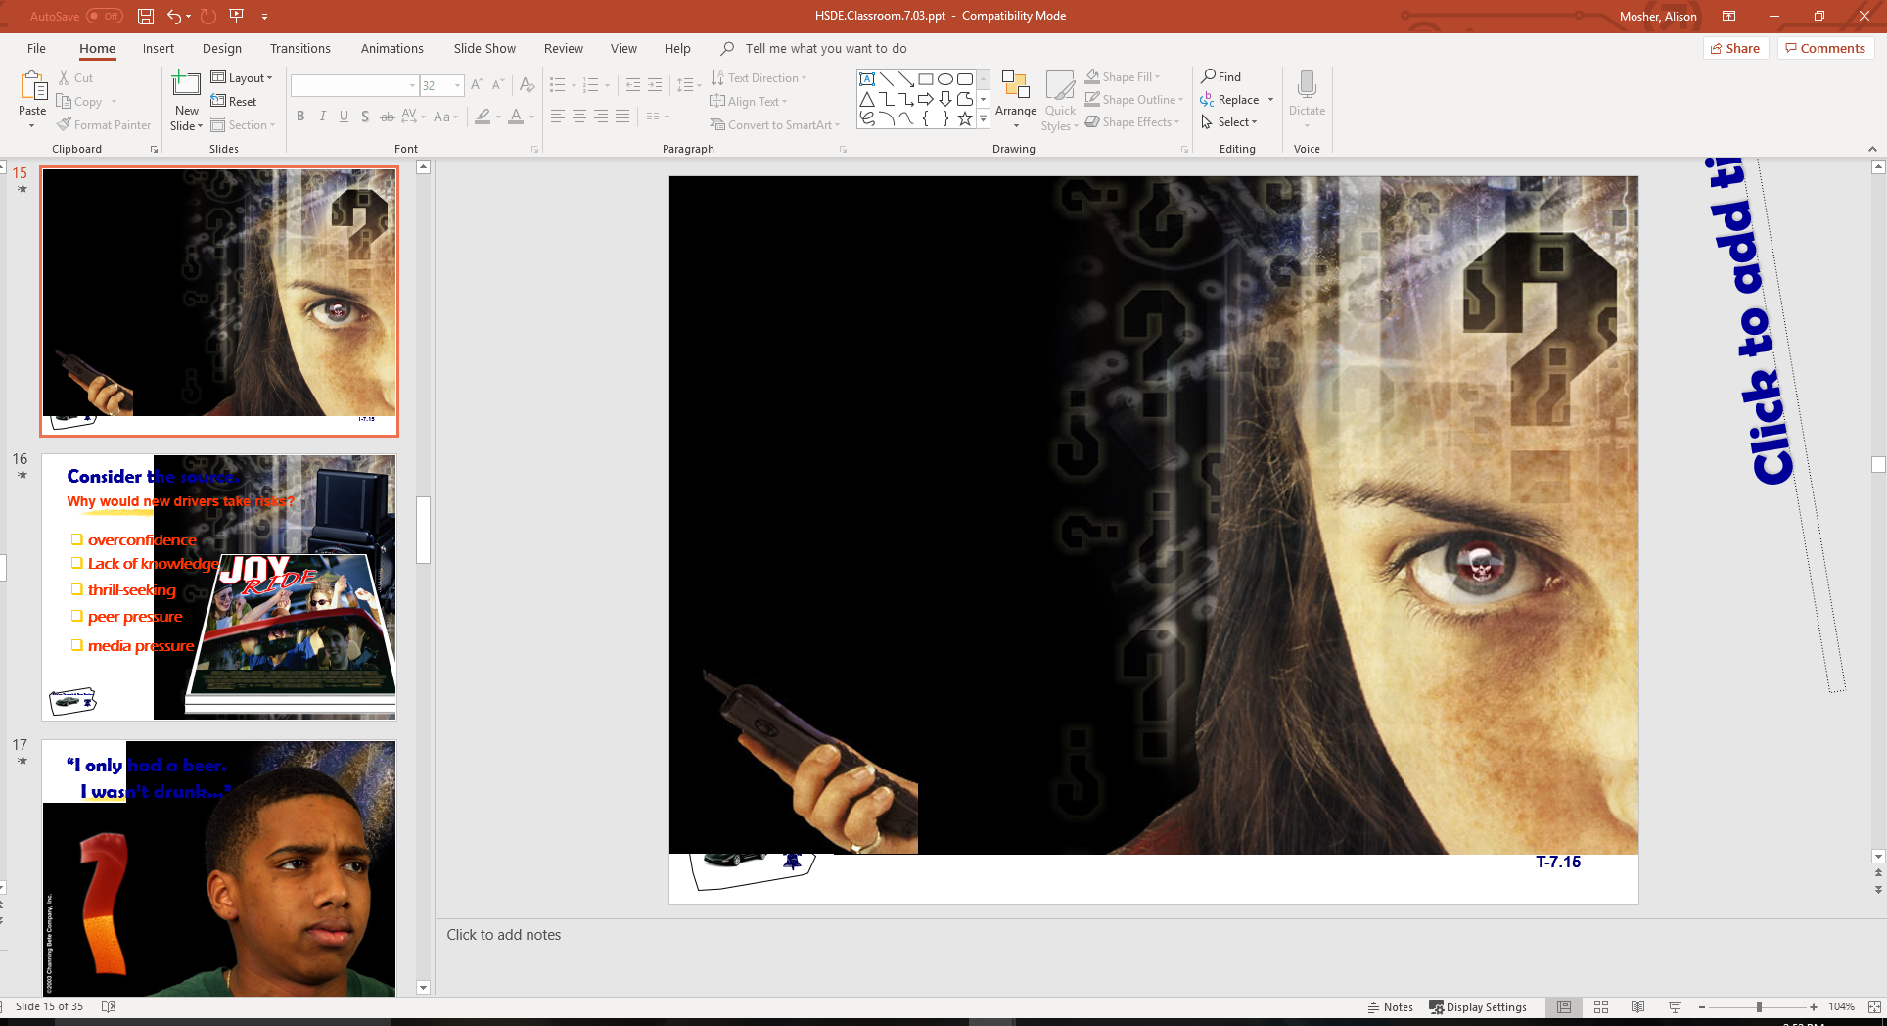
Are you a risk-taker?
Will you ever:
get frustrated or upset
behind the wheel?
forget to wear your
safety belt?
use your cell phone
while driving?
speed?
drink and drive?

Slide 16
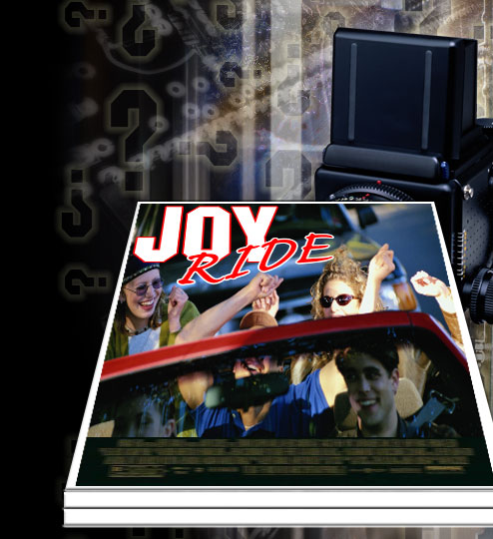
Consider the source. Why would new drivers take risks?
overconfidence
lack of knowledge
thrill-seeking
peer pressure
media pressure

Slide 17
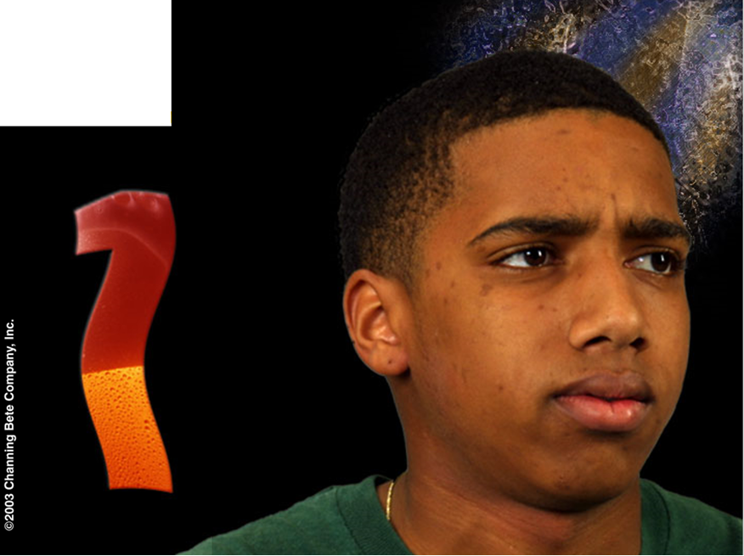
“I only had a beer...”
I wasn’t drunk.”

Slide 18
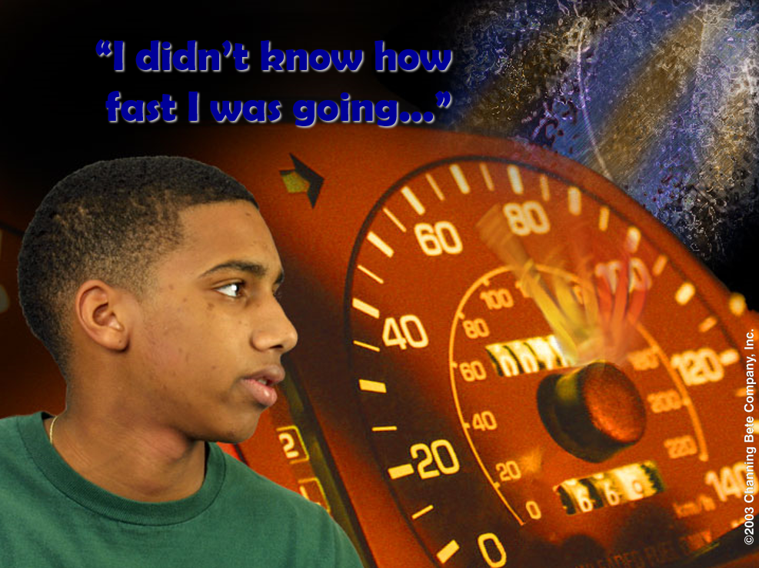

Slide 19
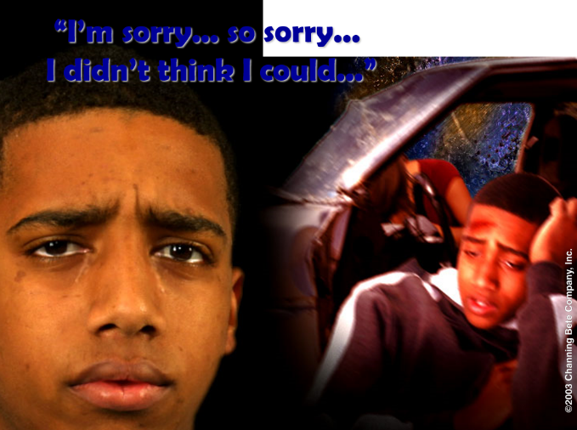

Slide 20
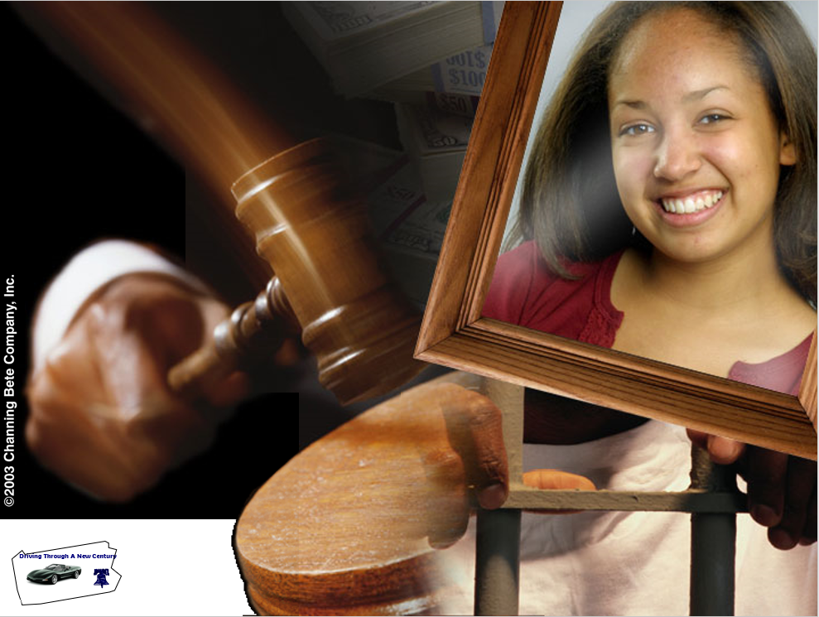

Slide 21
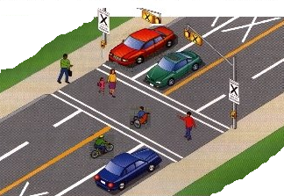
RISK ASSESSMENT
Risk Acceptance Involves Knowing:
  The Potential for Errors
  The Result of the Consequences
    Reward or False Positives
    Penalty, Damage, or Injury

Slide 22
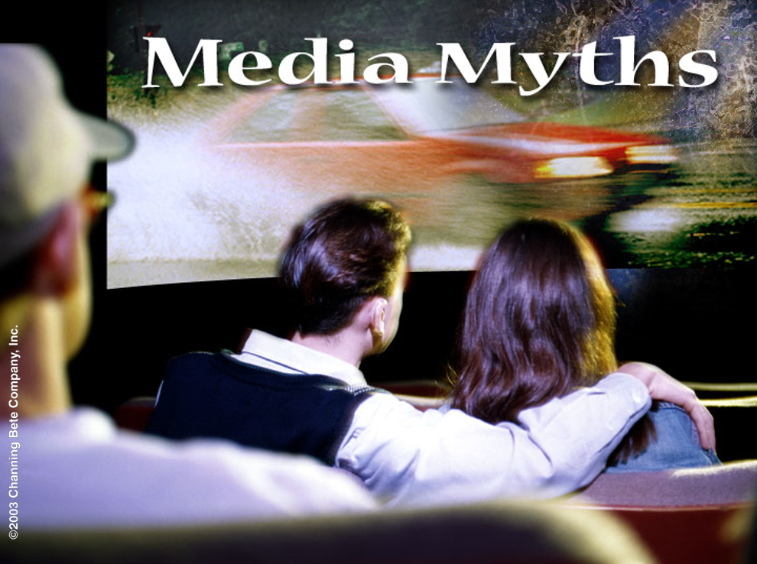

Slide 23
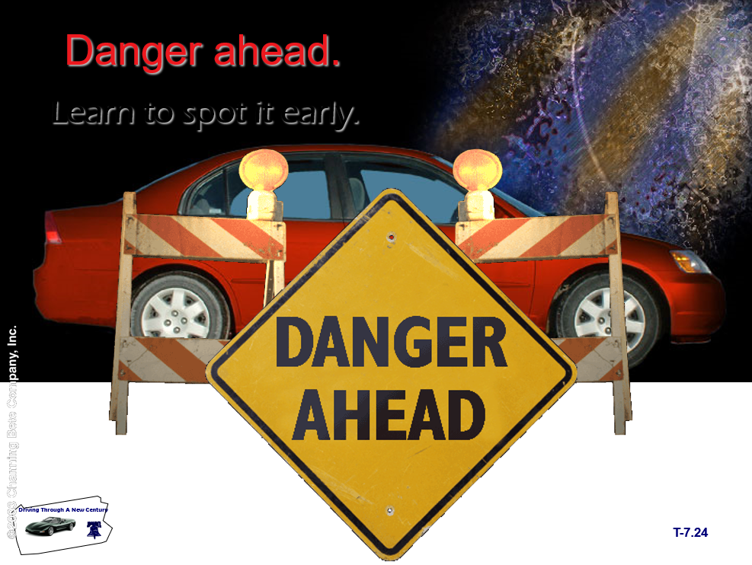

Slide 24
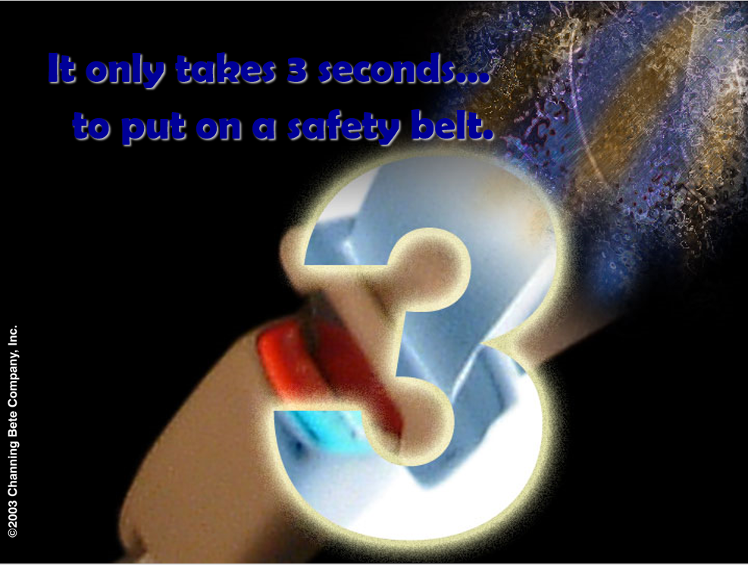

Slide 25
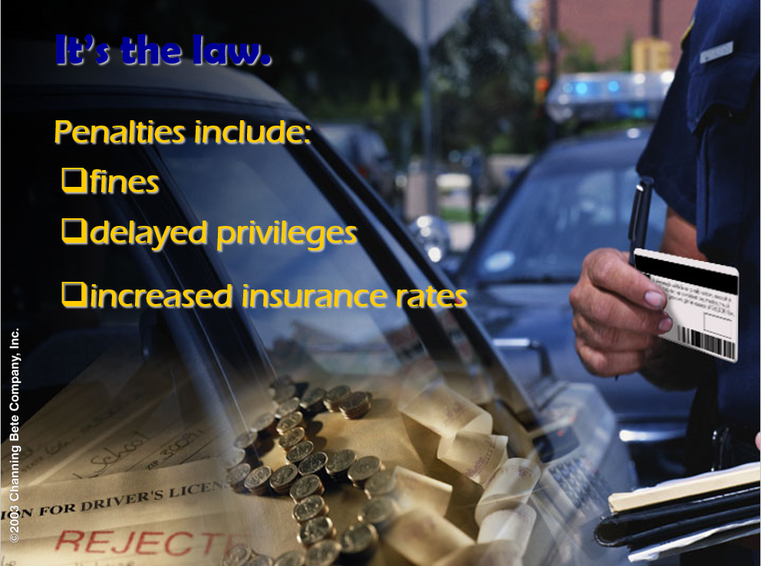

Slide 26
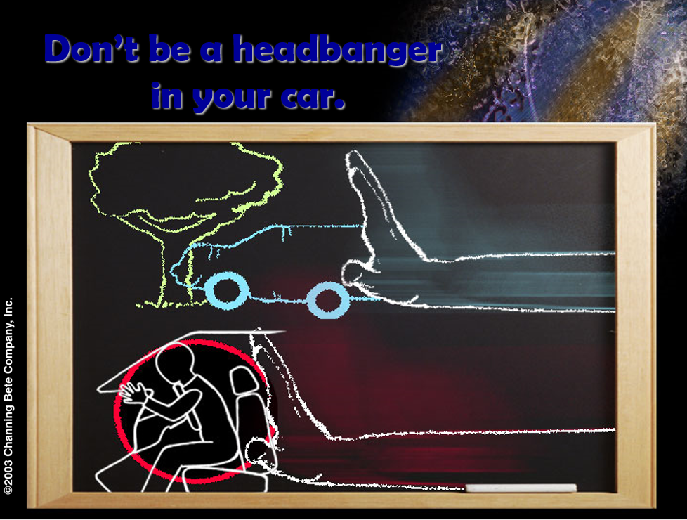

Slide 27
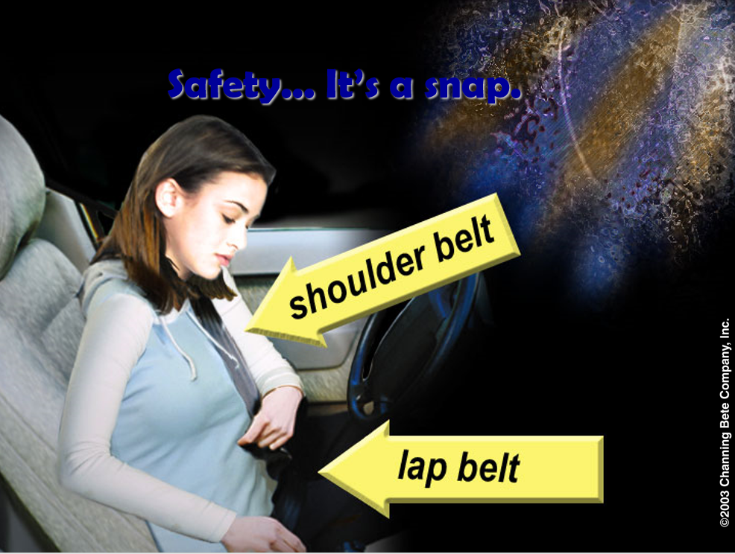

Slide 28
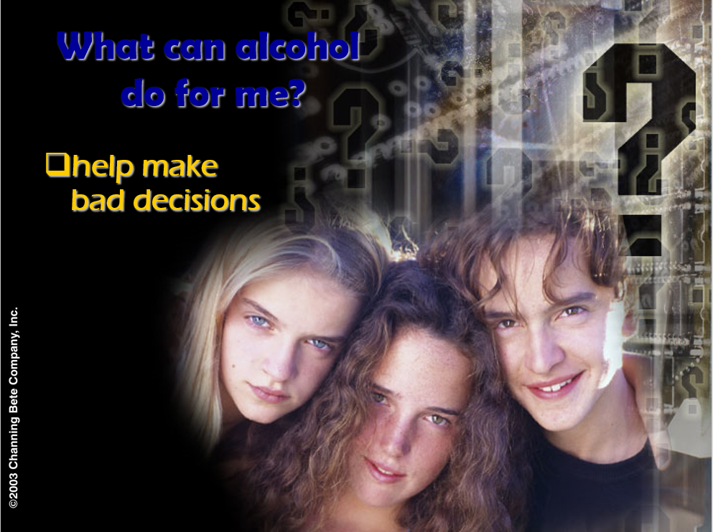

Slide 29
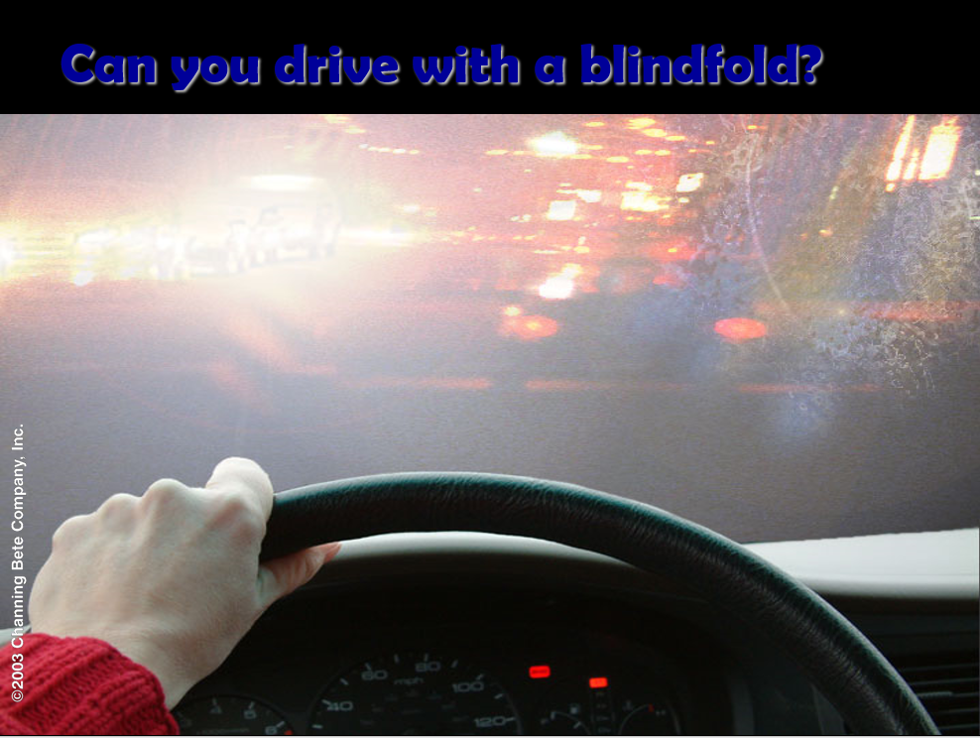

Slide 30
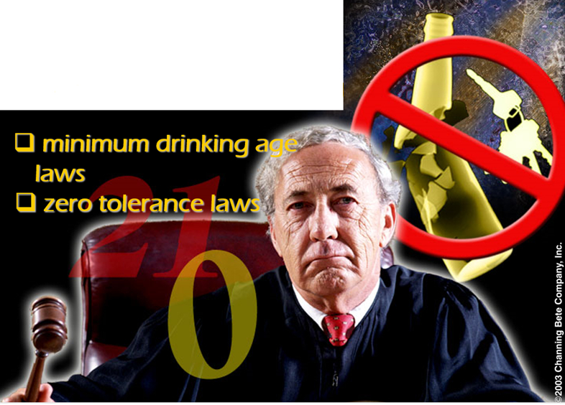
Respect the law.
Respect the law.

Slide 31
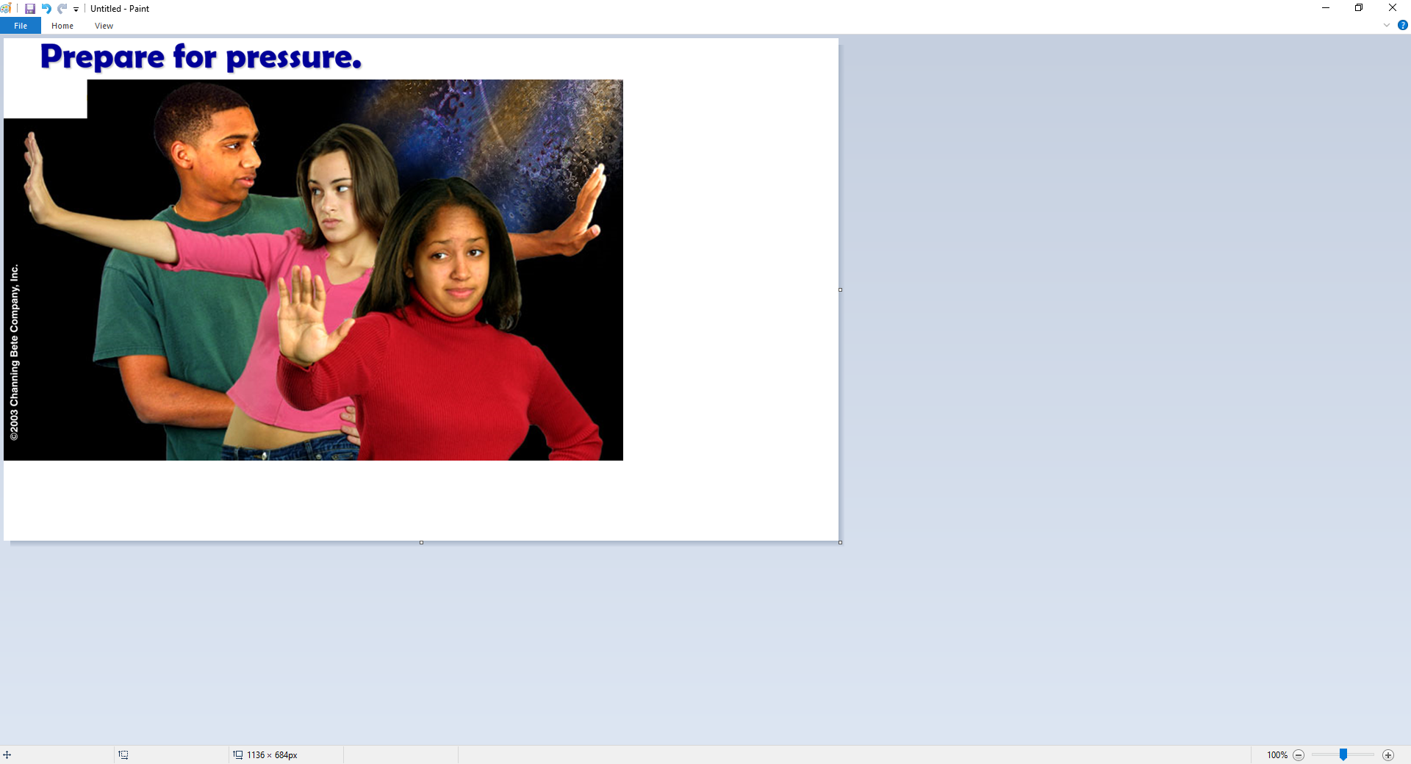

Slide 32
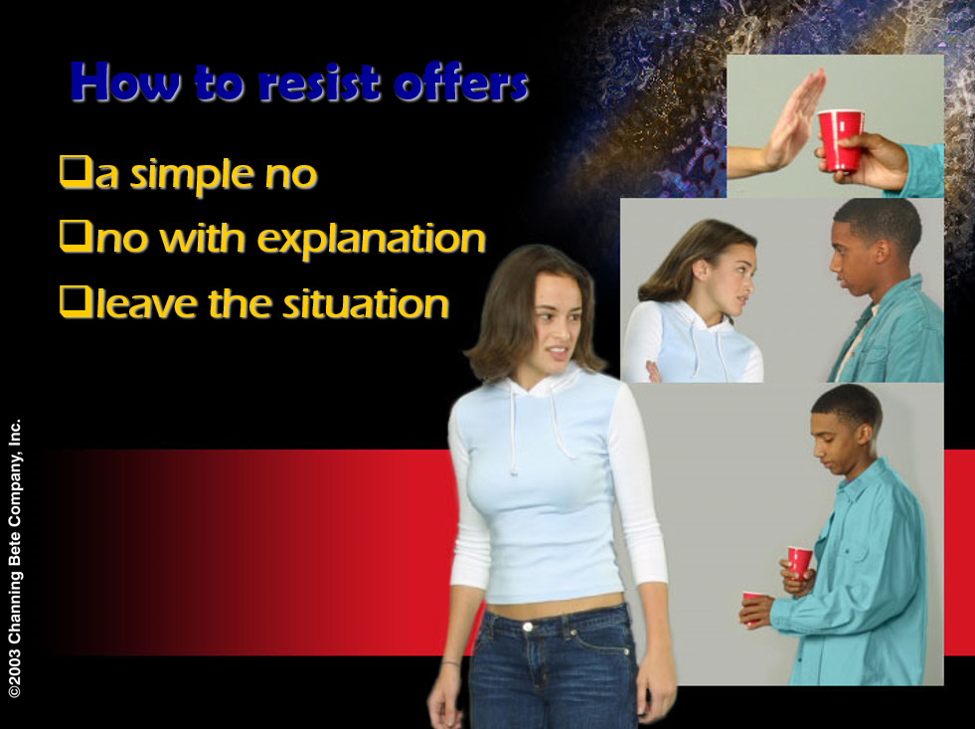

Slide 33
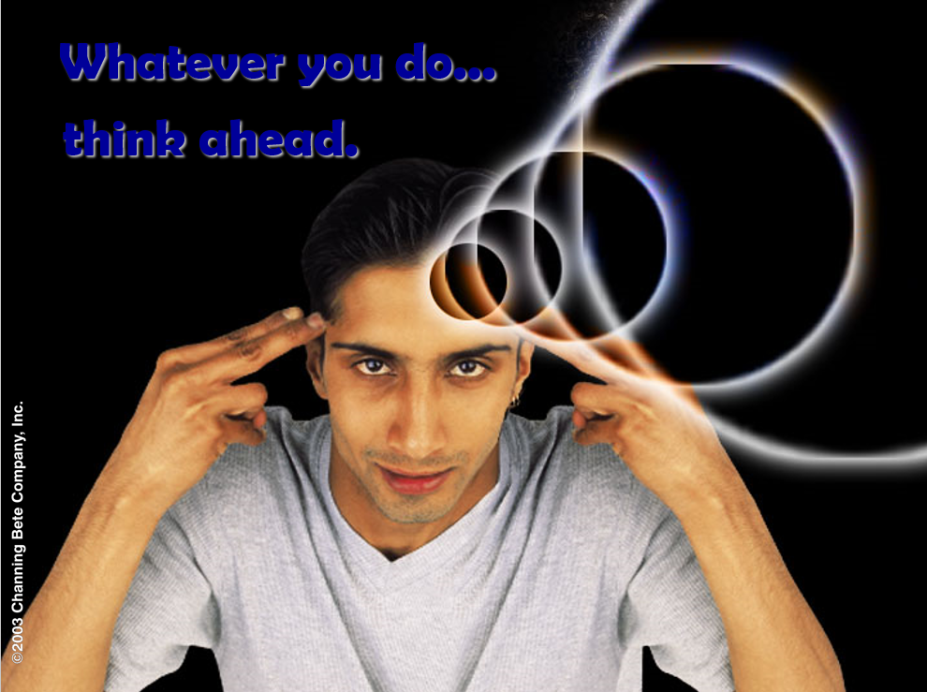

Slide 34
Assignment
Range Lesson
  Vehicle Space
  Reference points
  Both groups on Range
State Rules and Regulations
  Guest Speaker
  Signs, Signals, and Markings is next topic

