Slide 1

Charter School Trustee Training
Fiscal Management:
Raise and Use Resources Wisely
2018-19 Training

Slide 2
Introduction
Thank you for participating in this presentation on Financial Basics, the fifth of six Pennsylvania charter school trustee trainings provided by the Pennsylvania Department of Education.
This presentation is for informational purposes only. It is not legal advice and should not be relied upon as such. Schools should defer to their solicitor for legal advice.
Presentations of this PowerPoint without the Commonwealth’s recording do not represent the views of the Commonwealth or any Commonwealth agency.

Slide 3
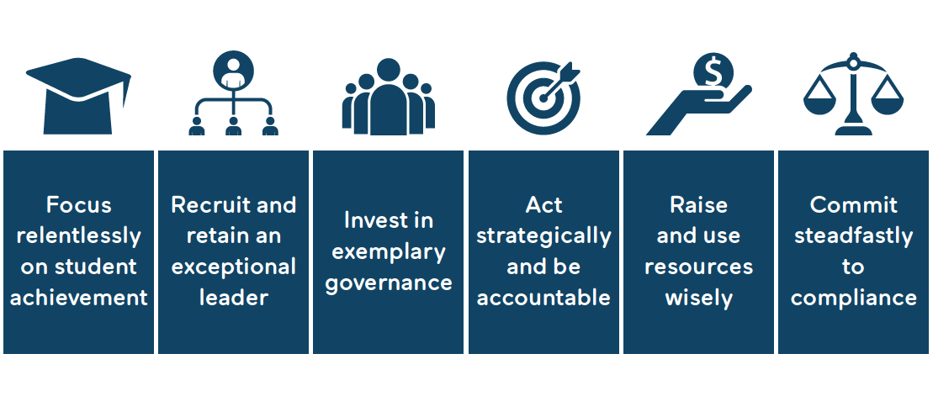
Standards for Effective Charter School Governance
About Charter Board Partners
About CBP

Slide 4
This Session
This Session
Standard Five:
Raise and Use Resources Wisely
Manage resources responsibly
Expand awareness and raise funds

Slide 5
Budget Basics-Charter School Funding
All charter school boards need a strong finance committee
In addition every board member must understand the basics of charter funding
Enrollment usually drives 90 percent of the budget
Charter boards must track and understand enrollment changes
Notes:
Link to PDF: https://www.education.pa.gov/Documents/K-12/Charter%20Schools/Charter%20School%20Funding/CSFunding%2024PS17-1725-A.pdf

Slide 6
Charter School Payments/Billing
Districts pay tuition for students who attend a charter school whose parents or guardians legally reside within the district’s boundaries.
There are calculated tuition rates based on each school district’s budgeted expenditures; these are not uniform for all school districts. Tuition rates are developed for regular education and special education students.
It is the burden of the district to demonstrate that it does not owe payments in dispute.

Slide 7
Facilities
Can be a major line-item in a charter school’s budget
Charter school students must be educated in a separate space from traditional public school students.

Slide 8
Facilities (cont.)
Charters often have to find funds to renovate their facilities.
Facility laws and regulations apply to any and all renovations.
Charter schools and their contractors are subject to certain statutes governing construction projects and construction-related work, including those relating to public bidding for certain projects.

Slide 9
Lease of a Facility
A charter school may lease property from public or private entities.
Further guidance on the charter school facility lease program is available from PDE’s Division of School Facilities, which is responsible for administering this program.
Notes:
Division of School Facilities: https://www.education.pa.gov/Teachers%20-%20Administrators/School%20Construction%20and%20Facilities/Pages/Charter-Schools.aspx

Slide 10
Debt Issuance
The Charter School Law (CSL) permits charter schools to incur debt for the construction of school facilities.
Any indebtedness incurred by a charter school does not impose any liability or legal obligation on the chartering school district.

Slide 11
Special Considerations
Financial Challenges and Issues
  Poor financial management
  Fraud
  Resource-“A User’s Guide to Fiscal Oversight: A Toolkit for Charter School Governing Boards”
Notes:
A User’s Guide to Fiscal Oversight: A Toolkit for Charter School Governing Boards https://charterschoolcenter.ed.gov/sites/default/files/Fiscal%20Oversight%20Toolkit%20-%20Boards%20(1).pdf

Slide 12
Special Considerations
Section 1703-A of the School Code specifically defines charter schools as nonprofits, which must be chartered as a 501(c)3, a special designation of the IRS tax code
  Donations are tax deductible
  990 Form
  Cannot be an “action organization”
  Cannot net and distribute profits

Slide 13
Fundraising and Expanding Awareness
Charter schools are, in most instances, eligible to receive state and federal grants.
Please review the resources document for a link to the Master Agreement
Notes:
Master Agreement Link: http://www.education.pa.gov/Teachers%20-%20Administrators/Pages/PDE-Master-Standard-Terms-and-Conditions.aspx

Slide 14
Some Things to Consider
Does the board regularly review financial data?
When discussing financial data, does your board connect the budget to academic implications?
Do you know what your board’s policy is on fundraising?

Slide 15
Contact/Mission
For more information on charter school
governance best practices visit
www.education.pa.gov
and www.charterboards.org
The mission of the Department of Education is to ensure that every learner has access to a world-class education system that academically prepares children and adults to succeed as productive citizens. Further, the Department seeks to establish a culture that is committed to improving opportunities throughout the commonwealth by ensuring that technical support, resources, and optimal learning environments are available for all students, whether children or adults.

